Slide 1
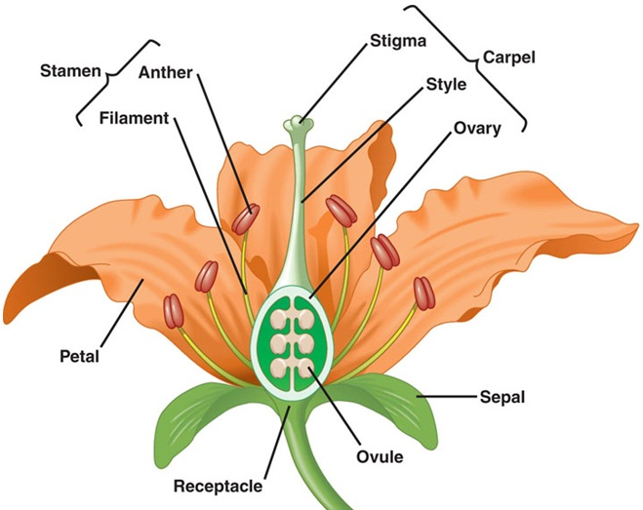
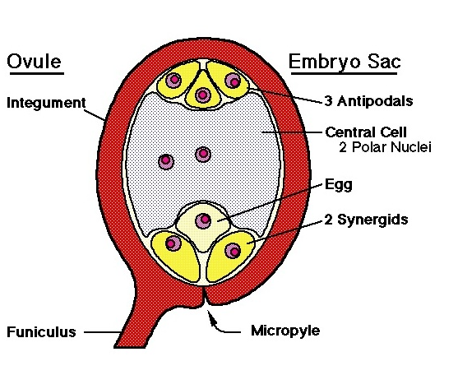
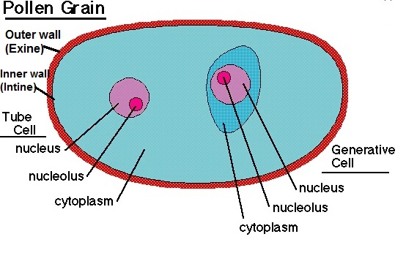

Slide 2
SEXUAL REPRODUCTION IN ANGIOSPERMS ---
FERTILIZATION AND EMBRYOGENESIS

Slide 3
Events after pollination
The Mature Embryo Sac
The mature embryo sac is made up of seven cells with a total of eight nuclei and has an opening called the micropyle.
At the micropylar end of the embryo sac, there are three cells; two synergid cells and an egg cell. In the middle of the embryo sac, there is a large cell with two nuclei called polar nuclei.
Opposite the micropylar end are three antipodal cells. The arrangement of these cells in the embryo sac varies with different plants.

Slide 4
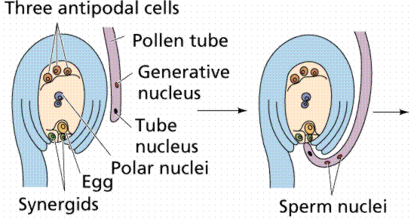
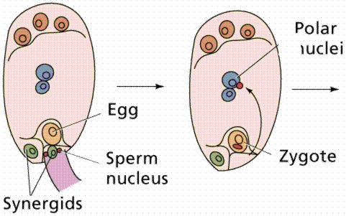
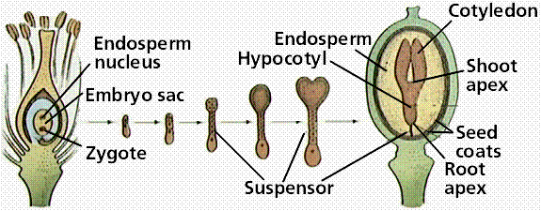

Slide 5
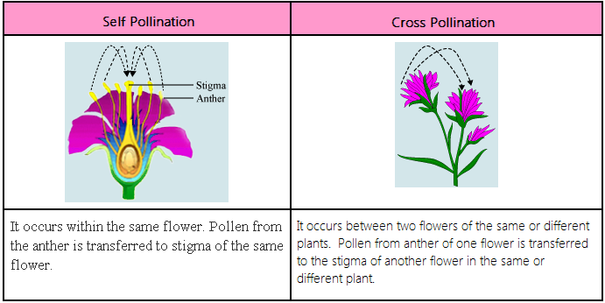

Slide 6
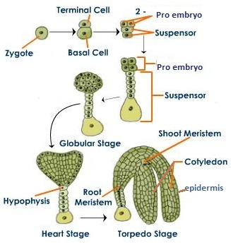

Slide 7
Description of the Mature Dicot and Monocot seed
A seed is a miniature embryonic plant enclosed by a covering, the seed coat and with some reserved nutrients. Seeds consist of the following parts, an outer covering called the seed coat, an embryonic axis and storage tissue.

Slide 8
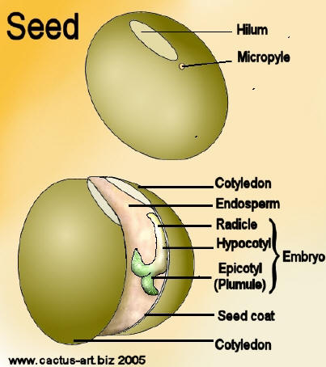
Structure of the Dicot seed (bean seed)
The shape of seeds varies among dicot plants. They can be rounded (bambara bean), cylindrical (groundnut) or kidney shaped (cowpea and canavalia) etc.
The bean seed is flat, kidney-shaped and has a notch on one side. There is a long white scar along the notch. This scar is known as the hilum.
A small pore called micropyle is located at one end of the hilum.

Slide 9
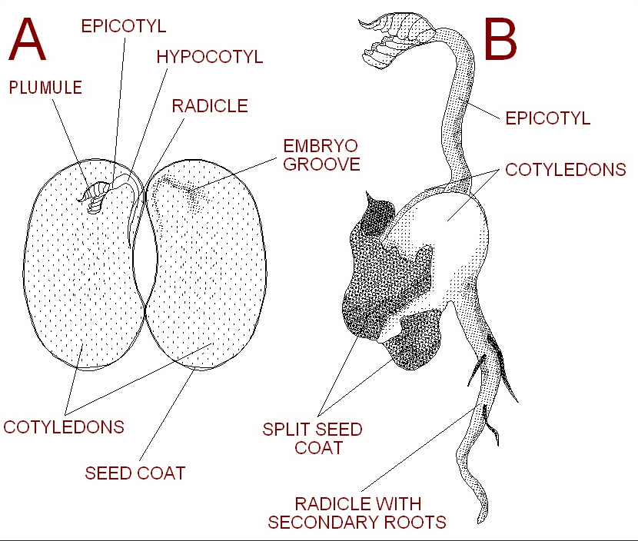

Slide 10
1. Seed coat:
This has 2 layers: Outer layer, the TESTA, and an layer called the TEGMEN.
Within the surface of testa there is a tiny opening- MICROPYLE through which water enters and hydrates the seed for commencement of germination.
2. Cotyledons
There are two fleshy cotyledons in bean seed – due to stored food in the form of protein and starch grains.
They are connected with each other along the longitudinal embryo-axis.
Since the cotyledons completely enclose the nutritive endosperm during the embryonic development and become fleshy, there is no separate existence of the endosperm. Hence, such a seed is known a exalbuminous or nonendospermic seed.
In the middle of the two cotyledons is the tiny embryo, waiting to grow.

Slide 11
Embryo
The embryo is the juvenile plant made up of two parts: the radicle, or the first root, and the plumule, or the first leaves. When water enters the micropyle, the radicle starts growing and moves down and out through the micropyle into the soil . Then the plumule swells and grows, pushing its way through the testa and up through the soil until it reaches the light.
Radicle:
There is a small, rod-shaped part of the embryo-axis that lies near the micropyle. During seed germination the radicle is the first to emerge through the micropyle. The radicle develops into primary root which eventually becomes the tap root.
Plumule:
It is the first embryonic apical bud having a growing point, the shoot apical meristem, covered by delicate unexpanded leaves. The plumule is connected with the radicle by means of hypocotyl. During seed germination they give rise to shoot system.

Slide 12
Hilum
The hilum, or scar, on a bean is the site where the bean was originally attached in the fruit of the plant. It is the 'navel' of the bean and can be found on the surface of the testa at the indentation of the bean.
Hypocotyl
The hypocotyl is the portion of the axis between the radicle and the cotyledons. It becomes part of the stem and connects the latter to the root.
Epicotyl
The epicotyl is the area above the cotyledons and below the plumule. It also becomes a part of the stem.

Slide 13
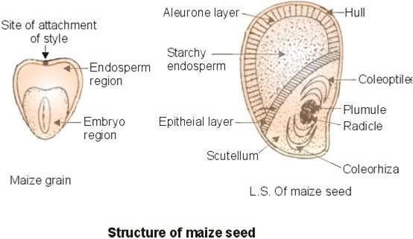
Structure of monocot (maize seed)

Slide 14
Endosperm:
The Endosperm occupies about 2/3 of the total seed and is located in the broader part of the maize grain.
There is a continuous layer of the large cubical cells immediately beneath the hull and forming the outermost layer of the endosperm known as the aleurone layer. The cells here contain protein granules.
The rest of the endosperm consists of starch-laden cells, which also contain some lipid

Slide 15
Embryo:
The embryo of the maize grain is located beneath the endosperm.
It is demarcated from the latter by a single layer of epithelial cells which is the outermost layer of the cotyledon also known as the scutellum. The cells of the epithelial layer secrete digestive enzymes during seed germination which digest the nutrients stored in the endosperm. They also translocate the digested nutrients to the growing embryo.
The embryonic axis consists of a radicle and a plumule.
The radicle is partially covered and protected by coleorhiza.
The plumule is partially covered and protected by coleoptile.

Slide 16
SEED GERMINATION
Under normal conditions the mature embryo does not continue to grow while the seed is still attached to the parent plant. After dispersal of the seed, if environmental conditions are favorable there is resumption of the growth of embryo inside a viable non-dormant seed. This is the process known as germination.

Slide 17
A MATURE SEED
Viable (living embryo)
Non viable (dead embryo)
Dormant
Non-dormant
The mature embryo before the seed is shed from the parent plant enters a resting stage during which its metabolic rate is very low.

Slide 18
Conditions required for seed germination
Availability of water
Availability of oxygen
Suitable temperature
Sometimes light

Slide 19
Water –
A seed contains 10-15% of water and is generally dehydrated. So the viable dormant seed has to absorb water through micropyle or through permeable seed coat to become active and exhibit germination.
Water hydrates the seed making the seed coat to soften, swell and weaken and also hydrates the embryo.
Enzymes that are present in the seeds are activated because of the hydration.
It is also used for the cell enlargement and cell division which results in the elongation of the radicle.
As the radicle elongates it pushes its way through the testa which has been soften and weakened and emerges out of the seed.
When the radicle emerges out the germination is completed.

Slide 20
Oxygen –
In the dormant condition the seeds respiratory rate is very low due to low metabolic rate and so oxygen is required in very small quantities.
For germination, oxygen is needed in large quantities. The seeds obtain this oxygen from the air contained in the soil.
Oxygen is required for the aerobic respiration which provides the growing embryo with maximum energy for cell division and cell enlargement.
In the absence of oxygen, the embryo undergoes anaerobic respiration that results in the formation of ethanol or acetic acid which are poisonous to the embryo and hinders its further growth.

Slide 21
Temperature –
a suitable temperature is required for germination because of enzymes that catalyze the metabolic activities. Enzymes haves minimum, optimum and maximum temperature requirements.
The range of temperature requirement is higher for tropical plants then for temperate. This is reflected in the temperature requirement of seeds and the best germination occurs at the optimum temperature range.
Enzymes are sensitive to heat and are denatured (completely destroyed) at higher temperature above 60⁰C. Below 0⁰C enzymes are normally inactivated but not destroyed.
Examples of cardinal temperatures (⁰C) for germination of Grains/seeds
Grain/Seed | Minimum | Optimum | Maximum
Zea mays (Maize) | 8-10 | 32-35 | 40-44
Cucumis melo (Melon) | 16-19 | 30-34 | 45-50
Oryza sativa(Rice) | 10-12 | 30-37 | 40-42

Slide 22
Light –
Not all the seeds are affected by light. However, the seeds of certain grasses and some varieties of lettuce require light for germination.
These seeds will not germinate in absence of light because of an inhibitor which is only broken down by in presence of light.
Most of the small sized seeds require light for germination and their germination is inhibited when buried deep in the soil.
In contrast, the seeds of other plants such as onion, geraniums and poppies will germinate only in the dark. In these light stimulates the synthesis of compounds that inhibit seed germination.

Slide 23
The Process of seed germinations
Seed absorbs water by imbibition (a physical process in which living or dead plant materials takes up water or liquid mainly by adsorption) and seed coat softens and burst. It is the first sign of germination.
The imbibed water hydrates the cytoplasm which leads to activation of enzymes in the embryonic axis that mobilize the reserve food material for growth.
Chemical energy stored in the form of starch is converted to sugar, which is used during germination.
There is an increase in the respiration rate that generates energy (ATP) for cell enlargement and cell division. This results in increase in size of the embryo which pushes against the seed coat and it bursts open.
The growing radicle is the first to emerge out of the seed and helps to anchor the seed in the soil. It also allows the embryo to absorb minerals and water from soil.
The germination process ends as soon as the radicle emerges from the seed coat.

Slide 24
Mobilization of reserve food material for development of seedling in monocot
On hydration of the seed, the cells of the embryonic axis produce gibberellic acid
After 24 hours the scutellum also produces gibberellic acid.
The gibberellic acid is transported to the aleurone layer where it induces the synthesis of an enzyme, α-amylase. The enzymes namely protease, ribonuclease, β-1,3-glucanase and lipases are already present in the aleurone layer. These enzymes are hydrated and activated. After hydration all 5 enzymes (α-amylase, protease, ribonuclease, β-1,3-glucanase and lipase) in the aleurone layer are released into the endosperm.
These enzymes break down the stored food material in the endosperm cells –
α-amylase breaks down starch to sugar
proteases break down proteins to amino acids
ribonuclease breaks down RNA to nucleic acid
β-1,3-glucanase breaks down hemicelluloses (a component of the cell wall of endosperm cells) to sugars
lipases breaks down oils into glycerol and fatty acids

Slide 25
The broken down food material are transported from the endosperm through the scutellum into the growing regions (root and shoot apices) of the embryonic axis.
Prior to the transport of nutrients from the endosperm, the embryo produces IAA (Indole Acetic Acid) that is transported to the scutellum for the development of vascular tissue in the scutellum.
The developed vascular tissue are the conduit/channel for the nutrient (sugars, amino acids, nucleic acids)flow to the embryonic axis.
The growing regions of the embryonic axis use the nutrients for the cell division and expansion of the divided cells which will result in increase in size of the embryonic axis – seedling growth.

Slide 26
Mobilization of reserve food material for development of seedling in dicots
Enzymes namely proteases, ribonuclease, β-1,3-glucanase and lipases are already present in the cotyledons.
α-amylase is freshly synthesised prior to mobilization of food reserve in the cotyledon.
These enzymes break down the stored food material in the cotyledon or endosperm cells
α-amylase breaks down starch to sugar
proteases break down proteins to amino acids
ribonuclease breaks down RNA to nucleic acid
β-1,3-glucanase breaks down hemicelluloses (a component of the cell wall of endosperm cells) to sugars
lipases breaks down oils into glycerol and fatty acids
In addition, cytokinins (another group of plant hormones) are also thought to be involved in controlling breakdown of reserves in the seeds.
The breakdown reserves are transported to the embryonic axis for cell division and enlargement of the divided cells leading to increase in size of the embryonic axis – seedling growth.

Slide 27
Modes of Germination or Seedling Emergence
The way in which the shoot emerges from the seed during germination varies from species to species.
The shoot can either be accompanied by the cotyledons or endosperm or it can emerge alone leaving the cotyledon or endosperm underground.
Thus there are 2 modes of germinations: Epigeal and Hypogeal

Slide 28
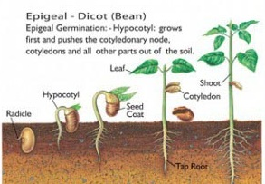
Epigeal germination
In epigeal germination, both the plumule and cotyledons are thrust out of the ground by the elongation of the hypocotyl.
In this type of germination the cotyledon assume additional functions.
They protect the plumule as it is pushed through the soil.
They may also become chlorophyllous and photosynthesize. Eg. Cowpea, Mango, Castor, etc.

Slide 29
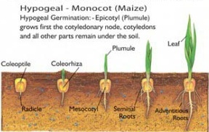
Hypogeal germination
In hypogeal germination, the epicotyls elongate thrusting the plumule upwards out of the ground leaving the cotyledons below the ground. Eg. Maize, Rice, Millet, Garden pea, etc.

