Slide 1
Motors
贺思远，FELFrost

Slide 2
Sources
https://github.com/sweetsinpackets/arduino_motor

Slide 3
Contact
Mail: sweetsinpackets@gmail/163.com
Will be replied: explanations (why it is)
May not be replied: details (how it is)
Won’t be replied: instructions (how to do)
Or anytime you catch me.
ensuring an answer.
QQ: 963815116, Wechat: sharksweets

Slide 4
No stupid questions.
No hesitation for questions.
But you should first try…

Slide 5
About your programs
I suggest that for one group, choose one to solo the programming.
If not, make sure the program is divided into each greatly separate function part.
Ensure your naming and annotation.

Slide 6
Useful format
Naming:
hardware_(function)_member
ex: Servo1_raise_angle
Notes:
What is it, what it is for, what to do.
ex: //The speed up function for motor1 to speed up from 0 to 255.

Slide 7
Definition
Making use of #define
It help you make clear for the pins and names you use.
You can just change the definition whenever you need to change the pins.

Slide 8
Void-void functions
Get some basic functions to do repeated work.
ex: stop and start your car.
Take unfamiliar short codes into functions.
ex: sensors get data.
If you are not clear with your program, whenever it can , use void-void functions.

Slide 9
Suggections on functions
Declaration on top, definitions at bottom.
Don’t pass a class object if not final.
Use switch-case to avoid passing too much pin.
Parameter-functions in parameter-functions.
If necessary, don’t forget the difference the difference of type and type&.
If you have two or more, use pointers instead.

Slide 10
Errors - codes
Serial.println()
Use strings to figure out which part it breaks
Use string+number to figure out which loop
For loop in loop(), use extra string to clarify.
I hope you won’t use loop in loop.
Make sure you have a logic map.

Slide 11
Errors - hardware
Sensors may return unusual data.
ex: light sensor return negative data.
ex: Distance sensor return huge data.
Write a filtering function based on range or delta.

Slide 12
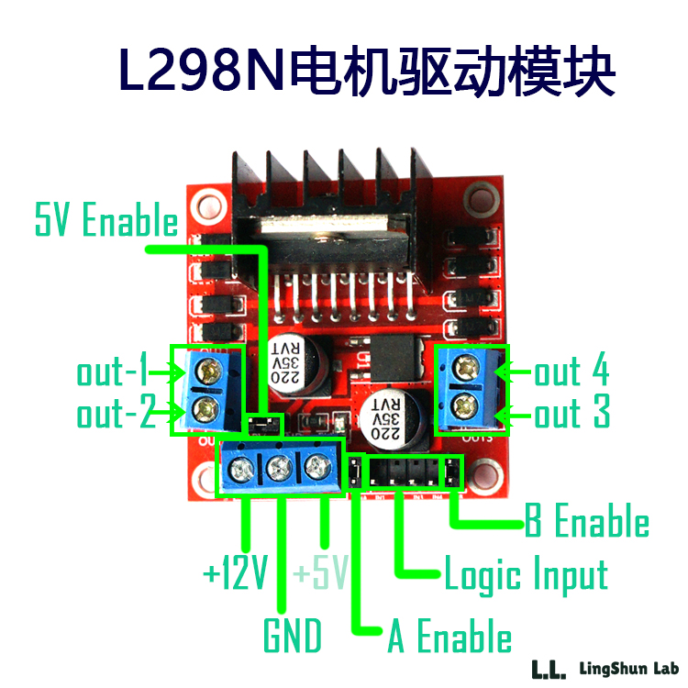

Slide 13
DC motor test!
Open and upload the DC_test.ino from the package.
Don’t forget to turn to COM3!

Slide 14
int input1 = 5;
int input2 = 6;
int input3 = 9;
int input4 = 10;
#define input1 =5;
#define input2 =6;
#define input3 =9;
#define input4 =10;

Slide 15
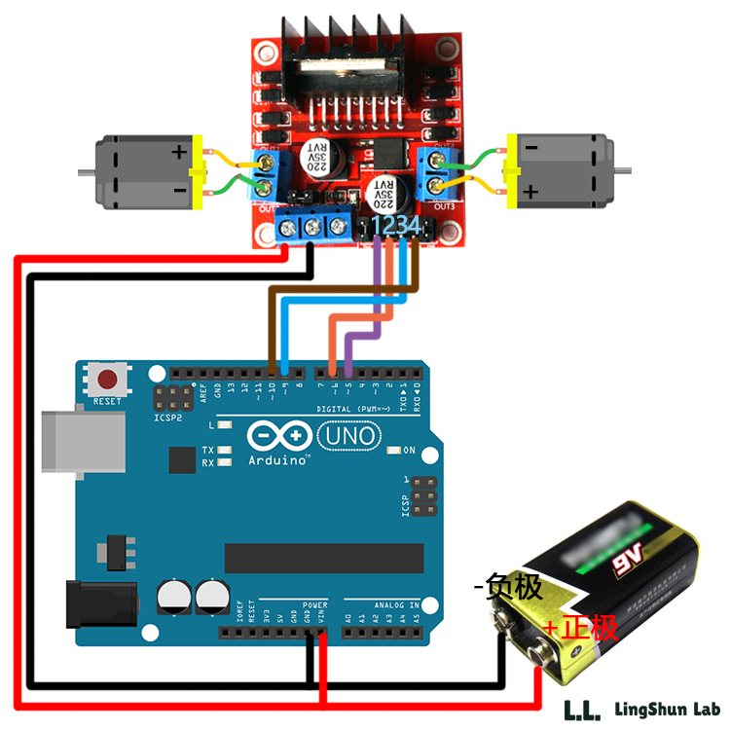

Slide 16
Some explanations
The power of arduino is not enough, so the L298n need extra power.
High-High and Low-Low can both make the motor stop.
High-Low and Low-High has different direction.

Slide 17
Try to turn the speed!
Another kind of instruction of connecting.
IN1 <====> 3
IN2 <====> 4
ENA <====> 10
Upload the DC_speed.ino
By the way: The program is from Liu Chang.

Slide 18
Enable(使能)
ENA and ENB
If ENA or ENB is HIGH, the motor works.
If ENA or ENB is LOW, the motor stops.
Why ENA can range from 0-255?

Slide 19
Speed Control
In program, you can just change the value of ENA or ENB to change the speed.
Range : 0-255 (Linear)
Calculate the turning angle.
The actual speed depends.

Slide 20
PWM
Pulse Width Modulation
脉冲宽度调制
~pin on your arduino
Simulate “analog quantity” by digital signals
Digital signals: HIGH and LOW
Analog quantity: numbers

Slide 21
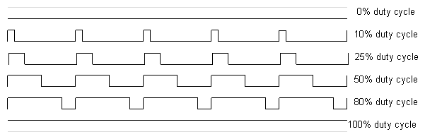
PWM

Slide 22

PWM
A certain time period
The percentage of HIGH

Slide 23
Make PWM (bad example)
digitalWrite(pin, HIGH);
delayMicroseconds(100);
digitalWrite(pin, LOW);
delayMicroseconds(1000 - 100);
Fast PWM, Phase-Correct PWM
For more information, please refer to www.arduino.cc.

Slide 24
Probable PWM and speed
Assume the percentage of HIGH is x%.
x% time the motor works.
Thus in the short time period,
it goes x% of the max distance.
Since the time period is short,
it can be regarded as x% speed.

Slide 25
PWM and speed
Under a certain frequency, the power is given in square wave pulse (方波脉冲)
The motor is actually an inductance(电感), which means it has the ability to hinder current and voltage change.
The result is power will be distributed averagely on time.

Slide 26
Problems – don’t go straightly
L298n don’t start two motors at same time.
Difference in motors.
Mechanical structure.
Solutions:
PWM switch.
Set a delay time.

Slide 27
Problems – tiny movement
You may find the motor have a long starting time and unexpected speed, especially you need it to do move only a little.
Under this situation, I suggest you to use more accurate motor, or substitutions like servo.
Or you can do a lot experiments.

Slide 28
Addition
DC motors are easily to break down. Don’t turn it on unnecessarily.
If DC motors run too slow, add to the voltage of L298n.
The battery is also easily to run out. Make sure you have enough same type of replaceable units.

Slide 29
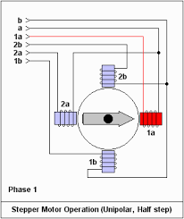
Stepper Motor
相：线圈数量
拍：转子转一圈通电 次数
拍等于相或相的两倍

Slide 30
Stepper Motor
单四拍（单相通电） A-B-C-D-A
双四拍（双相通电） AB-BC-CD-DA-AB-
八拍 A-AB-B-BC-C-CD-D-DA-A
更高拍更加精确

Slide 31
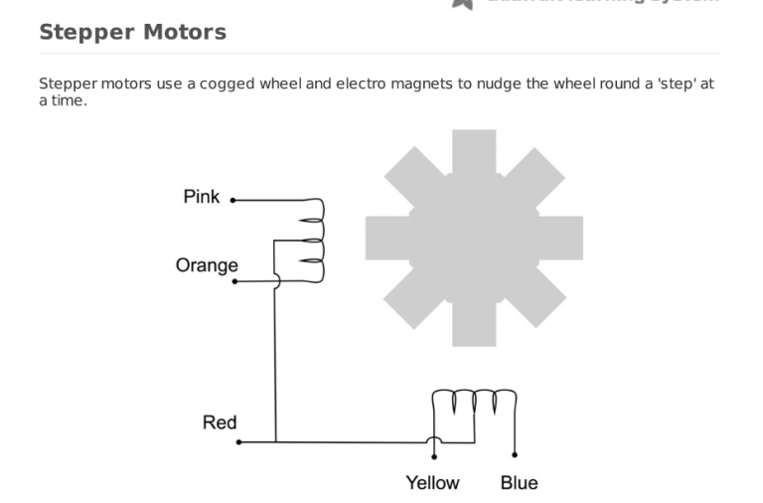
The 28BYJ-48 type need to connect the Red line to 5V.

Slide 32
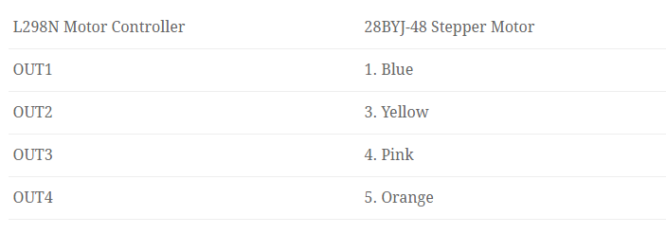
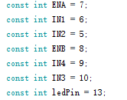
ENA <====> 7
IN1<====> 6
IN2 <====> 5
ENB <====> 8
IN4 <====> 9
IN3 <====> 10

Slide 33
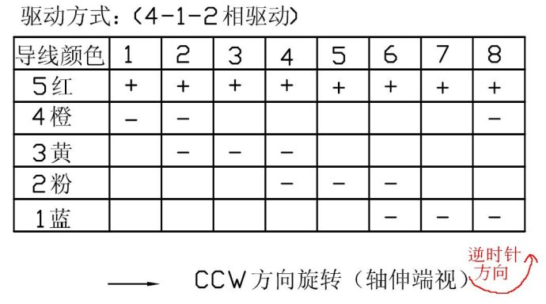
28BYJ-48
4相位，1，2相位交替

Slide 34
28BYJ-48
See the attached code, stepper_double_four.ino (cited), it gives an example for the double-four.
See the attached code, stepper_eight.ino (cited) ,it gives an example for the eight.

Slide 35
More details about 28BYJ-48
https://blog.rjdlee.com/arduino-wemos-with-l298n-controller-and-28byj-48-stepper-motor/
http://42bots.com/tutorials/28byj-48-stepper-motor-with-uln2003-driver-and-arduino-uno/

Slide 36
Stepper.h
<stepper.h>
Construct functions
Stepper(steps, pin1, pin2)
Stepper(steps, pin1, pin2, pin3, pin4)
steps: the number of steps in one revolution of your motor. (Here refer to the actual times, not the previous one.)
Ex: Stepper myStepper = Stepper(100, 5, 6);

Slide 37
Stepper.h
setSpeed(rpms)
rpms: the speed at which the motor should turn in rotations per minute - a positive number (long)

Slide 38
Stepper.h
step(steps)
steps: the number of steps to turn the motor(int)
Note that the time completed will related to the setspeed(rpms) function

Slide 39
Stepper.h
Easy use: if you have a sensor, like potentiometer, than you can use the stepper.ino to get easy control of your stepper motor.
Before you use the stepper.h ,you still need to make sure your wiring is correct and you have read the instructions.

Slide 40
Thanks & Claims
The ppt has used quite a lot of individual works, without permission, including L.L Lab, Instruction, Brown.
The ppt is only for education use, no reprinting and financial use.
The code is from website, public. Some may not under GNU General Public License. Please ensure it before you use.

