Slide 1
What Technical Communication Graduates Require to Survive in the Industry
Sridhar Rao

Slide 2
Introduction
Progress in the field
Remain as updated as possible
Jack of all trades, master of some
Paper’s objective:
Focus on skills required to be absorbed in the industry
Focus on what managers hiring are looking for

Slide 3


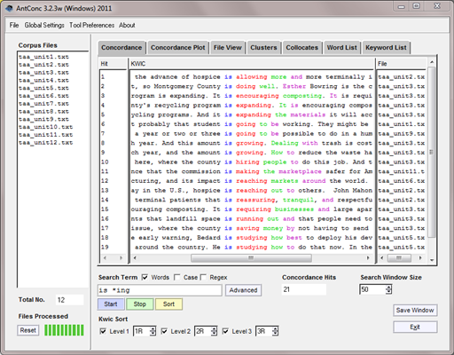
Method
Interview
Corpus Analysis

Slide 4
Key Findings
Interview
Corpus Analysis
Tools
Digital Literacy
Technical/Writing Skill
Managers’ Expectations
Educational Background
Tools
Technologies
Degree
Key words
Job titles

Slide 5
Results
Many differences
Microsoft Office Suite
Adobe Creative Suite
XML, HTML, CSS, JavaScript
Job Titles
Degree requirement

Slide 6
Discussion
Job ads not accurate
Small sample size
Focus on appropriate tools
Writing skills
Hiring requirements
Adaptability

