Slide 1
The difference between data, information, and knowledge
Dr. Lam
TECM 4180

Slide 2
Before we differentiate data, information, and knowledge…
POLL

Slide 3
Data vs. Information vs. Knowledge
Data- raw numbers, words, etc. that lack context or meaning (e.g., 33,715)
Information- application of structure to data to convey meaning (e.g., “enrollment at UNT 33,715 for Spring 2014)
Knowledge- understanding of a specific subject through experience or education (e.g., “33,715 is up from 33,505 in Spring 2013”)

Slide 4
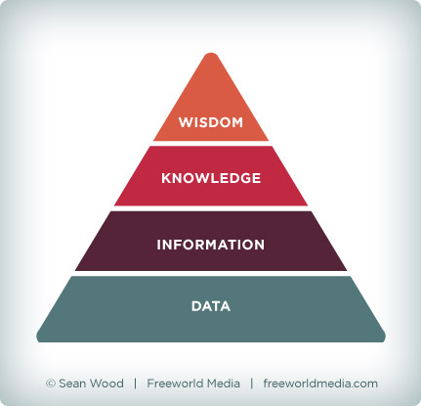
Visually…

Slide 5
Data and information are foundational
Can you think of a terrible piece of “knowledge” not built on information and data?
Consolidate your student loans!

Slide 6
Example 1
Raw Data
Yes, Yes, No, Yes, No, Yes, No, Yes, No, Yes, Yes
Context
Responses to the market research question – “Would you buy brand x at price y?”
Processing
Information
???
Creative commons attribution to FatMax 2007

Slide 7
Example 2
Raw Data
42, 93, 96, 84, 96, 86
Context
Jayne’s scores in the six AS/A2 ICT modules
Processing
Information
???
Creative commons attribution to FatMax 2007

Slide 8
Example 3
Raw Data
111192, 111234, 55234
Context
The previous and current readings of a customer’s gas meter
Processing
Information
???
Creative commons attribution to FatMax 2007

Slide 9
Knowledge Examples
Using the 3 previous examples:
A Marketing Manager could use this information to decide whether or not to raise or lower price y
Jayne’s teacher could analyze the results to determine whether it would be worth her re-taking a module
Looking at the pattern of the customer’s previous gas bills may identify that the figure is abnormally low and they are fiddling the gas meter

Slide 10
A few notes about data, information, and knowledge
Data (provided it hasn’t been manipulated, and has been collected correctly) is objective, and therefore, rarely “incorrect”
A yes is a yes, a no is a no
Information, however, is context dependent. This means it can sometimes be “wrong”
E.g., “Customers preferred Coke to Pepsi” (but when or where or who?)

Slide 11
Applying this to project 1
Will you knowledge base contain knowledge, information, or data?

Slide 12
Apply what you know
In groups, come up with a list of potential knowledge areas or topics for your knowledge base?
What are some things a student needs to know about XXX that are not posted on a website.
E.g., Prof. XXX is a hard grader.
E.g., GAB 111 is not very crowded compared to other labs.
In groups, go through each question you have written for your interviews. Determine what data, information, and knowledge you will gain from each question.

