Slide 1
Information Architecture
TECM 4180
Dr. Lam

Slide 2
What does an architect do?
Starting the Project The architect talks to the client about expectations, project requirements and budget. This information forms the design brief. Design Phase The architect analyses the design brief and the building site conditions, and determines the best location and orientation. The architect then develops ideas through rough plans, sketches and models. These ideas are brought together into concept design drawings. Design development, documentation & building approvals The architect compares the concept design drawings with the design brief and develops the technical detail for the project with the project team. Detailed drawings and specifications are prepared for the builder. The drawings are lodged to obtain local authority building approval. The method of engaging a builder for the project is determined. Construction The architect works with the builder and other project team members to ensure that the project is constructed in accordance with the drawings and specification. After construction Projects have a warranty period called the defects liability period. It is the architect’s responsibility to follow up any relevant issues or outstanding work with the client and the builder.
*From Australian Institute of Architects

Slide 3
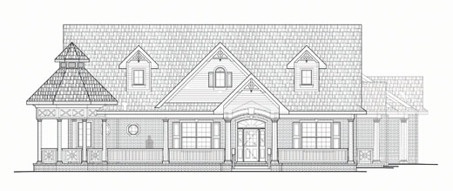
House Metaphor

Slide 4
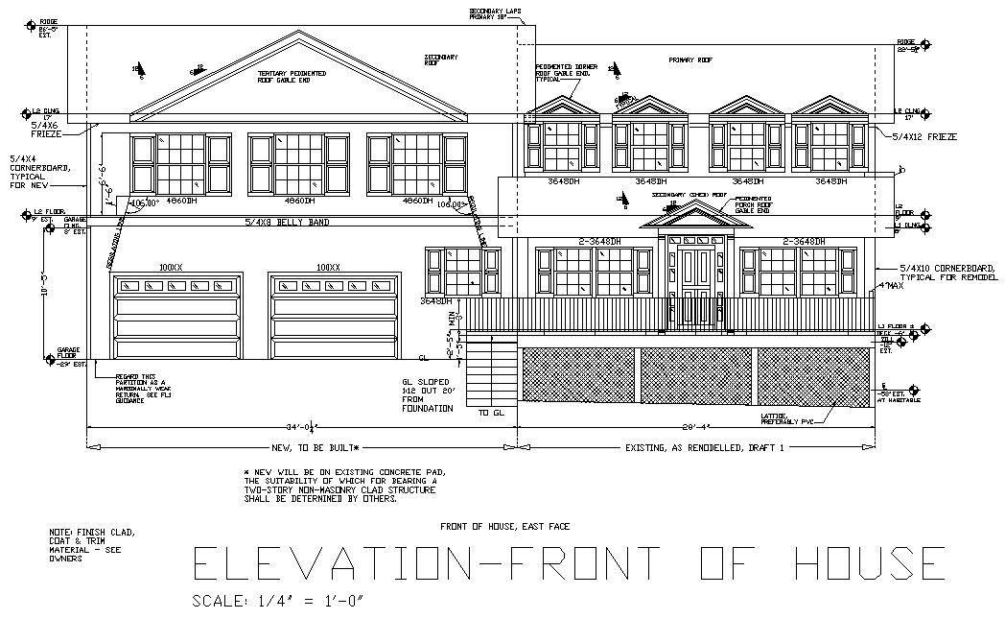
Blueprints

Slide 5
Architect vs. Information Architect
Architect | Information Architect
Starting the Project | User interviews and constructing a user profile
Design Phase | Brainstorming and coming up with topic ideas
Design development, documentation & building approvals | Organizing the topics into meaningful categories
Construction | Building the site
After construction | Testing it on users and making adjutments

Slide 6
What is information architecture?
Information architecture (IA) refers to the structure or organization of your website. It describes the ways in which the different pages of your site relate to one another and ensures information is organized in a consistent and predictable way on each page.
assessing existing and needed content,
organizing the pages,
providing clues to help use the site efficiently, and
developing navigational structure.

Slide 7
Two major types of IA
Macro-level IA
Site map
Micro-level IA
Wireframe

Slide 8
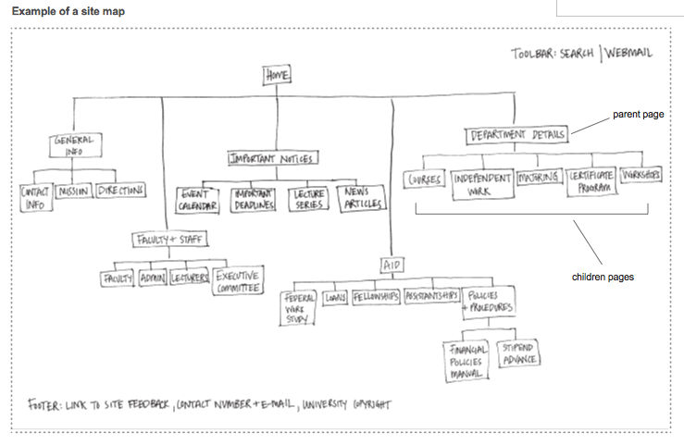
Site Map

Slide 9
Key Characteristics of a Site Map
Visual representation of the site
It’s a planning tool
Shows hierarchical relationships
Parent/child
Shows peer relationship
How pages on the same level connect

Slide 10
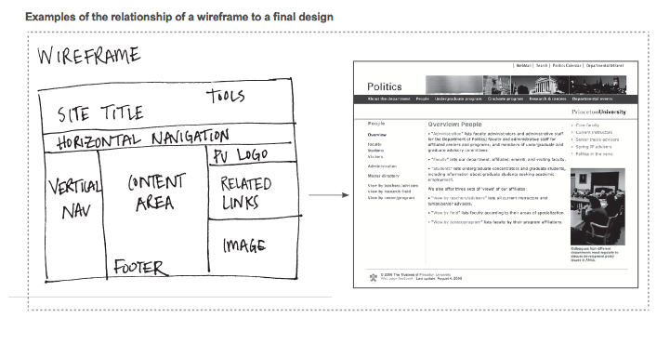
Wireframe

Slide 11
How do I create great information architecture?
Define key stakeholder’s goals
Identify your users’ goals and expectations
Defining your site’s content areas
Organizing the content areas
Creating the site map
Outlining your navigational structure
Labeling your content areas
Creating wireframes

Slide 12
Step 1: Define Key Stakeholder’s Goals
What are the key stakeholders’ expectations in creating or redesigning this site?
Examples: making the site more intuitive/easier to use, explaining what you do, explaining the services you offer, gathering visitor feedback, attracting or serving new audiences, reducing the number of phoned-in requests for assistance, boosting the number of applications from target groups or regions, increasing attendance at events, building a sense of community.
What specific functional requirements do the key stakeholders want included in this site?
Examples: including a search tool, providing self-service options, having downloadable PDFs or interactive forms, having an events calendar, enabling people to sign up for events or apply online, having an intranet for internal communications purposes.

Slide 13
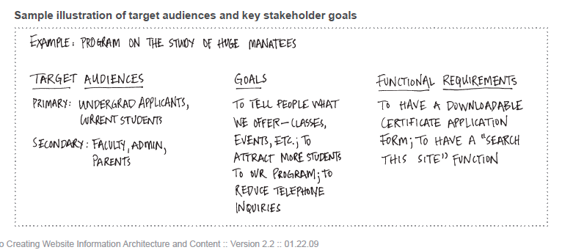
Sample Illustration of target audiences and key stakeholder’s goals

Slide 14
Step 2: Identifying your users’ goals and expectations
Ultimate goal of IA: Anticipate user’s needs
Conduct interviews with a wide variety of users
If you can’t conduct interviews, answer key questions about your users

Slide 15
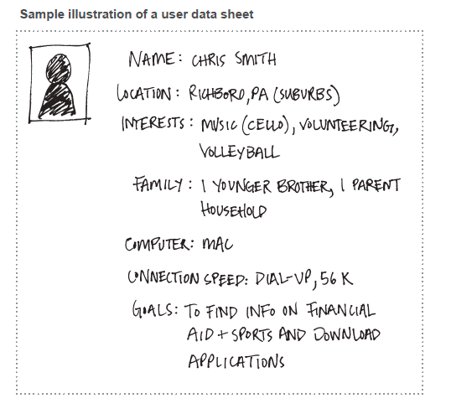
Sample Illustration of a User Data Sheet

Slide 16
Step 3: Defining your site’s content areas
Helps develop navigational structure (and not the other way around)
Analyze the content you already have. Decide what to keep, revise, or remove
List all the content areas users will want to find on your site

Slide 17
Step 4: Organizing the Content Areas
Putting your brainstormed content into groups
One method is the Card Sort
https://www.youtube.com/watch?v=TNvdgXCqEvM

Slide 18
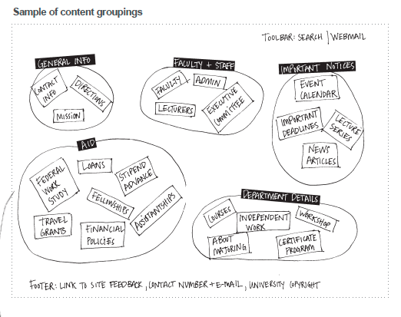
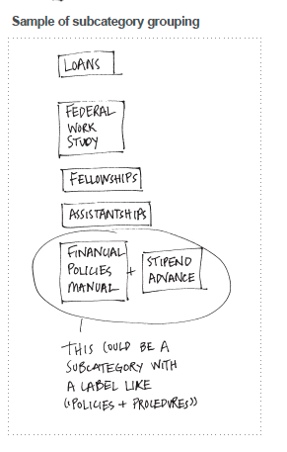

Sample of content groupings

Slide 19
Step 5: Creating the site map
Site maps are visual representations of the content areas
Not every page will have a child, but every all pages has a parent

Slide 20
Site Map

Slide 21
Step 6: Outlining your navigational structure
Take site map and draw a navigation bar
Navigational items should NEVER point to 1) other sites and 2) non-HTML files (like pdf, doc, etc.)
Links to other sites and documents should be placed in your central content area or a “related links” section.
Analogy: textbook TOC

Slide 22
Navigation guidelines
Vertical navigation- If your navigation links is small (less than 20), left or right column navigation might be appropriate
Horizontal navigation- If your navigational links is more than 20, you might need to put main navigation in horizontal and sub navigation on each page in a column.
Adding audience navigation – If site is very large (100 or more pages), consider adding navigation for key audiences.

Slide 23
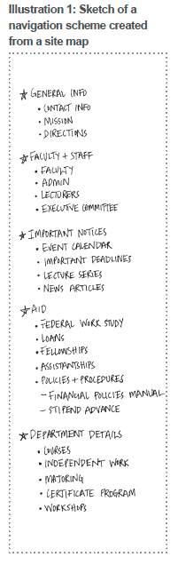
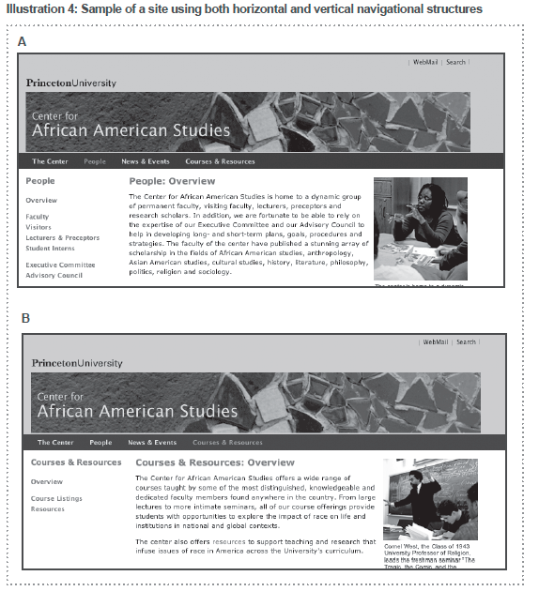
Navigation Sketch

Slide 24
Step 7: Labeling the content areas
Accurate and meaningful labels are essential
Users click words, so the words need to make sense
Test your wording
Labels shouldn’t be more than 3 words long

Slide 25
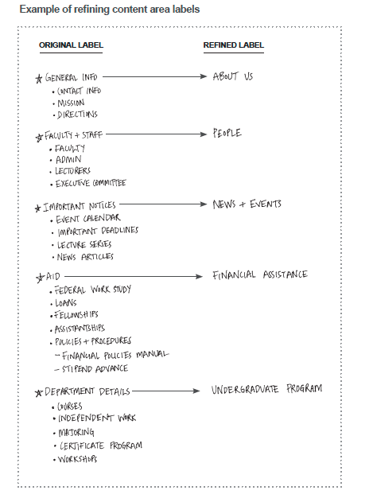
Refining content area labels

Slide 26
Step 8: Creating the Wireframes
A wireframe is a sketch or blueprint that closely represents how the areas of a page will be organized.
This is the deliverable to hand off to a professional designer (designer will develop a mockup)

Slide 27
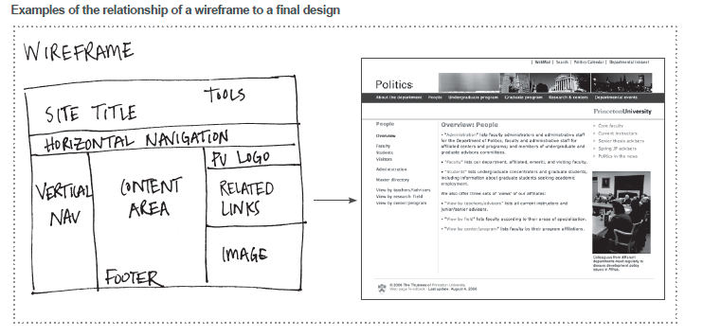
Wireframe to Mockup

