Slide 1
Introduction to the Video Tutorial
TECM 4180
Dr. Lam

Slide 2
Why Video Tutorials?
“Despite the need for instruction, users still steadfastly refuse to engage with traditional printed manuals. Novick and Ward found that…an underwhelming 20% of problems were solved using a manual. Most participants gravitated toward other people (90%) and online help (75%)” (Swarts, 2012)
Other reasons for Video Tutorials
Unlike manuals, most videos are informal—the narrator is speaking to us
Can be entertaining
“Seductive in the sense that advertising and marketing writing is”

Slide 3
Project 3
Create a tutorial on a technical subject
Must be delivered on a screen (traditional video tutorial/ screencast, animated illustration, or web-based module)

Slide 4
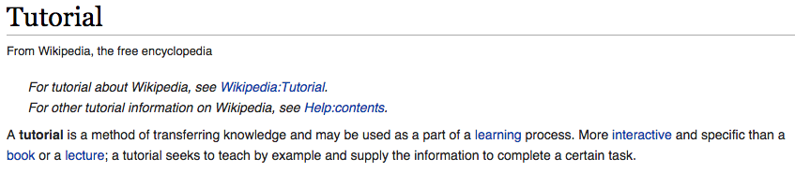
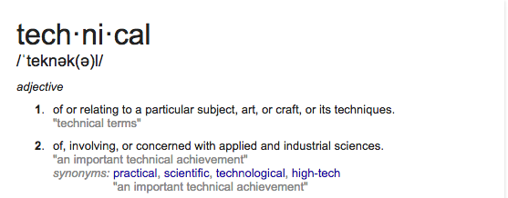
Let’s Define Some Terms

Slide 5
FAQs
Q: How long should the video be?
A: Probably between 4 minutes and 20 minutes.
Q: What do we do if we don’t have a camera?
A: Use your smart phone! Most smart phones actually shoot HD (720p or better) video.
Q: What if we want to do a screencast?
A: Use Camtasia! It’s free for 30 days and has FANTASTIC post-production options that are fairly easy to figure out. You could also use CamStudio (Not to be confused with Camtasia Studio); QuickTime on a Mac (No editing capabilities), Screen-cast-o-matic.
Q: Speaking of video editing, what/how do I do that?!?
A: Windows Movie Maker (Windows) and iMovie (Mac) are probably already on your computer. Camtasia (stated previously) also will have plenty of power. Watch some video tutorials on YouTube to learn how to edit video (oh, the irony).

Slide 6
So, what topic should you do your video on?
“Generate lots of highly specific content and let the users sort it out. This is a lesson that some forum managers are learning as well. I am not suggesting that videos be made on a 1-to-1 ratio of questions asked to videos made. That’s what a forum is for. What a video might be for is addressing issues that multiple people ask about. A robust tagging vocabulary would then help users find what they are seeking.” (Swarts, 2012)
Good Places to Start
What technical knowledge do you already possess?
What are you interested in?
What will people care about??

Slide 7


Slide 8
What’s the process?
Pick a topic
Narrow to a very specific video tutorial topic
Research the topic
Write a script
Create a storyboard
Record
Post-production

