Slide 1
Infographics
TECM 4180
Dr. Lam

Slide 2
Project 2: Infographic
Three key characteristics of an Infographic:
It is visual- An infographic is a visual image (e.g., chart, diagram, picture)
It tells a story – Infographics should present a very clear and easy-to-understand story
It represents data or information – Infographics are visual representations of existing data or information

Slide 3
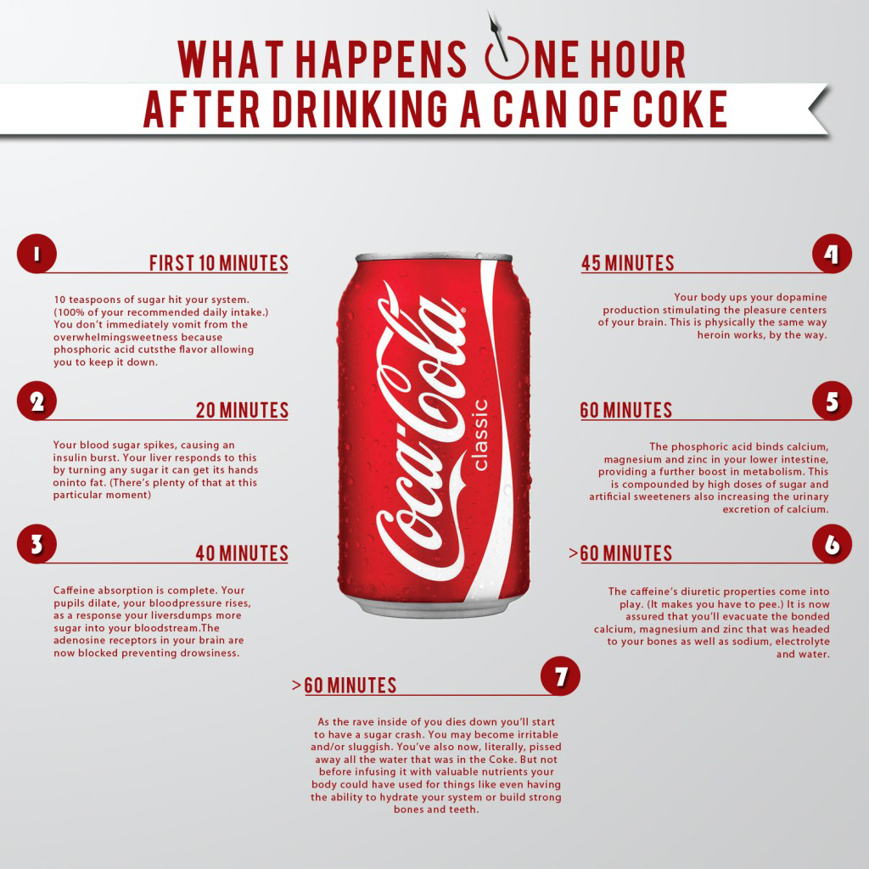

Slide 4
http://www.creativebloq.com/sites/creativebloq.com/files/images/2013/04/controllersfull2.jpg

Slide 5
What Infographics do?
Turn data into information, and maybe even knowledge
Make people think about data in a new and interesting way
Educate, persuade, or inform audiences

Slide 6
Process?
Start with a topic where there is data available
Educate yourself
Determine your narrative (story)
Identify problems in the narrative (confounding variables)
Choose a format
Determine a visual approach
Revise

Slide 7
Three keys to choosing a topic
Pick one that means something to you
Pick one that you’ve already researched
Pick one that has potential for mass appeal

Slide 8
Find Data
There is a TON of free, publicly available data (pretty much any government organization provides loads of data)
Find reputable sources and see what they’re citing

Slide 9
Educate yourself
Learn as much as you can about the topic
Consider all viewpoints, even those you don’t agree with

Slide 10
Find the Narrative
What is the most compelling piece of data you can find?
Look for comparisons
Look in places you might not necessarily expect
Find data that supports your main data point
Craft your visualization around this main point or thesis

Slide 11
Let’s look at some open data sources
https://www.dallasopendata.com/Police/Police-Bulk-Data/ftja-9jxd
http://www.texastransparency.org/Data_Center/Search_Datasets.php
Take a look at a dataset.
Determine how you might visualize something from the data.

Slide 12
Choose a Format
Think about the story you are telling and the relationships you are trying to convey
Select one or more graphical elements to reflect these relationships
E.g., comparing variables over time (use a line chart)

Slide 13
Some types of Infographics
How to
http://visually.visually.netdna-cdn.com/VectorInfographicsWebbyartsDownloadFreeVectorsGraphics_4dcb82680ac86_w587.jpg
Comparison
http://www.informationisbeautiful.net/visualizations/gender-pay-gap-us/
Flow chart
http://visually.visually.netdna-cdn.com/infographicbeerisalwaystherightanswerbeerampwhiskey_4dcd80118fe76_w587.jpg
Categorization
http://visually.visually.netdna-cdn.com/301_infographic_w587.jpg
Time line
http://visually.visually.netdna-cdn.com/thehistoryofchristmascookieskillerinfographicsbysubmit_4e6079a880018_w587.jpg
Geographic
http://visually.visually.netdna-cdn.com/infographiccurrentbreweriesoftheoriginal13statesbeer_4f277eee8bedb_w587.jpg
Visual article
http://visually.visually.netdna-cdn.com/alcoholaddictionrehabinternational_4f1de9e6adbff_w587.png

Slide 14
Next Steps?
Brainstorm!
Start by writing of list of topics you are interested in
Research your top topics to determine if there is enough data/information
Pick a topic and begin thinking about how to visualize it

