Slide 1
Storytelling with Data
Dr. Lam
TECM 4180

Slide 2
Three elements to a successful infographic
Understands audience
Anderson page 62 communication goals worksheet due with Project 2
A clear framework
Essentially, what is the data? Is it clear to everyone? What parts of the data will need explaining?
It tells a story
From Harvard Business Review (https://hbr.org/2013/04/the-three-elements-of-successf)

Slide 3
What makes a good story?
Poll

Slide 4
Parts of a Story
Introduction to the situation
A series of events involving tension or conflict
Resolution

Slide 5
Storytelling with data
https://www.youtube.com/watch?v=hVimVzgtD6w

Slide 6
Let’s First Start With Narrative
Narrative is defined as
“an account of a series of events, facts, etc., given in order and with the establishing of connections between them.”

Slide 7
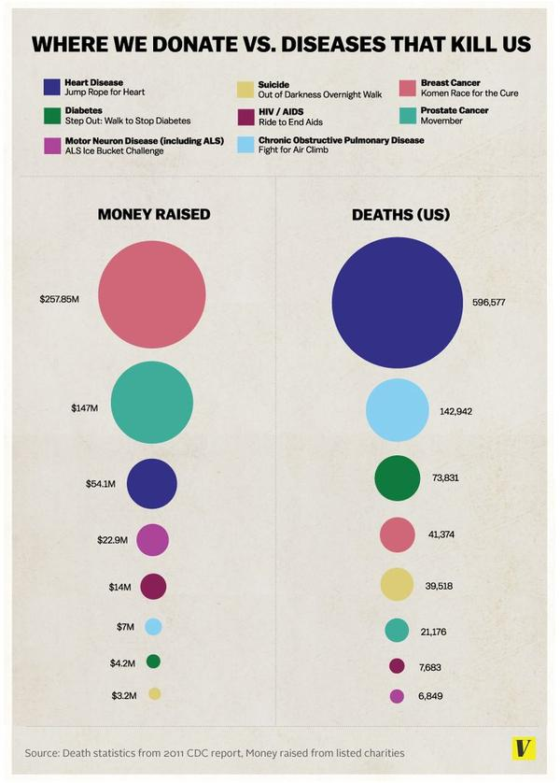

Slide 8
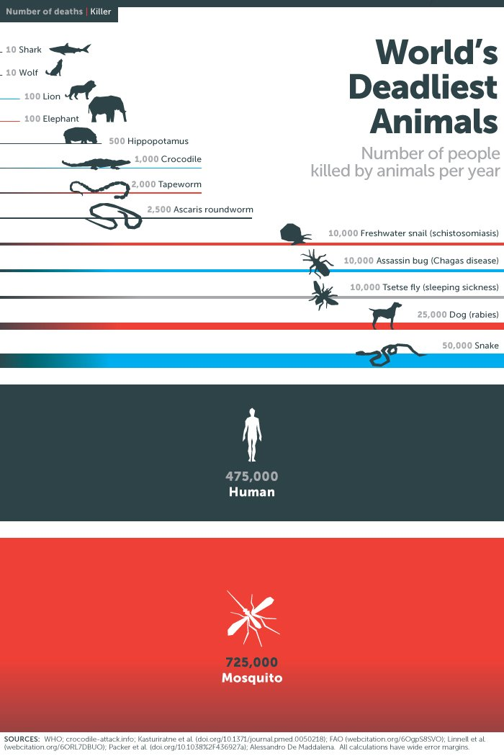

Slide 9
Visual Strategies for Storytelling
Color – Used to convey emotion
Repetition
Proximity (Gestalt Psychology)

Slide 10
What is the story that your data tells?
What is the situation or context?
How will you make this known to your reader?
What conflict or tension is being displayed?
What is your resolution? What do you want your audience to do or feel after viewing your infographic?

