Slide 1
Analyzing and Visualizing Data
Dr. Lam
TECM 4180

Slide 2
What we’ll cover
Different types of graphics
When to use graphics
What graphics to choose
What to include with a graphic

Slide 3
Types of graphics
Graphic Type | Description | Examples
Decorative | Visuals added for aesthetic appeal or humor | Person riding a bike in a lesson on how a bike pump works
Representational | Visuals that illustrate the appearance of an object | Screen captures Photograph of equipment
Organizational | Visuals that show qualitative relationships among content | A matrix like this table A concept map A tree diagram
Relational | Visuals that summarize quantitative relationships | A bar graph or pie chart A map with circles of different sizes

Slide 4
Types of graphics (cont.)
Graphic Type | Description | Examples
Transformational | Visuals that illustrate changes in time or space | Animated demonstration of software A time-lapse of seed germination
Interpretive | Visuals that make intangible phenomena visible and concrete | Drawings of molecules

Slide 5
Poll
Text CHRISLAM138 to 22333

Slide 6
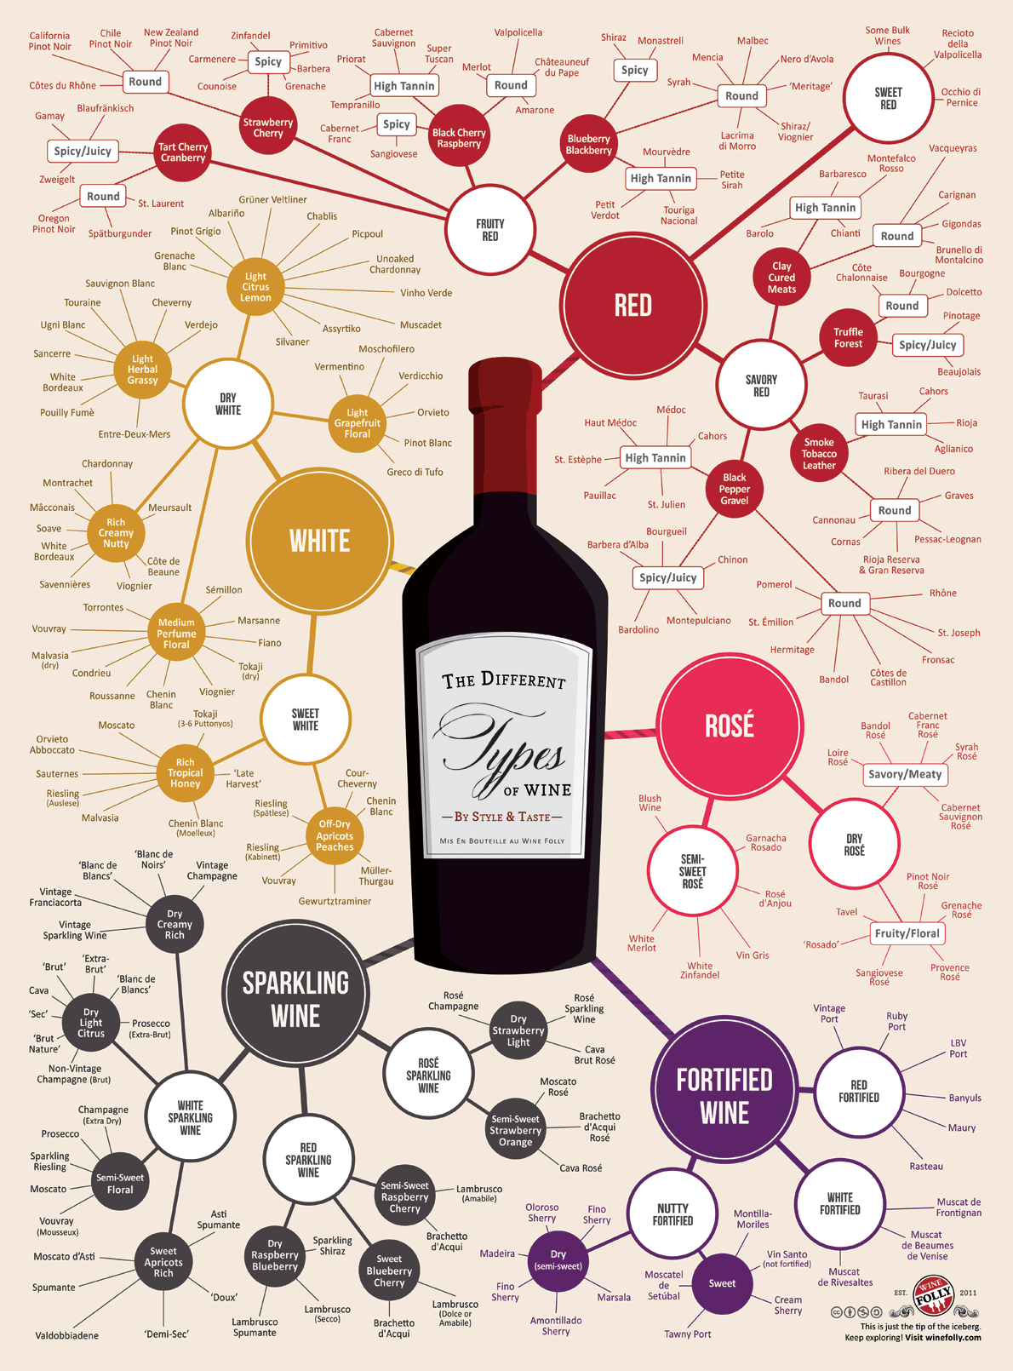
Image 1

Slide 7
Options
A: Decorative
B : Representational
C: Organizational
D: Relational
E: Transformational
F: Interpretive

Slide 8
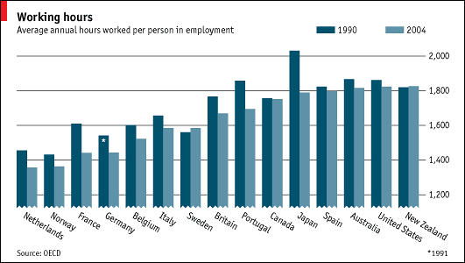
Image 2

Slide 9
Options
A: Decorative
B : Representational
C: Organizational
D: Relational
E: Transformational
F: Interpretive

Slide 10
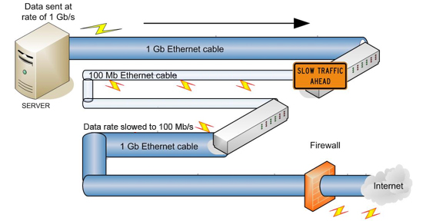
Image 3

Slide 11
Options
A: Decorative
B : Representational
C: Organizational
D: Relational
E: Transformational
F: Interpretive

Slide 12
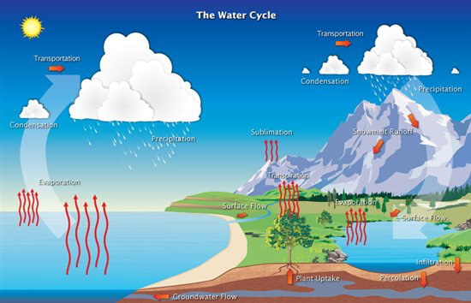
Image 4

Slide 13
Options
A: Decorative
B : Representational
C: Organizational
D: Relational
E: Transformational
F: Interpretive

Slide 14

Image 5

Slide 15
Options
A: Decorative
B : Representational
C: Organizational
D: Relational
E: Transformational
F: Interpretive

Slide 16
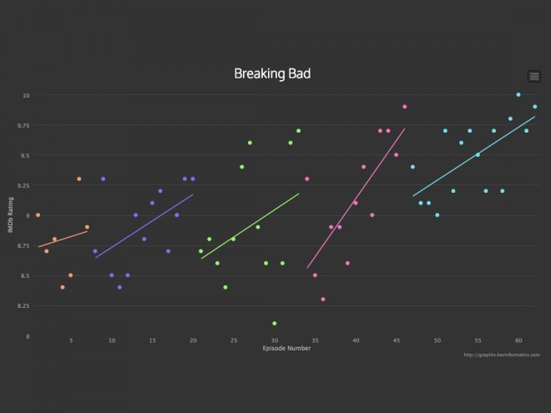
Image 6

Slide 17
Options
A: Decorative
B : Representational
C: Organizational
D: Relational
E: Transformational
F: Interpretive

Slide 18
Tables
Purpose: To help your readers find data or other information rapidly
Tables can be useful to compare data, but may not be as effective as a more visual representation
Include a descriptive title, row and column headings, unit of measure (if needed), and source
Comparison of Foods
Food | Calories | Fat
Apple | 101 | 0
Apple Pop tart | 191 | 2.9g

Slide 19
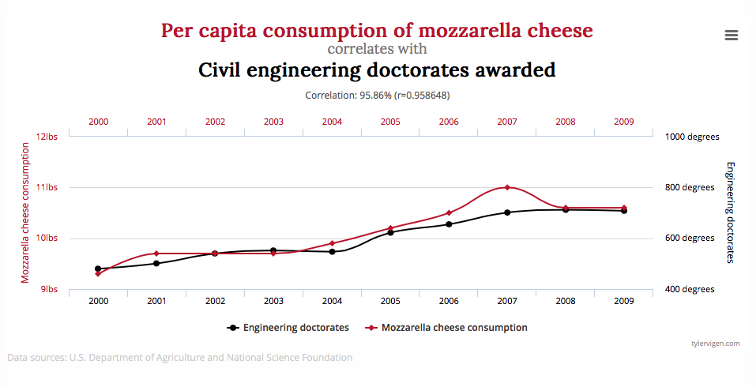
Line Graph
Purpose: To show trends and cycles; To show the relationship between two or more variables
Tend to be good for interval level variables (numerical data)

Slide 20
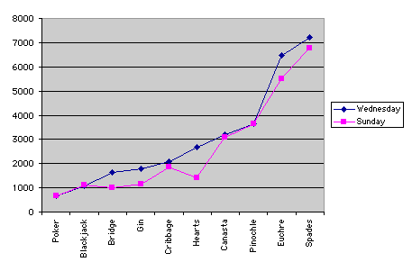
What’s wrong with this?

Slide 21
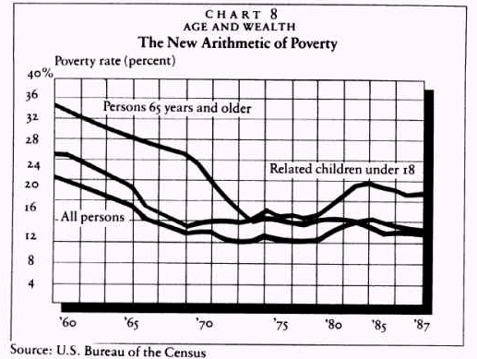
What’s wrong with this?

Slide 22
Line graphs: things to avoid
Ethical labeling/scale
Time across x-axis

Slide 23
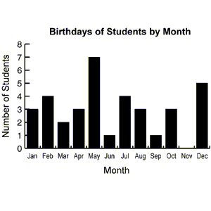
Bar Graph
Purpose: To help readers compare quantities and see trends at a glance
Tend to be good to display categorical variables

Slide 24
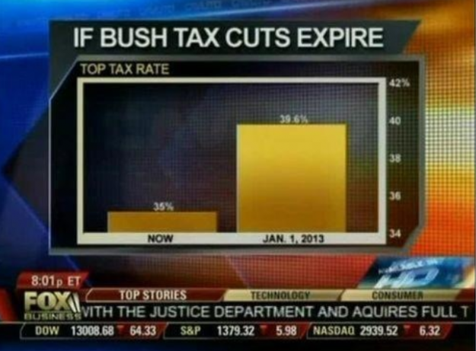
What’s wrong with this?

Slide 25
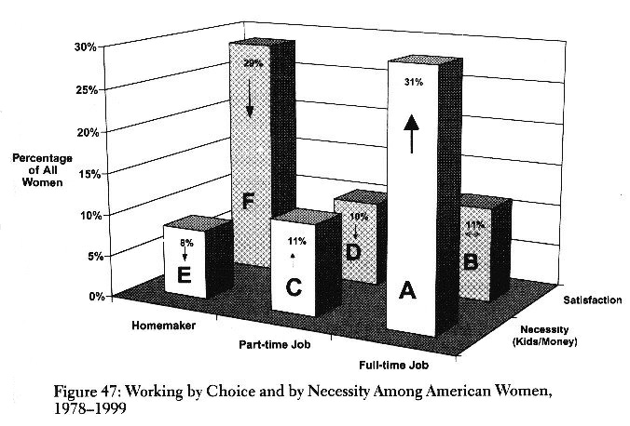
What’s wrong with this?

Slide 26
Bar Graphs: Things to avoid
Ethical labeling/scale
3-D representations
Overly complex bar graphs that try to do too much

Slide 27
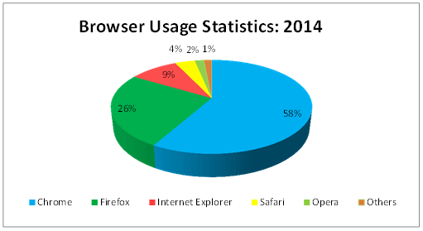
Pie Chart
Purpose: To show the composition of a whole

Slide 28
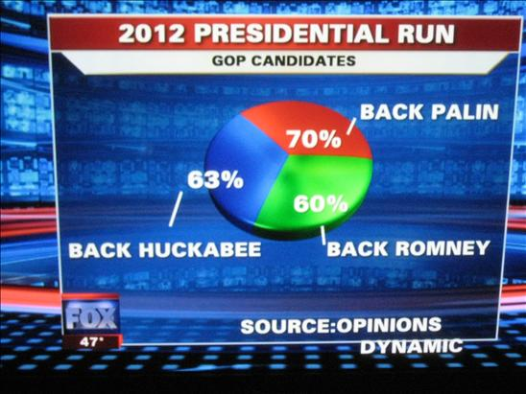
What’s wrong with this?

Slide 29
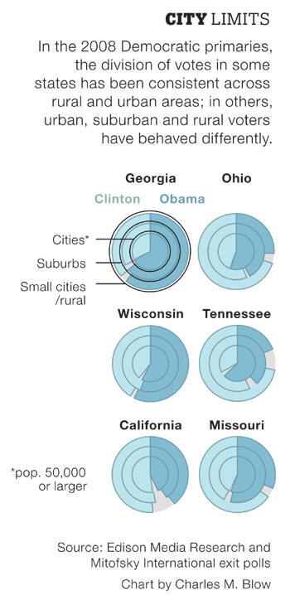

Slide 30
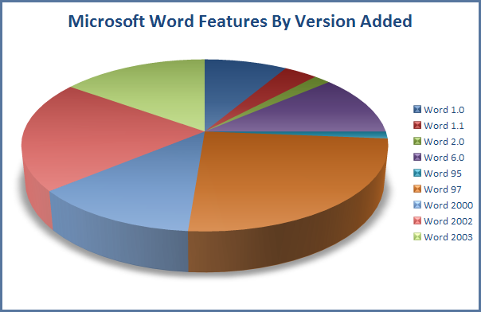
What’s wrong with this?

Slide 31
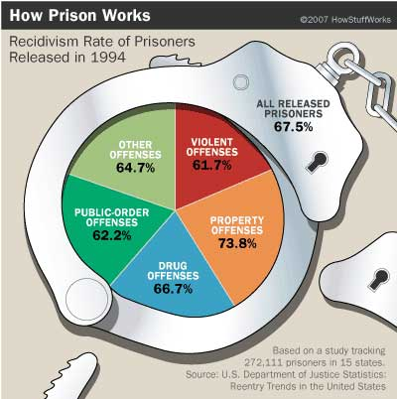
What’s wrong with this?

Slide 32
Pie Charts: Things to avoid
Not representing parts of a whole
Not adding up to a whole
Overly complex representations or too many comparisons

Slide 33
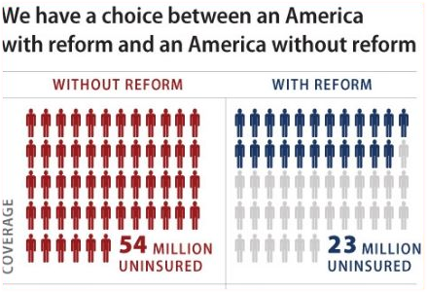
Pictographs
Purpose: To help readers compare quantities and see trends
Simply introduces an additional visual element to an already existing graph (bar, line, etc.)

Slide 34
Things to consider for your project 2
Your infographic should (probably) use multiple types of visuals (organizational, representative, decorative, etc.)
The interesting trends occur when you look at multiple variables side by side
Variable 1: Gender
Variable 2: Income
Variable: Time
It’s ok to use multiple visuals to tell your story. You don’t have to accomplish it all with one visual

