Slide 1
Content Life Cycle
Dr. Lam
TECM 4180

Slide 2
What is the content life cycle?
It’s a model for planning and deploying content
Planning being the operative word
Creating content is a process.

Slide 3
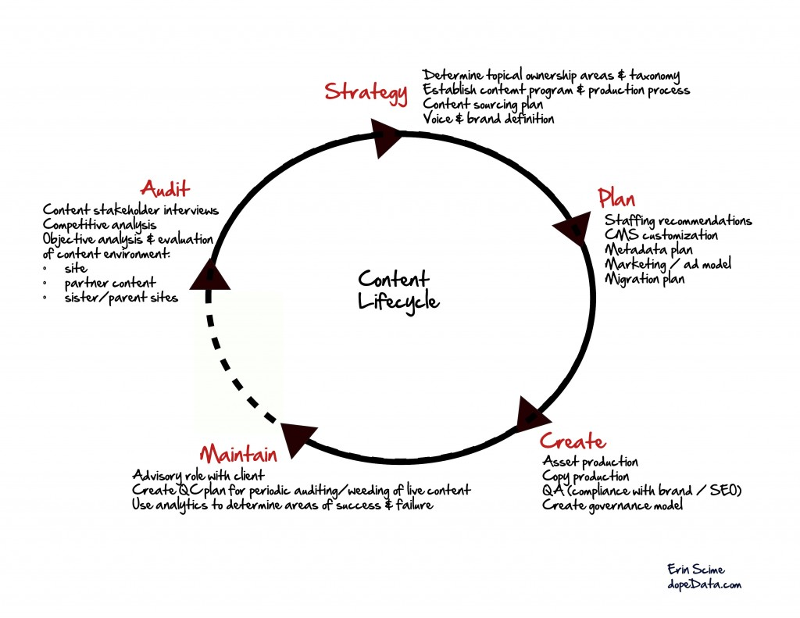
So, what are the steps?

Slide 4
Content lifecycle as applied to this course
Step in Content Lifecycle | Our project | Why it’s helpful | What you have to turn in for the project
Audit | User interviews | Gives us insight into our users and what they know/don’t know. | Primary research documents (questions and answers) Audience Profile
2. Strategy | Information architecture (Card sort) | Gives us a plan for the content we’ll create and how we’ll organize that content | Site Map and Wireframes
3. Plan | Structured authoring guides (we’ll finish these today!) | Gives us a plan to create content that gives us guidelines for writing our content. | No official deliverable, but potential for extra credit if turned in.
4. Create | Writing and editing the articles | Obvious…hopefully | KB with at least 10 topics and 20 articles.
5.Maintain | We won’t cover this in project 1 | It helps plan for future of content

Slide 5
Let’s do an exercise
Write an article that teaches students to change their password. The article should have an introduction and conclusion.
Play musical chairs with another person in your group.
Insert structured headings—i.e, headings that would apply across ALL articles (e.g., “Introduction” instead of “How to change your MyUNT Password”)
Play musical chairs again. In the document, insert grammar, capitalization, and writing style rules for each structured heading.
Play musical chairs one last time. In the document, write design rules for each piece of structured content (e.g., title, headings, paragraphs, numbered lists)
Compare results.
Create a master document that has agreed upon structured sections, grammar rules, and design rules.
Now you have a creation plan for “how to” articles. Your welcome!

