Slide 1
Writing an Empirical Report: The IMRaD Structure
Dr. Lam
TECM 4180

Slide 2
The value of writing
There is nothing more dependent on writing than research.
Why?

Slide 3
Why else is this important?
Consumers of research
You form opinions based on research (whether you know it or not)
You make decisions based on research (whether you know it or not)
There is a lot of junk out there

Slide 4
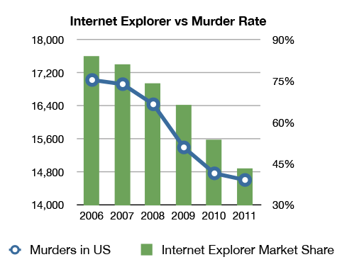
Some funny junk…

Slide 5
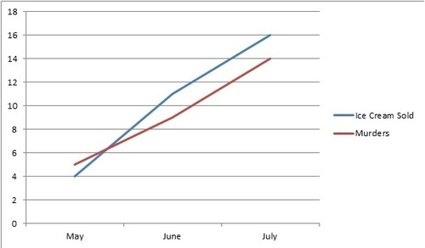
More funny junk…

Slide 6
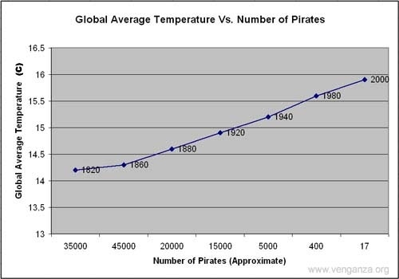

Slide 7
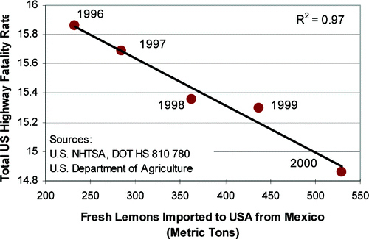

Slide 8
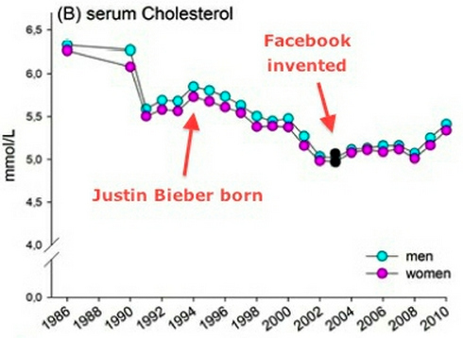

Slide 9
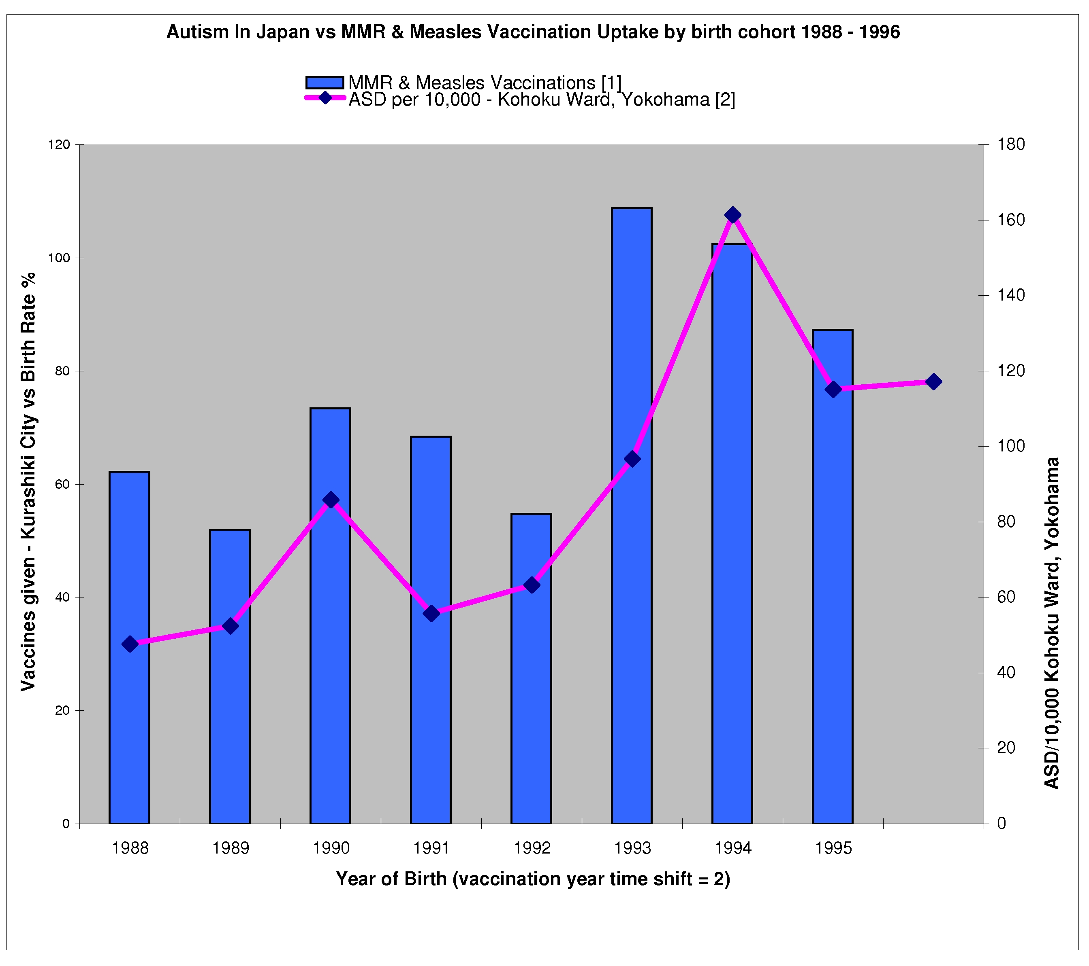
More serious junk…

Slide 10
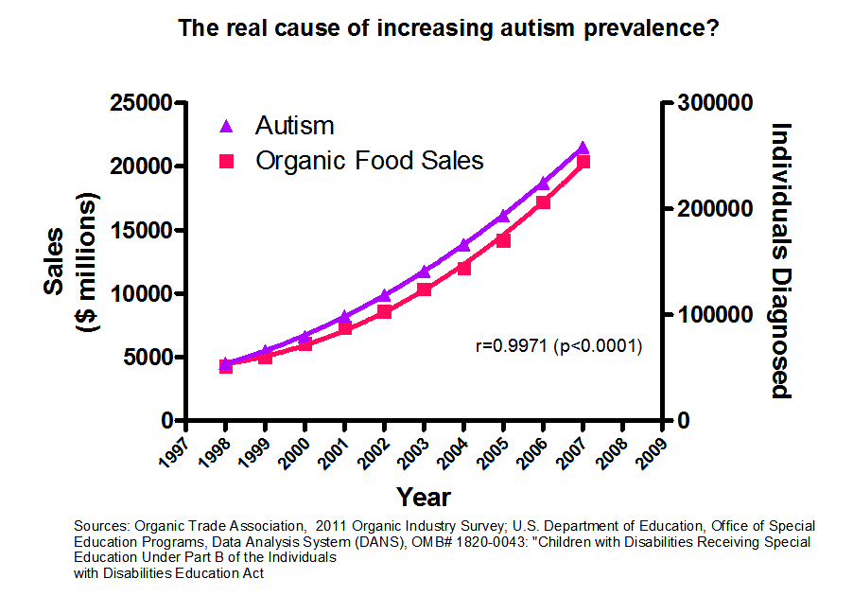

Slide 11
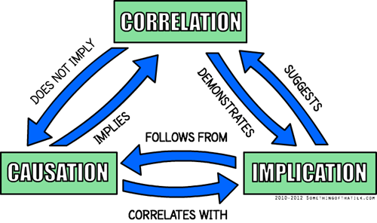

Slide 12
So as consumers of research…
It’s essential to be informed
It’s essential to be critical
But, mostly, it’s essential to be informed

Slide 13
POLL
TEXT CHRISLAM138 to 22333

Slide 14
IMRaD
Introduction - Why was the study undertaken? What was the research question, the tested hypothesis, or the purpose of the research?
Methods - When, where, and how was the study done? What materials were used or who was included in the study groups (patients, etc.)?
Results - What answer was found to the research question; what did the study find? Was the tested hypothesis true?
Discussions - What might the answer imply and why does it matter? How does it fit in with what other researchers have found? What are the perspectives for future research?

Slide 15
Introduction
Provide context for the research:
Outline the topic, condition, problem
Topic: Technology in the classroom
Condition: Technology is advancing at a rapid rate
Problem: Even with advancements of technology, we aren’t integrating new technology into our classrooms
Provide significance
Why is it important that we study this problem?
Why is it important for the organization or other stakeholders?
Provide specific objectives of the study
What are goals of the research study?

Slide 16
POLL
Text CHRISLAM138 to 22333

Slide 17
Method
Think of the methods section like a recipe. It should include enough detail so that another researcher could replicate the study.
Data sources/participants
Procedure
Measures and/or materials

Slide 18
Results
Think of these as an objective report of the results. This section should NOT interject any personal opinions or theories.
Usually present descriptive results first (demographic information; mean, median, mode, etc.)
Then present results related to each research question or hypothesis
May also present secondary or exploratory results
Use statistical terminology and refer to graphical elements to depict findings clearly

Slide 19
Recommendations

