Slide 1
How is technical editing relevant to your life?
TECM 4190
Dr. Lam

Slide 2
It will (more than likely) help you get a job
Enough said…

Slide 3
Programmer (CS)
Provides application software development services or technical support typically in a defined project
Codes, tests, debugs, documents, implements and maintains software applications
Writes technical specifications and other forms of documentation
Suggests technical alternatives and improves/streamlines processes and systems
Excellent verbal and written communication skills to technical and non-technical audiences of various levels in the organization (e.g., executive, management, individual contributors)

Slide 4
Audit Coordinator (accounting/math)
Must have excellent verbal and written communication skills in order to present and explain information to internal and external customers.
Ability to write letters.
Must have practical experience with Word, Excel, Adobe applications. Must have ability to make independent decisions that are generally guided by established procedures.

Slide 5
Electrical Engineer
Demonstrated ability to communicate effectively both verbally and in writing.
Develop written documentation and reports for such items as designs; specifications; customer plan reviews; electrical reviews for Development Review Committee items; equipment selections; standards; procedures; agenda items for the Public Utilities Board, Planning & Zoning Commission and City Council; planning studies; special reports; project proposals; or any other area of department responsibility.
Identify and provide justifications for projects for inclusion in the capital improvement plan. Participate in the preparation and administration of the department’s budget and implementation of the work plan.

Slide 6
Lab Research Assistant (biology/chemistry/physics/engineering)
Strong oral and written communication skills.
Be an effective, contributing member of the team.

Slide 7
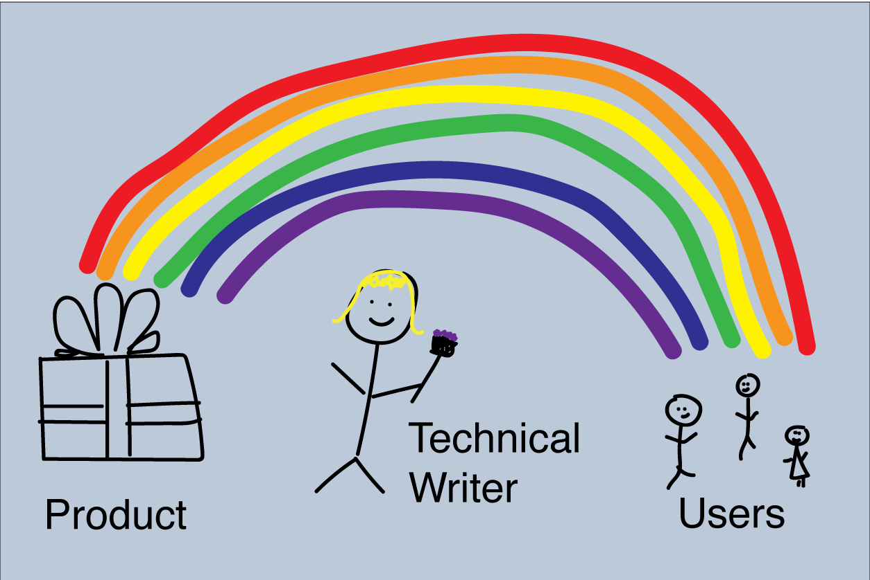
You are a user advocate…
Advocate- (Noun): a person who speaks or writes in support or defense of a person, cause, etc.

Slide 8
Let’s learn a little about users…
I found this book very useful. I am a WordPress user and a cut and paste coder, who is still struggling with understanding CSS. This book starts with the basics of web design, HTML, and CSS; and ends with wire-framing, design tips, SEO, and analytics. The author is somehow able to present a wide variety of information in a clear and precise way, with large graphics and illustrations that break everything down into digestible sections.
Unlike the Dummy books, which are very simplistic and leave you with just a vague overview. This book will take a novice and beyond, and fill in the gaps and make somewhat dry coding information simple and easy to understand. The information is presented in a clear, easy to understand format. With the help of this book, CSS is finally starting to make sense.
This book is not only useful for the beginner, or web publisher that is used to using WordPress, it also makes a great reference with an easy to use index and list of CSS properties and HTML elements. This is the exact book I needed.

Slide 9
Another one…
this book is so amazing. everything is broken down to the smallest detail on almost every syntax for html5 and css3. it makes html and css so understandable and simple. with all full color pages of graphics and pictures, you can study html and css anywhere without a text editor. because the specific topics span two or so pages, I can study this book in-between clients at work! I am still learning foundation codes like html and css and even with all the websites and books, this one book has been essential to my growth and learning.

Slide 10
And one more…
My last computer course was 14 years ago in college so I am not brilliant in this area by any means, but I read this book in 3 days and then used it to create a website for my wedding. My finance was pretty impressed which was fun. The book notes that 90% of what you need is covered and the rest is googleable. I think thats true. That said, I had tried to pick up some html and css before from online sites and I found that the excellent presentation and layout of this book vastly accelerated my learning. This is my first Amazon review, the first time I was so amazed by a purchase that I felt the need to leave feed back. As a further testament, I already preordered this authors book on Jquery and java script.

Slide 11
Now some bad one’s…
I want to learn HTML, and I believed the introduction to the book, which says you don't need to know anything about HTML. I tried Chapter 1's coding exercise in Textedit. What the book doesn't tell you is that Textedit (and anything else like it) automatically creates the first half of the code and then inserts all the stuff you just coded into a paragraph element. In the browser, the "page" you've just created simply shows the code you just created. So chapter 1 is a complete failure of instruction, in my opinion. I did figure out how to fix it by using a word processor to look at the page's code and delete the superfluous code. What a waste of time. I am really annoyed.

Slide 12
A mediocre one…
I have to say, from the get-go, I found this book to be FANTASTIC. Clear explanations, an informal, conversational styles, and reiteration of points so as to aid the reader's memory of the multitude of elements and attributes. My HTML and CSS skills have improved dramatically since beginning this book.
HOWEVER, upon reaching chapter 8, I found myself at a bit of a dead end. Chapter 8 focuses on the use of social networking sites and how to implement their respective like boxes and 'follow me' buttons into your new website. This excited me as I wanted to create a site of my own that I could promote through my Facebook page and vice versa. Unfortunately, the instructions for doing so seem no longer valid. Even the source code of the example sites didn't work and brought up an error message. This was especially disappointing, as part of the reason I bought this book was because it was so up to date and included this particular chapter. I had already put in a lot of hard work in building up the example website, so was frustrated at not getting this function to work. I have been on the publisher's forums but there is no mention of how to rectify this problem. I would have assumed an error on my part had it not been for the author's own markup (downloaded from the publisher's website) failing to work as well.

Slide 13
So, what do these reviews have in common?
Yes, they’re about the book. BUT, they’re really about themselves.
Positive reviews highlight personal success
Negative reviews highlight personal failure

Slide 14
Review 1
I found this book very useful. I am a WordPress user and a cut and paste coder, who is still struggling with understanding CSS. This book starts with the basics of web design, HTML, and CSS; and ends with wire-framing, design tips, SEO, and analytics. The author is somehow able to present a wide variety of information in a clear and precise way, with large graphics and illustrations that break everything down into digestible sections.
Unlike the Dummy books, which are very simplistic and leave you with just a vague overview. This book will take a novice and beyond, and fill in the gaps and make somewhat dry coding information simple and easy to understand. The information is presented in a clear, easy to understand format. With the help of this book, CSS is finally starting to make sense.
This book is not only useful for the beginner, or web publisher that is used to using WordPress, it also makes a great reference with an easy to use index and list of CSS properties and HTML elements. This is the exact book I needed.

Slide 15
Review 2
this book is so amazing. everything is broken down to the smallest detail on almost every syntax for html5 and css3. it makes html and css so understandable and simple. with all full color pages of graphics and pictures, you can study html and css anywhere without a text editor. because the specific topics span two or so pages, I can study this book in-between clients at work! I am still learning foundation codes like html and css and even with all the websites and books, this one book has been essential to my growth and learning.

Slide 16
Review 3
My last computer course was 14 years ago in college so I am not brilliant in this area by any means, but I read this book in 3 days and then used it to create a website for my wedding. My finance was pretty impressed which was fun. The book notes that 90% of what you need is covered and the rest is googleable. I think thats true. That said, I had tried to pick up some html and css before from online sites and I found that the excellent presentation and layout of this book vastly accelerated my learning. This is my first Amazon review, the first time I was so amazed by a purchase that I felt the need to leave feed back. As a further testament, I already preordered this authors book on Jquery and java script.

Slide 17
Review 4
I want to learn HTML, and I believed the introduction to the book, which says you don't need to know anything about HTML. I tried Chapter 1's coding exercise in Textedit. What the book doesn't tell you is that Textedit (and anything else like it) automatically creates the first half of the code and then inserts all the stuff you just coded into a paragraph element. In the browser, the "page" you've just created simply shows the code you just created. So chapter 1 is a complete failure of instruction, in my opinion. I did figure out how to fix it by using a word processor to look at the page's code and delete the superfluous code. What a waste of time. I am really annoyed.

Slide 18
Review 5
I have to say, from the get-go, I found this book to be FANTASTIC. Clear explanations, an informal, conversational styles, and reiteration of points so as to aid the reader's memory of the multitude of elements and attributes. My HTML and CSS skills have improved dramatically since beginning this book.
HOWEVER, upon reaching chapter 8, I found myself at a bit of a dead end. Chapter 8 focuses on the use of social networking sites and how to implement their respective like boxes and 'follow me' buttons into your new website. This excited me as I wanted to create a site of my own that I could promote through my Facebook page and vice versa. Unfortunately, the instructions for doing so seem no longer valid. Even the source code of the example sites didn't work and brought up an error message. This was especially disappointing, as part of the reason I bought this book was because it was so up to date and included this particular chapter. I had already put in a lot of hard work in building up the example website, so was frustrated at not getting this function to work. I have been on the publisher's forums but there is no mention of how to rectify this problem. I would have assumed an error on my part had it not been for the author's own markup (downloaded from the publisher's website) failing to work as well

Slide 19
“The threshold of suck”
Kathy Sierra coined the term “the threshold of suck”
Her argument is: once users get passed this threshold, passion is born
Users (and she argues all readers) want to feel like they can succeed at something
Passion, she argues, is what we want to instill into our users because passion produces results

