Slide 1
The IMRaD Structure
Dr. Lam
TECM 4190

Slide 2
Why is this important?
Your project, duh
Consumers of research
You form opinions based on research (whether you know it or not)
You make decisions based on research (whether you know it or not)
There is a lot of junk out there

Slide 3
What is research?
As a noun:
“the systematic investigation into and study of materials and sources in order to establish facts and reach new conclusions.”
As a verb:
“investigate systematically.”
There are all kinds of ways to study things, but for it to be considered research, it must be systematic.

Slide 4
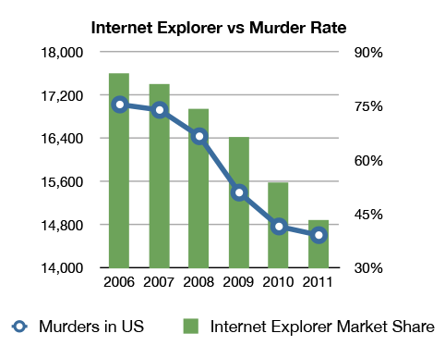
Some funny junk…

Slide 5
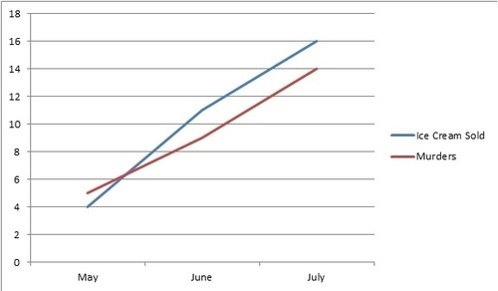
More funny junk…

Slide 6
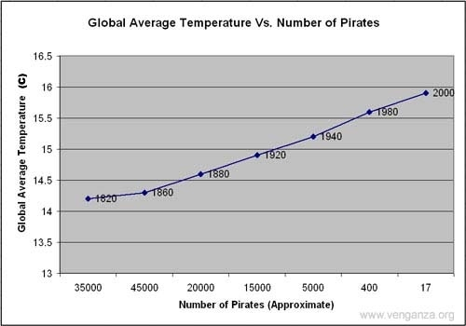

Slide 7
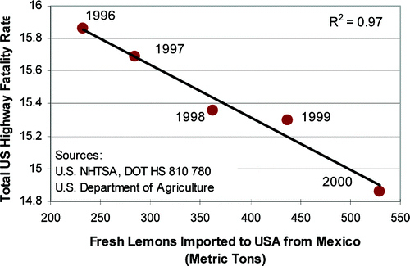

Slide 8
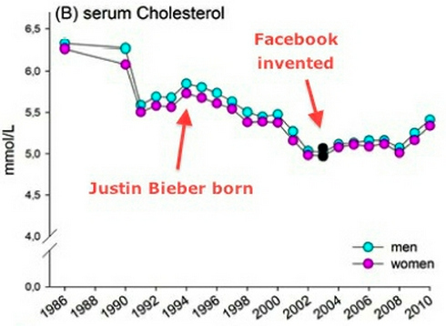

Slide 9

More serious junk…

Slide 10
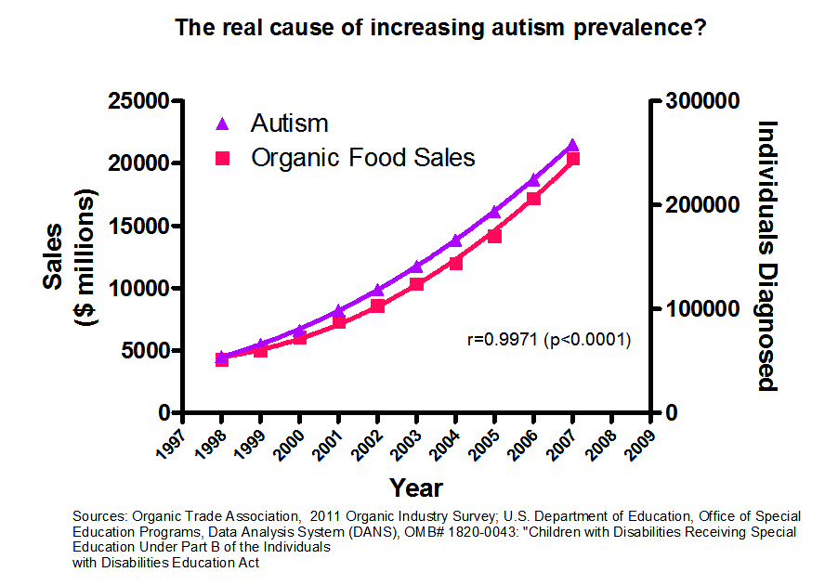

Slide 11
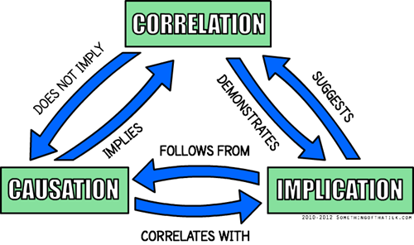

Slide 12
So as consumers of research…
It’s essential to be informed
It’s essential to be critical
But, mostly, it’s essential to be informed

Slide 13
As editors of research…
It’s essential to understand the standard conventions of empirical research
It’s important to be able to edit comprehensively
BUT, comprehensive editing means it’s also important to be able to edit content
This means understanding the fundamental characteristics of good research
This means doing the hard work of learning about the subject matter

Slide 14
IMRaD
Introduction - Why was the study undertaken? What was the research question, the tested hypothesis or the purpose of the research?
Methods - When, where, and how was the study done? What materials were used or who was included in the study groups (patients, etc.)?
Results - what answer was found to the research question; what did the study find? Was the tested hypothesis true?
Discussions - What might the answer imply and why does it matter? How does it fit in with what other researchers have found? What are the perspectives for future research?

Slide 15
Introduction
Provide context for the research:
Outline the topic, condition, problem
Topic: Technology in the classroom
Condition: Technology is advancing at a rapid rate
Problem: Even with advancements of technology, we aren’t integrating new technology into our classrooms
Provide significance
Why is it important that we study this problem?
Provide all relevant and related research and contextualizes that research (Literature Review)
Provide specific details about the study
What is the study?
What research questions are you trying to answer?
What hypotheses are you testing?

Slide 16
Literature Review
What is known about my topic?
What is the chronology of the development of knowledge?
Are there any gaps in knowledge of my subject? Which openings for research have been identified by other researchers? How do I intend to bridge the gaps?
Is there a consensus on relevant issues? Or is there significant debate on issues? What are the various positions?
What is the most fruitful direction I can see for my research as a result of my literature review? What directions are indicated by the work of other researchers?

Slide 17
Literature Reviews
Should identify individual studies or groups of related studies and:
Should outline what the research says
How the research was conducted (method) - optional
What was missing (gap)

Slide 18
Organizing Literature Reviews
Chronological
Topical
Methodological
Theoretical

Slide 19
Some common advice for literature reviews
Use evidence
Be selective
Use quotes sparingly
Summarize and synthesize
Keep your own voice
Use caution when paraphrasing

Slide 20
Research Questions vs. Hypotheses
They are sometimes used interchangeably, but this usage is incorrect.
Research questions:
Typically used in newer areas of inquiry
May not be very specific due to lack of current research on the topic
E.g., How will students respond to iPad integration in a technical communication classroom?
Hypotheses:
Very specific
Often based on previous empirical research or conventional wisdom
E.g., Students who use iPads for design prototypes will produce more effective designs than students who use traditional computer software.

Slide 21
Introduction Summary
Introduce the problem
Make sure there’s a logical and compelling reason to be studying the problem in the first place.
Discuss the literature
Make sure there’s a logical flow from previous research to the current study
Provide details and rationale for the study
Make sure research questions or hypotheses are formally stated with rationale for each.

Slide 22
Method
Think of the methods section like a recipe. It should include enough detail so that another researcher could replicate the study.
Study design
Data sources/participants
Procedure
Measures and/or materials

Slide 23
Results
Think of these as an objective report of the results. This section should NOT interject any personal opinions or theories.
Usually present descriptive results first (demographic information; mean, median, mode, etc.)
Then present results related to each research question or hypothesis
May also present secondary or exploratory results
Use statistical terminology and refer to graphical elements to depict findings clearly

Slide 24
Discussion
This is a more subjective section that allows a researcher to discuss theories and/or explanations and implications of the results.
Provide informed explanations
Compare to previous research
Limitations
Applications
Future research

Slide 25
References
APA: Social sciences (e.g., psychology, education)
MLA: Literature, arts, and humanities
AMA: Medicine, health, and biological sciences
Chicago: Used by many professional, non-scholarly publications

