Slide 1
Editing for Visual Design
TECM 4190
Dr. Lam

Slide 2
Why is design so important?
Intimately tied with decision making
Impacts perceptions well beyond “looking nice”
Credibility
Trustworthiness
Expertise
Impacts usability- “form follows function”

Slide 3
Design Principles We’ll Cover Today
Contrast
Repetition
Alignment
Proximity
These principles can be effective regardless of object, medium, and purpose
More info can be found in Robin Williams’ “The non-designer’s design book”

Slide 4
Why is it nice to have crap?
Supersedes “feeling”
It provides us (especially those of us who aren’t naturally design-oriented) with objective guidelines
It’s simple and will always (yes, always) make a document or product better

Slide 5
CRAP is a nice way to remember, but…
PARC is easier and more effective
Starting with proximity first is actually the best way to work as a designer
Information first, then design

Slide 6
Proximity
Proximity isn’t just a design element, it involves analysis and critical thinking
Group related elements
Separate different elements
Utilize white space to separate elements
Proximity involves “architecture”
Start by understanding what information you have (Inventory)
Grouping like pieces of information
Creating an organizational hierarchy

Slide 7


Proximity Example

Slide 8
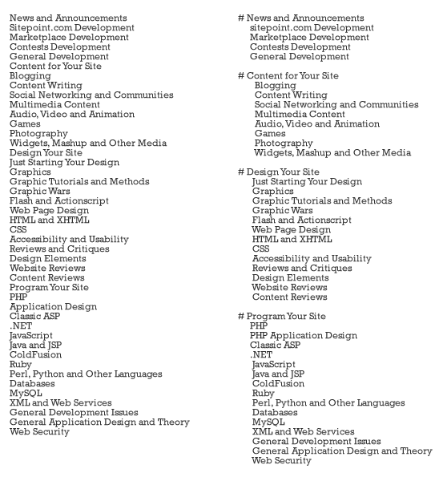

Slide 9
Proximity Practice
Emergency Contact
Employee Retirement System
Name Change Form
Voluntary deductions
Compensation History
Address
View Paycheck
Overtime requests
Phone number
W-4 Tax Forms
My Time Sheet
Employee ID

Slide 10
Alignment
Nothing on the page should be placed on the page arbitrarily (nothing!)
Every element should have some visual connection with another element on the page
Strong lines can make it easier for a user to scan a document
Good alignment often described as “clean”
Alignment, like proximity, also has an impact on information

Slide 11
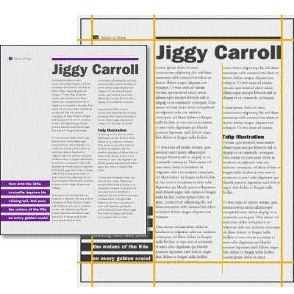
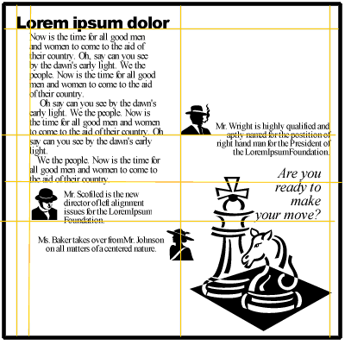
Alignment Example

Slide 12
Bad Alignment
http://www.restaurantguideatlanta.com

Slide 13
Repetition
Repeat visual elements of the design throughout the piece.
Color, shape, texture, spatial relationships, line thickness, sizes, etc.
Repetition helps develop organization and strengthens unity
Common repeated elements: headers and sub-heads; color; images or logos; spacing
Especially important in longer documents

Slide 14
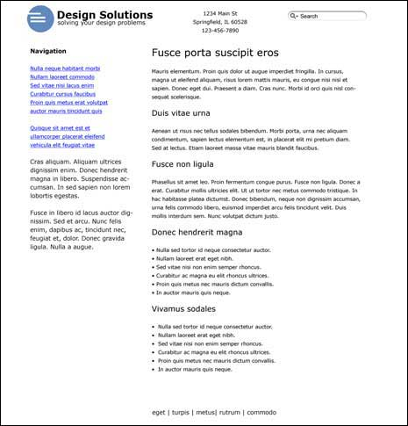
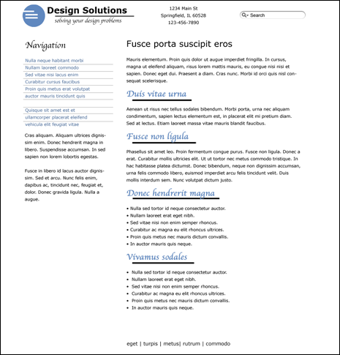
Repetition Examples

Slide 15
Bad Repetition
http://www.discoverychild.net/

Slide 16
Contrast
Make elements that are different appear very different.
Making elements only slightly different will only confuse the reader

Slide 17
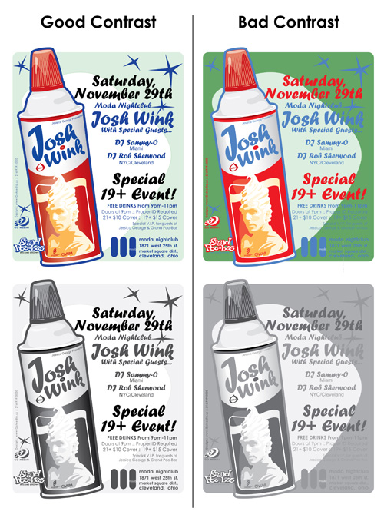
Contrast Examples

Slide 18
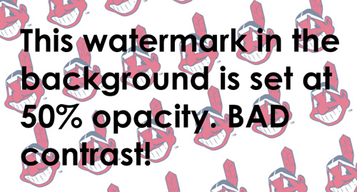
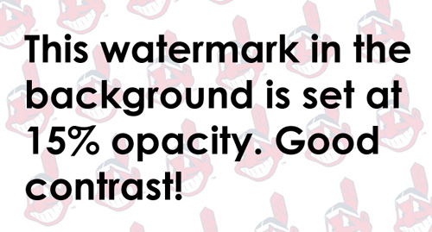
Contrast Example

Slide 19
Bad Contrast
http://reederapp.com/ios/

Slide 20
Contrast in Headers

Slide 21
Contrast in Headers- Better

Slide 22
Activity
Select a website
In a Word document, paste a screenshot of the website at the top.
Identify positive examples of proximity, alignment, repetition, and contrast
Identify negative examples of proximity, alignment, repetition, and contrast
Provide suggestions for improving each design principle

