Slide 1
Editing for the Web
TECM 4190
Dr. Lam

Slide 2
What makes a website “good”
Write down some characteristics that you consider define a “good” website.

Slide 3
Components of editing for the web
As an editor, there are several components you must consider (beyond copyediting, of course):
Technical considerations
Visual display and architecture
Alternative editing process

Slide 4
Technical Considerations
Sometimes clients will want you to edit directly on their websites or demo servers
This requires knowledge of technology
WYSIWYG vs. HTML/CSS

Slide 5
How do you author/edit in print?
Create a document cover page with the following:
Title: “Recommendation Report for TECM 4190”
“Name”
“Date”

Slide 6
Now let’s try something else
Visit unt.edu and click on the news article
Right-click and select “view page source”
Copy and paste into Notepad++
Save file as test.html on your desktop

Slide 7
What is HTML?
Hypertext Markup Language
Systems of descriptive tags (tag is a fancy word for a word inside of carats; e.g., <image>
Tags describe the semantic content of document, but do NOT describe any visual or design elements
As an editor, you don’t necessarily need to know how to author in HTML

Slide 8
What is CSS?
Cascading style sheets
A system that allows a user to alter all visual elements on a website (from font choices to layout)
Want to learn HTML/CSS? (BTW, I think EVERYONE should be literate in it)
Go to http://codeacademy.org

Slide 9
What is a WYSIWYG editor?
“What you see is what you get”
An interface that allows a user to edit the content (HTML) and the design (CSS) without knowing the languages
Think Wordpress, Wix, Dreamweaver

Slide 10
So, what does this mean for those editing websites?
You have several options:
Edit the actual HTML and CSS files (best option)
Copy the text from the website into a Word file to edit the language. Provide a written summary of design changes and a design style guide.

Slide 11
Visual Display and Architecture
Last week, we talked about CRAP
While CRAP principles are generally applied to print documents, they also apply to websites
There’s more to web design than just design principles though.
There’s single page and multi-page architecture

Slide 12
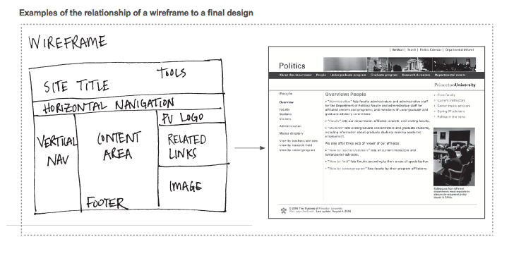
Single Page Architecture (Wireframe)

Slide 13
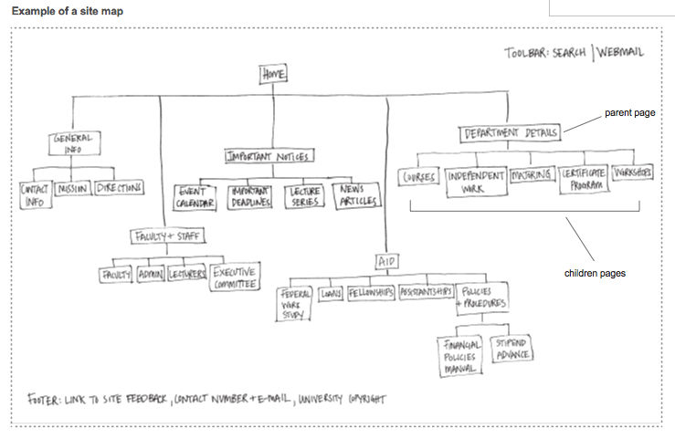
Multi-page Architecture

Slide 14
What to give to client
Provide the client with your language and design changes (as described in previous slides)
Provide client with a wireframe
Provide client with a sitemap

