Slide 1
Resume Writing (and Editing)
Dr. Lam
TECM 4190

Slide 2
Questions…
What’s the purpose of a resume?
How long (on average) do you think an HR professional looks at a resume?

Slide 3
What is the purpose of a resume?
Resumes do the following:
Save the HR person time
Serve as a record in your file
Get you an interview

Slide 4
Most resumes contain
Personal contact information
Objective
Education
Experience
Awards
Activities
Computer Skills
References

Slide 5
General resume advice
Today’s assignment readings
http://owl.english.purdue.edu/owl/resource/564/01/
http://www.rpi.edu/web/writingcenter/resume.html
Be careful: Avoid “quick tips” from Websites like Yahoo or Monster
Notes:
This is a good introduction to resumes. Today we’re going to cover the more advanced strategies.

Slide 6
My #1 all-time best resume tip
Give yourself time to write a resume
I can teach you every advanced strategy I know, have ever read about, or ever seen—but if you don’t give yourself the time to really work on a resume, you’ll never be able to use them.
Notes:
Who remembers writing out college application essays? Remember how much time you took doing them? Remember how many drafts you went through?
Resumes are your entrance essays to the world of work. You need to take them as seriously as college apps. However, the good thing is that they’re much, much easier to write.

Slide 7
Strategy #1
Think like a Human Resources professional

Slide 8
Make their lives easier.
Make your information easy to read.
Avoid long paragraphs and sentences
Choose an appropriate font and size
Give your contact information early and make it prominent

Slide 9
At first, you’re not trying to make it to the head of the list. . .
…you’re just trying not to get cut
Often, HR people eliminate the weakest resumes first
Remaining resumes are then grouped in terms of strength
What does this mean for you? That a simple mistake means you don’t know the rules of the game—and you get cut

Slide 10
Only give them information they want.
Tie every piece of information you give them to something they need
Looking for leadership? Give them leadership experience
Don’t tell them you do yoga, for example, unless they’re looking specifically for a balanced person
Notes:
Make sure you read the ad or email. For you to write an effective resume, you need to know what they’re looking for. If the position says, “Three years or more of experience” make sure you include three years of experience. Mention your three years of experience in your cover letter. These people are spending less than a minute on each resume—you need to make your few seconds count.
Occasionally you can stretch the limits, but generally these guidelines are firm. They have qualifications for a reason.

Slide 11
But people talk about their one “resume.” Is it really worth making up more than one?
Absolutely
Think about it—switch to PR professional mode
Is someone who took the extra effort to shape her resume to your business more interesting then someone who sent out a form resume?

Slide 12
Strategy #2—Show, don’t tell.
Never just tell the employer what you’re like—show them with examples, and let them describe you

Slide 13
Show, don’t tell, Example 1
I am a hardworking person with great organizational skills

Slide 14
Show, don’t tell, Example 1
I am a hardworking person with great organizational skills
I was elected the chair of my sorority’s budget committee. I was responsible for the accounts of 24 members and a yearly house budget of $32,000 dollars

Slide 15
Show, don’t tell, Example 2
I am a responsible student

Slide 16
Show, don’t tell, Example 2
I am a responsible student
In my two semesters at UNT, I have taken 31 credits and maintained my 3.7 GPA

Slide 17
Show, don’t tell, Example 3
I have strong leadership skills
Notes:
*These details do more than just show your qualifications—they set you apart from other competitors. Almost anyone can say they’re a responsible student. Not everyone can say they have your grade point average with your credit load.

Slide 18
Show, don’t tell, Example 3
I have strong leadership skills
I have been elected to a position in the 280-person Ballroom Dance Club for seven semesters
Notes:
*These details do more than just show your qualifications—they set you apart from other competitors. Almost anyone can say they’re a responsible student. Not everyone can say they have your grade point average with your credit load.

Slide 19
You may have noticed . . .
…that the previous examples use numbers
Numbers jump out on a page of text—use them to your advantage
Numbers preceded by a dollar sign are even more effective

Slide 20
Use action verbs.
Designed | Supervised | Created | Staffed
Tested | Studied | Earned | Saved
Gained | Programmed | Sold | Used
Notes:
Tip: Watch “was responsible for”

Slide 21
A hint
Search and destroy all “Was responsible for” phrases. These usually hide active impressive verbs
Original: Was responsible for the supervision of 12 video clerks.
Better: Supervised 12 video clerks.

Slide 22
Strategy #3
Make yourself look like a professional

Slide 23
Use parallelism.
Parallelism is a writing technique that places equally important parts in equal grammatical form
You want to use parallelism in lists—especially lists that begin with bullets

Slide 24
A common mistake in parallelism.
Today’s presentation will take the following format:
-examine the current dress code
-reasons for a change in the dress code
-new dress code explanation
-summary

Slide 25
Same example, with parallelism.
In today’s presentation, we will
-examine the current dress code
-give reasons for a change in the dress code
-explain the new dress code
-summarize the main points

Slide 26
You try: parallelism practice
Trained hourly employees in proper material handling procedures
Resolved discrepancies in shipments/receipts and in-transit accounts
Responsible for many employees’ work

Slide 27
Where should I look for parallelism mistakes?
Look carefully at the first word in each entry, especially under job experience
Generally, start each entry with an action verb—make sure they’re all parallel

Slide 28
Use visual hierarchy.
Visual Hierarchy- organizing output visually using formatting
You can use any visual hierarchy but user test it to ensure others understand

Slide 29
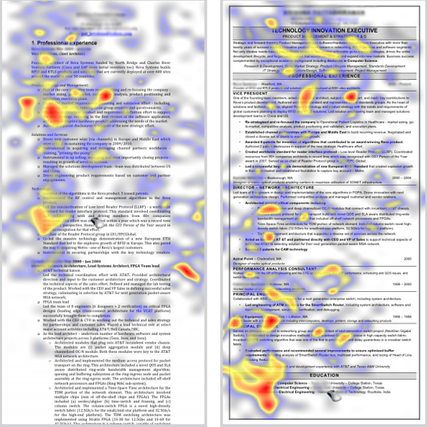

Slide 30
Examples of visual hierarchy.
In the following examples, which information is more important?
Rensselaer Polytechnic Institute, Troy, NY Bachelor of Science, Materials Science and Engineering
B.S. Materials Science and Engineering Rensselaer Polytechnic Institute, Troy, NY

Slide 31
Use white space strategically.
White space naturally attracts the eye
Items surrounded by white space attract attention—use white space strategically

Slide 32
Which is a better use of white space?
Supervised the monthly inventory
Managed 3 sales clerks
Sold $1,200 worth of apparel weekly
In this position, I managed three sales clerks, supervised the monthly inventory, and sold $1,200 worth of apparel weekly

Slide 33
Looking professional in the printing process.
Choose a proper color
White
Off-white
Gray
Choose a proper paper
Resume paper
Cotton content
Be 20- or 24-lb.

Slide 34
Looking professional in the printing process.
Whatever printer you use—
CHECK THE PRINTOUT!
Smudges, feathered lines, or faint ink do not make you look professional

Slide 35
The resume writing process
Hopefully, you’ve been creating a strong resume from the moment you stepped on UNT’s campus—if not sooner
Take notes on your achievements and keep them in a file
Notes:
By thinking about your resume early, you can find gaps in experience you need to fill.

Slide 36
Finding details
Ask yourself questions such as the following:
How many people did this involve?
How much money was involved?
How many hours did this take?
How many people did I supervise or report to?
How much money or man hours did I save?
If I made an improvement, how can I quantify it?

