Slide 1
Introduction to Knowledge Bases
Dr. Lam
TECM 4180

Slide 2
What is a knowledge base?
“a special kind of database for knowledge management. A knowledge base provides a means for information to be collected, organized, shared, searched and utilized.” -- Wikipedia

Slide 3
Characteristics of a good KB
Allows information to be easily collected
Has a way of clearly organizing inputted information
Can be shared
Can be searched
Will be utilized
Source :http://helpdeskhelps.com/education/what-is-a-knowledge-base/

Slide 4
KB Ecosystem
Knowledge Base
Content Writer
Information architect
Interface designer/information designer
User Interface
End user/Information seeker

Slide 5
KBs can be domain-specific or global
Domain-specific KBs are used on a relatively well-defined domain of interest.
E.g., Google scholar, DBLife, Echonest, IMDB
Global KBs attempt to cover the entire world
E.g., Freebase, Google’s knowledge Graph, YAGO, DBpedia

Slide 6
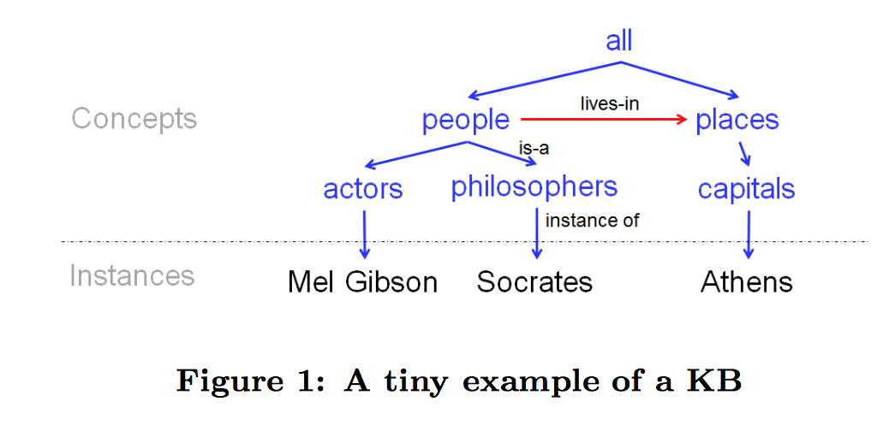
KB on a micro-level
KBs are made up of concepts, instances, and relationships
Instances are typically articles

Slide 7
Create a map using these concepts
Blair Witch Project
Heather Donahue
Boys and Girls
It’s always sunny in Philadelphia
Rob McElhenney
Charlie Day
Kaitlin Olson
The drew carey show
Ryan Stiles
Astro Boy
Eugene Levy
National Lampoon’s Vacation

