Slide 1
Turtles! Hill climbing! Hammers! Paper bags!
Frances Buontempo
ACCU 2018

Slide 2

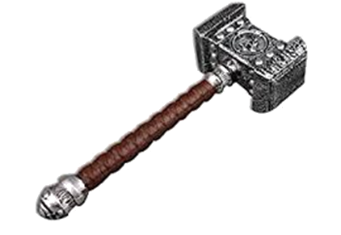

Overview
Turtles
In Python
Hill climbing
Or descending
Hammers
Simulated annealing
Particles Swarms – a bonus!
Local and global search
Gradient descent
Quick reminder about gradients and comparison with hill climbing
Neural networks
A quick overview
Paper bags
Permeate everything
Some have straight edges, some don’t
They could be shown 3D

Slide 3
Context: Optimisation
Objective functions, e.g.
f(x) = 0, what’s x?
f(inputs) == expected_output => f(inputs) - expected_output = 0
Make it small
Make it big
Simply the best
Thursday’s workshop.
https://conference.accu.org/2018/sessions.html#XSimplytheBestOptimisingwithanEvolutionaryComputingFramework
Error measures
Different error measures e.g. https://en.wikipedia.org/wiki/Cross_entropy

Slide 4
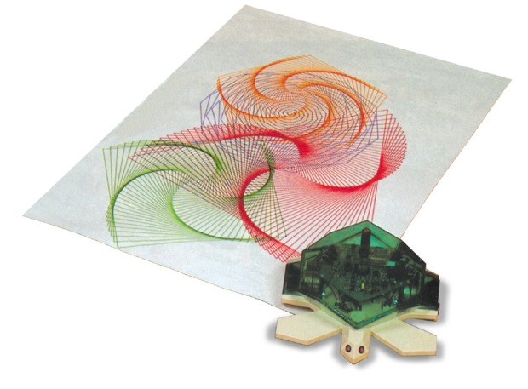

Logo
Yay! Robot turtles
Sadly none today
Robot turtle draws lines
You program the moves
Like spirographs
Seymour Papert, 1960s
"body syntonic" reasoning.
Yay! Neural networks!
"Perceptrons: An Introduction to Computational Geometry"
By Marvin Minsky and Seymour A. Papert
https://mitpress.mit.edu/books/perceptrons
Notes:
https://en.wikipedia.org/wiki/Turtle_graphics
By Valiant Technology Ltd., CC BY-SA 3.0, https://commons.wikimedia.org/w/index.php?curid=19501049

Slide 5
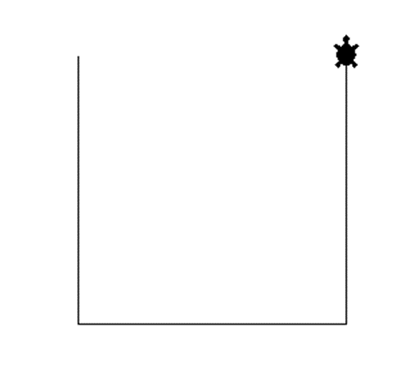
Turtles!
import turtle
def draw_bag():
turtle.shape('turtle')
turtle.right(90)
turtle.forward(70)
turtle.left(90)
turtle.forward(70)
turtle.left(90)
turtle.forward(70)
turtle.setworldcoordinates(-70., -70., 70., 70.)
draw_bag()
turtle.mainloop()

Slide 6
Code your way out of a paper bag
Jeff Atwood, co-founder of Stack Overflow, considers many programmer's inability to program on his blog.
https:blog.codinghorror.com/why-cant-programmers-program
He quotes Dan Kegel as saying "We're tired of talking to candidates who can't program their way out of a paper bag."
This is your chance to stand out from the pack!
Imagine a paper bag, represented by three sides.
Pick a point inside, and move to new points until some are out of the paper bag.
Draw a line joining these points, so you can see the path taken.

Slide 7
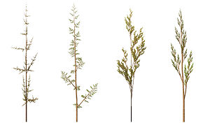
Code your way out of a paper bag
Lindenmayer Systems (L-systems)
http://python3.codes/drawing-fractals-with-lindenmayer-systems/
Recursion
Grammars
Trees, ferns…
Self-similar
fractals
Notes:
Pic from https://en.wikipedia.org/wiki/L-system
http://algorithmicbotany.org/papers/abop/abop-ch1.pdf

Slide 8
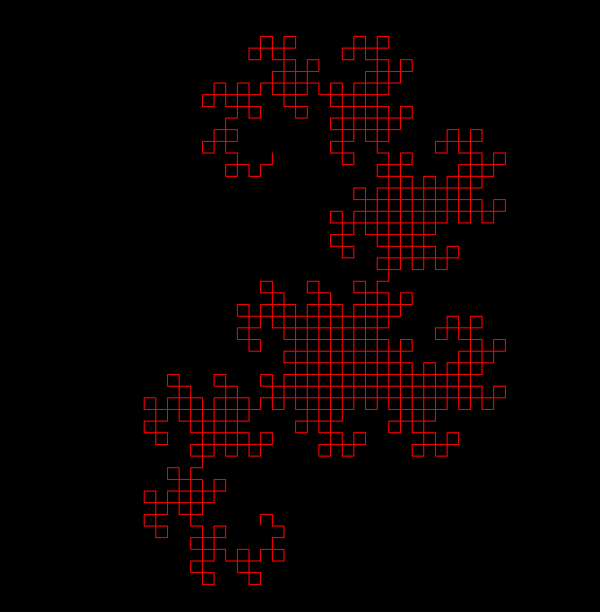
Dragons! T-shirt!
from turtle import*
def X(n):
if n>0: L("X+YF+",n)
def Y(n):
if n>0: L("-FX-Y",n)
def L(s,n):
for c in s:
if c=='-': lt(90)
elif c=='+': rt(90)
elif c=='X': X(n-1)
elif c=='Y': Y(n-1)
elif c=='F': fd(12)
bgcolor('black')
pencolor('red')
up()
goto(-20, 120)
down()
X(10)
hideturtle()
mainloop()
Notes:
https://trinket.io/python/c06f77c8e6

Slide 9
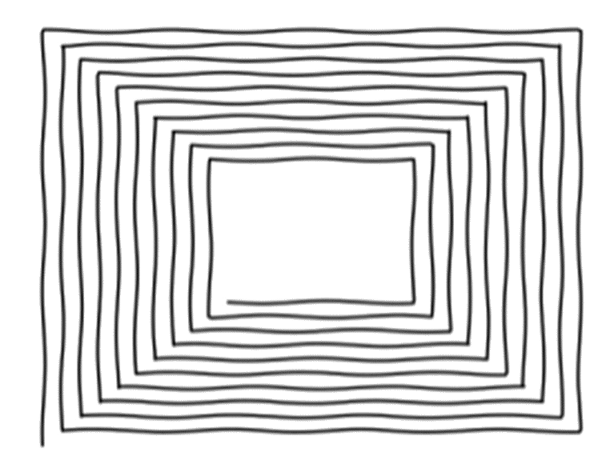
Spirangles

Slide 10
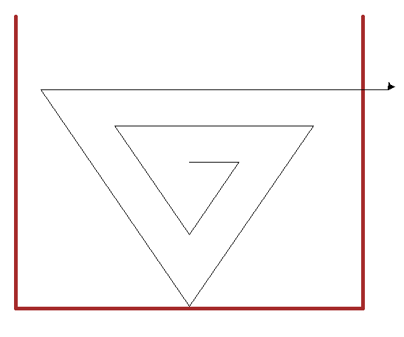
Spirangle code
def draw_triangles(number):
t = turtle.Turtle()
for i in range(1, number):
t.forward(i*10)
t.right(120)
Note to self: do a demo.
triangles.cmd

Slide 11
How did the turtle get into the paper bag?
Not a joke
Punchlines welcome
I don’t know
But let’s consider a few ways
Hill climbing
Simulated annealing
Particle swarms

Slide 12
What shaped paper bag?
Aside – mathematical functions
One y value per x value…
So, no rectangular bags here
Some near rectangular
Some crumpled up
Start line 1D (lines)
Then consider extensions

Slide 13
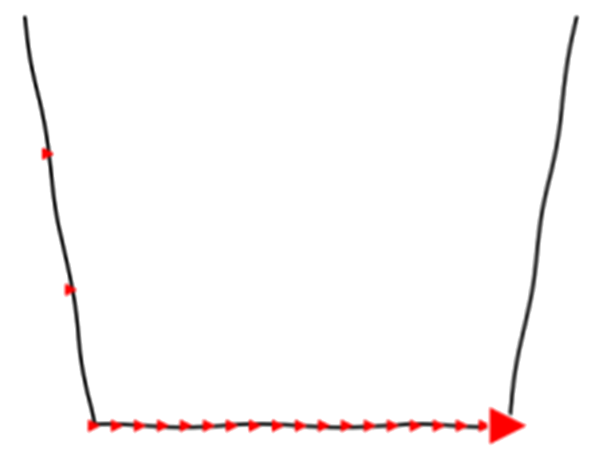
Hill walking
def seek(x, step, f):
height = f(x)
while True:
if f(x-step) < height:
x -= step
elif f(x+step) <= height:
x += step
else:
break
height = f(x)
yield x, height

Slide 14
What can possibly go wrong?
What step size?
Called a learning rate in machine learning
Learning rate is a meta-parameter
Decay…
Beware oscillations:
https://www.oreilly.com/ideas/contouring-learning-rate-to-optimize-neural-nets?imm_mid=0f59d0&cmp=em-data-na-na-newsltr_20170823
What shaped bag?
This affects what can go wrong…

Slide 15
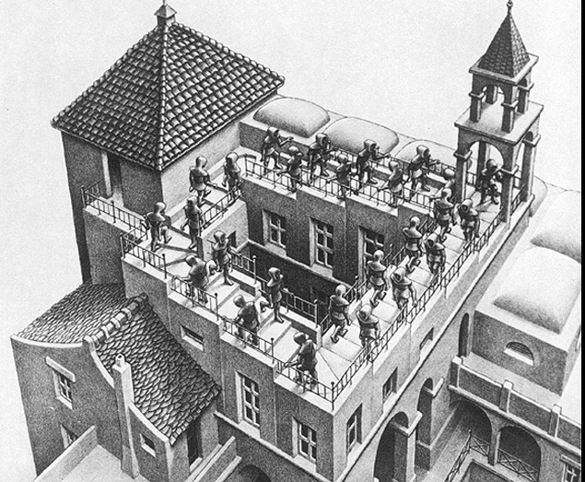
What else could go wrong?

Slide 16

An almost rectangular paper bag
Note to self to do a demo
slanty.cmd
Show off the quadratic bag too
$y=x^{2}$
quad.cmd
But…

Slide 17
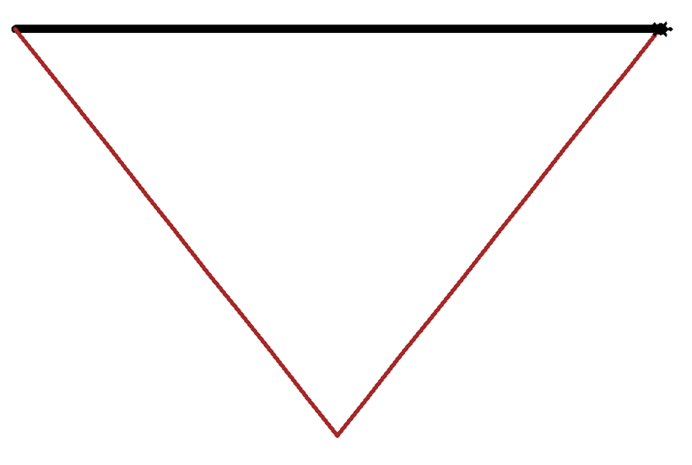
Stuck!
f(x) = | x | on [-10, 10]
fabs(x)
Step size constant 20
python into_bag.py -f=stuck
Could alter this over time
10 would work, 3 would get close.
Convergence
Or not

Slide 18
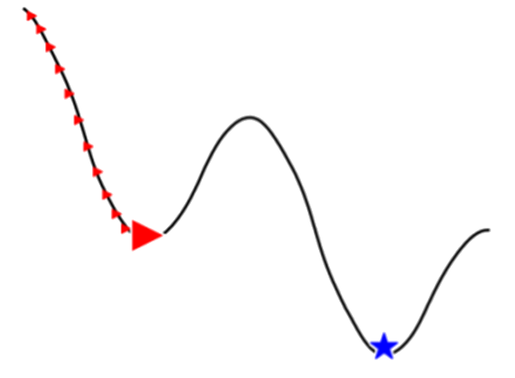
Crumpled bag
f(x) = 5*cos(x) - x
One minimum on screen
A local minima
Turtle considers a single left and right step
Guess what happens!
Note to self
Do a demo
crumple.cmd

Slide 19
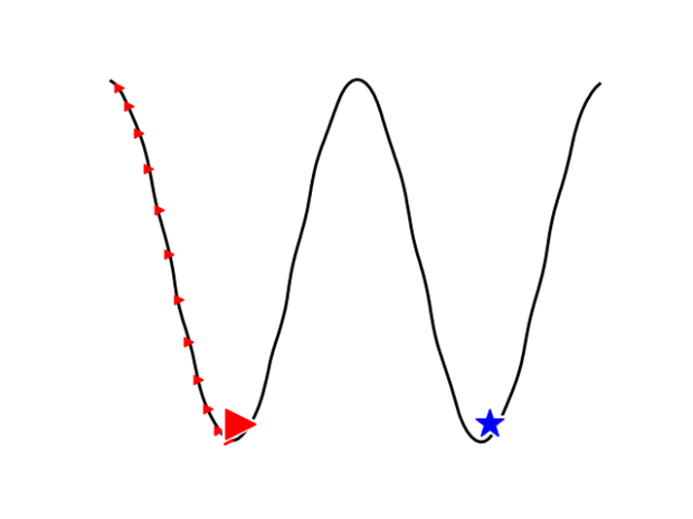
More than one minimum
E.g. cosine
Turtle considers a single left and right step
Guess what happens!
Note to self
Demo
cos.cmd

Slide 20
Global v. local minima
Don’t be greedy!
Hill-climbing – local only
How do you avoid this?
Make some suggestions…
Do the maths
Not always possible
Brute force
Not always time
Do something random…

Slide 21
Try random stuff
Metaheuristic: can find global minima
often population based e.g. ACO, PSO, GA, “evolutionary computing”
Simulated annealing
Like hill climbing but tries random points too, once in a while
Probabilistic approximation technique
Particle swarm optimisations
Particles remember a local best and a global best and compare notes
Other swarm optimisations too

Slide 22
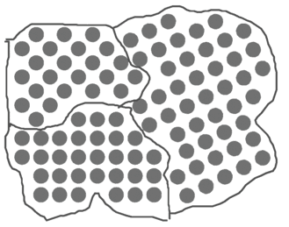
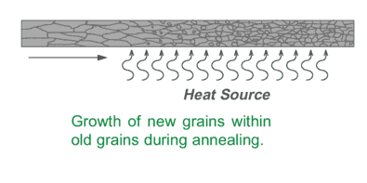
Actual annealing
“… a heat treatment that alters the physical and sometimes chemical properties of a material to increase its ductility and reduce its hardness, making it more workable.” (Wikipedia)
Statistical thermodynamics: Bolztmann distribution
p(state)=exp(mumble/T), for temperature T
Notes:
https://en.wikipedia.org/wiki/Annealing_(metallurgy)
http://www.the-warren.org/ALevelRevision/engineering/grainstructure.htm

Slide 23
Simulated annealing
For a while
Choose potential new x
(e.g. step left, right and a random jump)
Find y = f(x)
Better than before?
Good.
x = potential new x.
Continue
No? OK, maybe choose it anyway

Slide 24
Algorithm details: maybe requirements
Should decrease as the temperature, T, decreases
i.e. make turtle less likely to jump over time
You need to pick a temperature out of the air and make in smaller over time
Convergence
Want really bad new values to be unlikely
How much worse is it?
What does it cost?
A function of new and old values
Gives a number from 0 to 1
Is a probability
Pick a random number from 0 to 1 to compare
take the new (worse) value if the transition probability is higher
Notes:
http://katrinaeg.com/simulated-annealing.html and https://www.slideshare.net/ReversEngineering/heat-treatment-of-steels (slide 52 onwards)

Slide 25
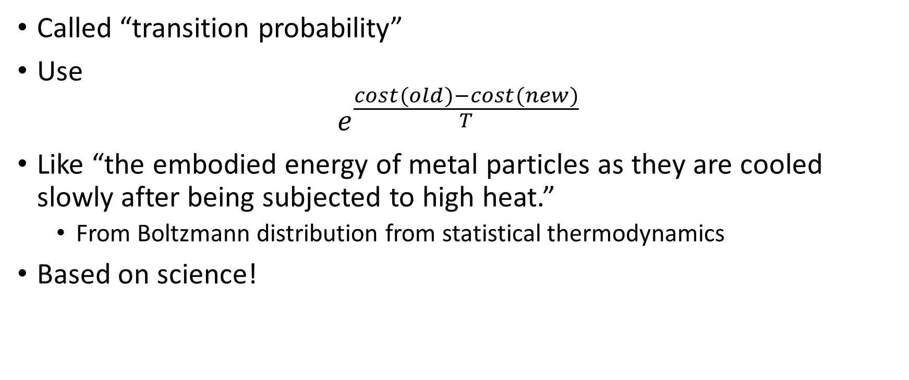
Maybe (jump) function choice
Called “transition probability”
Use
$$e^{\frac{cost(old)−cost(new)}{T}}$$
Like “the embodied energy of metal particles as they are cooled slowly after being subjected to high heat.”
From Boltzmann distribution from statistical thermodynamics
Based on science!
Notes:
http://katrinaeg.com/sim-anneal-overview.html

Slide 26
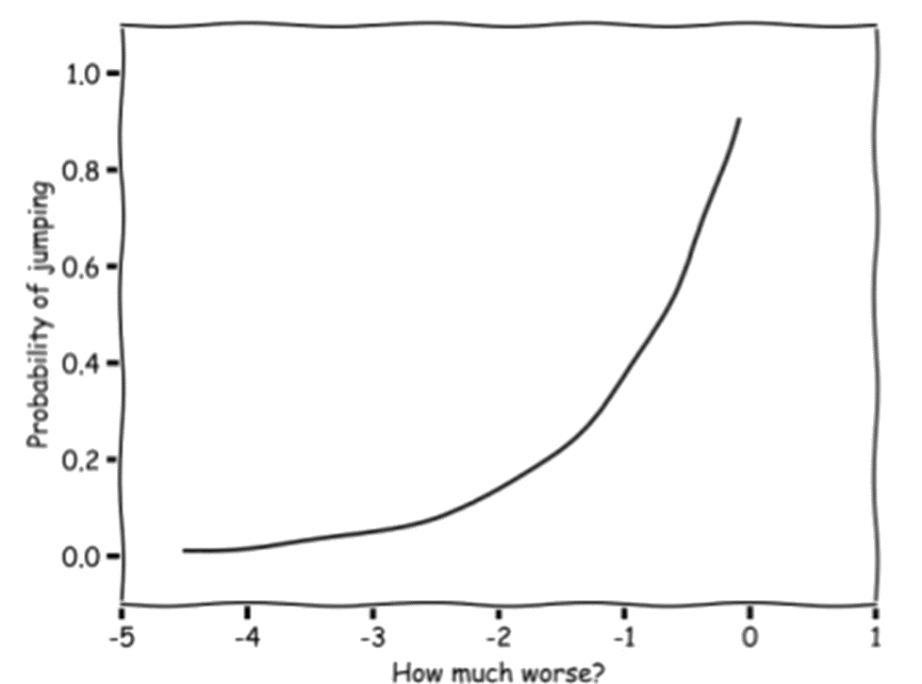
Exponential curve

Slide 27
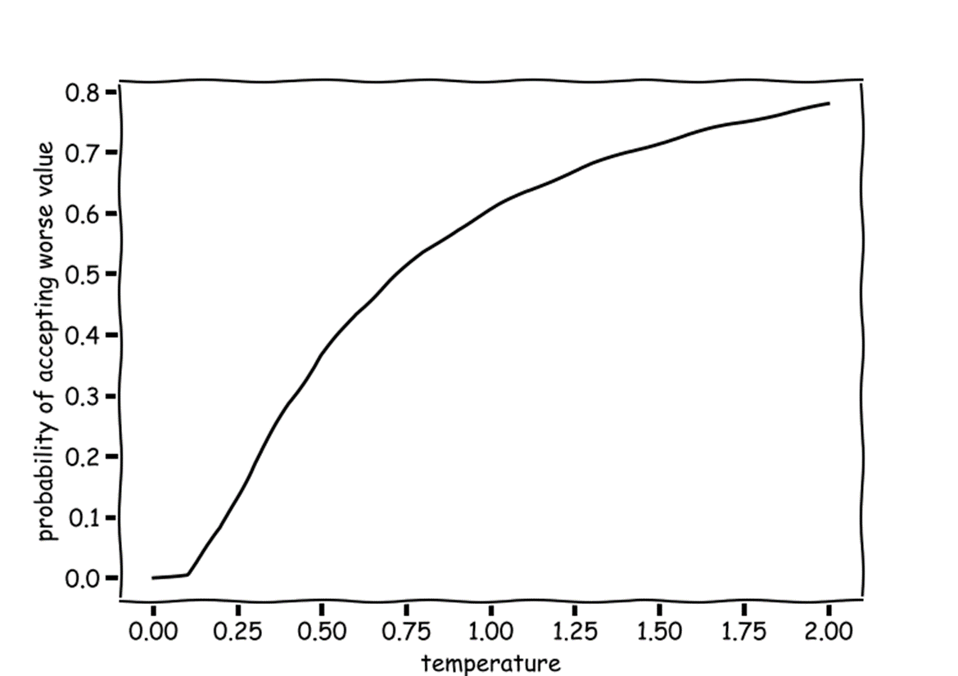
Maybe: cooler => less likely

Slide 28
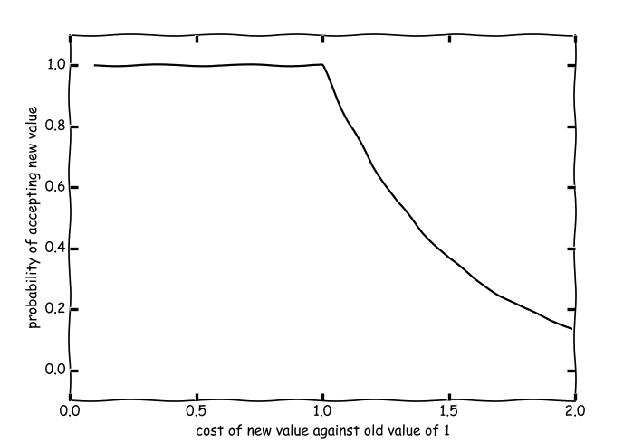
Maybe: new value gets worse

Slide 29
Algorithm details:
For a while
Choose potential new x
(e.g. last x +/- step or random jump)
Find y = f(x)
Better than before? Good. Continue
No? OK, maybe choose it anyway
For a while == until “cooled”
Start at temperature = 10.0?
Try something, see what happens
Make temperature -= 0.1 until we hit -5
Other numbers are available
Often temperature *= α
For some α (maybe between 0.8 and 0.99)

Slide 30
Algorithm details:
For a while
Choose potential new x
(e.g. last x +/- step or random jump)
Find y = f(x)
Better than before? Good. Continue
No? OK, maybe choose it anyway
Step size: new x value to try
Try +/-0.1, and something random
Decrease when temp <= 0
Random?
Gaussian

Slide 31
Algorithm details:
For a while
Choose potential new x
(e.g. last x +/- step or random jump)
Find y = f(x)
Better than before? Good. Continue
No? OK, maybe choose it anyway
Better == cost function
Use the y coordinate:
Lower is better

Slide 32
Transition probability
def transitionProbability(cost_old, cost_new, temperature):
if temperature <= 0:
return 0
elif cost_new < cost_old:
return 1
else:
return math.exp((cost_old - cost_new) / temperature)

Slide 33
Seek
def seek(x, step, f, temperature):
best_x, best_y = x, f(x)
while temperature > -5:
if temperature < 0: step /= 2.0
possible = [x-step, x+step, x+random.gauss(0, 1)]
x, jump = find_new_x(possible, f, x, best_y, temperature)
if not jump:
best_x = x
best_y = f(x)
yield x, f(x), temperature, jump
temperature -= 0.1

Slide 34
find
def find_new_x(possible, f, x, best_y, temperature):
if len(possible) == 0:
raise ValueError("Possible points empty")
jump = False
for new_x in possible:
new_y = f(new_x)
if new_y < best_y:
x = new_x
elif transitionProbability(best_y, new_y, temperature) > random.random():
jump = True
x = new_x
return x, jump

Slide 35
Simulated annealing
Note to self – do demo(s)
sa_slanty_bag
sa_quad
sa_cosine_slope
sa_cosine

Slide 36
Caveats
Decisions
Parameters: where to start,…
Cooling scheme: Subtract, multiply,…
See http://www.fys.ku.dk/~andresen/BAhome/ownpapers/permanents/annealSched.pdf
Might not work
Will it try more points than a brute false approach?
If you can do the maths, then do the maths
(Trying to code it for such problems as a learning exercise/for a talk is ok)
Nice walkthrough:
http://katrinaeg.com/simulated-annealing.html

Slide 37
What about several minima?
E.g. cosine
Try several turtles…
Questions?
How many?
Where do they start?
Note to self
Demo: sa_cosine_turtles
Keep variety
Niching methods etc

Slide 38
Swarm!
Success!
Let’s have more turtles!
Particle swarm
Paper Bag Escapology Using Particle Swarm Optimisation
https://accu.org/index.php/journals/2023

Slide 39
Particle Swarm Optimisation, PSO
Choose n
Initialize n particlesturtles randomly
For a while:
Update best global position (for synchronous)
Draw turtles current positions
Move turtles (for asynch: update global best here)
Update personal best position for each turtles

Slide 40
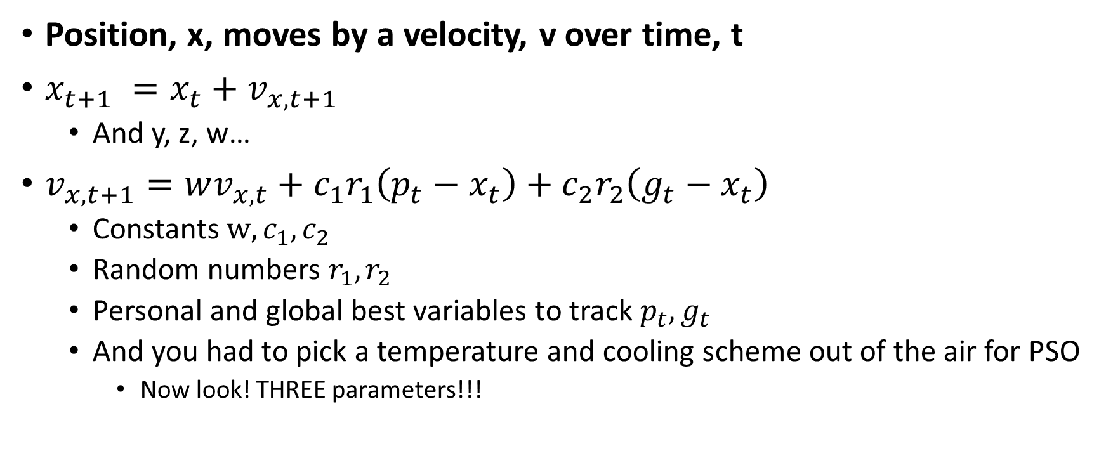
PSO Move
Position, x, moves by a velocity, v over time, t
$x_{t+1} =x_{t}+v_{x, t+1}$
And y, z, w…
$v_{x, t+1}=wv_{x,t}+c_{1}r_{1}\left(p_{t}−x_{t}\right)+c_{2}r_{2}\left(g_{t}−x_{t}\right)$
Constants $w, c_{1}, c_{2}$
Random numbers $r_{1}, r_{2}$
Personal and global best variables to track $p_{t},g_{t}$
And you had to pick a temperature and cooling scheme out of the air for PSO
Now look! THREE parameters!!!

Slide 41
Particle
class Particle:
def __init__(self, x, name):
self.x = x
self.best = x
self.velocity = random.random()
self.name = name
self.history = []

Slide 42
PSO: start with something random
def initialise(count, min_x, max_x):
particles = []
for i in range(count):
x = random.uniform(min_x, max_x)
particles.append(Particle(x, str(i)))
return particles

Slide 43
PSO Swarm
def swarm(count, min_x, max_x, epochs, f):
particles = initialise(count, min_x, max_x)
best = find_best(particles, particles[0].best, f)
for _ in range(epochs):
yield particles
best = find_best(particles, best, f)
update_velocity(particles, best)
move(particles, min_x, max_x, f)

Slide 44
Find best
def find_best(particles, best, f):
for particle in particles:
if f(particle.x) < f(best):
best = particle.x
return best

Slide 45
Update velocity
def update_velocity(particles, best, w=0.1, c1=0.4, c2=0.2):
for particle in particles:
r1 = random.random();
r2 = random.random();
particle.velocity = w * particle.velocity + \
c1 * r1 * (particle.best - particle.x) + \
c2 * r2 * (best - particle.x)

Slide 46
PSO Move
def move(particles, min_x, max_x, f):
for particle in particles:
x = particle.x + particle.velocity
if max_x < x:
particle.x = max_x
elif min_x > x:
particle.x = min_x
else:
particle.x = x
particle.history.append((particle.x, particle.velocity))
if f(particle.x) < f(particle.best):
particle.best = particle.x

Slide 47
PSO
Note to self: demo
pso_quad_1.cmd
pso_quad_2.cmd
pso_quad_10.cmd
pso_cosine_slope.cmd
pso_cosine.cmd
Parameters
Count? Epochs?
Using w = 0.5, c1 = 0.3, c2 = 0.3 fails badly
Using w = 0.5, c1 = 0.4, c2 = 0.2 looks better for >=2 turtles
Question: does a swarm of 1 ever work?
Answer – probably not
Does mean we have one example we can check by hand
Were it not for the pesky random numbers

Slide 48
A mixed success/fail
Equidistant carrots
two points are equally good
Parameters might need more experimentation
Certainly shouldn’t be hard coded!
How do you test code like this?
If it doesn’t work consistently is your implementation wrong?
Are your parameters wrong?
What does one turtle do?
What would you expect?
Discuss…

Slide 49
Gradient descent
Hill climbing is doing a gradient in one direction
Could do along each axis for more dimensions
Or linear combinations of axes…
Gradient descent:
Vanilla version – batch v. mini-batch
When fitting a big data set
https://machinelearningmastery.com/gentle-introduction-mini-batch-gradient-descent-configure-batch-size/
Stochastic gradient descent
Fixed learning rate v. decay
Alternative: Simplexes
Standard pathological surfaces
Notes:
https://en.wikipedia.org/wiki/Gradient_descent

Slide 50
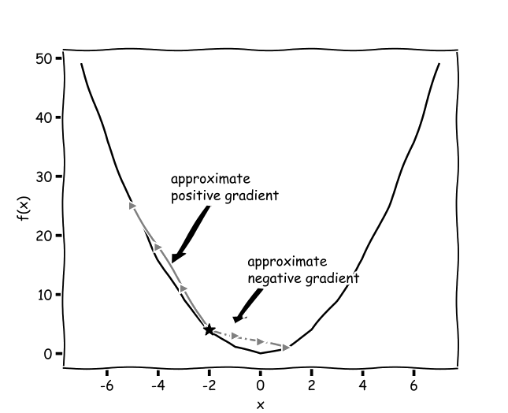
What’s a gradient?

Slide 51
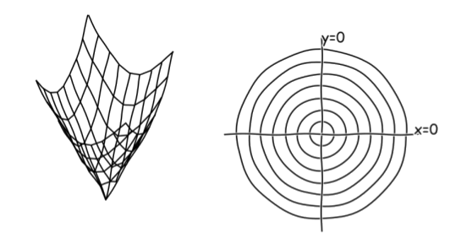
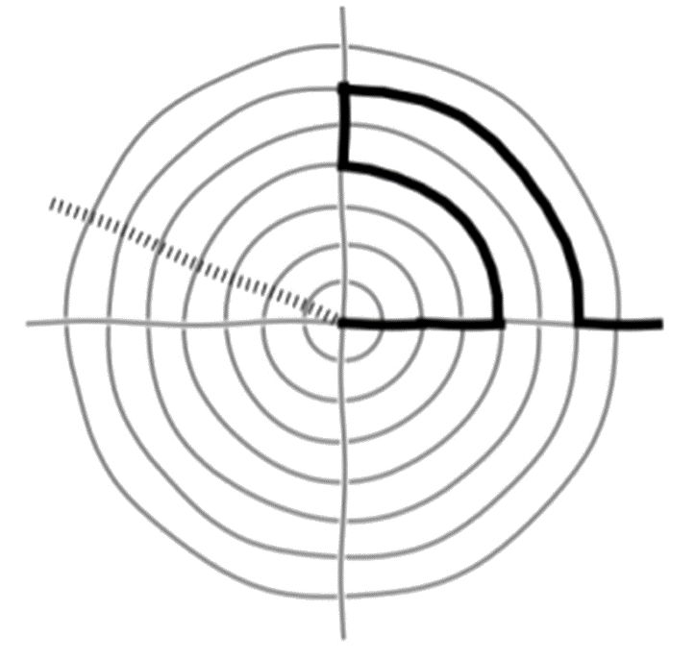
Gradients c.f. hill climbing

Slide 52
Gradients: problems
Finite difference
Numerical approximation to gradient
For when we can’t do the maths
Numbers!
The “vanishing gradient problem”
https://en.wikipedia.org/wiki/Vanishing_gradient_problem
Especially in neural networks:
“By the time the error signals traveled all the way back to the early layers, they were so small that the net couldn’t learn.” “deep (many layers) and “wide” (many parallel operations)”
Notes:
Quote from https://medium.com/towards-data-science/an-intuitive-guide-to-deep-network-architectures-65fdc477db41?imm_mid=0f59d0&cmp=em-data-na-na-newsltr_20170823

Slide 53
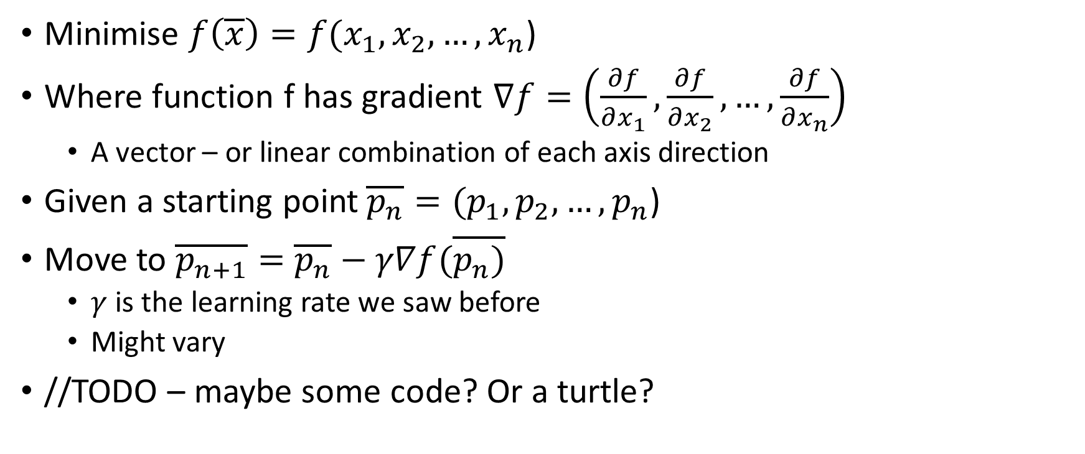
Gradient descent algo
Minimise $f\left(\overline{x}\right)=f(x_{1},x_{2},…,x_{n}$)
Where function f has gradient $∇f=\left(\frac{∂f}{∂x_{1}},\frac{∂f}{∂x_{2}}, …,\frac{∂f}{∂x_{n}}\right)$
A vector – or linear combination of each axis direction
Given a starting point$\overline{p_{n}}=(p_{1},p_{2},…,p_{n}$)
Move to $\overline{p_{n+1}}=$ $\overline{p_{n}}−γ∇f(\overline{p_{n})}$
$γ$ is the learning rate we saw before
Might vary
//TODO – maybe some code? Or a turtle?
Notes:
For code see e.g. https://en.wikipedia.org/wiki/Gradient_descent

Slide 54
Neural Networks
“Neural networks, in the most general sense, are function approximators”
https://www.countbayesie.com/blog/2017/5/9/kullback-leibler-divergence-explained
History:
1950s Rosenblatt’s “Perceptron” (a linear classifier)
1960s Minsky & Papert
-> 1990s academic stuff then hits the world.
See http://ml4a.github.io/ml4a/neural_networks/
They are usually trained on data (supervised learning)
f(input)= output
f worked out by magic mathematics

Slide 55
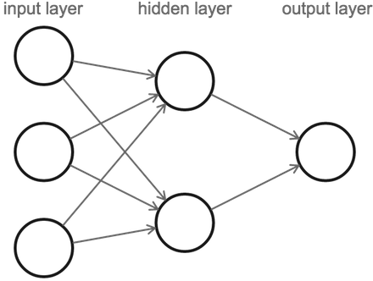
Typical feedforward NN
Predict
Notes:
http://ml4a.github.io/ml4a/neural_networks/

Slide 56
Overall idea
Linear classifier/regression
$f\left(x, y\right)= b + w_{1}x+w_{2}y$
More dimensions
$f\left(X\right)= b +\sum_{i}{w_{i}x_{i}}$
Introduce an activation function, σ
Like a neuron firing in a brain
“Squishing” non-linear function
E.g. sigmoid $f\left(z\right)=1/{1+e^{−z}}$
$z= b +\sum_{i}{w_{i}x_{i}}$
$f\left(X\right)=\text{σ}\left(z\right)=\text{σ}(b +\sum_{i}{w_{i}x_{i}})$
x₁
x₂
σ (z)
y
x₃
b
Notes:
http://ml4a.github.io/ml4a/neural_networks/

Slide 57
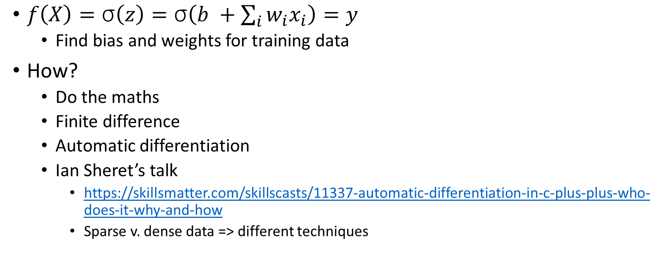
Backpropagation
$f\left(X\right)=\text{σ}\left(z\right)=\text{σ}\left(b +\sum_{i}{w_{i}x_{i}}\right)=y$
Find bias and weights for training data
How?
Do the maths
Finite difference
Automatic differentiation
Ian Sheret’s talk
https://skillsmatter.com/skillscasts/11337-automatic-differentiation-in-c-plus-plus-who-does-it-why-and-how
Sparse v. dense data => different techniques

Slide 58
ExcusesTech challenge
Representing a >1D bag needs 3D turtle graphics
I found this http://spencertipping.com/cheloniidae/
“Cheloniidae is an absurdly over-engineered turtle graphics library for Java.”

Slide 59
Wrap up
Try it your self:
Hill climbing
Solve a slider puzzle
https://towardsdatascience.com/solve-slide-puzzle-with-hill-climbing-search-algorithm-d7fb93321325
Gradient descent
Make a NN from scratch
http://www.wildml.com/2015/09/implementing-a-neural-network-from-scratch/

Slide 60

What did we learn?
Turtle graphics are fun
Fran needs a 3D implementation in Python
Problem solving
Try something and see if it works
Iteratively improve
Test your code as you go
Paper bag escapology a parable for coding well?
Using machine learning is absurdly over-engineered!
Upcoming book: http://pragprog.com/

