Slide 1

Agile v. Waterfall
Ben Theisen
CIS245-T302-T801
2215 1

Slide 2
Process
Agile
Waterfall
Agile is a continuous iteration of development and testing in the software development process.
Waterfall is a linear sequential life cycle model

Slide 3
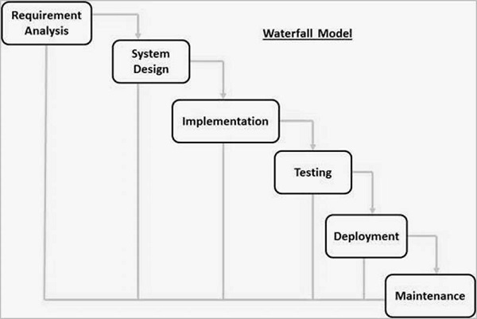
Waterfall
Credits:Tutorialspoint, SDLC Waterfall Model, 2021 Mar 17

Slide 4
Conceptual features
Agile
Waterfall
Emphasis on flexibility.
Incremental approach.
Emphasis on structure.
Sequential approach.

Slide 5
Flexibility
Agile
Waterfall
Allows changes as the project develops.
Once project begins there is little to no room to change approach.

Slide 6
advantages
Agile
Waterfall
Great for motivated teams who are invested in project development.
Easy to manage.
Easy to shift across teams or talent.

Slide 7
Scope
Agile
Waterfall
Great when client is highly involved throughout process.
Great for small projects.

Slide 8
References
Guru99. Waterfall vs. Agile. Visited on Mar 17 2021. Link: https://www.guru99.com/waterfall-vs-agile.html
Tutorialspoint. Waterfall Diagram. Visited on Mar 17 2021. Link: Tutorialspoint, SDLC Waterfall Model, 2021 Mar 17

