Slide 1


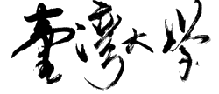
EUV-Aware Double Patterning
Presenter: | Chien-Yi Yang
May 13, 2021
Department of Electrical Engineering
National Taiwan University
Taiwan
GIEE, NTU

Slide 2
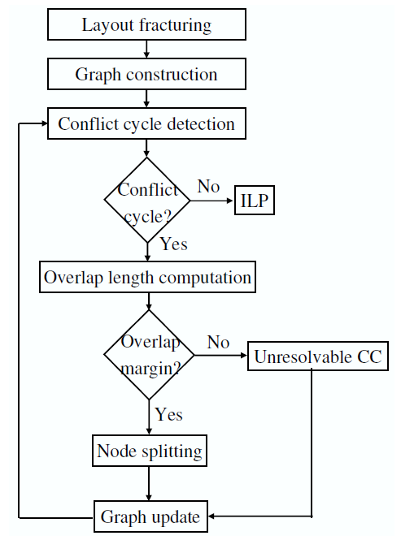
Currently Implementing
Andrew B. Khang, et al. 2008
GIEE, NTU

Slide 3
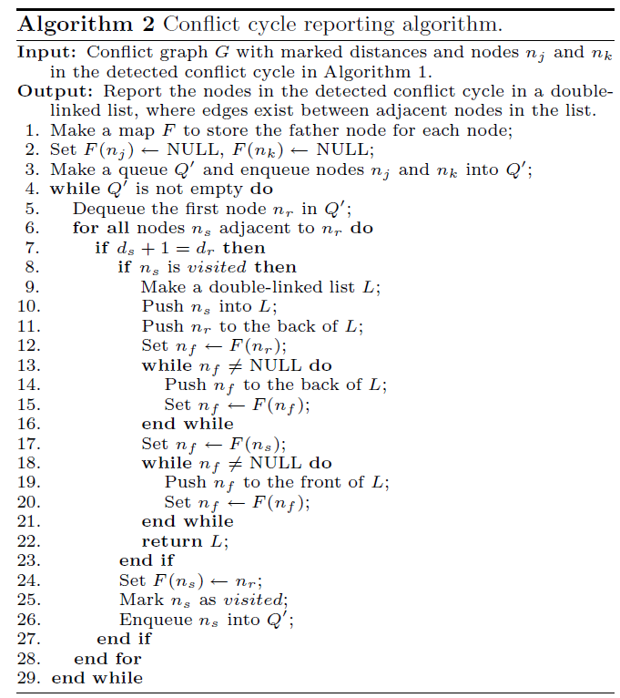

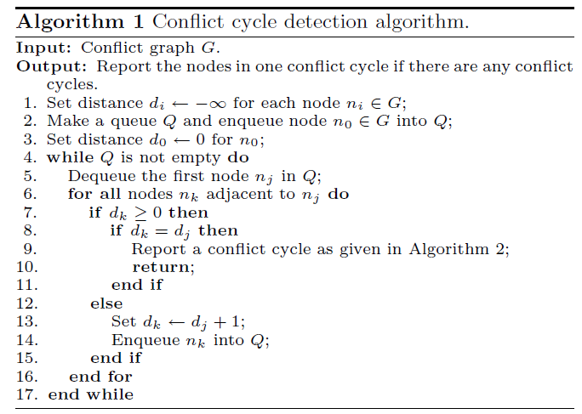
Currently Implementing
GIEE, NTU

