Slide 1



EUV-Aware Double Patterning
Presenter: | Chien-Yi Yang
April 29, 2021
Department of Electrical Engineering
National Taiwan University
Taiwan
GIEE, NTU

Slide 2
Problem Description
Objective: Simultaneously Minimize the difference of the two flare average and the larger of the two flare variances
  Sum of two avgs is a constant
  The objective is to make the more difficult one easier.
GIEE, NTU

Slide 3
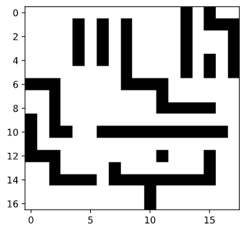
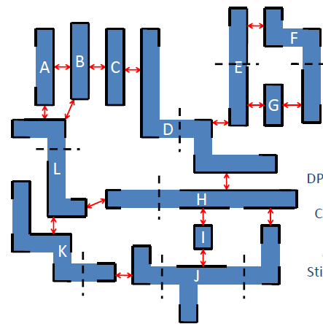
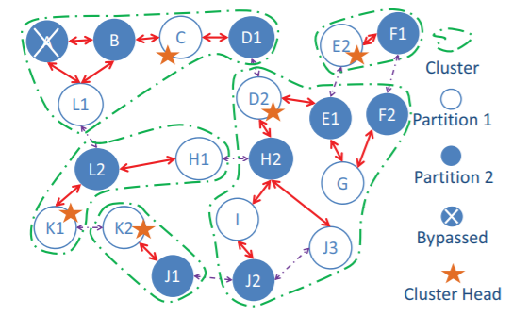
Current method
Xue Yu, Chris Chu 2009
GIEE, NTU

Slide 4
Todo
Finish the code of the above part.
Use simulated annealing to see the extend to which the difference can be.
GIEE, NTU

