Slide 1


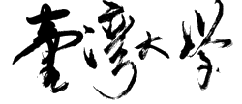
EUV-Aware Double Patterning
Presenter: | Chien-Yi Yang
December 24, 2020
Department of Electrical Engineering
National Taiwan University
Taiwan
GIEE, NTU

Slide 2
Problem Formulation
Double patterning with the simultaneous consideration of the effect of flare induced by EUV process
  Given a layout, generate a pair of mask accordingly and simultaneously minimize stitch, average flare, and flare variation
GIEE, NTU

Slide 3
Proposals
Benchmark
  ISCAS’85&89
Dummification after partitioning
Reinforcement Learning
  Since the conv of PSF is like NN behavior
GIEE, NTU

Slide 4
Todos
Survey of RL
Alg. Flow
GIEE, NTU

