Slide 1



EUV-Aware Double Patterning
Presenter: | Chien-Yi Yang
March 11, 2021
Department of Electrical Engineering
National Taiwan University
Taiwan
GIEE, NTU

Slide 2

Observations
Sum of flare by grid of the two partitions is a constant
  Sum of two Avgs is a constant
  Each Avg only has to do with sum of total grids
To mitigate the difference between the total flare of the two masks is balance-aware partitioning
GIEE, NTU

Slide 3
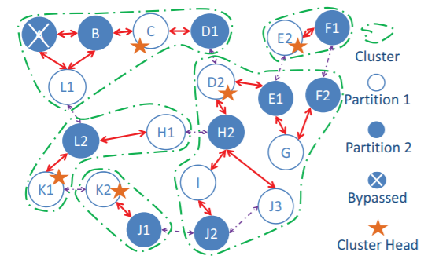
Findings
Some basic rules
  Only odd cycles are illegal
  There are determined partition
GIEE, NTU

