Slide 1


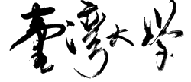
EUV-Aware Double Patterning
Presenter: | Chien-Yi Yang
January 14, 2021
Department of Electrical Engineering
National Taiwan University
Taiwan
GIEE, NTU

Slide 2
Last Week
Clearer objective(in the order of importance)
  Legal
  Min stitch, flare, flare variation
Consider the objectives simultaneously
  Since more unbalanced patterns induce less flare
  Give nearby components greater weights
GIEE, NTU

Slide 3
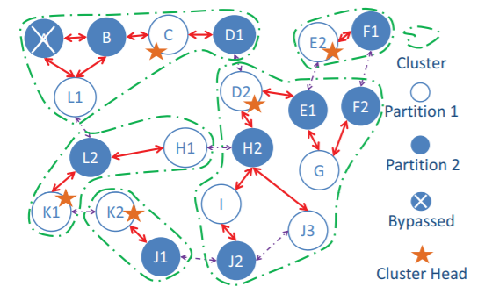
Findings
Some basic rules
  Only odd cycles are illegal
  There are determined partition
GIEE, NTU

