Slide 1


Edo State Independent Farmers Initiative Data Analysis on the total quantity of seeds, fertilizers, and crop protection products given out per LGA and District:
Heckerbella Limited September 2021

Slide 2
Executive Summary
This report shows the data analysis of the Edo State Independent Farmer’s Initiative (IFI) dataset shared with Heckerbella Limited. IFI was designed to encourage more farmers to contribute to Edo State Government’s vision, which is to boost food security in the state’s post-coronavirus (COVID-19) economy. Dataset of the farmers showing their bio data information as well as resources provided to them (quantity of crops, fertilizers and crop protection products) was shared with the Heckerbella team for data analysis. Data analysis was done on the farm size of farmers, total number of seeds, fertilizers and crop protection product given to farmers in all 3 districts and 18 local government and the outcome, shared in this document.

Slide 3
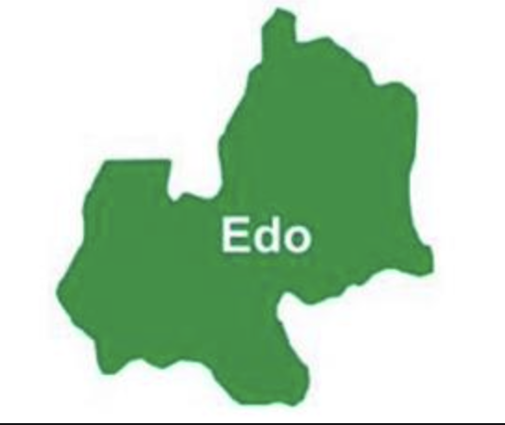
Index | 2020 | 2019
FAAC Allocation | ≈ ₦ 58.4Bn | ≈ ₦ 64.7Bn
State IGR | ≈ ₦ 27.2Bn | ≈ ₦ 29.5Bn
Total Revenue | ≈ ₦ 85.6Bn | ≈ ₦ 94.2Bn
% Share of Total States IGR | 2.08% | 2.21%
Edo is an inland state in the south-south geopolitical zone, bound in the north and east by Kogi, in the south by Delta state and in the west by Ondo state.
Edo state has an estimated 1.6 million hectares of cultivatable land, accounting to about 70% of its total land mass with abundance of solid minerals and gas, which serve as raw materials for manufacturers. Edo state has a comparative advantage over several other states in the Agricultural sector in Nigeria because of its strategic location, its natural resources, the soil topology, its crop and animal production. The Agricultural sector therefore holds significant socio-economic development opportunities for the State.

Slide 4
Projection by Hectarage
The dataset shared with Heckerbella limited shows that only 3,660 hectares of the 1.6million hectares which is about 0.22% of the cultivatable farmland in Edo State is presently in use. For Edo state to utilize 1% of the entire cultivatable farmland which stands at 16,636 hectares, it will need to provide 890,842 seeds, 95,531 fertilizers and 139,513 crop protection products across all districts. Projections for 5% and 10% cultivatable land is also shown below.
% Cultivatable Farmland | Seeds | Fertilizer | Crop Protection Product | Hectarage
0.22% | 195,985.25 | 21,017 | 30693 | 3,660
1% | 890,842.04 | 95,531 | 139,513 | 16,636
5% | 4,454,210.22 | 477,659 | 697,568 | 83,181
10% | 8,908,420.44 | 955,318 | 1,395,136 | 166,362
It was observed in the dataset provided for Edo North District, Etsako Central had Etsako West as it’s LGA. Heckerbella made the necessary adjustment to reflect the correct LGA which is Etsako Central in this report

Slide 5
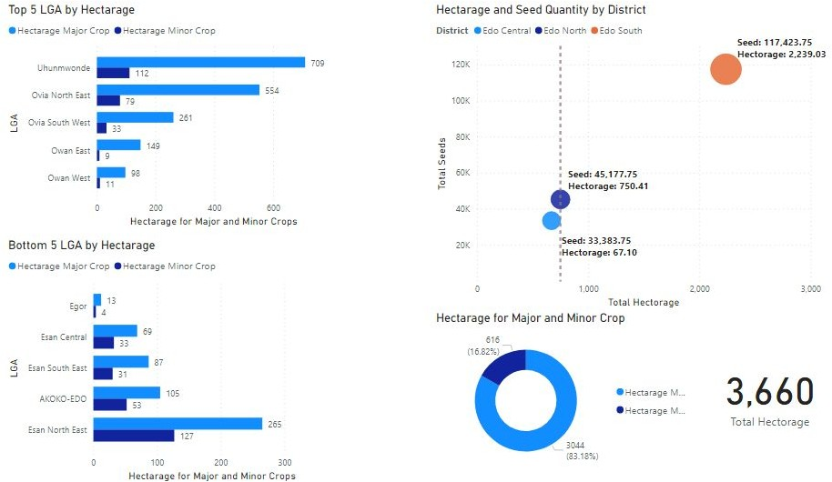
Hectarage metrics by LGA and District

Slide 6
The LGA with the biggest farmland is Uhunmwonde in Edo South with the following Hectarage values:
Minor Crop: 111.5
Major Crop: 708.5
Total: 820
The District with the biggest farmland is Edo South with a total hectarage of about 2239 out of the 3660 hectarage covered in this project.

Slide 7
The LGA with the biggest farmland is Uhunmwonde with the following Hectarage values:
Minor Crop: 111.5
Major Crop: 708.5
Total: 820
The District with the biggest farmland is Edo South with a total hectarage of about 2239.
LGA with the highest number of:
Seeds - Ovia North East
Fertilizer - Uhunmwonde
Crop Protection Products: Uhunmwonde
District with the highest number of seeds, fertilizer and CPP is Edo South.

Slide 8
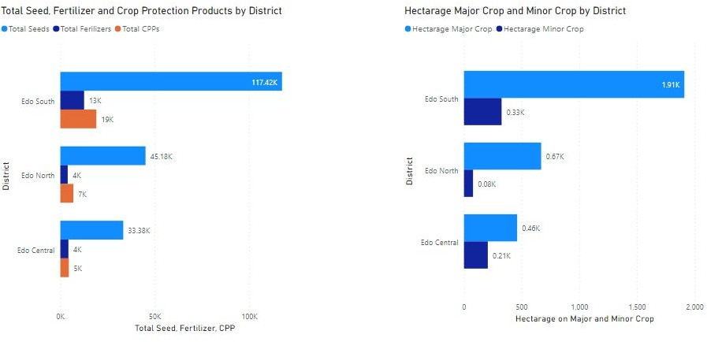

Slide 9
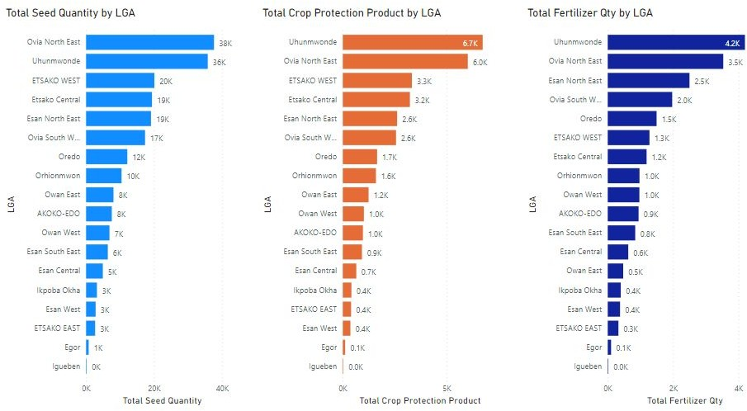
Distribution of seeds, fertilizers, and crop protection products by LGA

Slide 10
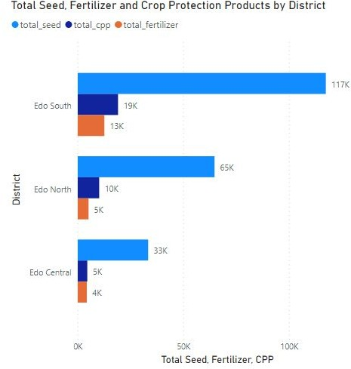
Distribution of seeds, fertilizers, and crop protection products by District
Allocation of the 3 different components Seeds Edo South = 54.4%, Edo North= 30.2% Edo Central = 15.3% Crop Protection Products Edo South = 55.8%, Edo North= 29.4% Edo Central = 14.7% Fertilizer Edo South = 59%, Edo North= 22.7% Edo Central = 18.2% Edo South was given the highest number of seeds, fertilizer and crop protection products.

Slide 11
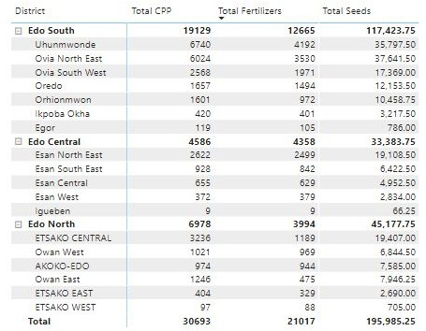
Total number of fertilizers, crop protection products and seeds given out per district

Slide 12
Distribution of seeds, fertilizers, and crop protection products by District
LGA with the highest number of:
Seeds - Ovia North East
Fertilizer - Uhunmwonde
Crop Protection Products: Uhunmwonde
District with the highest number of seeds, fertilizer and CPP is Edo South.
LGA in Edo North District with the highest number of: Seeds - Etsako West Fertilizer - Etsako West Crop Protection Products: Etsako West
LGA in Edo Central District with the highest number of: Seeds - Esan North East Fertilizer - Esan North East Crop Protection Products: Esan North East

Slide 13
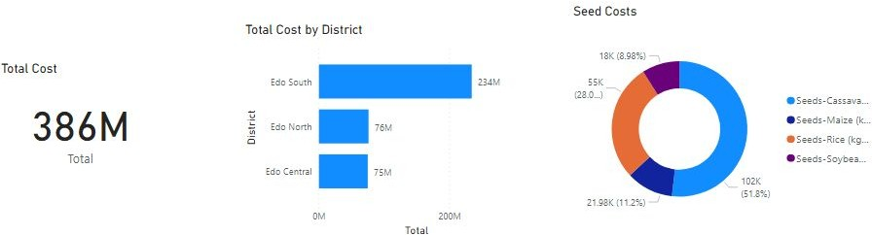
Analysis on Cost
The pie chart shows the cost of the seed inputs sent to the various Districts and the crop ratio in percentage shown below; Cassava - 51.8% (102,000) Rice – 28% (55,000) Maize – 11.2% (21,980) Soya Beans – 8.98% (18,000)
The Analysis on cost by district above shows the total amount spent on resources sent into the various districts in the form of both Seeds, fertilizers and cost protection products.

Slide 14
Conclusion
The N386million shown in the cost analysis is based on the amount spent on resources (seeds, fertilizers and crop protection products) over the 3660 hectares across all 3 districts. This accounts for 0.22% of the cultivatable farmland in the state. For Edo state to utilize 1% of the entire cultivatable farmland which stands at 16,636 hectares, it will need to provide 890,842 seeds, 95,531 fertilizers and 139,513 crop protection products across all districts which will cost the government N1.75Billion

Slide 15




Contact Us
business@heckerbella.com, support@heckerbella.com +234 7039911104, 8155819782 https://www.heckerbella.com

