Slide 1
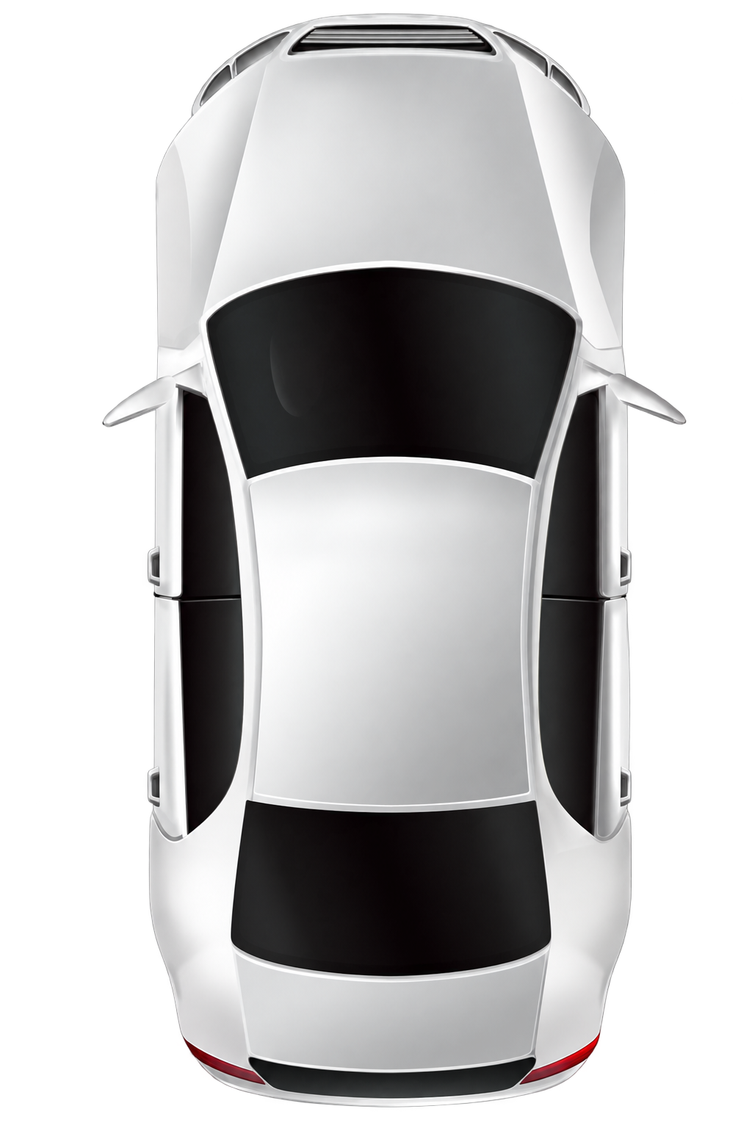
Option 1 — 1 BLE-CS + NFC
Configuration:
One BLE node: Bluetooth CS; calibrated RSSI fallback.
Door-handle and console NFC readers are baseline items and are omitted from later diagrams.
BLE + CS
NFC
NFC
Advantages:
Lowest BLE-node cost
NFC remains available if BLE is unavailable
Limitations:
One distance cannot determine 2D/3D position or reliably separate inside from outside
RSSI fallback has lower accuracy and weaker proximity assurance
Best fit: Entry vehicles; two- and three-wheelers
Notes:
[Sources]
- https://www.bluetooth.com/blog/bluetooth-channel-sounding-how-it-works/
- https://carconnectivity.org/the-car-connectivity-consortium-updates-ccc-digital-key-certification-program-with-additional-coverage-for-bluetooth-low-energy-and-ultra-wideband-technologies/

Slide 2
Option 2 — 3 BLE-CS
Configuration:
Three BLE ranging nodes support 2D multilateration.
Use Bluetooth CS when supported; otherwise use calibrated RSSI.
BLE + CS
Advantages:
Low BOM with basic positioning capability
Limitations:
Limited geometric redundancy; occlusion and multipath can create weak zones
RSSI fallback has lower accuracy and weaker proximity assurance
Best fit: Value and mid-range passenger vehicles
BLE + CS
BLE + CS
Notes:
[Sources]
- https://www.bluetooth.com/blog/bluetooth-channel-sounding-how-it-works/
- https://carconnectivity.org/the-car-connectivity-consortium-updates-ccc-digital-key-certification-program-with-additional-coverage-for-bluetooth-low-energy-and-ultra-wideband-technologies/

Slide 3
Option 3 — 4 BLE-CS
Configuration:
Four BLE nodes use Bluetooth CS for multi-anchor ranging.
Calibrated RSSI is the compatibility fallback.
BLE + CS
BLE + CS
Advantages:
Moderate cost with better coverage and redundancy
Positioning can continue when one anchor is degraded
NFC provides a separate access path
Limitations:
Inside/outside decisions still require vehicle and handset calibration
RSSI fallback provides weaker proximity assurance
Best fit: Mid- to upper-range passenger vehicles
BLE + CS
BLE + CS
Notes:
[Sources]
- https://www.bluetooth.com/blog/bluetooth-channel-sounding-how-it-works/
- https://carconnectivity.org/the-car-connectivity-consortium-updates-ccc-digital-key-certification-program-with-additional-coverage-for-bluetooth-low-energy-and-ultra-wideband-technologies/

Slide 4
Option 4 — 5 BLE-CS
BLE + CS
BLE + CS
Configuration:
Five BLE-CS nodes provide multi-anchor ranging and improved cabin coverage.
Use calibrated RSSI on phones without CS.
BLE + CS
Advantages:
Stronger geometric redundancy and coverage
More observations for cabin and perimeter classification
Limitations:
Higher BOM, power and integration effort
RSSI fallback remains less accurate and less relay-resistant than secure ranging
Best fit: Mid- to upper-range passenger vehicles
BLE + CS
BLE + CS
Notes:
[Sources]
- https://www.bluetooth.com/blog/bluetooth-channel-sounding-how-it-works/
- https://carconnectivity.org/the-car-connectivity-consortium-updates-ccc-digital-key-certification-program-with-additional-coverage-for-bluetooth-low-energy-and-ultra-wideband-technologies/

Slide 5
Option 5 — 1 CS + 5 UWB
UWB
UWB
Configuration:
BLE-CS supports discovery and distance gating.
Five UWB nodes provide secure, precise positioning.
BLE + CS
UWB
Advantages:
High positioning accuracy and strong proximity assurance
Can support CCC/Wallet digital keys when the full ecosystem requirements are met
Limitations:
Higher cost
A phone without UWB receives only one BLE-CS distance, not full position
Best fit: Mid- to upper-range passenger vehicles
UWB
UWB
Notes:
[Sources]
- https://www.bluetooth.com/blog/bluetooth-channel-sounding-how-it-works/
- https://carconnectivity.org/the-car-connectivity-consortium-updates-ccc-digital-key-certification-program-with-additional-coverage-for-bluetooth-low-energy-and-ultra-wideband-technologies/

Slide 6
6 — 5 + 5
BLE + CS
BLE + CS
UWB
UWB
Baseline: 5 BLE-CS + 5 UWB + NFC
Use UWB for secure, precise positioning when available.
Use multi-anchor Bluetooth CS for phones without UWB.
BLE + CS
UWB
Advantages:
Strong UWB positioning plus a capable non-UWB fallback
High coverage and redundancy
Can support CCC/Wallet digital keys when all ecosystem requirements are met
Limitations:
Highest BOM, power, RF coexistence and scheduling complexity
Best fit: High-end passenger vehicles
BLE + CS
BLE + CS
UWB
UWB
Notes:
[Sources]
- https://www.bluetooth.com/blog/bluetooth-channel-sounding-how-it-works/
- https://carconnectivity.org/the-car-connectivity-consortium-updates-ccc-digital-key-certification-program-with-additional-coverage-for-bluetooth-low-energy-and-ultra-wideband-technologies/

Slide 7
Option 7 — 1 CS + 2 UWB
Configuration:
One BLE-CS node provides distance gating.
Two UWB nodes use ToF + AoA for positioning.
BLE + CS
UWB
Advantages:
Lower UWB node count than a five-anchor architecture
Precise UWB positioning is possible with validated antenna geometry
Can support CCC/Wallet digital keys when all ecosystem requirements are met
Limitations:
Sensitive to antenna placement, orientation and occlusion
Less redundancy than multi-anchor UWB
Phones without UWB receive distance only
Best fit: Cost-sensitive vehicles with validated RF geometry
UWB
Notes:
[Sources]
- https://www.bluetooth.com/blog/bluetooth-channel-sounding-how-it-works/
- https://carconnectivity.org/the-car-connectivity-consortium-updates-ccc-digital-key-certification-program-with-additional-coverage-for-bluetooth-low-energy-and-ultra-wideband-technologies/

Slide 8
Bluetooth CS: Platform Constraints
Radio support alone is insufficient: OS support, an exposed API and runtime capability checks are also required. [1][3][4][5]
On iOS 27, an N1-equipped iPhone is the Initiator and the connected accessory is the Reflector. [1]
Third-party iOS apps can use public Core Bluetooth or Nearby Interaction APIs after AccessorySetupKit pairing; CS pauses when the app enters the background. [1][2][3]
Apple accessory baseline: Bluetooth 6.3, Inline PCT, Mode 0 + Mode 2, and T_FCS ≥ 100 µs. [1]
Android 16 adds unified Bluetooth CS ranging APIs and supports Initiator/Responder roles; hardware capability must be queried. [4][5]
Generic third-party background Bluetooth CS ranging is not allowed on Android; the documented background exception is UWB only. [4]
Concurrency is not guaranteed: a Responder handles one Initiator at a time and systems enforce session limits; validate controller capacity and scheduling. [4][6]
Notes:
[Sources]
- https://developer.apple.com/videos/play/wwdc2026/369/
- https://developer.apple.com/documentation/corebluetooth/measuring-distance-between-devices-using-channel-sounding
- https://developer.apple.com/documentation/nearbyinteraction/nidevicecapability/supportsbluetoothchannelsounding
- https://developer.android.com/develop/connectivity/ranging
- https://developer.android.com/reference/android/ranging/RangingCapabilities#getCsCapabilities()
- https://www.bluetooth.com/wp-content/uploads/Files/Specification/HTML/Core-60/out/en/low-energy-controller/channel-sounding.html

Slide 9
Bluetooth CS: Official References
[1] Apple WWDC26 — Find your accessory with Bluetooth Channel Sounding
developer.apple.com/videos/play/wwdc2026/369
[2] Apple Core Bluetooth — Measuring distance using Channel Sounding
developer.apple.com/documentation/corebluetooth/measuring-distance-between-devices-using-channel-sounding
[3] Apple Nearby Interaction — supportsBluetoothChannelSounding
developer.apple.com/documentation/nearbyinteraction/nidevicecapability/supportsbluetoothchannelsounding
[4] Android Developers — Range between devices
developer.android.com/develop/connectivity/ranging
[5] Android API — RangingCapabilities.getCsCapabilities()
developer.android.com/reference/android/ranging/RangingCapabilities
[6] Bluetooth Core 6.0 — Vol 6, Part H: Channel Sounding
www.bluetooth.com/wp-content/uploads/Files/Specification/HTML/Core-60/out/en/low-energy-controller/channel-sounding.html
Notes:
[Sources]
- https://developer.apple.com/videos/play/wwdc2026/369/
- https://developer.apple.com/documentation/corebluetooth/measuring-distance-between-devices-using-channel-sounding
- https://developer.apple.com/documentation/nearbyinteraction/nidevicecapability/supportsbluetoothchannelsounding
- https://developer.android.com/develop/connectivity/ranging
- https://developer.android.com/reference/android/ranging/RangingCapabilities#getCsCapabilities()
- https://www.bluetooth.com/wp-content/uploads/Files/Specification/HTML/Core-60/out/en/low-energy-controller/channel-sounding.html

Slide 10
RSSI Positioning: Engineering Guidance
Use case boundary: RSSI is suitable for coarse proximity and compatibility fallback, not secure distance bounding.
Modeling: Do not rely on a free-space path-loss formula alone.
Calibration: Collect data on the real vehicle across cabin, doors, trunk and perimeter zones.
Device diversity: Maintain handset-specific or capability-class profiles and update them continuously.
Validation: Measure false unlock, false reject, inside/outside classification and relay-risk behavior under worst-case conditions.
Notes:
[Sources]
- https://www.bluetooth.com/blog/bluetooth-channel-sounding-how-it-works/

Slide 11
UWB: Ranging, Positioning and Reuse
Ranging: Time-of-Flight / two-way ranging provides precise distance.
Positioning: ToF plus AoA can provide position with suitable antennas and geometry.
Digital key: BLE + UWB + NFC can support passive, location-aware CCC Digital Key architectures.
Reuse candidates: UWB radar hardware may also support Child Presence Detection and kick sensing.
Boundary: Do not claim drop-in replacement of ultrasonic parking sensors without independent coverage, safety and homologation validation.
Notes:
[Sources]
- https://carconnectivity.org/the-car-connectivity-consortium-updates-ccc-digital-key-certification-program-with-additional-coverage-for-bluetooth-low-energy-and-ultra-wideband-technologies/
- https://www.nxp.com/design/design-center/training/TIP-UWB-RADAR-AUTOMOTIVE-APPLICATIONS
- https://www.nxp.com/products/NCJ29D6

Slide 12
NFC Integration: Timing and Coexistence
Apple baseline: Confirm the required ECP revision against the current Apple program document; do not freeze an unverified public version number.
End-to-end timing: Budget the complete NFC transaction across reader, gateway, vehicle network, DK controller and secure storage.
Vehicle network: Classical CAN has an 8-byte payload and can add segmentation latency; CAN FD supports up to 64 bytes and is generally preferred, but measured timing is decisive.
Wireless charging: Validate antenna detuning, EMC, foreign-object behavior and thermal safety when NFC and charging coils are co-located.
Compatibility: Test supported phones, cards and low-power / power-reserve operating modes.
Notes:
[Sources]
- https://carconnectivity.org/the-car-connectivity-consortium-updates-ccc-digital-key-certification-program-with-additional-coverage-for-bluetooth-low-energy-and-ultra-wideband-technologies/
- https://www.can-cia.org/can-knowledge/can-fd-the-basic-idea

Slide 13
Secure Key Storage: SE vs. HSM
Secure Element (SE): Dedicated tamper-resistant component for key isolation and cryptographic operations; adds BOM and provisioning integration.
Embedded HSM: Security subsystem inside the MCU/SoC; lowers component count but assurance and capacity depend on the selected platform.
Decision criteria: Threat model, certification target, key lifecycle, cryptographic throughput, secure provisioning, diagnostics and serviceability.
Architecture rule: Private keys must remain non-exportable; expose operations through a narrow crypto service interface.

Slide 14
Vehicle Hardware Portability
DK main module: Abstract MCU/SoC, OS, vehicle network, BLE/NFC/UWB stacks and SE/HSM access behind stable interfaces.
Anchor modules: Use a common control/ranging API across radio vendors; isolate vendor drivers and firmware services.
Configuration: Keep anchor position, antenna configuration, power limits and vehicle variant data outside the core application.
Calibration: Treat RF calibration and phone profiles as vehicle-specific versioned data, not hard-coded logic.

Slide 15
Vehicle Software Portability
Portable core: Credential lifecycle, authentication, access policy and vehicle-state logic remain hardware-independent.
Protocol adapters: Separate CCC/Wallet, proprietary protocols and OEM backend integration from the core state machine.
Anchor software: Share the application protocol and diagnostics; isolate radio HAL, ranging data capture and vendor-specific control.
Independent evolution: Version algorithms, calibration, configuration and drivers separately with explicit compatibility rules.

Slide 16
Phase 1 Reuse Boundary
Reuse directly: Digital-key lifecycle flows, mobile/Wallet/cloud integration patterns, vehicle-side core logic and existing test assets.
Adapt per platform: MCU/OS, vehicle network, BLE/NFC/UWB drivers, secure storage, provisioning and diagnostics.
Calibrate per vehicle: Anchor placement, antennas, RF thresholds, ranging fusion and handset profiles.
Revalidate end to end: Apple/Android compatibility, concurrency, cybersecurity, timing, RF performance, fault handling and production provisioning.

