Slide 1


Digikey
SDK Development Business Overview
2026/05/11
SDV Infrastructure Technology Office, Electronic System Technology Department

Slide 2
Table of Contents
Product Overview
System Configuration
Development and Operation System
Division of responsibilities within SDK development T
(1) SDK Change, Maintenance and Development Process
(1) List of SDK Changes, Maintenance and Development Deliverables
(1) Overview of SDK Change, Maintenance and Development
(2) Outline of design confirmation and defect analysis related to SDK
Outline transfer schedule

Slide 3
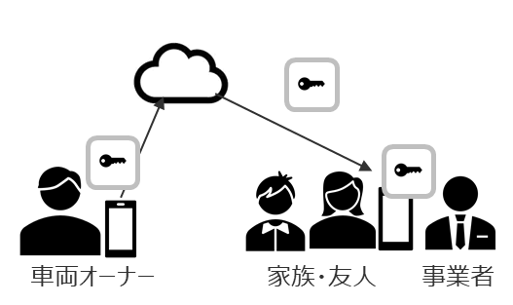
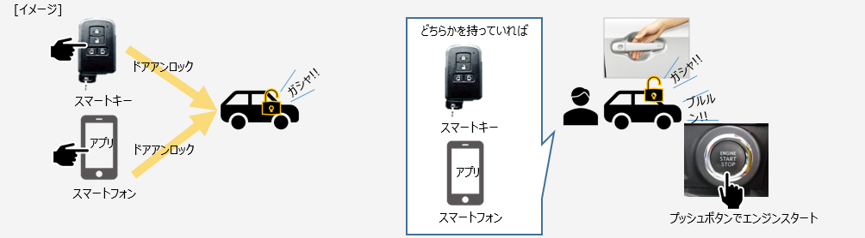
1. Product Overview
Feature Overview
"Your smartphone will be the key to your car."
(1) Door lock opening and closing
Instead of the traditional Fob key,
By operating your smartphone,
Door locks can be opened and closed.
(2) Start the engine
If you have a smartphone,
With the push of the push button,
The engine can be started.
(3) Smart Entry
If you have a smartphone,
With the touch of the door handle,
Door locks can be opened and closed.
(3) Digikey distribution
For family, friends, and businesses
Deliver a digital key.
Customer
(1) Japan: TMC
(2) North America: TMNA
(3) Europe: TME

Slide 4
2. system configuration
< Japan>
<North America and Europe>
Specification | Change Development/ Maintenance and Development | Utilization
TMC | TMC | TMC
TMC | TMC | TMC
DNJP | DNJP (IDEMIA) | DNJP (IDEMIA)
DNJP | DNJP (IDEMIA) | DNJP (IDEMIA)
TMC | TMC | TMC
DNJP (DNST) | DNJP (DNST) | DNJP (DNST)
DNJP | IDEMIA | IDEMIA
Services
Services
Specification | Change Development/ Maintenance and Development | Utilization
TMNA/ TME | TMNA/ TME | TMNA/ TME
TMNA/ TME | TMNA/ TME | TMNA/ TME
DNJP | DNJP (IDEMIA) | TMNA/ TME
TMNA/ TME | TMNA/ TME | TMNA/ TME
DNJP (DNST) | DNJP (DNST) | DNJP (DNST)
DNJP | IDEMIA | IDEMIA
Toyota Server
TMNA Server/
TME Server
Digikey Server
Server Software
Server Software
(DN provides parts)
Smartphone
Smartphone
Digikey App
OneApp
Digikey SDK*
Digikey SDK*
DA
DA
This document explains the red frame part
Legend:
DA: Device Agent;
DNST: Denso China;
DNJP: Denso JP
*No source diff for Digikey SDK (Build settings are different)

Slide 5
3. Development and operation system
Legend:
DNST: Denso China;
DNJP: Denso JP
Customer
DN
Customer
Customer
DNJP System T
IDEMIA
DNJP SDK Development T
DNST
DNJP Operation T
I want to outsource to FPT.
The following will explain the red frame part
(1): Regular (2): Irregular
Organization | Key roles | Remarks
Customer | (1) Application development and operation incorporating SDK (2) Market inquiry desk | TMC compiles requirements. In principle, we do not respond individually
System T | (1) Specification development and SDK release (2) Customer response to specifications and releases | Details are explained separately from System T
SDK Development T | (1) SDK modification, maintenance and development (2) Design confirmation and defect analysis of SDK | Currently knowledgeable in Android: AndroidStudio/Java, iOS: Xcode/Swift Engineers are working with 2.5 artificial (DNST)
Use T | (1) None (2) Responding to inquiries about market problems | Details will be explained separately from Operation T
IDEMIA | (1) DA modification, maintenance and development (2) design confirmation and defect analysis related to DA | DNJP is in charge of the contact point

Slide 6
4. Division of responsibilities within SDK development T
[Role of SDK Development T]
(1) SDK Changes, Maintenance and Development ⇒P.7~10
(2) Design confirmation and defect analysis for SDK ⇒ explained in P.11
[Division of responsibilities]
Person in charge | Responsibilities | Description
DNJP | ・Quality Assurance ・Progress management | ・Clarification of requirements ・Set milestones ・Coordination of related parties ・Work instructions - Review and approve all deliverables ・External review of deliverables (with system T, PM, quality leader) ・Release decision
FPT | ・Deliverable creation ・Progress report | ・Confirmation of requirements ・Creation of deliverables based on instructions and procedures ・Explanation of the created deliverables ・Progress report on the plan ・Launch of progress delays and problems

Slide 7
5. (1) SDK Change, Maintenance and Development Process
・Differential development is carried out using waterfall (V-shaped model) (basically, design document revision, implementation, and testing are only for differential support)
・Conduct creation and review for each process to determine whether DNJP will proceed to the next process.
[System T]
Specification development, whole system,
Responsible for regression evaluation
Requirement Definition
System Testing
Basic Design
Bonding Test
Conduct an evaluation using a vehicle simulation tool (no actual vehicle evaluation)
[SDK Development T]
SDK changes
Responsible for design, implementation, and evaluation
Detailed Design
Unit Tests
Implementation

Slide 8
6. (1) List of SDK Changes, Maintenance and Development Deliverables 1
All deliverables will be entrusted to FPT
Engineering | Deliverables | Classification | Deliverables Overview
Before the basic design begins | OS version upgrade survey report | Internal Information | A report that investigates changes to the new OS from the official websites of Google and Apple, and summarizes the changes and impacts
 | DA Renewal Impact Survey Report | Internal Information | A report that reviews DA software and documentation released by IDEMIA and summarizes the impact
 | Development man-hours estimate, development schedule | Internal Information | Estimates calculated from OS changes and specifications and documents planned based on them
Basic Design | Basic design document (core SDK, control SDK, respectively) | Quality Assurance Evidence | A basic design document that reflects the results of the design for the changes
 | Review Minutes | Quality Assurance Evidence | Evidence that the process was completed correctly
Detailed Design | Detailed design documents (core SDK, control SDK, respectively) | Quality Assurance Evidence | A detailed design document that reflects the results of the design for the changes
 | DRBFM | Quality Assurance Evidence | A worksheet summarizing concerns and countermeasures for changes (DNJP specified format)
 | Review Minutes | Quality Assurance Evidence | Evidence that the process was completed correctly
Implementation | Source code (core SDK, control SDK, sample app, respectively) | Customer Releases | SDK (Core SDK + Control SDK): Approximately 27,000 lines/OS
 | Source diff | Internal Information | A document summarizing the differences between the base software and the changed software
 | Static analysis result report, vulnerability analysis result report | Quality Assurance Evidence | A report summarizing the results of static and vulnerability analysis
 | Binary (Core SDK, Control SDK, Sample App *Each) | Customer Releases | Binary as a result of Build the modified source code
 | Review Minutes | Quality Assurance Evidence | Evidence that the process was completed correctly
Unit Tests | Program Test Specifications (Core SDK and Control SDK) | Quality Assurance Evidence | Approximately 6,000 items (past results: dozens of items per development)
 | Review Minutes | Quality Assurance Evidence | Evidence that the process was completed correctly
Bonding Test | Binding Test Specifications (Core SDK, Control SDK, respectively) | Quality Assurance Evidence | Approximately 9,000 items (past results: dozens of items per development)
 | DKSDK Model Evaluation Specification | Quality Assurance Evidence | Report on the results of evaluating functions that depend on smartphone models and operating systems (28 items× number of warranty terminals)
 | Digital Key System Bonding Inspection Report (may not require a recent assessment) | Quality Assurance Evidence | Report on the results of evaluating the functionality of Server/DA and SDK sequences and I/F changes
 | Review Minutes | Quality Assurance Evidence | Evidence that the process was completed correctly
*SDK: A library that is built into your app and released to the market. Sample app: An app used in the evaluation of the SDK in the DN (delivered to the customer as a reference, but not released to the market)

Slide 9
6. (1) List of SDK Changes, Maintenance and Development Deliverables 2
The blue letter deliverables were created by DNJP. Other than that, it will be entrusted to FPT.
Engineering | Deliverables | Classification | Deliverables Overview
After the Bonding Test | Service Quality Evaluation Plan | Quality Assurance Evidence | Listing the plans for each evaluation and the results of the evaluation, including teams other than SDK development T, and evidence that there are no problems with the quality of the SDK.
 | Build Configuration Check Results Report | Internal Information | Evidence that the SDK and sample app Build configuration are as designed
 | Release Table | Internal Information | A document that lists the version and purpose of the created SDK and sample app, as well as the associated requirements.
 | Release Checklist | Internal Information | Evidence to confirm that the delivered deliverables are appropriate and comprehensive
 | Pre-release Basic Verification Results Report | Internal Information | Report on the results of evaluating whether the basic functions work correctly
Somewhere in each process | OSS Application Form | Quality Assurance Evidence | A document that summarizes the library name, version, license name, etc. of the OSS you are using (DNJP Specified Format)
 | OSS Shipping Confirmation (Core SDK, Control SDK) | Quality Assurance Evidence | Documentation of proper completion of OSS management for customer deliveries (DNJP Specified Format)
 | [TMC format] OSS application form (core SDK and control SDK) | Customer Releases | A document that summarizes the library name, version, license name, etc. of the OSS you are using (TMC Specified Format)
 | Developer's Manual (Core SDK and Control SDK) | Customer Releases | Documentation to explain how to use the SDK to customer developers
 | SDK Information | Customer Releases | Documentation listing information on SDKs (including DA) used by customers to develop apps
 | Change Point List | Customer Releases | A list of where changes were made to the SDK, Server, IF, etc. for the changed items Documentation
 | SDK Update Development Environment Libraries | Customer Releases | Documentation for sharing changes to the development environment (including the OSS used) with customers Must be provided before delivery to the customer

Slide 10
7. (1) Overview of SDK Modification, Maintenance and Development
Approximate annual schedule
April | May | June | July | August | September | October | November | December | January | February | March
Android Change Investigation
Android maintenance and development
Android Change Investigation
iOS Change Investigation
iOS maintenance and development
Change (RC) Development
Change (RC) Development
Business Overview
Rotate the following cycle for each development three times a year.
Customer
Customer
Ordering
Ordering and Specification Issuance
Customer
DNJP System T
IDEMIA
SDK delivery
DA Delivery
Specification Issuance
Provided by DA
System Testing
Developed a V-shape
For deliverables, please refer to the list of deliverables on the previous page
Release
SDK Development T
Work instructions
DNJP SDK Development T
FPT
Deliverable Release
Reviews
Deliverables

Slide 11
8. (2) Overview of SDK design confirmation and defect analysis
Customer
About DA
Specification Inquiries/
Defect Analysis Request
Customer
Specification Inquiry
Customer
DNJP System T
IDEMIA
Answer
Answer
Confirmation request
Answer
SDK Development T
Work instructions
DNJP SDK Development T
FPT
Result Report
Answer
Request analysis
Answer
DNJP Operation T
Market Trouble Inquiry
Main Implementation Details | Deliverables | Uptime
In response to inquiries from customers (including defect indications), after the primary analysis of DNJP, SDK design confirmation and defect analysis are carried out under the instructions of DNJP. *If it is outside the scope of responsibility and it is not possible to investigate on your own, check "who" and "what", and then answer the DNJP SDK development T about what to do after that. | ・Confirmation result report ・Defect analysis report | In principle, weekday working days, 8 hours *In case of emergency, we may ask you to work on holidays.

Slide 12
9. Summary transfer schedule
Transferred
'26/4 | May | June | July | August | September | October | November | December | '27/January | February | March
QA
Briefing session
Explain the development process and business content of DN
Document Review
Expand and review the development documentation
①
OS
Change Investigation
Exploring changes in Android 15 and iOS 18 based on R/C# 8
Android Development
iOS Development
Develop based on R/C#8 and transfer Processes and technologies
②
Analysis
For the time being, we will ask for the Port of Bridge SE
On top of that, in the future, a system that does not go through Bridge SE
I'm thinking of moving to

