Slide 1

ACTIVE INFERENCE BIOFIRM HOMEOSTATIC AGENTS FOR BIOREGIONAL & REGENERATIVE FINANCE
ACTIVE INFERENCE INSTITUTE
FIRST PRINCIPLES FIRST
NOVEMBER 14, 2024

Slide 2


WHAT IS NEEDED FOR A NEW SCIENCE-BASED ECONOMY BASED UPON ENHANCING LIFE, NATURE AND EQUALITY?

Slide 3
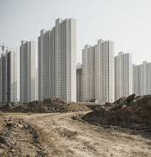
WHAT IS NOT NEEDED
Commodification of Nature and People
Total Fungibility of All Asset Classes
Unbounded Concentration: Wealth, information, and power
Maximization of Private Utility
Extractive Value Metrics: With negative externalities
Zero-Sum, Winner-Takes-All Incentives
Lack of Transparency, Accountability, and Collective Purpose

Slide 4
WHAT IS NEEDED - BIOMIMETIC FIRMS AND ECONOMY
No Negative Externalities
Non-Zero-Sum Incentives
Value Recognition: Aligned with biocapacity, diversity, and resilience
Agency: Empowering nature, species, and people
Homeostatic Fungibility: Among various asset types
Scale & Domain-Free Metrics: Scientific and adaptable
Transparency, Explainability, Accountability
Scalable Learning and Adaptation: Automatable processes
Decentralized Governance: Nested and autonomous systems

Slide 5
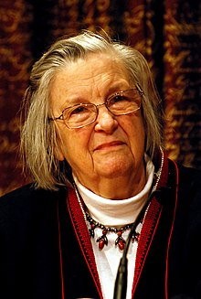
ALIGNMENT WITH ELINOR OSTROM’S WORK ON GOVERNANCE OF THE COMMONS
CLEARLY DEFINED BOUNDARIES Rights to withdraw resources and the boundaries of the Common Pool Resource (CPR) must be clearly specified.
CONGRUENCE WITH LOCAL CONDITIONS Appropriation rules, including time, place, technology, and quantity, align with local labor, materials, and economic factors.
COLLECTIVE-CHOICE ARRANGEMENTS Individuals impacted by operational rules can actively participate in modifying those rules.
MONITORING Monitors who audit CPR conditions and user behavior are accountable to or are the appropriators themselves.
GRADUATED SANCTIONS Violators of operational rules face sanctions proportional to the severity and context of the offense, imposed by peers or accountable officials.
CONFLICT-RESOLUTION MECHANISMS Appropriators and officials have access to low-cost, local venues for resolving conflicts efficiently.
RECOGNITION OF ORGANIZATIONAL RIGHTS Appropriators' rights to create institutions are respected and not challenged by external authorities.
NESTED ENTERPRISES For larger systems, activities such as appropriation, monitoring, enforcement, and governance are managed through multiple layers of nested organizations

Slide 6
OSTROM’S SOCIAL-ECOLOGICAL SYSTEM
A coherent system of biophysical and social factors that regularly interact in a resilient, sustained manner
Defined across multiple spatial, temporal, and organizational scales, often hierarchically linked
Comprises critical resources (natural, socio-economic, cultural) regulated by interconnected ecological and social systems
A dynamic, complex system characterized by continuous adaptation

Slide 7
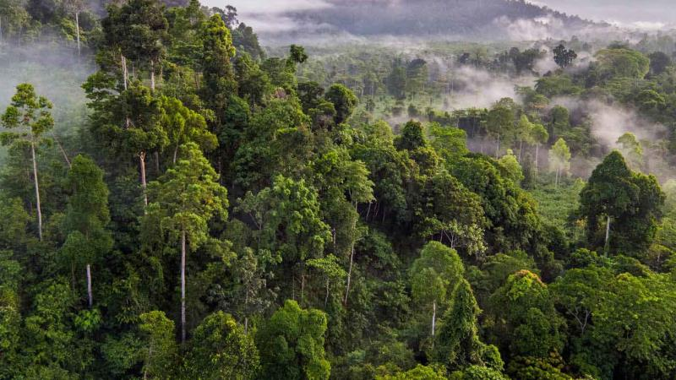
TEHANU – GIVING AGENCY AND VALUE TO NATURE AND SPECIES
“Animals, trees, and countless other species are essential to the global economy. Our world cannot truly prosper if only humans benefit from its resources.
We build infrastructure that supports a circular flow of money and data between humans and other species, ensuring mutual flourishing.
Tehanu exists with the belief that for these species to thrive, they must actively participate in our economy.”

Slide 8
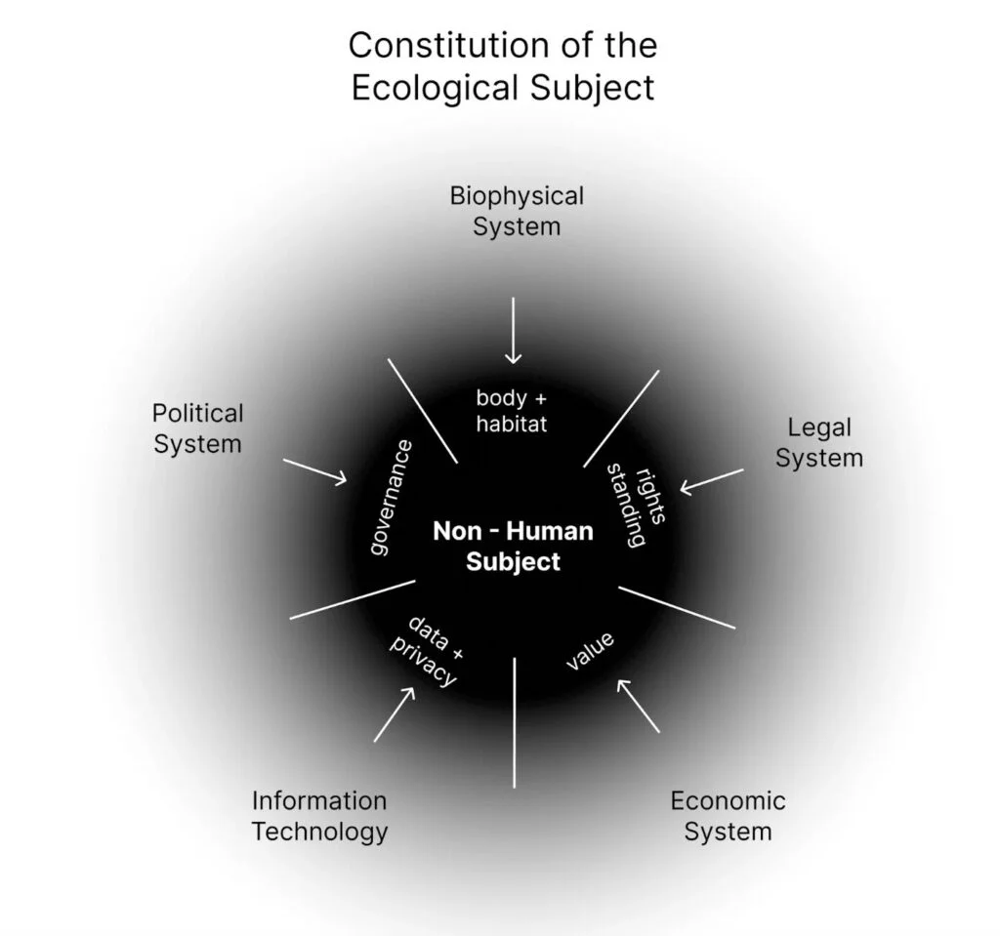
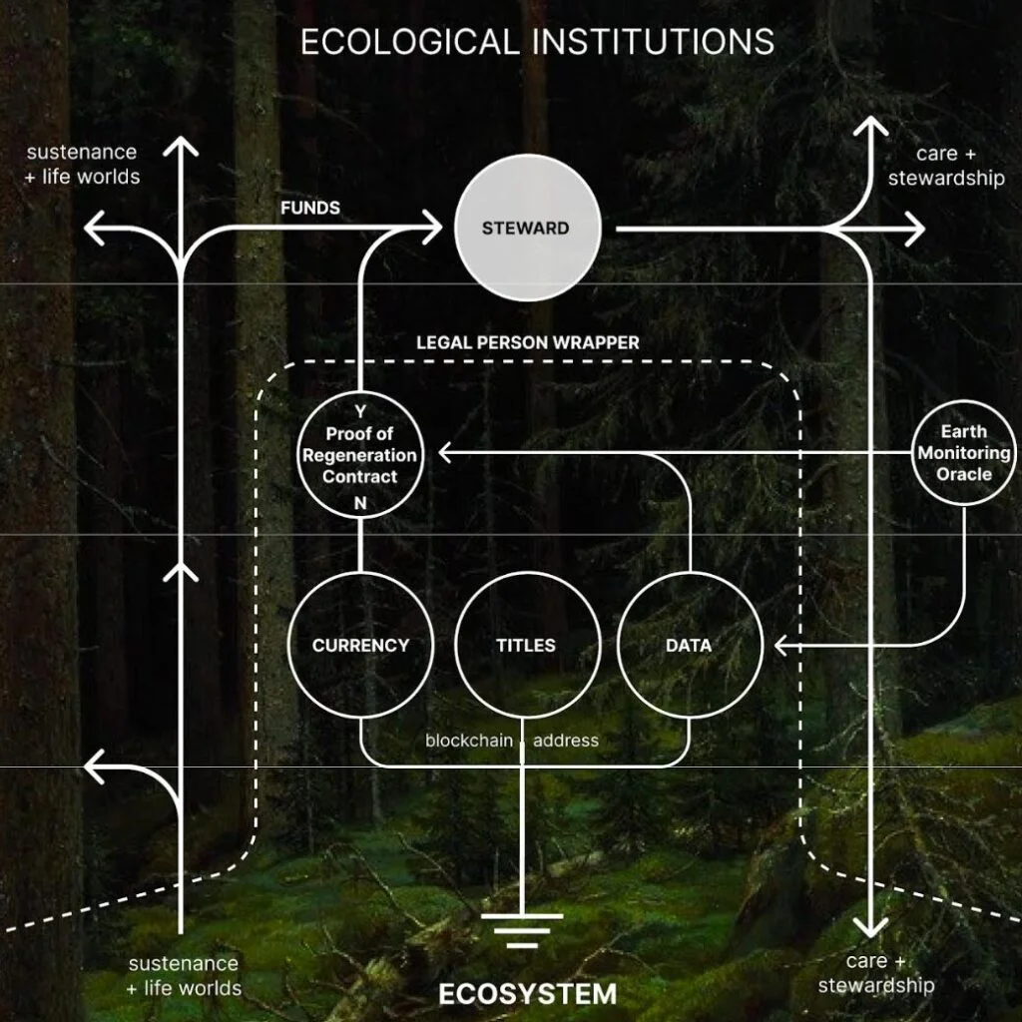
GIVING AGENCY TO NATURE: REGEN NETWORKS AND ECOLOGICAL INSTITUTIONS

Slide 9

BIOREGIONAL HUB STRATEGY
VISION AND PRINCIPLES
Align with living systems principles and Indigenous wisdom
Serve the Bioregional Regeneration Strategy realization
Emphasize inclusive, participatory governance representing the bioregion
CORE COMMITMENTS
Address power imbalances; ensure transparency and empowered participation
Treat growth and returns as a means, not an end
STRATEGIC APPROACHES
Leverage an integrated capital structure for organizing, weaving, and activation
Raise funds from purpose-aligned investors and funders
KEY ACTIONS
Provide aggregation and matchmaking services
Implement an integrated approach to sensing and MRV (Monitoring, Reporting, and Verification)
Invest in impactful storytelling

Slide 10
BIOMFIRM MEETS BIOFI OPERATIONAL AND ASPIRATIONAL CRITERIA
First Principle- based grounded in the scientific method & Bayesian Statistics-Markov blanket
Computationally tractable scale and domain-free metrics for sensing MRVs
Open-source kernel of biofirm – based upon homeostatic –biomimetic principles of self-organization, self-healing, self-modeling, nested alignment around shared goals and outcomes
Highly automated functions and competencies through learning interfacing with LLMs
Scalable through secure edge networks to enable value exchange among diverse biofirms
Poly-centric governance and “nested enterprise” through shared outcomes & telos
Cooperative incentives and value allocation – FEP & Shapley Value
Autonomous and decentralized governance and value recognition and allocation.
Gives agency to Nature, species and individuals to
Intrinsic governance and security by initial design and telos.
Principled means on interfacing biomimetic economy with current Fiat economy
Provides a principled basis for valuing ” nature- based “currencies and assets

Slide 11

LET’S MAKE IT REAL
john@fp1.ai
www.fp1.ai

