Slide 1

A template/ approach to Reproducible Generative Research
Research infrastructure that documents itself — a case study for meta-science and science-integrity teams
Notes:
Opening: name the audience explicitly — meta-science / science-integrity groups, not general investors.

Slide 2

The problem
• Research groups publish claims about their own tools and pipelines that no one outside the team can re-check.
• Manuscripts describing infrastructure go stale the moment the infrastructure changes underneath them.
• Reproducibility efforts usually stop at the data and code layer — the documentation layer is still hand-maintained and drifts silently.
Notes:
Land the problem in one sentence a non-technical funder can parse without repo context.

Slide 3

What template_template is
• A manuscript that is generated FROM the repository it describes, not written ABOUT it from memory.
• Every metric in the paper — module counts, test counts, pipeline stages — is computed live by template_template's own introspection code.
• One of 23 public exemplar templates in the same monorepo, each independently tested and coverage-gated.
Source: infrastructure/project/public_scope.py
Notes:
This slide answers 'what is it' concretely — no adjectives, only mechanism.

Slide 4

How it works
• src/template_template/introspection.py scans infrastructure/ modules, the pipeline DAG, and the public project roster.
• metrics.py turns that scan into a dictionary of ${variable} values; inject_metrics.py substitutes them into the manuscript text.
• Re-running the pipeline regenerates the paper from current repository state — the citation and the artifact cannot drift apart.

Slide 5
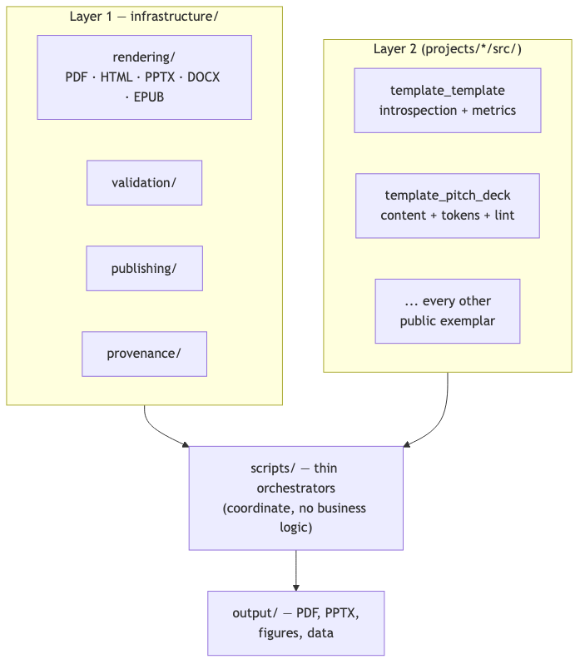

Two-layer architecture, at a glance
Source: CLAUDE.md

Slide 6

Proof, not adjectives
130 tests
99.37% coverage on template_template's own source — the same gate every exemplar in the repo must pass.
Source: docs/_generated/COUNTS.md

Slide 7

Already public
• Concept DOI 10.5281/zenodo.20419007, 9 durable publication records already on file: Zenodo, GitHub, PyPI (sandbox), IPFS, Software Heritage, GitHub Pages, Netlify, Hugging Face, OSF.
• Licensed Apache-2.0 — the introspection code, not only the prose, is available for a science-integrity team to audit directly.
Source: projects/templates/template_template/manuscript/config.yaml

Slide 8

Why this matters for science integrity
• A funder or reviewer can clone the repository and regenerate the exact figures and counts cited in the manuscript, on their own machine.
• The same no-mocks, coverage-gated testing discipline that verifies the code also verifies the claims made about the code.
• The pattern generalizes across the whole projects/templates/ folder — all 23 exemplars, not just one cherry-picked example — follow the identical thin-orchestrator, two-layer architecture.
Source: docs/_generated/active_projects.md

Slide 9

Cite this deck
• This pitch deck (template_template_pitch_short.pdf) is its own exemplar in the same monorepo — it has its own source, tests, and citable identity, separate from the DOI of the project it pitches.
• This deck's own DOI: 10.5281/zenodo.21281509.
• Every slide also carries a QR code to its own standalone, citable page — see the deep-linking mechanism described later in the medium and long versions of this deck.
Source: projects/templates/template_pitch_deck/manuscript/config.yaml

Slide 10

The ask
• Adopt this pattern for your own methods papers: bind every reported number to the code that produced it, not to a hand-typed table.
• Pilot it on one existing manuscript in your group before committing to a full rewrite.
• Happy to pair with your team through a first regeneration cycle, if useful — no prior engagements to point to yet, this pattern is newly forkable.
• Open to funding conversations and scoping a consulting engagement for a deeper or custom integration — no prior engagements exist yet; this is an invitation to talk, not an established offering.

Slide 11

Questions
Research infrastructure that documents itself — a case study for meta-science and science-integrity teams
Notes:
Closing slide — leave contact/repo pointer to the resolved GitHub token.

