Slide 1
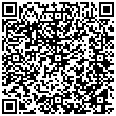
A Domain Language for Specifying Controlled Methods
A controlled-method specification pitch for reproducible research teams

Slide 2
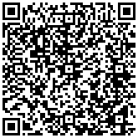
Why methods drift

Slide 3
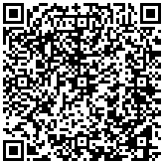
Prose is necessary but not sufficient
• A method description can be readable while leaving stages, units, and
acceptance predicates ambiguous.
• The remedy is a small typed contract that can be validated before compilation.

Slide 4
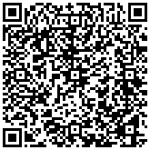
The controlled pipeline
• Parse the method specification, validate staged dependencies, compile
deterministic outputs, and emit a receipt.
• Exact-value tests and negative controls protect the surfaces most likely to drift.
Source: projects/templates/template_methods_paper/src

Slide 5
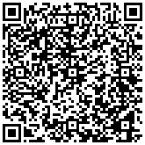
What remains bounded
• A passing compiler proves local method consistency, not scientific truth or
external validity.
• Forks must add domain evidence and publication authorization before
extending the claim.
Source: projects/templates/template_methods_paper/README.md

Slide 6
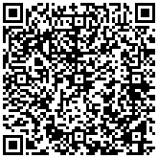
Adoption path
• Choose one existing workflow, encode its invariant stages, and compare the
receipt across two deterministic runs.
• Use the failed case as the design signal; do not hide it behind a skipped tool.
Source: projects/templates/template_methods_paper/tests

