Slide 1
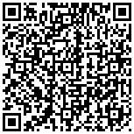
A Domain Language for Specifying Controlled Methods
A controlled-method specification pitch for reproducible research teams

Slide 2
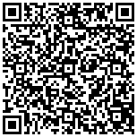
Audience and failure mode

Slide 3
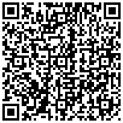
Methods are interfaces
• A method is an interface between a question, its inputs, and the claims its
outputs can support.
• When that interface is implicit, later changes can silently alter the meaning of a
result.

Slide 4
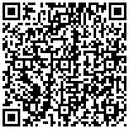
A small controlled language
• The DSL names stages, dependencies, units, and exports as data that can be
parsed and validated.
• Compilation remains deterministic and offline by default, with no hidden
network or LLM path.
Source: projects/templates/template_methods_paper/src

Slide 5
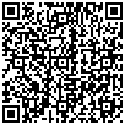
Negative controls carry the argument
• Malformed stages, changed literals, and invalid units must fail before a receipt
can be treated as current.
• The focused tests exercise those failures without repeating the full refresh
path.
Source: projects/templates/template_methods_paper/tests

Slide 6
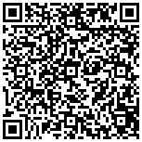
What the receipt means
• It binds a local source revision, method plan, output schema, and deterministic
compiler result.
• It does not substitute for a domain comparator, real data provenance, or
owner-authorized publication.
Source: projects/templates/template_methods_paper/README.md

Slide 7
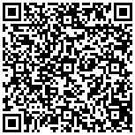
A bounded next step
• Encode one production method and review the diff with its domain owner.
• Promote only the claims whose evidence and acceptance predicates are
explicit.

