Slide 1
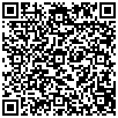
A Domain Language for Specifying Controlled Methods
A controlled-method specification pitch for reproducible research teams
Notes:
Open with the methods audience and the narrow claim boundary.

Slide 2
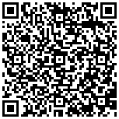
The methods problem
• Research methods are often described as prose before their assumptions
become executable.
• A controlled specification keeps inputs, stages, outputs, and validation criteria
explicit.

Slide 3
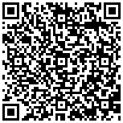
What template_methods_paper contributes
• The DSL compiles a declared method plan into deterministic artifacts and a
versioned export receipt.
• The source and test suite make malformed stages and changed numeric
values fail closed.
Source: projects/templates/template_methods_paper/src

Slide 4
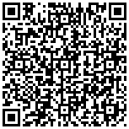
The invitation
• Start with one method that already has a clear input/output contract.
• Keep external data, publication, and domain-validity claims behind their own
evidence gates.
Source: projects/templates/template_methods_paper/README.md

