Slide 1

A template/ approach to Reproducible Generative Research
Research infrastructure that documents itself — a case study for meta-science and science-integrity teams
Notes:
Opening: name the audience explicitly — meta-science / science-integrity groups, not general investors.

Slide 2

The problem
• Research groups publish claims about their own tools and pipelines that no one outside the team can re-check.
• Manuscripts describing infrastructure go stale the moment the infrastructure changes underneath them.
• Reproducibility efforts usually stop at the data and code layer — the documentation layer is still hand-maintained and drifts silently.

Slide 3

Why this is a science-integrity problem, not just a tooling problem
• A stale claim about infrastructure is a form of unverified evidence, structurally similar to an uncheckable statistic in a results section.
• Peer review rarely re-derives a paper's own infrastructure description; it is trusted by default.
• Meta-science groups exist precisely to close gaps like this — this deck is itself an instance of the pattern it is describing.

Slide 4

Landscape

Slide 5

Where meta-science tooling stands today
• Electronic lab notebooks and preregistration platforms address the experiment layer, not the infrastructure-description layer.
• Literate-programming tools (R Markdown, Jupyter, Quarto) bind prose to code within one document, but rarely to a whole repository's live state.
• Very few public examples exist of a manuscript that introspects and reports on the software system that produced it, at repository scale.

Slide 6

Adjacent practice this builds on
• Ten Simple Rules for Reproducible Computational Research (Sandve et al., 2013) — the base discipline of tracking exactly what produced each result.
• Good Enough Practices in Scientific Computing (Wilson et al., 2017) — version control, testing, and modular code as baseline hygiene.
• FAIR principles for research software (Lamprecht et al., 2020) — Findable, Accessible, Interoperable, Reusable, extended here to the manuscript layer itself.

Slide 7

What template_template is
• A manuscript that is generated FROM the repository it describes, not written ABOUT it from memory.
• Every metric in the paper — module counts, test counts, pipeline stages — is computed live by template_template's own introspection code.
• One of 24 public exemplar templates in the same monorepo, each independently tested and coverage-gated.
Source: infrastructure/project/public_scope.py

Slide 8

“Autopoietic: the paper regenerates itself from the code it describes.”
— template_template/README.md
Source: projects/templates/template_template/README.md

Slide 9

How it works

Slide 10

Introspection
• src/template_template/introspection.py discovers infrastructure/ subpackages, the pipeline.yaml stage DAG, and the public exemplar roster.
• The scan reads the filesystem and YAML directly — it does not depend on any external service or cached snapshot.
• Function-level entry points (discover_infrastructure_modules, discover_projects, load_pipeline_stages_from_yaml) each return typed, testable dataclasses.

Slide 11

Metrics
• metrics.py turns the introspection scan into a dictionary of ${variable} values — the same token convention used across every exemplar's manuscript.
• build_manuscript_metrics_dict computes counts directly; nothing is copy-pasted from a prior run.
• save_metrics_json persists the full dictionary to output/data/metrics.json for downstream inspection.

Slide 12

Injection
• inject_metrics.py substitutes ${variable} values into manuscript/*.md, writing the resolved text to output/manuscript/ for rendering.
• Unresolved tokens are never silently dropped — a missing variable is a build failure, not a blank space in the PDF.
• Re-running the pipeline regenerates the paper from current repository state — the citation and the artifact cannot drift apart.

Slide 13

Visualization
• Four figures — architecture overview, pipeline stages, module inventory, comparative feature matrix — are generated from the same live data, not hand-drawn.
• generate_architecture_viz.py orchestrates dedicated figure modules sharing one palette module, so the visual language stays consistent across all four.
• Regenerating figures after a code change is one script call, not a redraw in an external tool.

Slide 14
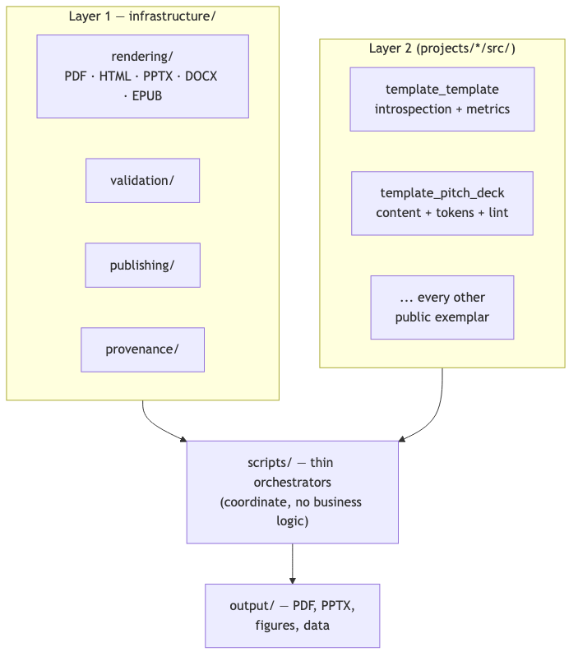

Two-layer architecture, at a glance
Source: CLAUDE.md

Slide 15
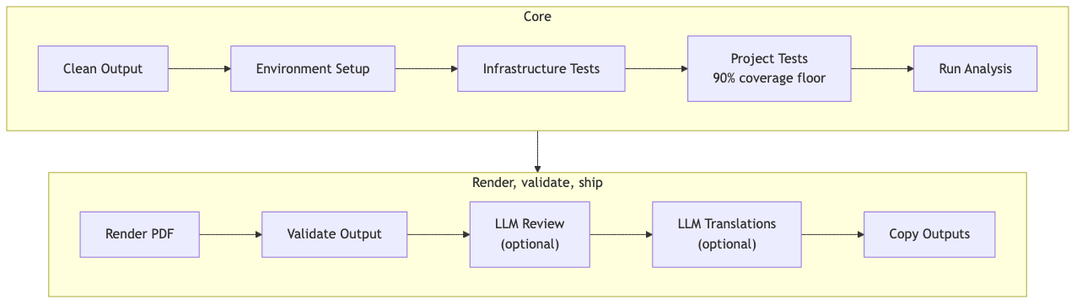

The core pipeline, stage by stage
Source: CLAUDE.md

Slide 16

Two-layer architecture, in depth

Slide 17

Layer 1 — infrastructure/
• Generic, reusable modules: rendering (PDF/HTML/PPTX/DOCX/EPUB), validation, publishing, provenance, security.
• No project-specific logic lives here — a change to infrastructure/ affects every exemplar identically.
• This deck's own PDF/PPTX renderers (infrastructure/rendering/slide_deck.py, pptx_deck.py) are new additions to this same layer.

Slide 18

Layer 2 — projects/{name}/src/
• Each exemplar's own domain logic: template_template's introspection/metrics, a code-project's optimizer, this deck's own content loader and token/cliche validators.
• Kept out of infrastructure/ by convention, enforced by an automated project/infrastructure-boundary drift check.
• Thin orchestrator scripts (projects/{name}/scripts/) coordinate the two layers but implement no business logic themselves — a size/complexity gate enforces this directly.
Source: projects/templates/template_template/src/template_template

Slide 19

Testing discipline
• No mocks, anywhere: tests use real files, real YAML, real rendered output — never unittest.mock or MagicMock.
• 90% coverage floor on every exemplar's own src/; 60% floor on shared infrastructure/.
• A project fails its own gate the same way regardless of which exemplar it is — there is no per-project exception without an explicit, documented reason.

Slide 20

Proof, not adjectives

Slide 21

Measured, not asserted
147 tests
97.66% coverage on template_template's own source — the same gate every exemplar in the repo must pass. No partial-credit reporting path exists.
Source: docs/_generated/COUNTS.md

Slide 22

Already public
9 platforms
Durable publication records already on file (concept DOI 10.5281/zenodo.20419007): Zenodo, GitHub, PyPI (sandbox), IPFS, Software Heritage, GitHub Pages, Netlify, Hugging Face, OSF. Licensed Apache-2.0.
Source: projects/templates/template_template/manuscript/config.yaml

Slide 23

This deck is an instance of the same claim
• Every number on the previous two slides was read live from template_template's own manuscript/config.yaml and this monorepo's generated coverage report — not typed into this YAML file by hand.
• src/deck_tokens.py::build_deck_tokens is the function that did the reading; you can run it yourself and get the same numbers.
• A token-resolution audit fails this deck's own build if any of these values ever go missing.
Source: projects/templates/template_pitch_deck/src/deck_tokens.py

Slide 24

The pattern generalizes

Slide 25

The full roster, not one cherry-picked example
• projects/templates/ holds all 24 public exemplars: template_active_inference, template_advanced_literature_review, template_autopoiesis, template_autoresearch_project, template_autoscientists, template_code_project, template_data_descriptor, template_eda_notebook, template_formal, template_gold_refinement, template_literature_meta_analysis, template_madlib, template_methods_paper, template_newspaper, template_pitch_deck, template_pools_rules_tools, template_prose_project, template_redacted_report, template_registered_report, template_search_project, template_sia, template_storybook, template_template, template_textbook.
Source: docs/_generated/active_projects.md

Slide 26

One contract across all public exemplars
• template_active_inference is called out here only as one concrete instance to point to — every name in that list is an independently-built exemplar following the identical two-layer architecture, not a hand-picked best case.
• Neither exemplar's coverage gate or drift check required any special-casing to add — the contract is uniform across all 24 projects, and the folder itself is the evidence, not a claim about it.
Source: docs/_generated/active_projects.md

Slide 27

What makes an exemplar 'public'
• A single hand-edited registry (infrastructure/project/public_scope.py) lists every project name in public CI/documentation scope.
• Everything else under projects/ (working, ongoing, archive folders) stays local-only by construction, never accidentally published.
• An automated confidentiality audit fails CI if a private project path is ever tracked by mistake.

Slide 28

Governance and confidentiality

Slide 29

Public vs. private, by construction
• Only projects/templates/ is public and CI-gated; private working projects render locally through the same pipeline without ever being tracked.
• A dedicated audit (scripts/audit/check_tracked_all.py) enforces this on every push, not only at release time.
• The same separation pattern that lets a lab keep unpublished work private, while still exercising the identical tested pipeline, day to day.

Slide 30

Publishing surface
• A registry of 20 publishing platforms — Zenodo, arXiv, GitHub, PyPI, OSF, Software Heritage, Hugging Face, IPFS, and more — with per-platform automation where an API exists.
• Platforms without a submission API (arXiv) are documented as a manual step, not silently skipped or falsely marked complete.
• Every 'published' status in a project's README is compiled from that project's own config.yaml, not hand-written prose that can drift out of sync.

Slide 31

Reproducibility guarantees

Slide 32

What reproducible means here
• Fixed RNG seeds and MPLBACKEND=Agg for headless, deterministic figure generation.
• Two consecutive pipeline runs against the same repository state produce byte-identical rendered output.
• Coverage and test counts are read from a generated report (docs/_generated/COUNTS.md), never hardcoded into prose that could go stale.

Slide 33

How you would verify this deck's own claims
• Clone the monorepo, run the same pipeline command shown in this project's README, and regenerate this exact deck.
• Diff the regenerated PDF/PPTX against the committed output — a token-honesty test already does this as part of the project's own CI gate.
• Nothing in this pitch requires trusting the presenter; it requires running the pipeline.

Slide 34

Scientific integrity, by construction

Slide 35

Independent gates, not one
• No-mocks testing policy, CI-enforced: scripts/audit/verify_no_mocks.py fails the build if any test imports MagicMock, mocker.patch, or unittest.mock — a checked gate, not a style preference.
• Coverage floors are enforced per project (90%) and for shared infrastructure (60%), not averaged away across the monorepo.
• A byte-level reproducibility invariant: two renders of identical content in the same environment produce an identical PDF — verified by a real, passing test, not assumed across every OS/toolchain combination.
Source: tests/infra_tests/rendering/test_slide_deck.py

Slide 36
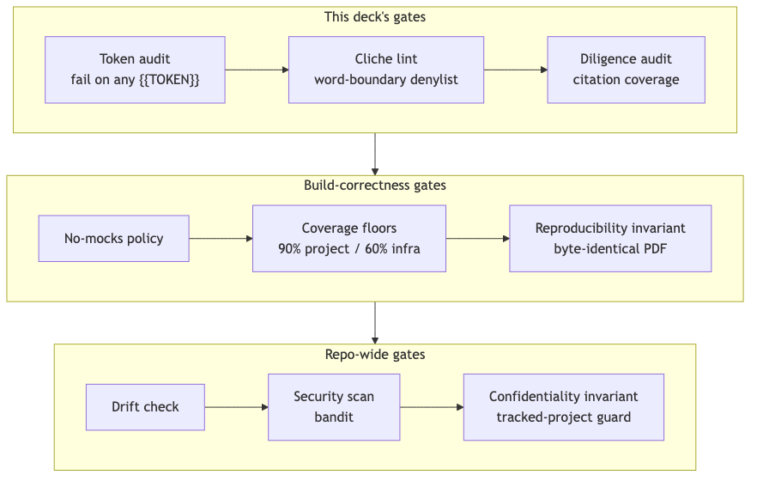

The integrity stack, gate by gate
Source: projects/templates/template_pitch_deck/src/token_resolution.py

Slide 37

Why gates instead of a style guide
• A style guide is a request; a gate is a build failure — the difference between 'we ask reviewers to check citations' and 'the render script exits non-zero if one is missing'.
• Each gate here targets one specific failure mode it was built to catch: a stale token, a cliche phrase, an uncited fact, a non-reproducible artifact.
• None of these gates existed before this exemplar needed them — each was added because a real defect surfaced during this project's own development, not speculatively.
Source: projects/templates/template_pitch_deck/src/diligence_audit.py

Slide 38

What happens when a gate fails
• scripts/10_audit_deck_content.py exits non-zero on the first unresolved token or cliche hit — the render script never runs against unaudited content.
• scripts/30_audit_diligence.py exits non-zero if any fact-bearing slide lacks a source citation — a deck can be complete and still fail to ship.
• Fail-closed, not fail-open: an audit that cannot run is treated as a failure, never silently skipped and reported as a pass.
Source: projects/templates/template_pitch_deck/scripts/10_audit_deck_content.py

Slide 39

Coverage isn't a headline number
• Every one of 24 public exemplars is measured independently, not summarized into one repo-wide percentage.
• The chart on the next slide is generated from the same docs/_generated/COUNTS.md factsheet this deck's own 97.66% figure comes from — one source of truth, two presentations.
Source: docs/_generated/COUNTS.md

Slide 40
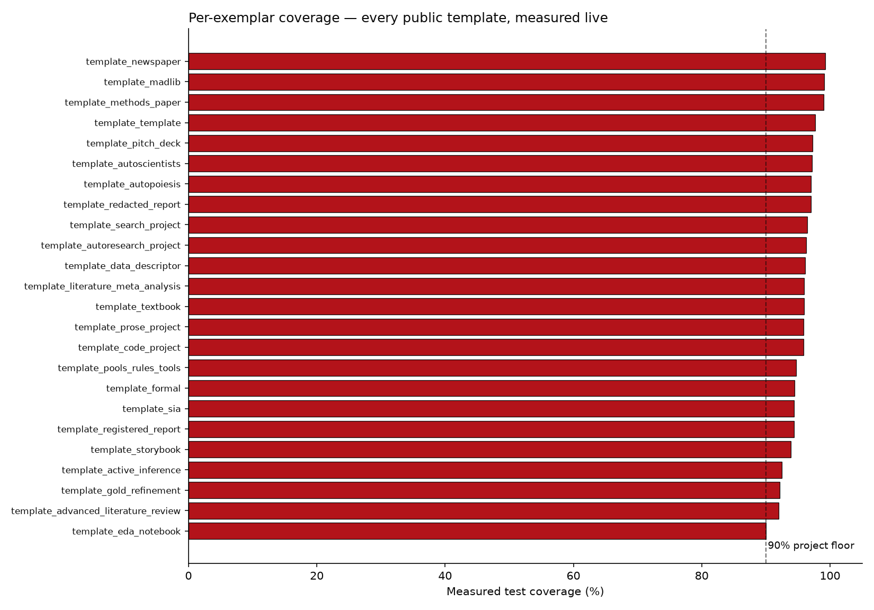

Per-exemplar coverage, measured live
Source: docs/_generated/COUNTS.md

Slide 41
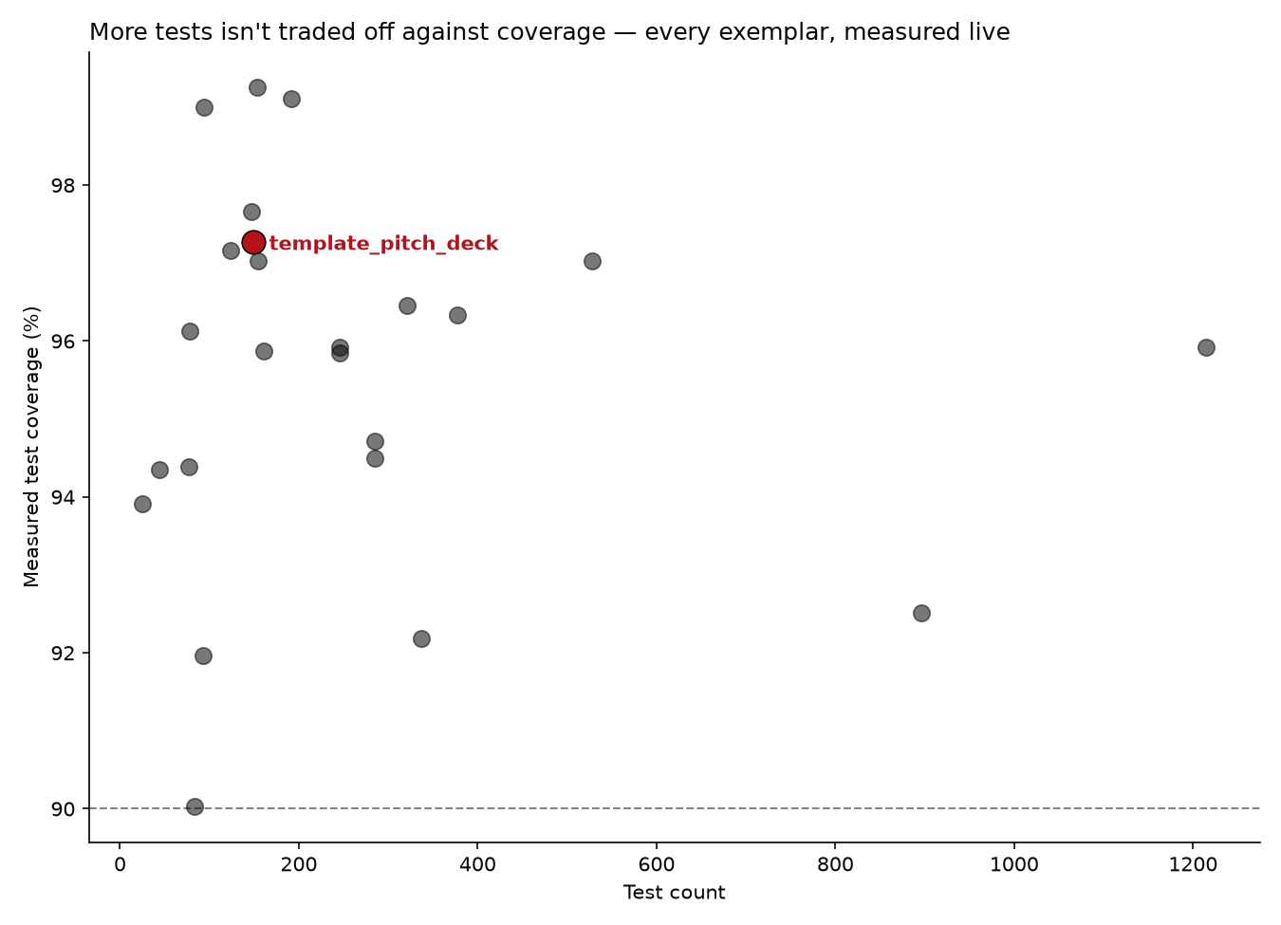

Test volume and coverage aren't a tradeoff
Source: docs/_generated/COUNTS.md

Slide 42

This deck audits itself
• src/token_resolution.py fails the build on any unresolved double-curly-brace placeholder — the same discipline this slide's own template_template token was resolved by.
• src/cliche_lint.py and src/diligence_audit.py both run inside render_orchestration.py itself, before that deck length's own PDF/PPTX is written — a slide referencing a live-sourced token with no citation blocks that length's render, it does not just fail a separate, skippable check.
• None of these checks are generic infrastructure — they are this project's own src/, built specifically because a pitch deck is exactly the kind of document that tempts unverifiable claims.
Source: projects/templates/template_pitch_deck/src/diligence_audit.py

Slide 43

The chain of custody: slide → QR → GitHub
• Every slide in this deck carries its own QR code, linking to a standalone, real Markdown page for that exact slide under output/slides_standalone/.
• Once this output/ directory is committed and pushed, a photo of a projected or printed slide can be traced back to its precise source page on GitHub — not just to the deck as a whole. Locally, the generated page already exists; the QR only resolves once it is actually published.
• Mechanically, this is the same source-citation system with one more hop: a citation links out to evidence; the QR links to the slide's own generated page, which repeats that same citation.
Source: projects/templates/template_pitch_deck/src/standalone_slides.py

Slide 44

Cite this deck
• This pitch deck is its own exemplar in the same monorepo — it has its own src/, tests, and citable identity, distinct from the DOI of template_template, the project it pitches.
• This deck's own DOI: 10.5281/zenodo.21281509.
• That status is read live from this project's own manuscript/config.yaml at render time — the moment a real Zenodo deposit is recorded there, this slide's own text updates on the next regeneration, the same way every other fact in this deck does.
• This deck's DOI is deposited through the same infrastructure.publishing pipeline every other exemplar in this monorepo uses — nothing deck-specific to build, only a deposit to make.
Source: projects/templates/template_pitch_deck/manuscript/config.yaml

Slide 45

What's actually inside infrastructure/

Slide 46

Not a black box
• 25 importable subpackages, 752 tracked Python files total under infrastructure/ — a real inventory anyone can `git ls-files` themselves, not a claimed abstraction.
• The largest single subpackage, core, holds 129 files — still a minority of the whole, not a monolith wearing a modular label.
• Every number on this slide is computed live by src/infra_facts.py at render time, reusing the exact same counters docs/_generated/COUNTS.md is built from.
• The next chart narrows the total to importable subpackages, excluding 2 top-level file(s): infrastructure/__init__.py and mcp_server.py.
Source: projects/templates/template_pitch_deck/src/infra_facts.py

Slide 47
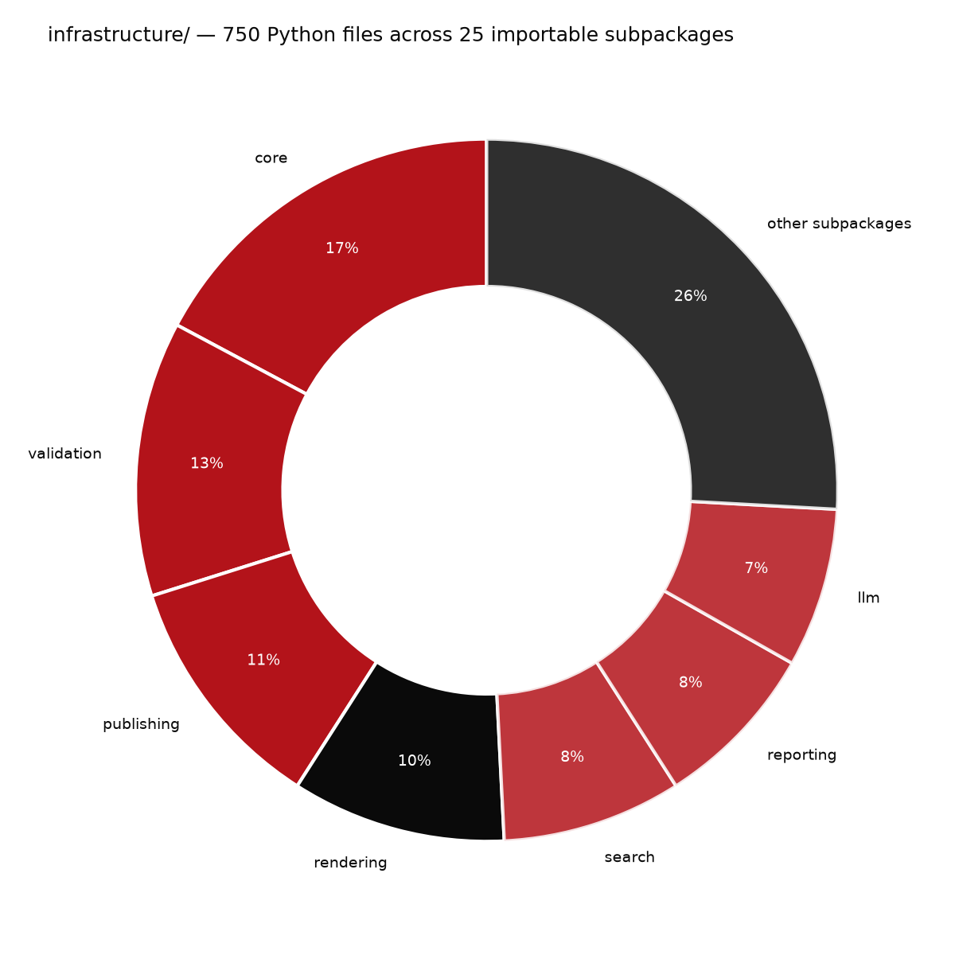

infrastructure/, by subpackage
Source: projects/templates/template_pitch_deck/src/infra_facts.py

Slide 48

Why partition it this way
• Each subpackage boundary matches a real reuse boundary: rendering/, validation/, publishing/, provenance/ each solve one generic problem every exemplar needs, independent of any project's domain logic.
• A change inside one subpackage cannot silently reach into another without an explicit import — the boundary is enforced by the drift check, not just convention.
• This is the same two-layer split described earlier in this deck, now shown at the resolution of individual subpackages instead of the whole layer.

Slide 49

Roadmap

Slide 50

What comes next for this exemplar
• Extend token-sourced facts beyond one pitch subject to any exemplar in the roster, so a new deck for a different project needs only new content YAML, not new code.
• Add a second validated pitch (a broader meta-science-group deck) reusing the same rendering and audit pipeline.
• Track deck-generation coverage and drift in the same CI gates that already watch every other public exemplar.

Slide 51

Where this could go next for your organization
• A grant-report deck generated the same way a manuscript is — bound to the same project data your team already tracks.
• A recurring quarterly-update deck that regenerates instead of being rebuilt from scratch each cycle.
• A shared content schema across your organization's decks, so a house style survives staff turnover.

Slide 52

The ask
• Adopt this pattern for your own methods papers: bind every reported number to the code that produced it, not to a hand-typed table.
• Pilot it on one existing manuscript in your group before committing to a full rewrite.
• Happy to pair with your team through a first regeneration cycle and help define your own introspection surface, if useful — no prior engagements to point to yet, this pattern is newly forkable.

Slide 53

Funding & consulting
• The code itself is available to adopt directly today — real, tested, and licensed for reuse, no engagement required to start.
• Open to funding conversations for a dedicated integration (a new pitch subject, a distinct theme, a deeper introspection surface) — no such engagement exists yet, this is an invitation to scope one, not an established program.
• Open to scoping a consulting engagement on request — pairing through a first regeneration cycle, or adapting the two-layer architecture to an existing codebase outside this monorepo. No such engagement has happened yet; this is an invitation, not a track record.

Slide 54

Appendix

Slide 55

Glossary
• Autopoietic — a system that regenerates its own description from its own live state, rather than from a fixed snapshot.
• Thin orchestrator — a script that coordinates infrastructure/ and src/ calls but contains no business logic itself.
• Coverage floor — the minimum percentage of source lines a test suite must exercise before the pipeline is allowed to proceed.
• No-mocks policy — a testing rule requiring real files, real data, and real computation instead of simulated objects.

Slide 56

Citation and contact
• Concept DOI: 10.5281/zenodo.20419007.
• Repository: docxology/template_template, licensed Apache-2.0.
• This deck itself: projects/templates/template_pitch_deck in the same monorepo.
Source: projects/templates/template_template/manuscript/config.yaml

Slide 57

Questions
Research infrastructure that documents itself — a case study for meta-science and science-integrity teams
Notes:
Closing slide — leave contact/repo pointer to the resolved GitHub token.

