Slide 1

A template/ approach to Reproducible Generative Research
Research infrastructure that documents itself — a case study for meta-science and science-integrity teams
Notes:
Opening: name the audience explicitly — meta-science / science-integrity groups, not general investors.

Slide 2

The problem
• Research groups publish claims about their own tools and pipelines that no one outside the team can re-check.
• Manuscripts describing infrastructure go stale the moment the infrastructure changes underneath them.
• Reproducibility efforts usually stop at the data and code layer — the documentation layer is still hand-maintained and drifts silently.

Slide 3

Landscape

Slide 4

Where meta-science tooling stands today
• Electronic lab notebooks and preregistration platforms address the experiment layer, not the infrastructure-description layer.
• Literate-programming tools (R Markdown, Jupyter, Quarto) bind prose to code within one document, but rarely to a whole repository's live state.
• Very few public examples exist of a manuscript that introspects and reports on the software system that produced it, at repository scale.

Slide 5

What template_template is
• A manuscript that is generated FROM the repository it describes, not written ABOUT it from memory.
• Every metric in the paper — module counts, test counts, pipeline stages — is computed live by template_template's own introspection code.
• One of 24 public exemplar templates in the same monorepo, each independently tested and coverage-gated.
Source: infrastructure/project/public_scope.py

Slide 6

“Autopoietic: the paper regenerates itself from the code it describes.”
— template_template/README.md
Source: projects/templates/template_template/README.md

Slide 7

How it works

Slide 8

Introspection
• src/template_template/introspection.py discovers infrastructure/ subpackages, the pipeline.yaml stage DAG, and the public exemplar roster.
• The scan reads the filesystem and YAML directly — it does not depend on any external service or cached snapshot.
• Function-level entry points (discover_infrastructure_modules, discover_projects, load_pipeline_stages_from_yaml) each return typed, testable dataclasses.

Slide 9

Metrics and injection
• metrics.py turns the introspection scan into a dictionary of ${variable} values — the same token convention used across every exemplar's manuscript.
• inject_metrics.py substitutes those values into manuscript/*.md, writing the resolved text to output/manuscript/ for rendering.
• Re-running the pipeline regenerates the paper from current repository state — the citation and the artifact cannot drift apart.

Slide 10

Visualization
• Four figures — architecture overview, pipeline stages, module inventory, comparative feature matrix — are generated from the same live data, not hand-drawn.
• generate_architecture_viz.py orchestrates dedicated figure modules sharing one palette module, so the visual language stays consistent across all four.

Slide 11
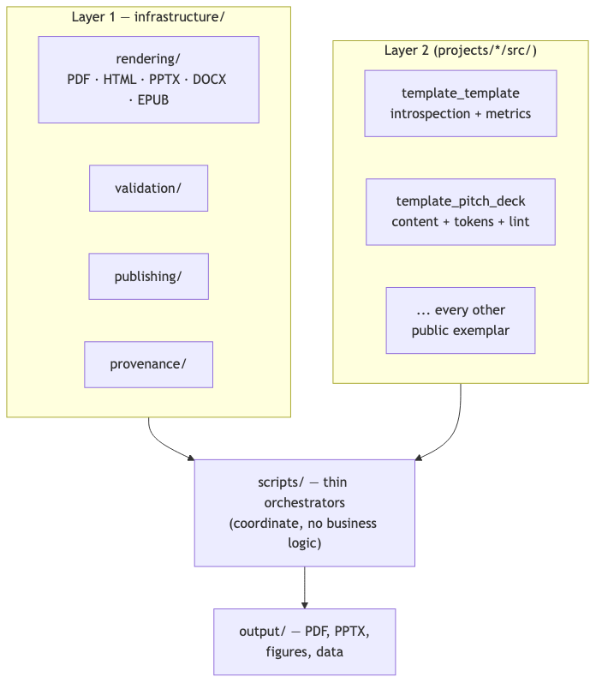

Two-layer architecture, at a glance
Source: CLAUDE.md

Slide 12
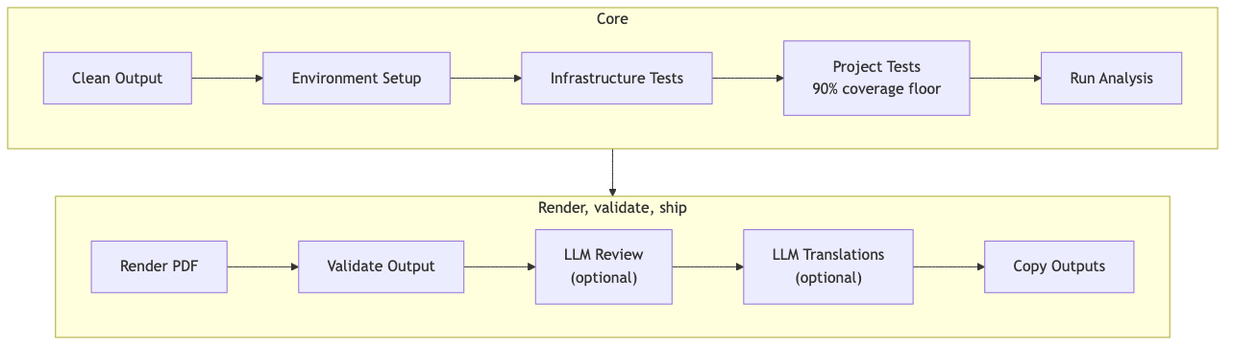

The core pipeline, stage by stage
Source: CLAUDE.md

Slide 13

Proof, not adjectives

Slide 14

Measured, not asserted
147 tests
97.66% coverage on template_template's own source — the same gate every exemplar in the repo must pass.
Source: docs/_generated/COUNTS.md

Slide 15

No partial credit
• 90% project-coverage floor and a no-mocks testing policy apply to this project exactly as they do to the 24 other exemplars.
• Every pipeline run either passes its own gate or fails loudly — there is no partial-credit reporting path.
Source: infrastructure/project/public_scope.py

Slide 16

Already public
• Concept DOI 10.5281/zenodo.20419007, with a version-specific Zenodo deposit for the current release.
• 9 durable publication records on file: Zenodo, GitHub, PyPI (sandbox), IPFS, Software Heritage, GitHub Pages, Netlify, Hugging Face, OSF.
• Licensed Apache-2.0 — the introspection code, not only the prose, is available for a science-integrity team to audit directly at docxology/template_template.
Source: projects/templates/template_template/manuscript/config.yaml

Slide 17

The pattern generalizes

Slide 18

The full roster, not one cherry-picked example
• projects/templates/ holds all 24 public exemplars: template_active_inference, template_advanced_literature_review, template_autopoiesis, template_autoresearch_project, template_autoscientists, template_code_project, template_data_descriptor, template_eda_notebook, template_formal, template_gold_refinement, template_literature_meta_analysis, template_madlib, template_methods_paper, template_newspaper, template_pitch_deck, template_pools_rules_tools, template_prose_project, template_redacted_report, template_registered_report, template_search_project, template_sia, template_storybook, template_template, template_textbook.
Source: docs/_generated/active_projects.md

Slide 19

One contract across all public exemplars
• template_active_inference is called out here only as one concrete instance to point to — every name in that list is an independently-built exemplar following the identical two-layer architecture, not a hand-picked best case.
• Neither exemplar's coverage gate or drift check required any special-casing to add — the contract is uniform across all 24 projects, and the folder itself is the evidence, not a claim about it.
Source: docs/_generated/active_projects.md

Slide 20

Two-layer architecture
• Layer 1 (infrastructure/): generic, reusable — rendering, validation, publishing, provenance, testing utilities.
• Layer 2 (projects/{name}/src/): domain-specific — each exemplar's own algorithms, kept out of infrastructure/ by convention and enforced by drift checks.
• Thin orchestrator scripts (projects/{name}/scripts/) coordinate the two layers but implement no business logic themselves.

Slide 21

Governance and confidentiality
• Only projects/templates/ is public and CI-gated; private working projects render locally through the same pipeline without ever being tracked.
• A dedicated audit (scripts/audit/check_tracked_all.py) fails CI if any private project path is accidentally committed.

Slide 22

Scientific integrity, by construction

Slide 23

Independent gates, not one
• No-mocks testing policy, CI-enforced: scripts/audit/verify_no_mocks.py fails the build if any test imports MagicMock, mocker.patch, or unittest.mock — a checked gate, not a style preference.
• Coverage floors are enforced per project (90%) and for shared infrastructure (60%), not averaged away across the monorepo.
• A byte-level reproducibility invariant: two renders of identical content in the same environment produce an identical PDF — verified by a real, passing test, not assumed across every OS/toolchain combination.
Source: tests/infra_tests/rendering/test_slide_deck.py

Slide 24
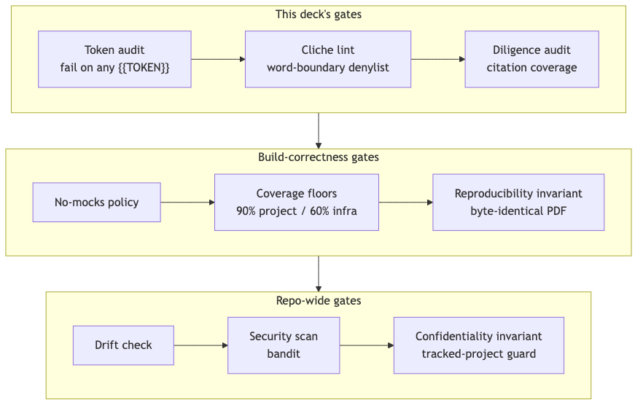

The integrity stack, gate by gate
Source: projects/templates/template_pitch_deck/src/token_resolution.py

Slide 25

Coverage isn't a headline number
• Every one of 24 public exemplars is measured independently, not summarized into one repo-wide percentage.
• The chart on the next slide is generated from the same docs/_generated/COUNTS.md factsheet this deck's own 97.66% figure comes from — one source of truth, two presentations.
Source: docs/_generated/COUNTS.md

Slide 26
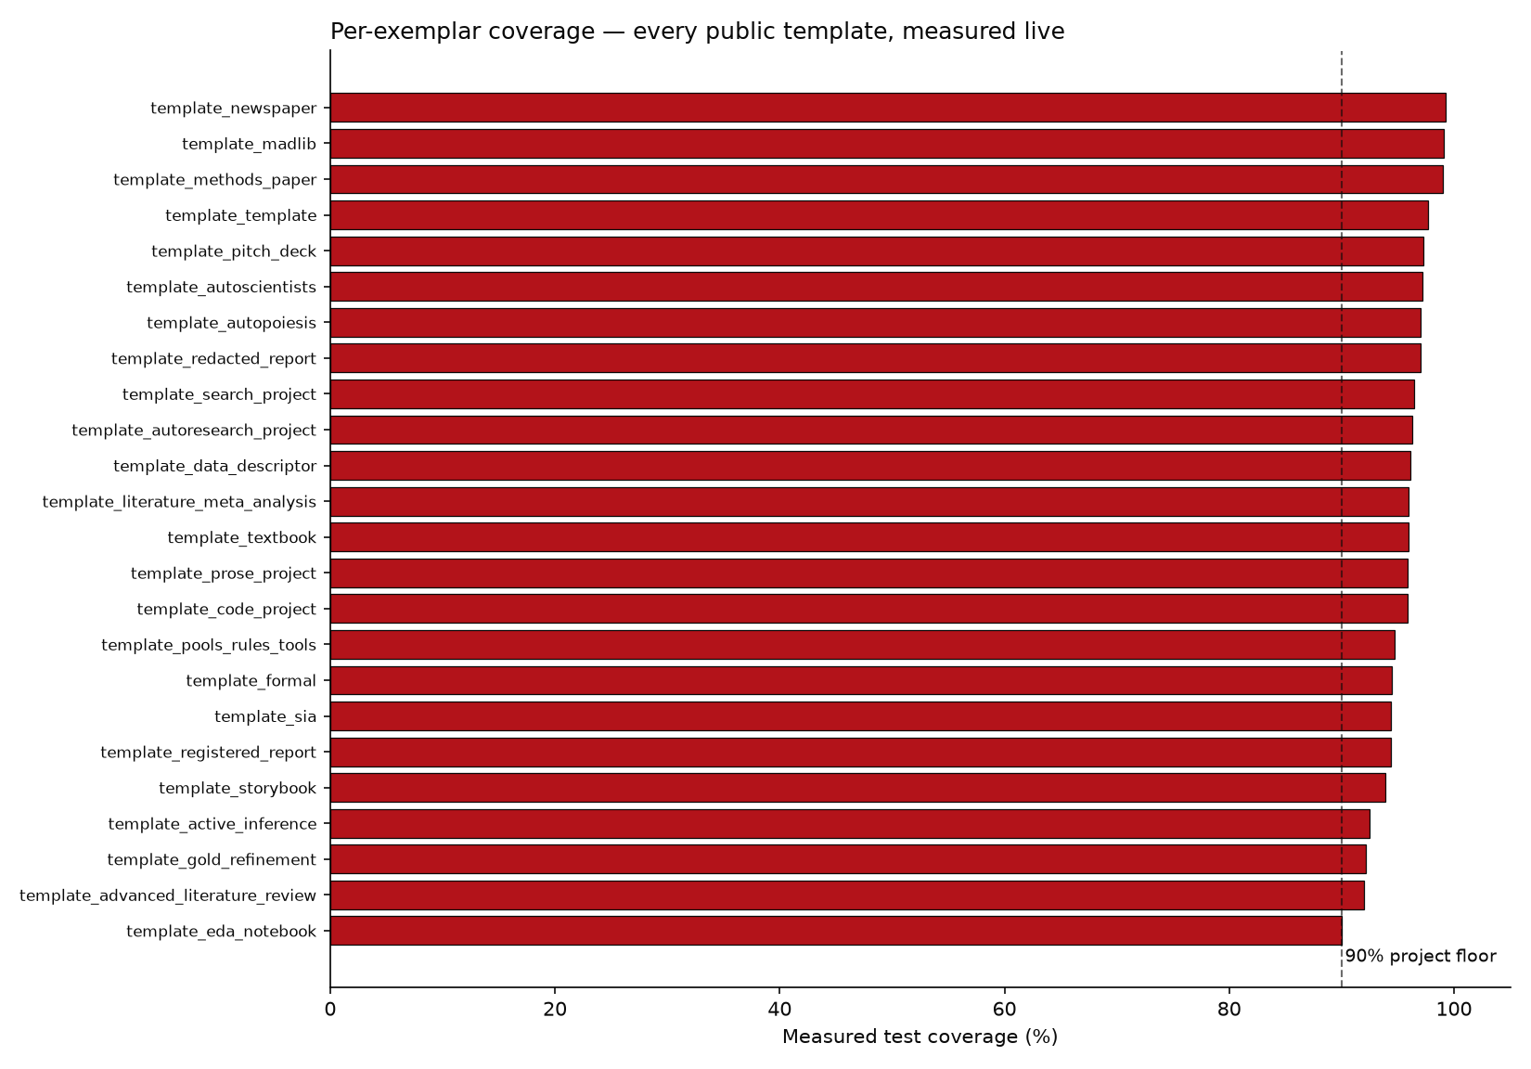

Per-exemplar coverage, measured live
Source: docs/_generated/COUNTS.md

Slide 27
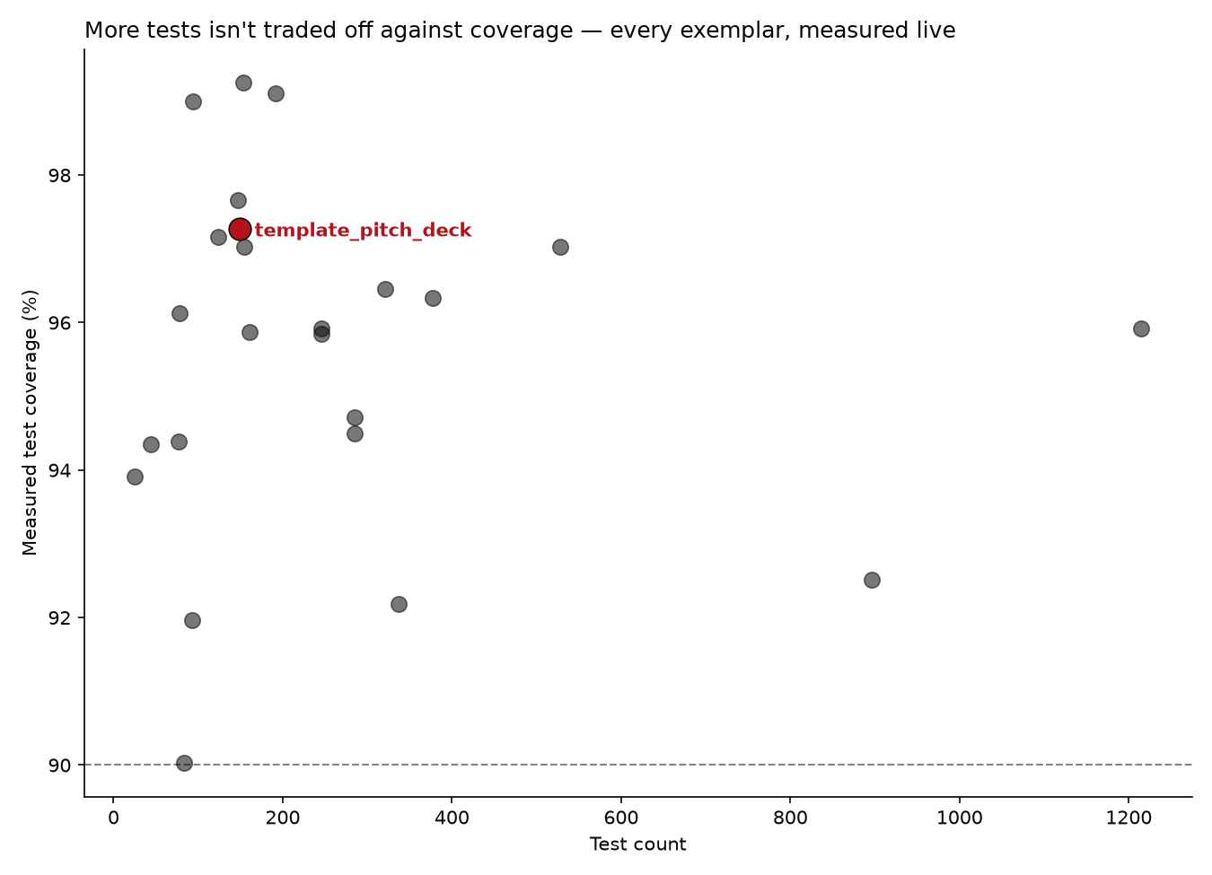

Test volume and coverage aren't a tradeoff
Source: docs/_generated/COUNTS.md

Slide 28

This deck audits itself
• src/token_resolution.py fails the build on any unresolved double-curly-brace placeholder — the same discipline this slide's own template_template token was resolved by.
• src/cliche_lint.py and src/diligence_audit.py both run inside render_orchestration.py itself, before that deck length's own PDF/PPTX is written — a slide referencing a live-sourced token with no citation blocks that length's render, it does not just fail a separate, skippable check.
• None of these checks are generic infrastructure — they are this project's own src/, built specifically because a pitch deck is exactly the kind of document that tempts unverifiable claims.
Source: projects/templates/template_pitch_deck/src/diligence_audit.py

Slide 29

The chain of custody: slide → QR → GitHub
• Every slide in this deck carries its own QR code, linking to a standalone, real Markdown page for that exact slide under output/slides_standalone/.
• Once this output/ directory is committed and pushed, a photo of a projected or printed slide can be traced back to its precise source page on GitHub — not just to the deck as a whole. Locally, the generated page already exists; the QR only resolves once it is actually published.
• Mechanically, this is the same source-citation system with one more hop: a citation links out to evidence; the QR links to the slide's own generated page, which repeats that same citation.
Source: projects/templates/template_pitch_deck/src/standalone_slides.py

Slide 30

Cite this deck
• This pitch deck is its own exemplar in the same monorepo — it has its own src/, tests, and citable identity, distinct from the DOI of template_template, the project it pitches.
• This deck's own DOI: 10.5281/zenodo.21281509.
• That status is read live from this project's own manuscript/config.yaml at render time — the moment a real Zenodo deposit is recorded there, this slide's own text updates on the next regeneration, the same way every other fact in this deck does.
Source: projects/templates/template_pitch_deck/manuscript/config.yaml

Slide 31

What's actually inside infrastructure/

Slide 32

Not a black box
• 25 importable subpackages, 752 tracked Python files total under infrastructure/ — a real inventory anyone can `git ls-files` themselves, not a claimed abstraction.
• The largest single subpackage, core, holds 129 files — still a minority of the whole, not a monolith wearing a modular label.
• Every number on this slide is computed live by src/infra_facts.py at render time, reusing the exact same counters docs/_generated/COUNTS.md is built from.
• The next chart narrows the total to importable subpackages, excluding 2 top-level file(s): infrastructure/__init__.py and mcp_server.py.
Source: projects/templates/template_pitch_deck/src/infra_facts.py

Slide 33
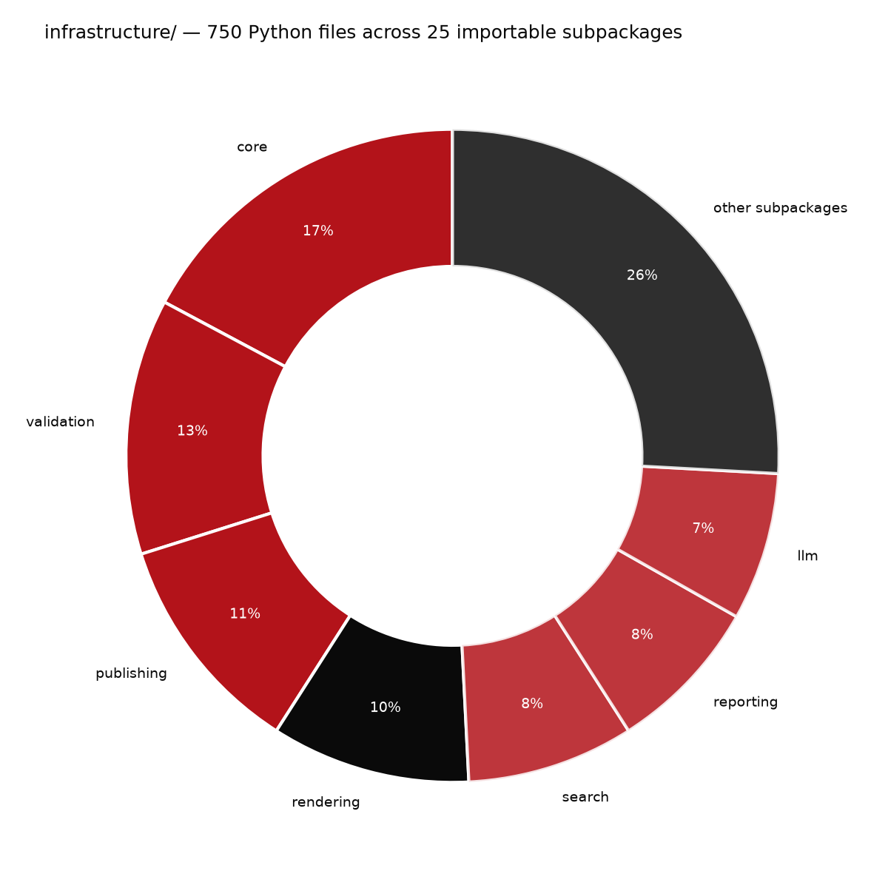

infrastructure/, by subpackage
Source: projects/templates/template_pitch_deck/src/infra_facts.py

Slide 34

Roadmap

Slide 35

What comes next for this exemplar
• Extend token-sourced facts beyond one pitch subject to any exemplar in the roster, so a new deck for a different project needs only new content YAML, not new code.
• Add a second validated pitch (a broader meta-science-group deck) reusing the same rendering and audit pipeline.
• Track deck-generation coverage and drift in the same CI gates that already watch every other public exemplar.

Slide 36

The ask
• Adopt this pattern for your own methods papers: bind every reported number to the code that produced it, not to a hand-typed table.
• Pilot it on one existing manuscript in your group before committing to a full rewrite.
• Happy to pair with your team through a first regeneration cycle and help define your own introspection surface, if useful — no prior engagements to point to yet, this pattern is newly forkable.

Slide 37

Funding & consulting
• The code itself is available to adopt directly today — real, tested, and licensed for reuse, no engagement required to start.
• Open to funding conversations for a dedicated integration (a new pitch subject, a distinct theme, a deeper introspection surface) — no such engagement exists yet, this is an invitation to scope one, not an established program.
• Open to scoping a consulting engagement on request — pairing through a first regeneration cycle, or adapting the two-layer architecture to an existing codebase outside this monorepo. No such engagement has happened yet; this is an invitation, not a track record.

Slide 38

Questions
Research infrastructure that documents itself — a case study for meta-science and science-integrity teams
Notes:
Closing slide — leave contact/repo pointer to the resolved GitHub token.

