Slide 1
Final Four Project
Team Members:
Denton Brosh
Bill McCrosky
Jordan Miller
Dan O’Donnell

Slide 2

Project Background
“…. Since 2016, we have identified how the new regulatory framework will affect manufacturers, wholesaler, retailers and consumers in Colorado.” - Department of Revenue
Starting on January 1, 2019 consumers will be able to purchase beer over 5% sold at retail locations that previously sold only 3.2% beer.

Slide 3
Problem Statement
What impact did the new law have on new liquor openings (count) and locations where new stores are opening.
We focused our data analysis on 4 liquor license types
LIQUOR - FERMENTED MALT BEVERAGE
LIQUOR – RETAIL
LIQUOR - DRUG STORE
LIQUOR – STORE

Slide 4
Data Sources Used
Active Liquor Store License Data
Source: City of Denver Open Data Catalog
https://www.denvergov.org/opendata
See License terms: (CC BY 3.0)
Recently Approved Liquor Licenses in Colorado
Source: Colorado Information Marketplace
https://data.colorado.gov/Business/Recently-Approved-Liquor-Licenses-in-Colorado/htyp-tqzh/data

Slide 5
Data Flow
CO. Open Data
Pandas Data Frames
Data Cleansing Activities
CO Info. Mkt
Google geo code API requests
Google gmap
Final Data Frames
Conclusions

Slide 6
Data Cleansing Activities
Activities
Read license data formatted as CSV into Pandas data frames
Strip out calendar year from license number (e.g 2013-BFN-1065524 )
Identify all grocery stores that hold active liquor licenses
Identify the number of new licenses issued by year
Identify the businesses with liquor licenses issued prior to 2016
Identify the businesses with liquor licenses issued 2016 and after

Slide 7
Google geo code API requests
License data included x and y coordinates which weren’t useable with gmaps <include an example>
Built an API request to pass in the business address from the license data <include an example> requesting the coordinates (i.e. Latitude, Longitude) for each address
Issues encountered
Coordinates were for locations outside of Denver
Ownership vs. physical location
Similar addresses in multiple cities
Specified bounds on the API Request for SW Denver to NE Denver

Slide 8
Create Final Data Frames
Appended the Latitudes and Longitudes to the master dataframe
Created 3 separate data frames
Grocery stores that sell full strength beer
Businesses with liquor licenses issued prior to 2016
Business with liquor licenses issued 2016 and after

Slide 9
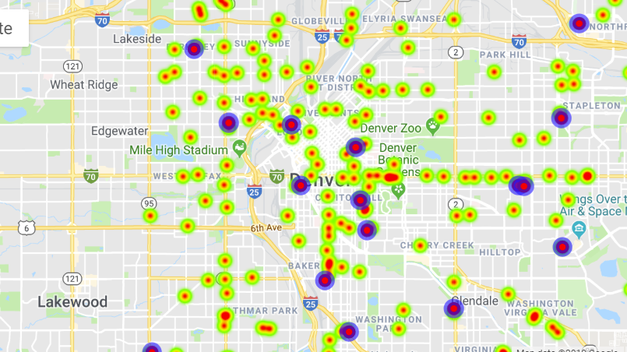
Google gmap
We could not get the hover_over feature to work so we used the info_box_content instead.

Slide 10
Conclusions – Liquor Store Openings
Bar chart here
Bar chart comments

Slide 11
Conclusions – Placement of New Liquor Stores

Slide 12
Conclusions – Who are the new entrants?

Slide 13
Post Mortem
What did we learn
90/10 - 90% of the time sourcing, transforming, syntaxing, troubleshooting (Data Jockeying); 10% - concluding
Inherent risk of data mining bias (impact of the many assumptions)
What would we do differently
What did we want to do

