Slide 1
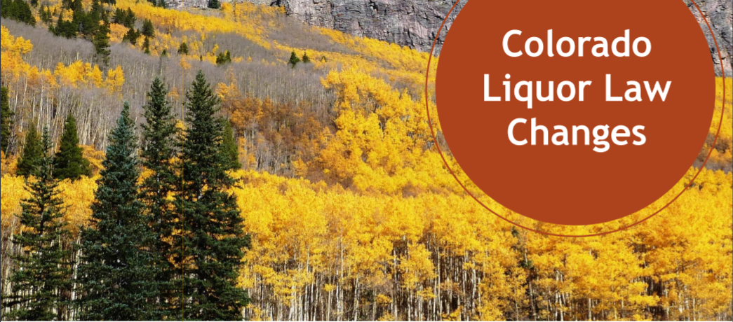
Final Four Project
Team Members:
Denton Brosh
Bill McCrosky
Jordan Miller
Dan O’Donnell

Slide 2
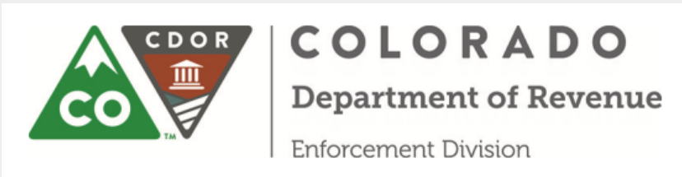
Project Background
Starting January 1, 2019 consumers will be able to purchase full-strength beer at retail locations (Retail liquor stores (RLS), liquor-licensed drugstores (LLDS) and fermented malt beverage (FMB) off-premises licensees) which previously sold only 3.2% strength beer.
- This does not include wine and spirits, both of which continue to be sold only at shops of licensed independent liquor retailers
“…. Since 2016, we have identified how the new regulatory framework will affect manufacturers, wholesaler, retailers and consumers in Colorado.” - Department of Revenue

Slide 3
Problem Statement
How large of an impact does new state law have on current independent liquor retailers, number of recently submitted independent liquor licenses applications (count) and locations where new stores are opening?
In order to answers these questions, we focused our data analysis on 4 liquor license types
LIQUOR - FERMENTED MALT BEVERAGE
Grocery Stores (think King Soopers, Safeway, etc.)
LIQUOR – RETAIL
Big Box Retailers (think Target, Wal-Mart, etc.)
LIQUOR - DRUG STORE
Pharmacies (think CVS, Walgreens, etc.)
LIQUOR – STORE
Independent Retail Liquor Stores (think Morgan’s Liquor down the street)

Slide 4
Data Sources Used
Active Liquor Store License Data
Source: City of Denver Open Data Catalog
https://www.denvergov.org/opendata
See License terms: (CC BY 3.0)
Recently Approved Liquor Licenses in Colorado
Source: Colorado Information Marketplace
https://data.colorado.gov/Business/Recently-Approved-Liquor-Licenses-in-Colorado/htyp-tqzh/data
Google geocodes – some x and y coordinates from the above data sources weren’t usable in our google maps data visualization

Slide 5
Data Flow
CO. Open Data
Pandas Data Frames
Data Cleansing Activities
CO Info. Mkt
Google geo code API requests
Google gmap
Final Data Frames
Conclusions

Slide 6
Data Cleansing Activities
Activities
Read license data formatted as CSV into Pandas data frames
Strip out calendar year from license number (e.g. 2013-BFN-1065524)
Identify all grocery stores that hold active liquor licenses
Identify the number of new licenses issued by year
Identify the businesses with liquor licenses issued prior to 2016
Identify the businesses with liquor licenses issued 2016 and after

Slide 7
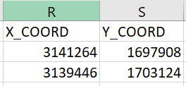

Google geo code API requests
License data included x and y coordinates which weren’t useable with gmaps
Built an API request to pass in the business address from the license data
Issues encountered
Coordinates were for locations outside of Denver
Similar addresses in multiple cities
Specified bounds on the API Request for SW Denver to NE Denver

Slide 8
Create Final Data Frames
Appended the Latitudes and Longitudes to the master data frame
Created 3 separate data frames from master data frame:
Grocery stores that sell full strength beer
License Type: Liquor – Fermented Malt Beverage & Liquor - Retail
Businesses with liquor licenses issued prior to 2016
License Type: Liquor - Store
Business with liquor licenses issued 2016 and after
License Type: Liquor - Store

Slide 9
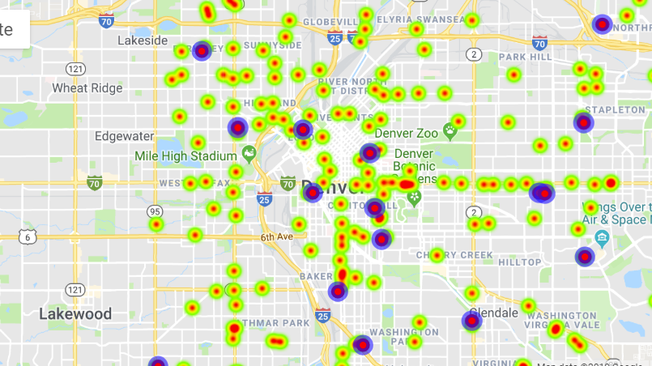
Google gmap
We could not get the hover_over feature to work so we used the info_box_content instead.

Slide 10
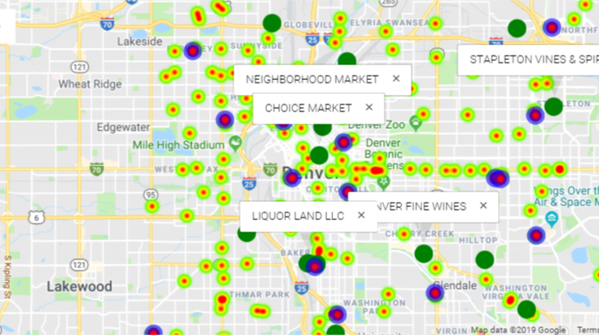
Conclusions – Who are the new entrants?
- Grocery Stores? No
- Big Box Retailers? No
- Pharmacies? No
Independent Retailers

Slide 11
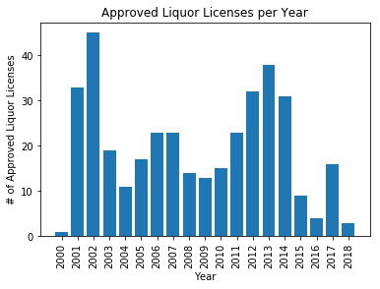
Conclusions – Liquor Store Openings
Clear decline in number of approved liquor licenses beginning in 2015 (law began to take shape in 2016 before it was instituted on 1/1/19).
Either Prospective Independent Liquor Retailers forecast business would not be profitable due to new law OR the state of CO approves a fixed number of Liquor Licenses (now including RLS, LLDS, and FMB licenses) to public and new entrants have taken a greater percentage of approved licenses.

Slide 12
Conclusions – Placement of New Liquor Stores
We can’t make a completely informed prediction regarding the placement of new liquor stores in Colorado
Is this due to the lack of data available on effects of new law? Expand on how the data is relatively new and cannot provide enough foresight to make an accurate prediction
Under new law, retailers recently approved to sell full strength beer are not to be located within 1500 feet of independent liquor retailers – this has yet to be put into full effect – do “fine print” sections of new law take time to fully develop or is something else driving the lack of legislation enforcement?
“(Across Corona Street is) the first public school built in Denver. From (the school’s) door to (King Sooper’s) door, it’s not even 400 feet. The old law was 500. If you go by the old variances, that school is way too close for them to have alcohol. If you go by the bill passed originally, we’re so close that King Soopers should have bought us out before they could attain the beer. But because of the lobbying of Coors mostly and some other companies, they gave this specific King Soopers a variance.” – Businessden.com
From our research, assuming all parts of new law are put into place as 2019 progresses, we hope to see the locations of newly minted full beer retailers to adhere to new law requirements in relation to independent liquor retailers

Slide 13
CONCLUSIONS – EFFECTS OF NEW LAW TOWARDS INDEPENDENT LIQUOR RETAILERS
Will the new liquor laws in Colorado put independent liquor retailers out of business?
Unfortunately, it’s to early to predict. The new law has been in place for just over four months; sales figures from both independent retailers and new entrants are not yet publicly available.
11 News reached out to grocery stores like Safeway and King Soopers to see how the law change impacted their beer sales. Both chains said they could not release specific numbers for competitive reasons but said customers are responding well. – KKTV 11 News
Interviews with an array of independent liquor retailers regarding the new law effects have yielded mixed results:
“My beer sales are about only 20-25 percent. I’m about 50 percent liquor,” said Gregor Huesgen, who owns Downtown Fine Spirits and Wines. “I basically planned for that in the last 3-4 years.” – KKTV 11 News
“I think people just braced for World War III, and it wasn’t bad at all,” said Justin Roach, the general manager for Veterans Wine and Liquor. “It was actually pretty laid back. We have a very, very good customer base, and they just stuck with us. We’ve been doing great.” – KKTV 11 News
“It’s going to affect a lot of small business owners. We can’t compete with King Soopers and Safeway. They can afford to buy hundreds of cases, because they’re a corporation. I can’t afford that. The law isn’t fair. I heard 300 small businesses in Colorado are going to be closed. “ – businessden.com
“It’ll affect our business tremendously. Over 60 percent of our revenue is from beer sales. We have a strong customer base, but we’ve heard a lot of people say that one-stop shopping is easier for them. So that hurts us.” – businessden.com

Slide 14
Post Mortem
What did we learn
90/10 - 90% of the time sourcing, transforming, syntaxing, troubleshooting (Data Jockeying); 10% - concluding
Inherent risk of data mining bias (impact of the many assumptions)

