Slide 1
GIT & GITHUB
Manasa Dodda
Miracle Software Systems, Inc.

Slide 2
Agenda
Version Control Git GitHub Workflow of Git Three Main Threes Key Concepts

Slide 3
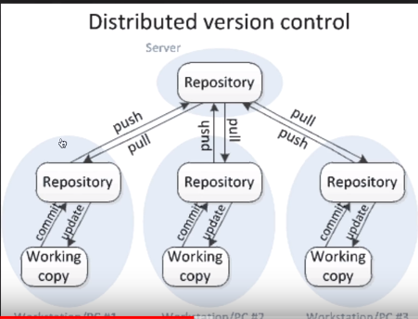
What is Version control ?
A system that keeps records of your changes Allows for collaborative development Allows you to know who made what changes and when Allows you to revert any changes and go back to a previous state

Slide 4
What is Git ?
Started in 2005 Distributed version control Users keep entire code and history on their location machines Users can make any changes without internet access (Except pushing and pulling changes from a remote server) Install Git: Windows - http://git-scm.com/download/win After installing Git in your Windows system, just open your folder/directory where you want to store all your project files; right click and select ‘Git Bash here’.

Slide 5
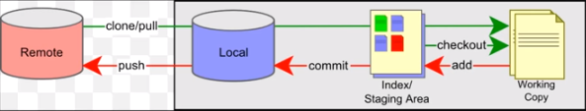
What is GIT HUB ?
A website to upload your repositories online Provides backup Provides visual interface to your repo Makes collaboration easier Work flow of Git:

Slide 6
Three main trees:
There are a lot of ‘states’ and ‘places’ a ﬁle can be : Working directory: Local on your computer Staging/index: When a ﬁle is ready to be put in a commit you add it onto the ‘index’ or ‘staging’ using $ git add filename.extension Commit history: This commits your changes to the repository with an explanation message. Files are added to the local repo using $ git commit -m “message” Every commit has a hash code which looks like “4aa7a6f26459b161b6ce96903a9bc066efae1dfc”

Slide 7
Key Concepts: Repositories (‘repo’)
A collection of all the ﬁles and the history(commits) of those ﬁles. Can live on a local machine or on a remote server (GitHub!) The act of copying a repository from a remote server is called cloning Cloning from a remote server allows teams to work together, a folder is created after cloned in the local $ git clone <repo url from GitHub account> The process of downloading commits that don’t exist on your machine from a remote repository is called pulling changes $ git pull --all The process of adding your local changes to the remote repository is called pushing changes $ git push -u origin master

Slide 8
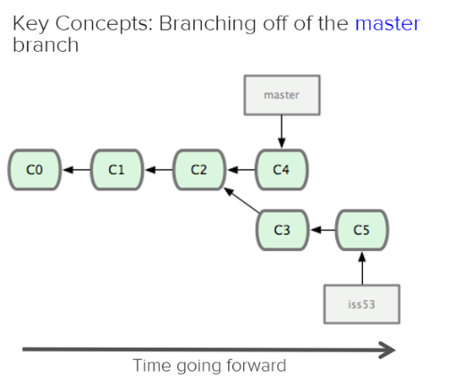
Key Concepts: Branches
All commits in git live on some branch contained in a repository.
The main branch in a project is called the ‘master’ branch
When you want to make any changes to your project you make a new branch based on a commit.
$ git branch branch-name
$ git branch
$ git branch -d branch-name
$ git push origin :branch-name
$ git branch -a --contains <commit-id>

Slide 9
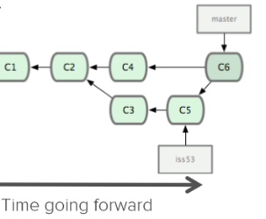
Key Concepts: Merging
Once you’re done with your feature, you merge it back into master using
$ git merge branch-name

Slide 10
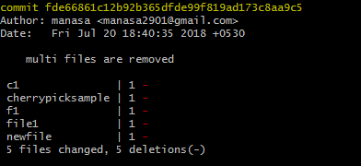
Key Concepts: Get information about things
To view the commit history,
$ git log
It has different options:
To view last two commits,
$ git log -2
To view abbreviated state for each commit,
$ git log --stat
To print each commit on a single line,
$ git log --pretty=oneline

Slide 11


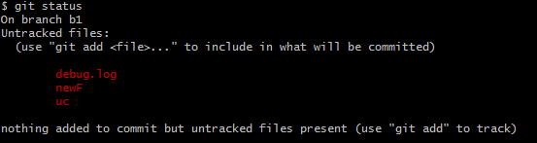
Cont..
To view in a format,
$ git log --pretty=format:"%h - %s“
To show the working tree status,
$ git status

Slide 12

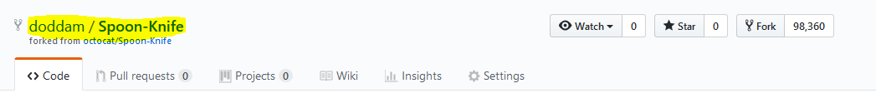
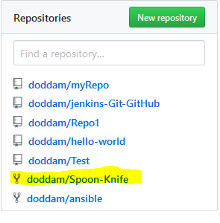
Key Concepts: Forking
A fork is a copy of a repository. To fork a repo, need to go for repo required and click on fork symbol Asks for GitHub credentials, provide it. Now, you have a fork of the original octocat/Spoon-Knife repository, can check your repositories list now

Slide 13
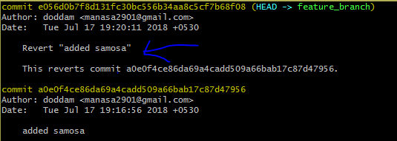
Key Concepts:
Checkout: Undo uncommitted changes, $ git checkout - - filename Revert: Undo committed changes using revert. Changes are committed explicitly, $ git -n revert <commit-id> changes are directly committed, $ git revert <commit-id>

Slide 14
Cont..
Reset: When you have made some changes, you no longer wanted them to be committed you just wanted to go back to the older clean state $ git reset --hard HEAD This can be used to remove commits from the current branch. Stashing: Use $ git stash save "message“ to save changes temporarily in local memory. $ git stash list $ git stash apply <stash-name> $ git stash pop $ git stash drop $ git stash drop <stashid> $ git stash clear

Slide 15
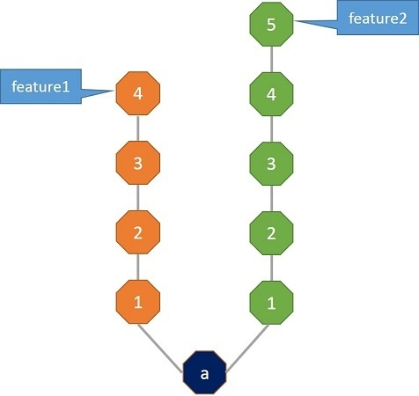
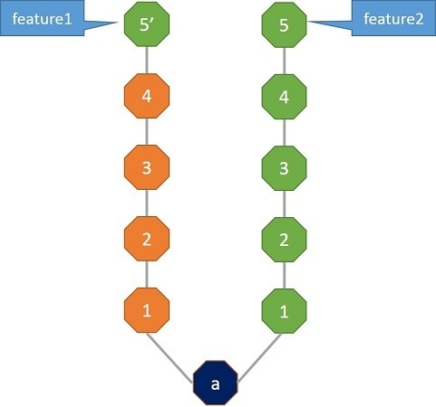
Cont..
Cherry-pick: Cherry-pick simply means picking a commit from a branch and applying that commit onto another branch. $ git cherry-pick COMMIT-ID

Slide 16
THANK YOU!

