Slide 1

COLOR RECOGNITION
DODDA SAI SACHIN
41611044
CSE WITH SPECIALIZATION IN ARTIFICIAL INTELLIGENCE AND MACHINE LEARNING
Guided by :
Internal Guide Name

Slide 2
Presentation Outline
Abstract
Introduction
Objective
Existing Availabilities
Disadvantage of existing Product
System Architecture / Ideation Map
Design Requirements
Product Working Principle
Application - Snapshots
Reference

Slide 3
Abstract
Extract colors from Image
dynamic and user-friendly solution
Complementary colors
The interactive web interface
Real-time visualization

Slide 4
Introduction
In the world of design, color selection plays a pivotal role in conveying emotions, aesthetics, and messages.
This project introduces a powerful and interactive tool designed to simplify the process of creating captivating color palettes from images.
By harnessing advanced algorithms, including color quantization and luminance-based sorting.

Slide 5
Introduction
Additionally, it identifies complementary colors to offer users a well-rounded selection for their creative projects.
Through an intuitive web interface, users can effortlessly upload images and witness the instant transformation into harmonious color schemes

Slide 6
Objectives
The primary objective is to build a user-friendly, web-based application .
The project aims to accurately extract dominant colors from images while preserving their visual harmony.
The tool should offer real-time visualization of color palettes as users upload and adjust images.
Ensure that the tool is accessible on multiple platforms.

Slide 7
Objectives
Implement stringent privacy and security .
Develop an intuitive and user-friendly interface

Slide 8
Existing Availabilities
Colormind : Colormind is an AI-driven color palette generator that can create color schemes from images or generate random palettes. It also provides color accessibility information.
ColorZilla (Browser Extension):ColorZilla is a browser extension available for Firefox and Chrome. It provides an eyedropper tool for identifying colors on web pages and creating color palettes.

Slide 9
Disadvantages of the existing Product
Lack of Real-time Visualization
Dependency on Internet Connection
Limited Complementary Color Identification

Slide 10
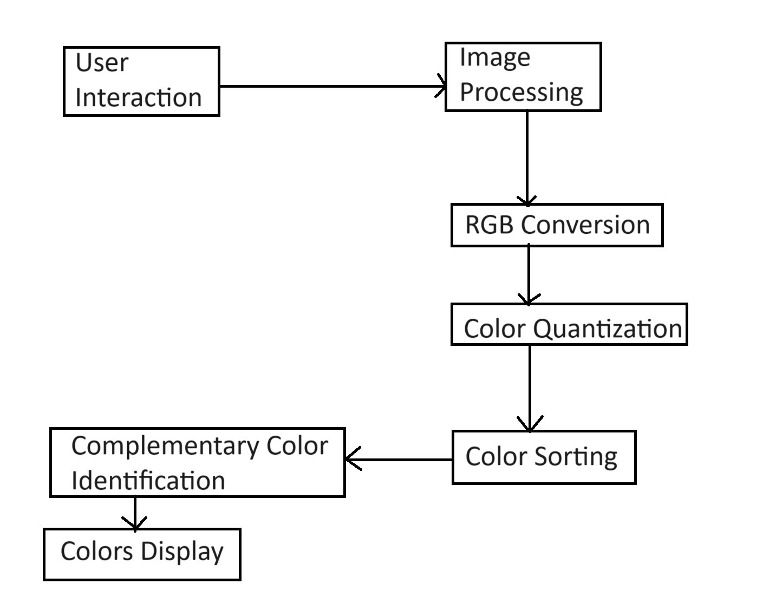
System Architecture / Ideation Map

Slide 11
Design Requirements
Software Requirements
Web Development Environment
Web Browser
Web Hosting

Slide 12
Design Requirements
Hardware Requirements
Development Machine : A computer with sufficient processing power, memory, and storage for web development tasks
Operating System: Windows 8, Windows 10, MAC OS, Linux.
Internet Connection : A reliable internet connection for development, testing, and deployment.

Slide 13
Product working principle
Image Upload and Processing
RGB Conversion
Color Quantization
A color quantization algorithm groups similar colors together and creates a representative set of dominant colors.

Slide 14
Product working principle
Color Sorting
Complementary Color Identification
Palette Display
Real-Time Visualization

Slide 15
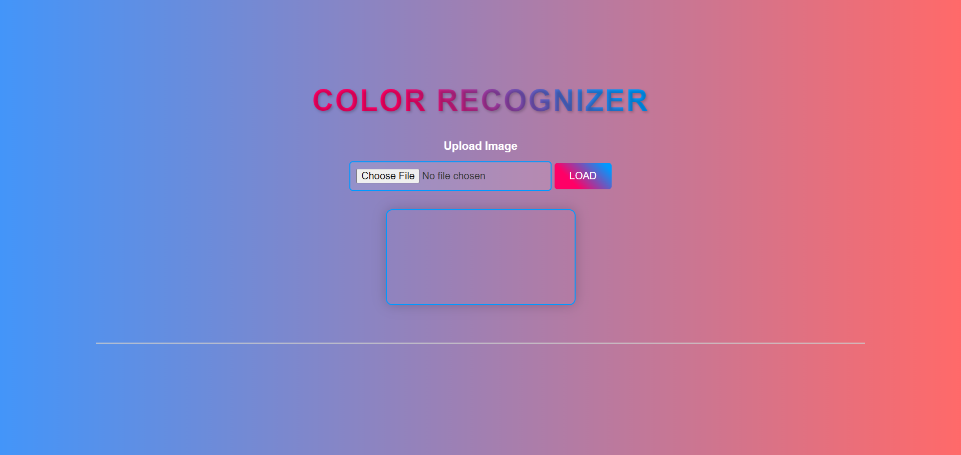
Application - Snapshots

Slide 16
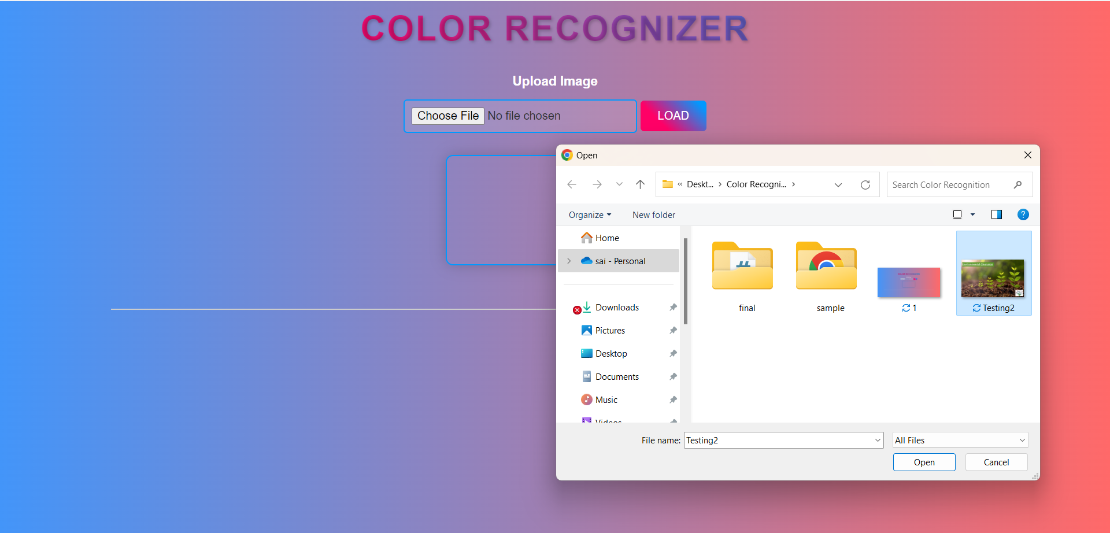
Application - Snapshots

Slide 17
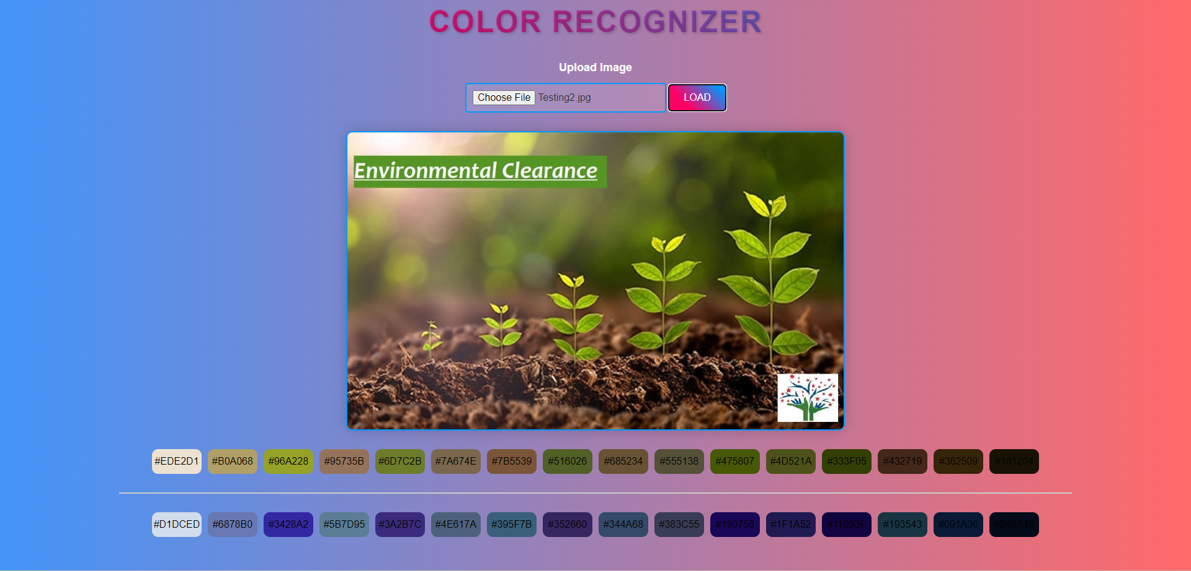
Application - Snapshots

Slide 18
Reference
Detect color objects : https://medium.com/swlh/detect-color-objects-with-tracking-js-623a15b14732
Colour Detection using Pandas & OpenCV : https://data-flair.training/blogs/project-in-python-colour-detection/
Simple Color Recognition : https://www.youtube.com/watch?v=t71sQ6WY7L4
How to Identify Colors in Javascript : https://stackoverflow.com/questions/10773441/how-to-identify-colors-in-javascript

Slide 19

THANK YOU

