Slide 1
Enhanced MODNet: Incorporating Feature Interactions for Improved Human Matting
G23
Boya Wang u7632096 & Yiling Xie u6968972

Slide 2
Content
Problem Motivation
Problem Description
Existing works
Method
Evaluation
Conclusion & Future Work

Slide 3
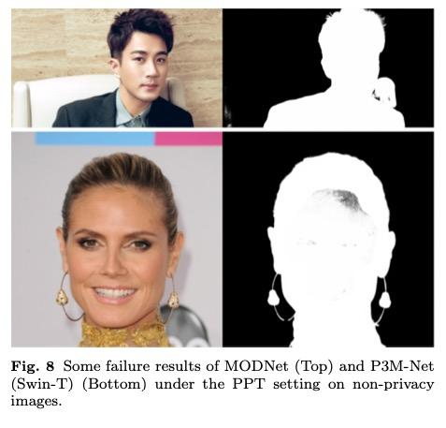
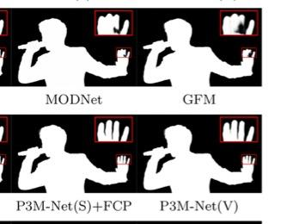

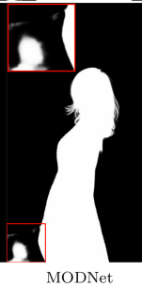
Problem Motivation
Addressing MODNet Limitations
Incorporating Feature Interactions
Utilizing Real-World Complex background Dataset
Minimizing Disparity
Modnet Global Semantics Fault
Modnet Locality Fault

Slide 4
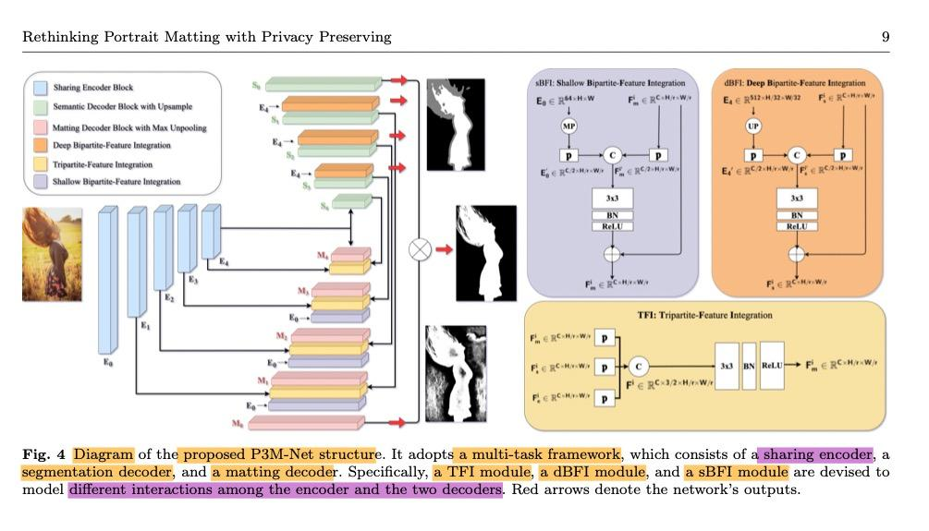
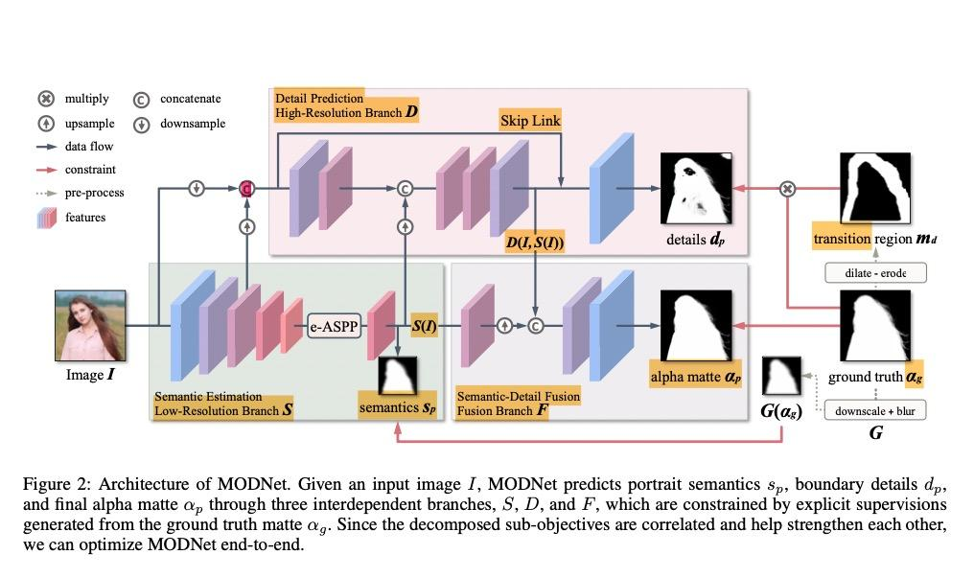
Problem Description
Enhance the interaction of encoder and decoder
Use backbone with attention mechanism

Slide 5
Existing works
EXISTING MODEL
PROBLEM
NOVELTIES/CONTRIBUTIONS
Trimap-Free
SHM (Chen et al., 2018)
HAtt (Qiao et al., 2020)
SHMC (Liu et al., 2020)
GFM (Li et al., 2022)
MODNet (Ke et al., 2020)
P3M (Ma et al., 2023)
MODNet often struggle with correctly predicting the context due to their inability to explore feature interactions between the encoder and decoder.
Address these limitations
Use of UGD-12k with complex background
P3M-Net
Strong emphasis on modeling the interactions between encoders and decoders to enhance privacy-insensitive matting

Slide 6
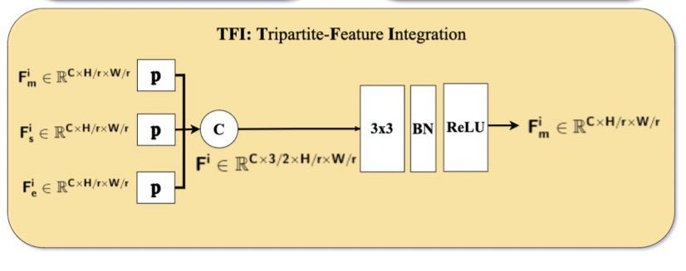
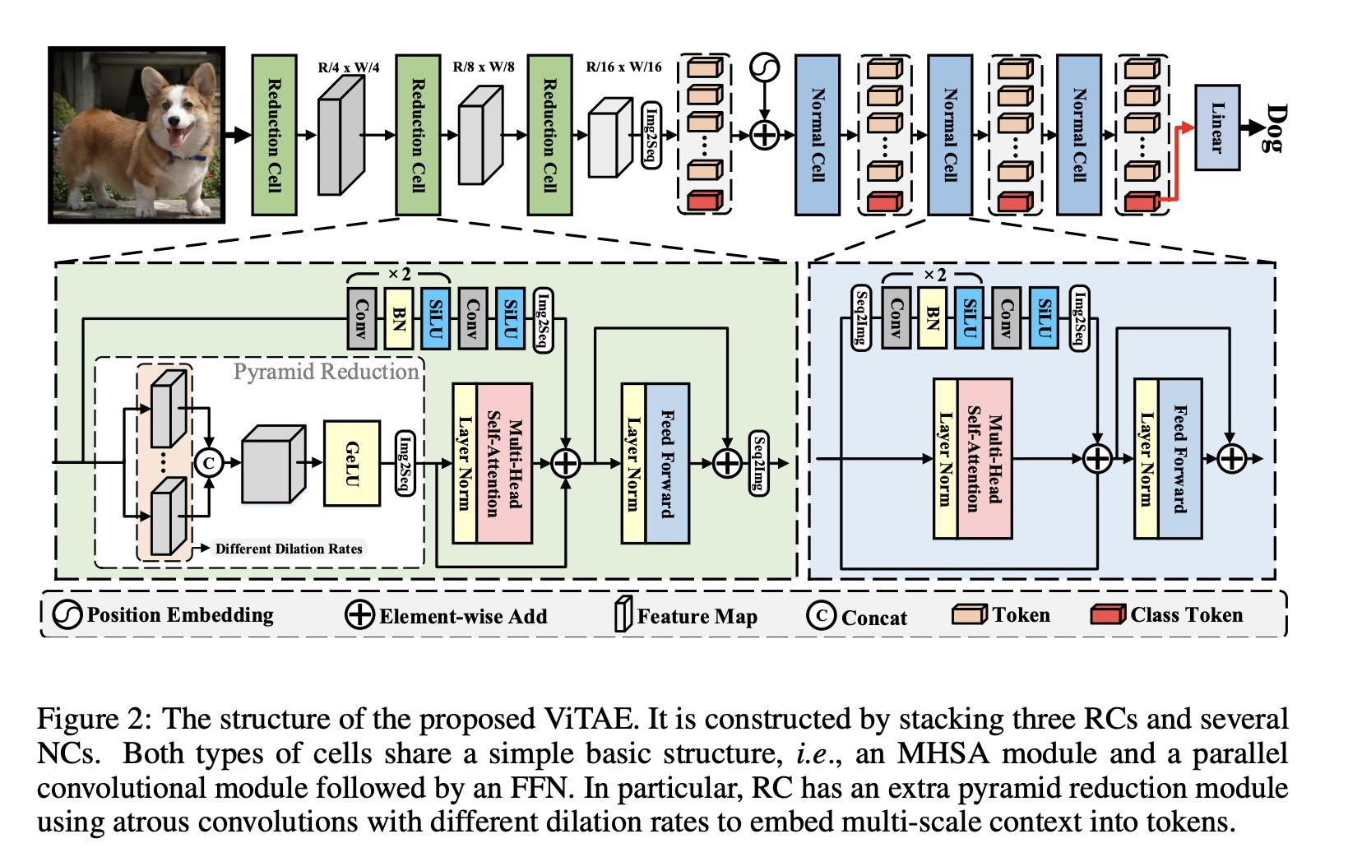
Method
Framework:
Parallel CNN + Encoder-Decoder
Contributions:
TFI: Interaction between encoder and decoder
ViTAE-S: Attention Mechanism

Slide 7

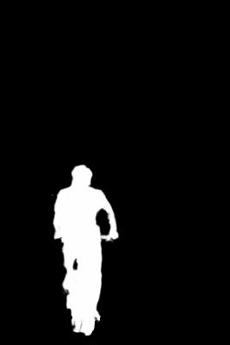

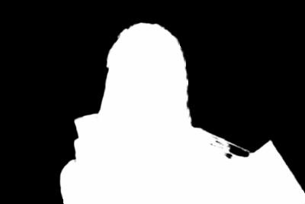
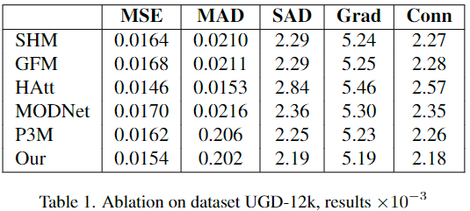


Evaluation
Qualitative:
UGD-12k Testing Set (image, alpha)
Quantitative:
Mean Squared Error (MSE)
Mean Absolute Difference (MAD)
Sum of Absolute Differences (SAD)
Gradient (Grad.)
Connectivity (Conn.)

Slide 8
Conclusion & Future Work
Conclusion:
Interaction of Encoder and Decoder in end-to-end models brings improvement in global semantics
Attention mechanism can enhance the locality performance of matting models
Future Work:
Apply enhanced MODnet to videos
Test for performance on different resolution data

Slide 9
Thank you for watching and listening!
Q&A

Slide 10
References
Xu Y, Zhang Q, Zhang J, et al. Vitae: Vision transformer advanced by exploring intrinsic inductive bias[J]. Advances in neural information processing syXu Y, Zhang Q, Zhang J, et al. Vitae: Vision transformer advanced by exploring intrinsic inductive bias[J]. Advances in neural information processing systems, 2021, 34: 28522-28535.stems, 2021, 34: 28522-28535.
Ma S, Li J, Zhang J, et al. Rethinking portrait matting with privacy preserving[J]. International journal of computer vision, 2023: 1-26.
Ke Z, Sun J, Li K, et al. Modnet: Real-time trimap-free portrait matting via objective decomposition[C]//Proceedings of the AAAI Conference on Artificial Intelligence. 2022, 36(1): 1140-1147.

