Slide 1
Privacy-Preserving Data Publishing (PPDP)
Máster en Seguridad Informática (Ciberseguridad)
Juan Manuel Dodero University of Cadiz, Spain

Slide 2
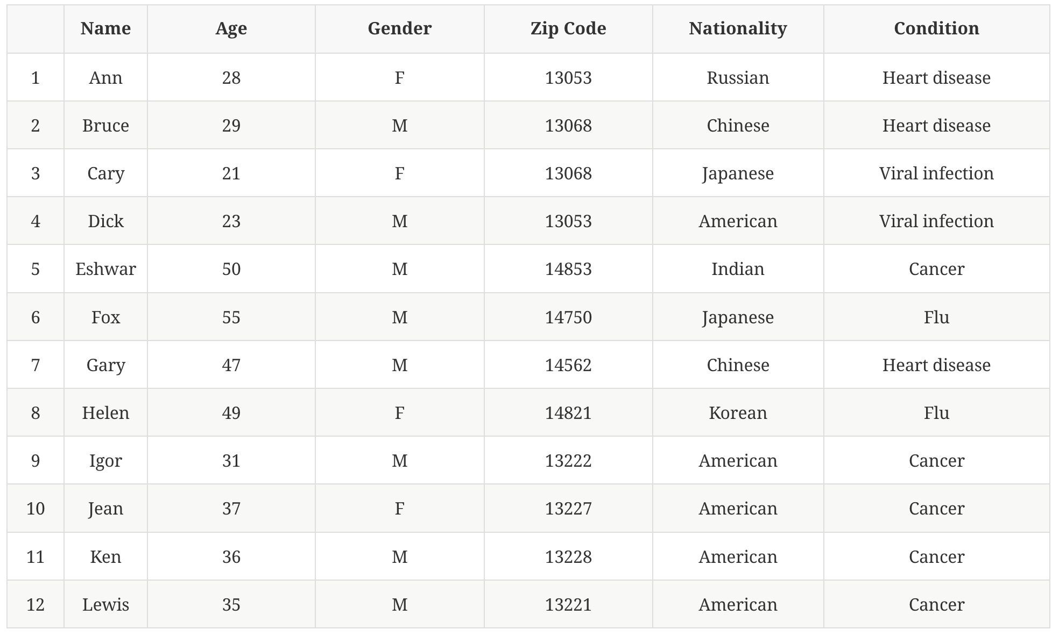
linking attack
Is it safe to remove name and release the dataset?

Slide 3
linking attack
an attacker might obtain voter registration lists and find out:
the only 28-year-old female (F) living in 13053 is #1
can almost be sure that #1 is Ann’s
⇒ discovers Ann’s disease
table is not k-anonymous

Slide 4
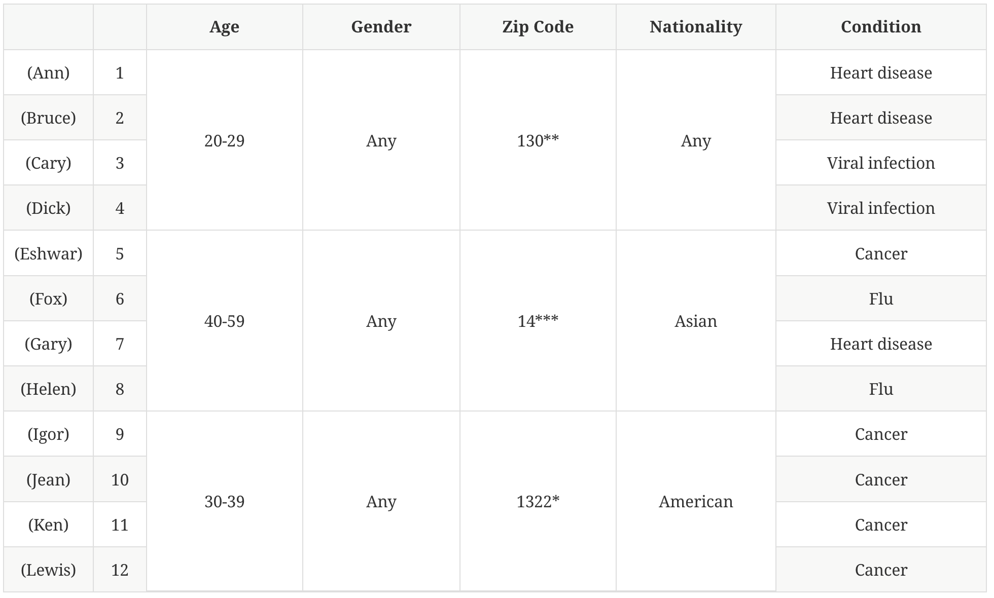
privacy criterion – e.g. k-anonymity
e.g. 4-anonymous table
definition:
given a set of Quasi-Identifying attributes Q₁,...,Q_{d}, release candidate D∗ is said to be k-anonymous with respect to Q₁,...,Q_{d} if each unique tuple in the projection of D∗ on Q₁,...,Q_{d} occurs at least k times
safe for linking attacks
unsafe for other attacks (e.g. individuals 9-12)

Slide 5

public data
data aggregation
contingency tables
microdata (non-aggregate)
confidentiality mechanisms
cell suppression [1]
data swapping [1, 2]
sampling, geographic coarsening, top/bottom coding [2]
synthetic data [2]

Slide 6
sanitization mechanisms
generalization
coarsening some attribute values in the original table
suppression
replacing some attribute values (or parts of values) by a special symbol
swapping
swapping some attribute values
bucketization
(1) partition the original table into non-overlapping groups (buckets); (2) release projection on the non-sensitive + sensitive attributes
randomization
add random noise; sanitized data are sampled from a probability distribution [synthetic data] or created by perturbing the values
multi-view release
release multiple views of a single dataset after applying one or more of the former sanitizing methods

Slide 7
sanitization mechanisms
examples on data privacy by
B.C. Chen, D. Kifer, K. LeFevre & A. Machanavajjhala: “Privacy-Preserving Data Publishing,” Foundations and Trends in Databases, 2 (1–2), pp. 1-167

Slide 8
quasi-identifiers
medical record table

Slide 9
generalized medical record table
(version 1)
suppression
generalization
(equivalence classes)

Slide 10
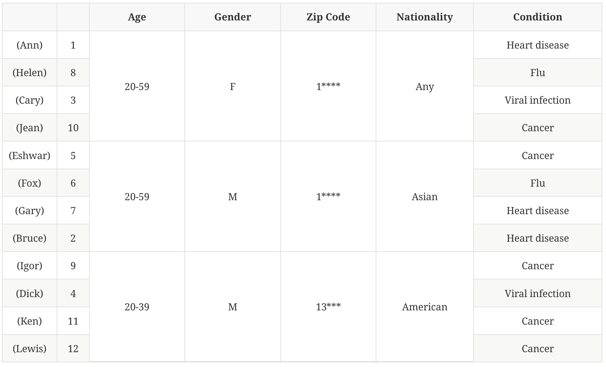
generalized medical record table
(version 2)
suppression
generalization
(equivalence classes)

Slide 11
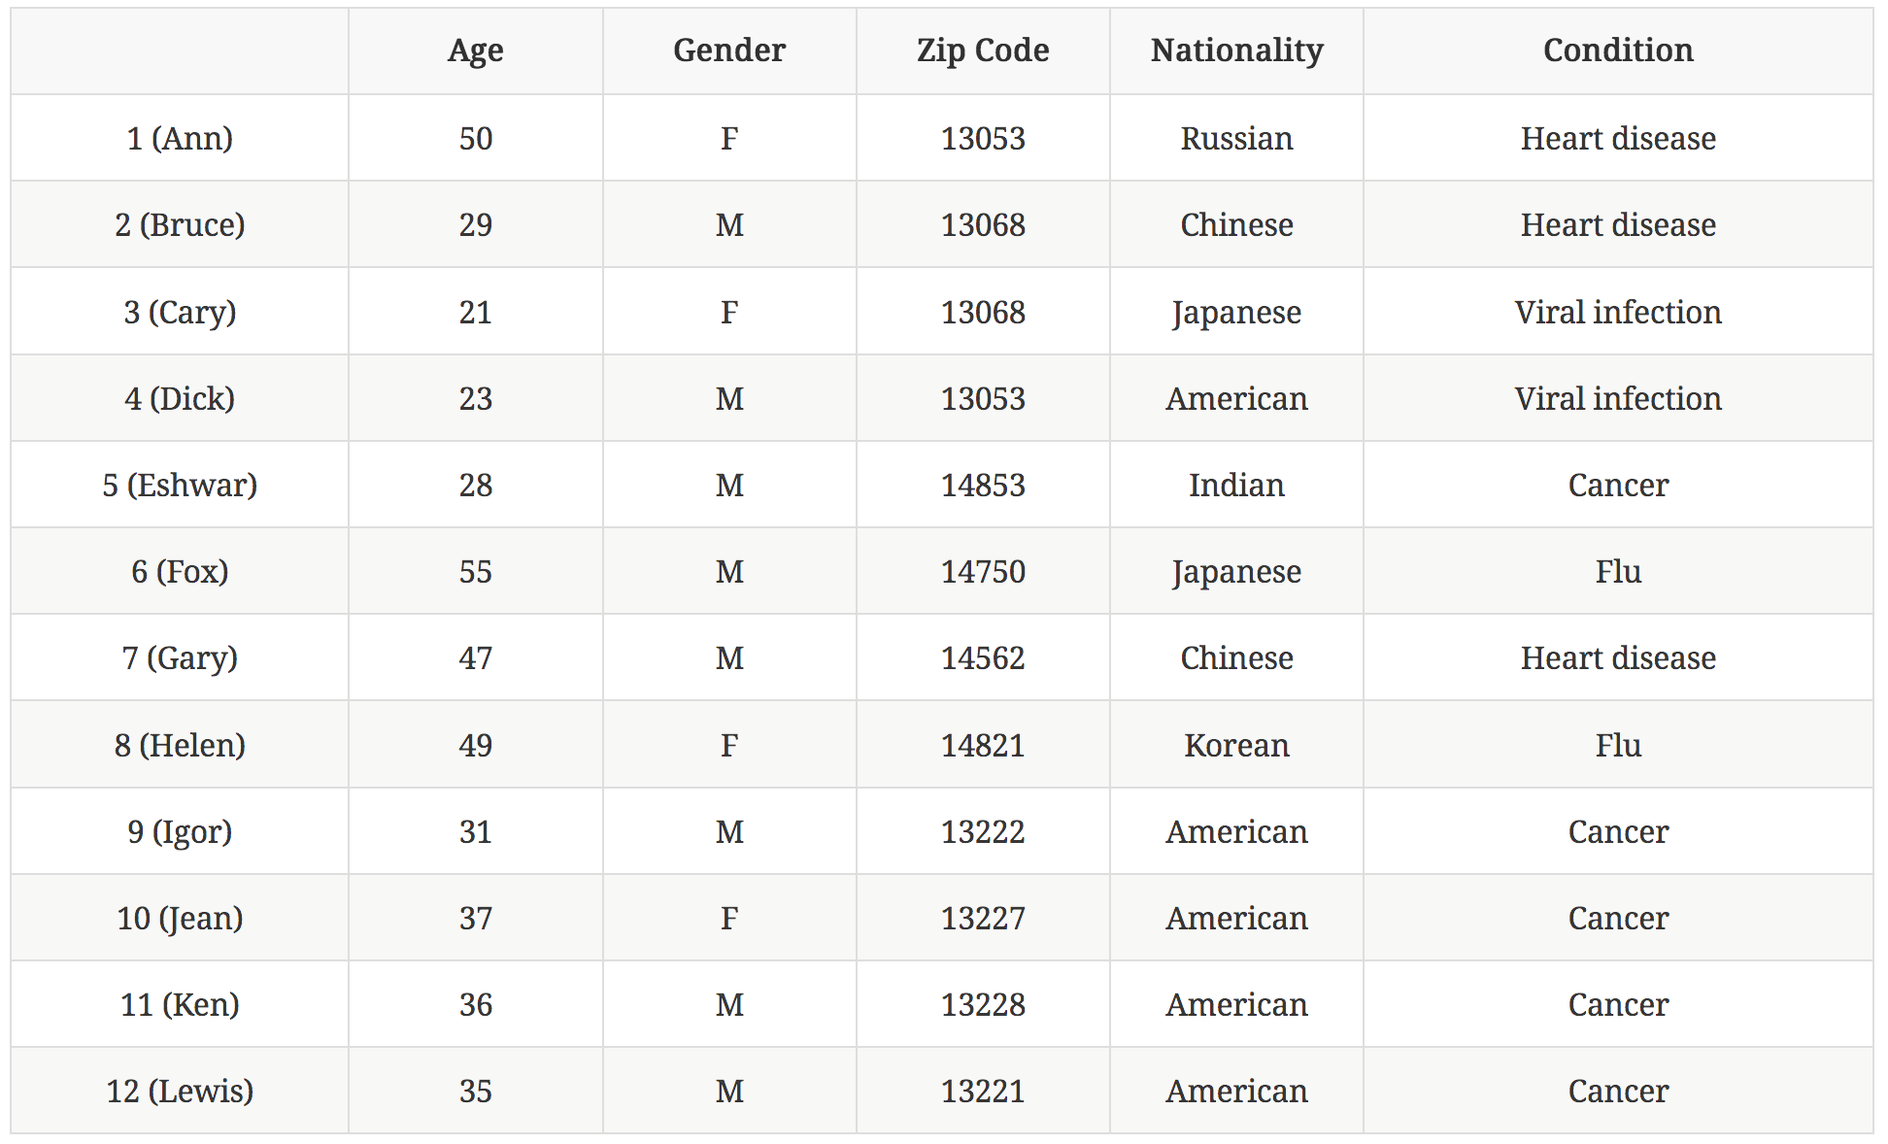
swapping
swapped records
swapping

Slide 12
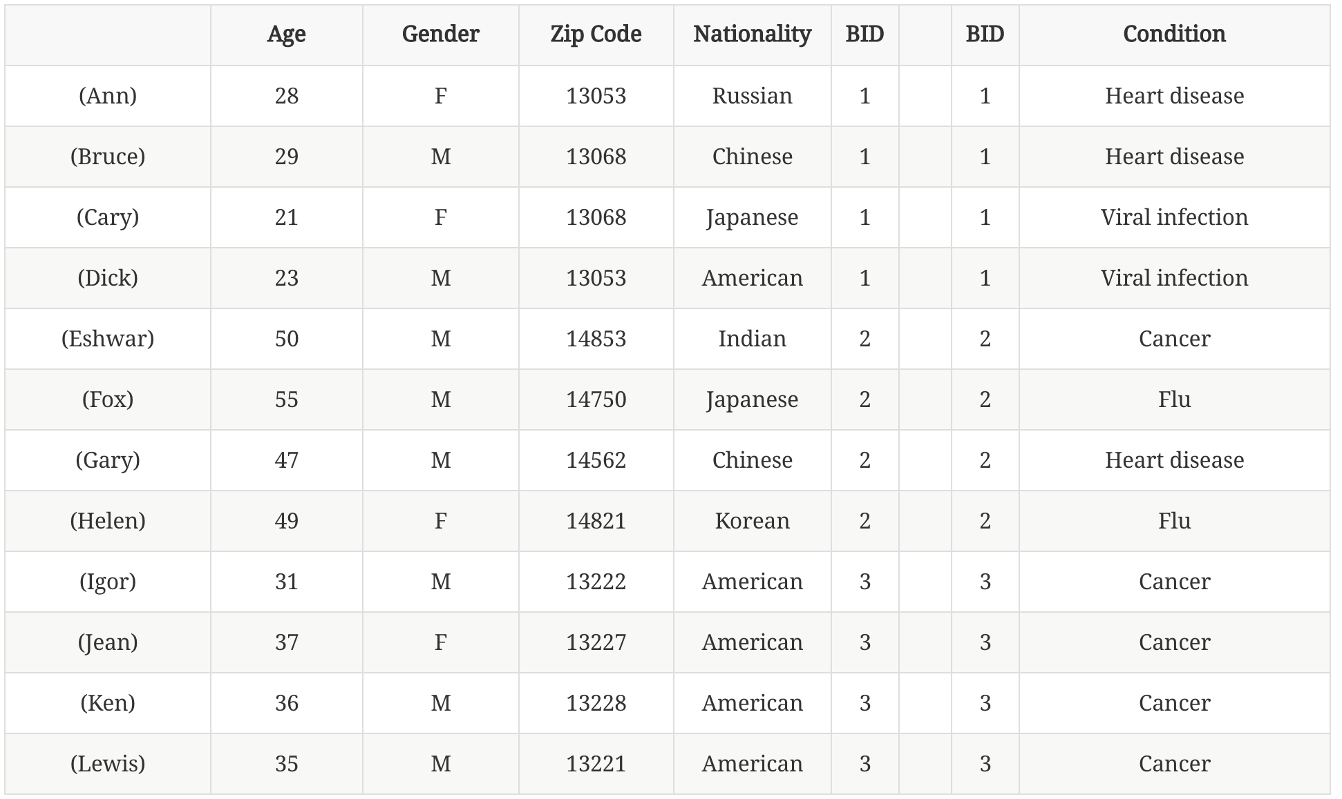
bucketization
partitioning in non overlapping groups
buckets

Slide 13
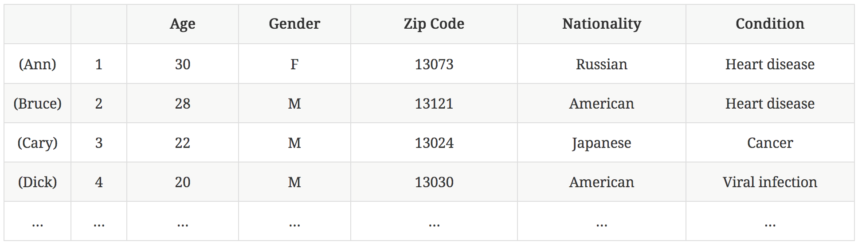
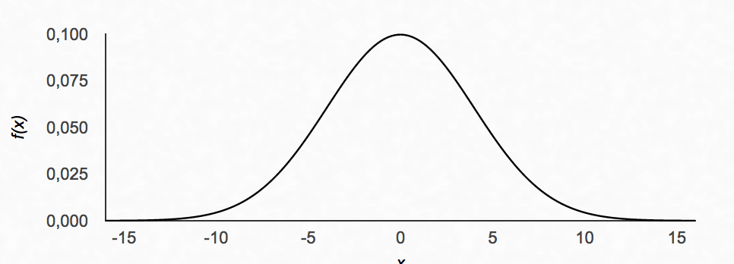
randomization
remove names
add random noise
for numeric attributes: add gaussian noise
for categorical attributes: replace by random value in the domain
random values
add gaussian noise to:
Age ~ N(μ=0, σ=4)
Zip Code ~ N(μ=0, σ=500)
Gender, Nationality, Condition:
replace with p=0.25 by random value
otherwise, keep original

Slide 14
privacy criteria options
k-anonymity
each individual (row) is indistinguishable from at least k–1 other rows in the dataset
l-diversity
there are at least l-distinct sensitive values that are of roughly equal proportion
c,k-safety (α,β)-privacy
γ-amplification differential privacy
etc.

Slide 15
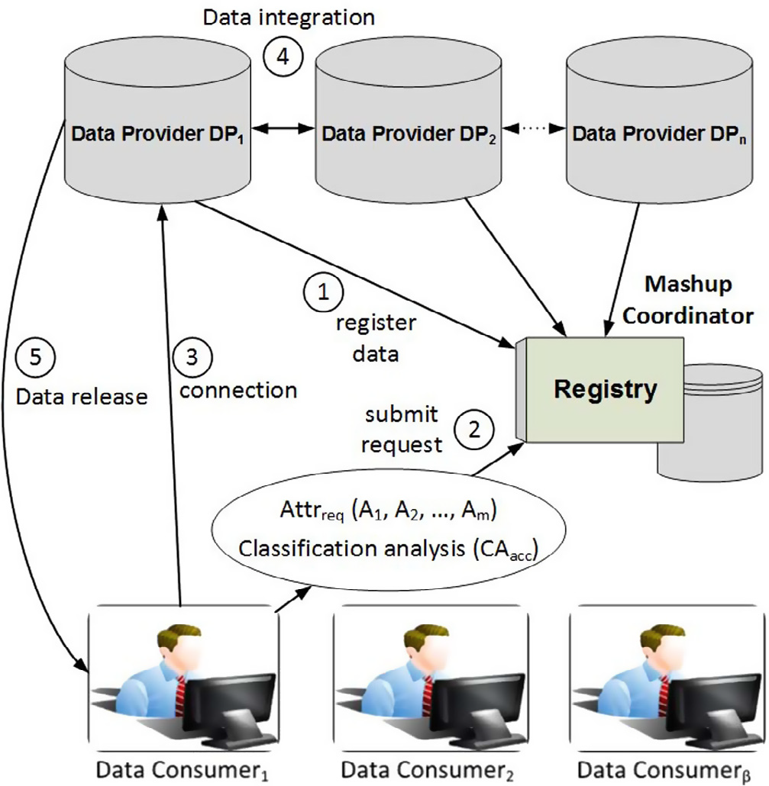
privacy-preserving data mashup

Slide 16
quasi-identifiers
remember: medical record table
quasi-identifying attributes may belong to different datasets (and custodians)

