Slide 1

DSA
Week 5
Queues
Data Structures and Algorithms (DSA)
Prescribed Module/Elective
Diploma in CSF, IT
Year 2 (2020/21), Semester 4

Slide 2
Topics
Introduction of the ADT queue
Implementation of the ADT queue
Applications of the ADT queue

Slide 3
References
1. Data Abstraction and Problem Solving with C++ 5th Edition
☞ chapter 7

Slide 4
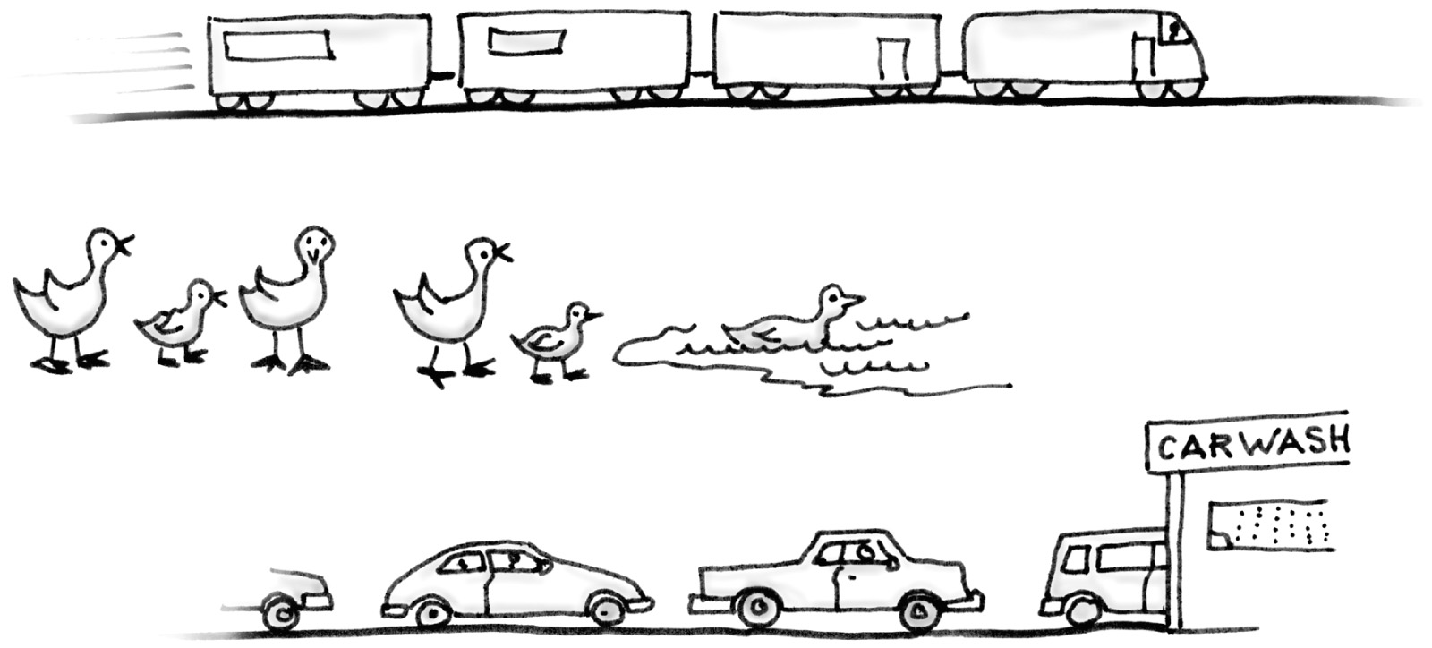
1. Queue ADT
A queue is another form of data structure for organizing data.
Important property: FIFO (First-in First-Out)
First item placed on the queue will be removed first.
e.g.
Carrano, Data Structures and Abstractions with Java, Second Edition, (c) 2007 Pearson Education, Inc. All rights reserved. 0-13-237045-X
Queues are very appropriate for many real-world simulations.
Notes:
The Queue data type is also known as the First In First Out (FIFO) data type since the element that is inserted from the back of Queue will travel to the front side before it can be removed.
As we can see in the train diagram, there is a line of carriages from the engine which is the front of the train.
A queue of ducks are waiting their turn to go into the pond.
A car wash where the car that wants to be washed has to be in line from the back of the queue and wait until all the cars in front have been served.

Slide 5
Queue ADT
Queue ADT
is a collection of items
operations can only occur at the queue’s two ends
items can only be removed from front of queue
new items can only be added to back of queue
Notes:
A queue data type is a list with some restrictions to the effect that the inserting operation (enqueue) can only be performed from one side (called the back) and the removing operation (dequeue) can only be performed from the other side (called the front). Similar to the Stack data type, we can develop the Queue data type by using the array or LinkedList data type.

Slide 6
2. Implementing Queue ADT
Steps
Identify and list the operations for Queue ADT
list of operations required for Queue ADT
Specify the Queue ADT interface
☞ function prototypes of the operations for Queue ADT
(Queue.h)
Implement the Queue operations
☞ implementation of the operations for Queue ADT (Queue.cpp)
Notes:
We use the same 3 steps to implement a Queue ADT.
First we identify and list the operations for the Queue ADT.
Next, we create the Queue.h file.
Lastly, we write the codes for the functions in the Queue.cpp file.

Slide 7
Step 1 : Identify and list the operations for Queue ADT
The purpose of this step is to identify and list the operations required for the ADT.
Operations (for Queue ADT)
create an empty queue destroy the queue add an item to back of queue(enqueue) remove an item from front of queue (dequeue) retrieve/ look at item at front of stack (getFront) check whether the queue is empty
Notes:
Step 1 – before we start coding, we need to identify and list the operations required.
We want to be able to do the following (see slide)

Slide 8
Step 2 : Specify the Queue ADT (Queue.h)
The purpose of this step is to specify the function prototypes/headers of each of the operations clearly
Specification of Queue ADT
Queue() ~Queue() //for pointers-based implementation enqueue(ItemType& item):boolean dequeue():boolean dequeue(ItemType& item):boolean getFront(ItemType& item):void isEmpty():Boolean
Notes:
Step 2, we write the functions for each of the operations listed in step 1.
The destructor ~Queue() is for pointers-based implementation only. Because, if using array-based implementation, we should not delete the array.

Slide 9
Pointer-based Implementation of Queue ADT
Pointers can be used to link data to form a queue.
Pointer-based implementation is more straightforward than array-based.
frontNode
backNode
item
next
item
next
item
next
Annie
John
…
Mic
Node
Node
Node
Likewise, need to have a inner structure known as a Node:
- item (to store the data item)
- next (to store the address of next node)
Notes:
For pointer-based implementation of queue, we need two nodes – the frontNode and the backNode. The frontNode points to the front of the queue and the backNode points to the last Node in the queue.
We use a node that has a structure consisting of the item to be stored and next which stores the address of the next Node. Next effectively is the pointer to the next Node.
So the Node with item “Annie” points to the Node with item “John” and so on. The list Node has the item “Mic” and its points to NULL, meaning that is the end of the queue.

Slide 10
Pointer-based Implementation of Queue ADT
frontNode
backNode
item
next
item
next
item
next
Annie
John
…
Mic
Node
Node
Node
Overall Queue ADT needs:
a pointer frontNode to point to the node at front position (initially point to NULL)
a pointer backNode to point to the node at back position (initially point to NULL)
Notes:
Initially frontNode and backNode points to NuLL.
When a node is inserted (or enqueued), frontNode ad backNode will point to this node. Because this node is the front as well as the back Node.
When more nodes are enqueued, each node is attached to the last node in the queue and the backNode will then point to this new node (which becomes the last node).

Slide 11
Pointer-based Implementation of Queue ADT
Note
adding items can only be done at the back
removing items can only be done from the front
Adding & removing data involves manipulation of linkages including frontNode and backNode
Queue can dynamically grow and shrink
Additional memory need to store the linkages
frontNode
backNode
item
next
item
next
item
next
Annie
John
…
Mic
Node
Node
Node

Slide 12
Node Structure
Recall format for declaring the node structure in C++ is:
struct Node
{
ItemType item; // to store the data item
Node *next; // pointer to point to next node
};
item
next

Slide 13
Specification of Queue ADT(Pointer-based) - Queue.h
// Queue.h - Specification of Queue ADT (Pointer-based implementation)
#pragma once
typedef int ItemType;
class Queue
{
private:
struct Node
{
ItemType item; // a data item on the queue
Node *next; // pointer to next node
};
Node *frontNode;
Node *backNode;
public:
Queue(); // constructor
~Queue(); // destructor
// add a new item to the back of the queue
// pre : size < MAX_SIZE
// post: item is added to the back of the queue
bool enqueue(ItemType& item);
. . .
};
Download from MEL

Slide 14
Enqueueing an item at back of Queue
To enqueue a new item at the back of the Queue, need to :
☞ create a new node to store the item
☞ make the back node’s next pointer to point to the new node
☞ Make the back node point to the new node
frontNode
backNode
2
Annie
John
…
Mic
newNode
1
Annie
* Need to consider case of empty queue
Notes:
To enqueue an item into the queue, we need to perform 2 steps:
Make the current backNode point to the newNode.
Make the backNode point to the newNode.
The above is done if there is at least one element in the queue.
So we need to include in our algorithm, the case when the queue is empty i.e. frontNode and backNode are both NULL. See next slide.

Slide 15
Algorithm : enqueue an item at back of Queue
boolean enqueue(ItemType& item)
Create a new node Store the item to the node Initialize the next pointer to null If queue is empty set front node (pointer) to point to new node Else set back node’s next pointer to point to the new node set back node (pointer) to point to new node Return true
Notes:
Note that there are 2 conditions when inserting a new element in the Queue.
The insertion does not depend on the number of elements inside the queue, so the time complexity for this operation is always O(1) for both best and worst case.

Slide 16
Dequeue an item from front of the Queue
To dequeue item from front of the Queue, you need to :
☞ Use a temp pointer to point to front node
☞ Make the frontNode point to the next node in queue
☞ Make removed node’s next pointer point to NULL and deallocate memory from removed node
frontNode
2
backNode
Annie
John
…
Mic
1
3
* No shifting of items required
* Need to consider the case of queue having only one node
temp
Notes:
Removing an item can be performed from the front only which is done by using the dequeuer operation.
There are 3 steps:
Create a temp Node pointer to point to the frontNode (in this case, the Annie node)
Make the frontNode now point to whatever the temp Node next is pointing to (in this case, the John node)
Set the temp Node next to NULL.
We don’t need to do anything to the backNode.

Slide 17
Algorithm : dequeue item from front of Queue
boolean dequeue()
If frontNode points to same location as backNode (i.e. only one node in queue) set frontNode to NULL set backNode to NULL Else set temp (pointer) point to the front node make frontNode(pointer) point to the next node in stack make removed node’s next (pointer) point to NULL deallocate memory from removed node
Notes:
Similar to the enqueuer() function, the dequeuer() function does not depend on the number of items inside the queue. The time complexity of this operation is O(1) for both best and worst case.

Slide 18
Algorithm : retrieving an item from front of Queue
boolean getFront(ItemType& item)
If queue is not empty item would be item contained in the front node
Notes:
We can only fetch the front value of a queue. So the getFront() function gets the front element and passes it back thru’ the parameter.
Since it just returns the value of the front element, the time complexity for this operation is O(1) for both best and worst case. Take note that the queue needs to be checked that it is not empty first.

Slide 19
Array-based Implementation of Queue ADT
In cases, when fixed-size queue is not a problem, an array can be used to represent a queue.
A naïve array-based implementation:
front: 0
back: 3
2
4
1
7
…
Array indices
0
1
2
3
MAX_SIZE -1
2 variables to keep indexes of front and back of queue (similar to top for array-based Stack ADT):
- front (index of 1st item)
- back (index of last last)
Notes:
An array may also be used to implement a queue.
We need to store the MAX_SIZE which is the maximum number of data items the queue can hold and the array index of the data items at the front and back of the queue (front and back) and the array itself.

Slide 20
Array-based Implementation of Queue ADT
Note
Enqueue of item can only be added at the back
Dequeue of item can only be done from the front
Enqueue and dequeue of data is fast (access front or back via index)
number of items can be stored is limited
may waste storage (array may not be fully utilized)
front: 0
back: 3
2
4
1
7
…
0
1
2
3
MAX_SIZE -1
Array indices

Slide 21
Specification of Queue ADT(Array-based) - Queue.h
// Queue.h - - Specification of Queue ADT (for naïve array-based implementation)
#pragma once
const int MAX_SIZE = 100;
typedef int ItemType;
class Queue
{
private:
ItemType items[MAX_SIZE];
int front;
int back;
public:
// constructor
Queue();
// add a new item to the back of the queue
// pre : size < MAX_SIZE
// post: item is added to the back of the queue
bool enqueue(ItemType& item);
// removes item from the front of the queue
// pre : queue is not empty
// post: item front of queue was removed
bool dequeue();
. . .
};
Download from MEL

Slide 22
Array-based Implementation of Queue ADT
Problem for naïve array-based implementation:
Rightward Drift
After a sequence of additions and removals, the items will drift towards the end of the array.
front: 47
back: 49
6
10
2
48
49
Array indices
0
47
MAX_SIZE -1
back could be equal to MAX_SIZE – 1 and yet, the queue contains only a few items!!
Possible solution: shifting elements to left upon dequeue/ when back = MAX_SIZE – 1 (but recall shifting is costly)

Slide 23
Array-based Implementation of Queue ADT
Elegant solution: Circular array
Advance front and back indexes by moving them clockwise around the array.
When either front or back advances past MAX_SIZE – 1, it wraps around 0 => avoids rightward drift
MAX_SIZE -1
0
2
1
4
1
7
2
front: 0 back: 3
3

Slide 24
Array-based Implementation of Queue ADT
MAX_SIZE -1
0
MAX_SIZE -1
0
2
dequeue
1
1
4
4
1
front: 1
back: 3
1
front: 0
back: 3
2
2
7
7
3
3
MAX_SIZE -1
0
MAX_SIZE -1
0
dequeue
enqueue
1
1
1
front: 2
back: 4
1
front: 2
back: 3
7
2
9
7
2
3
4
3

Slide 25
Array-based Implementation of Queue ADT
How to determine the queue-full and queue-empty conditions? front is one slot ahead of back?
MAX_SIZE -1
0
MAX_SIZE -1
0
dequeue
1
1
1
front
4
7
2
5
2
front: 4 back: 4
front: 5 back: 4
4
3
4
3
back
front
back
MAX_SIZE -1
0
MAX_SIZE -1
0
6
2
enqueue
6
2
6
1
6
1
9
4
9
4
front
8
1
front
8
1
5
7
2
5
7
2
front: 5 back: 3
front: 5 back: 4
9
4
3
4
3
back
back

Slide 26
Array-based Implementation of Queue ADT
Solution: use another variable to keep number of items
- front (index of 1st item)
- back (index of last last)
- count
Check (count == MAX_SIZE) to see queue is full
Check (count == 0) for queue is empty
MAX_SIZE -1
0
2
1
4
1
7
2
front: 0 back: 3 count: 4
3

Slide 27
Array-based Implementation of Queue ADT
Other approaches:
using a boolean flag isFull (same cost of maintaining a counter)
Declaring MAX_SIZE + 1 locations for the array, but only MAX_SIZE of them can be filled with items
(avoid time overhead of maintaining counter/ flag, but memory wasted if array stores data of complex type)
MAX_SIZE -1
0
2
1
4
1
7
2
front: 0 back: 3 count: 4
3

Slide 28
Specification of Queue ADT(Array-based) - Queue.h
// Queue.h - - Specification of Queue ADT (for circular array-based implementation)
#pragma once
const int MAX_SIZE = 100;
typedef int ItemType;
class Queue
{
private:
ItemType items[MAX_SIZE];
int front;
int back;
int count;
public:
// constructor
Queue();
// add a new item to the top of the stack(push)
// pre : size < MAX_SIZE
// post: item is added to the top of the stack
bool enqueue(ItemType& item);
// removes item from top of the stack(pop)
// pre : stack is not empty
// post: item top of stack was removed
bool dequeue();
. . .
};
Download from MEL

Slide 29
Implementing the operations (Array based queue)- Queue.cpp
#include "Queue.h" // header file containing the ADT specification
// constructor
Queue::Queue()
{
front = 0;
back = MAX_SIZE – 1; // back = -1 for non-circular array
count = 0;
}
Download from MEL

Slide 30
Queue ADT – enqueue() function
// enqueue new item at back of the queue
bool Queue::enqueue (ItemType& item)
{
bool success = (count != MAX_SIZE);
if(success)
{
back = (back + 1) % MAX_SIZE; // back++ for non-circular array
items[back] = item; // enqueue the item
count++;
}
return success;
}

Slide 31
Queue ADT – dequeue() function
// dequeue item from front of the queue
bool Queue::dequeue()
{
bool success = !isEmpty();
if (success)
{
front = (front + 1) % MAX_SIZE; // dequeue item
// front++ for non-circular array
count--;
}
return success;
}

Slide 32
Queue ADT – getFront() function
// get item from front of the queue
void Queue::getFront(ItemType& item)
{
bool success = !isEmpty();
if (success)
item = items[front];
else
item = -1;
}

Slide 33
Queue ADT – isEmpty()
// check if the queue is empty
bool Queue::isEmpty()
{
return count == 0; // return (back = -1 && front = 0) for
// circular array
}

Slide 34
3. Applications of Queue ADT
Reading a string of characters
A queue can retain characters in the order in which they are typed
Queue q;
while (not end of line)
{
Read a new character ch
q.enqueue(ch)
}
Once the characters are in a queue, the system can process them as necessary
Processing print jobs
Print jobs can also be stored in a queue as well before printer processes them.
Download pseudocode from MEL

Slide 35
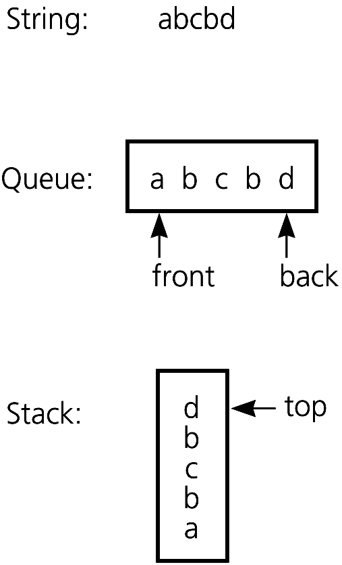
Applications of Queue ADT
Recognizing Palindromes
A palindrome – a string of characters that read the same from left to right as it does from right to left e.g. “Madam, I'm Adam” string input is inserted into both a queue and stack
.
Download pseudocode from MEL
Copyright © 2007 Pearson Education, Inc. Publishing as Pearson Addison-Wesley. Ver. 5.0.

Slide 36
Applications of Queue ADT
Recognizing Palindromes
char at front of queue = char at top of stack
=> continue to process
Repeat until either ADT is empty => string is palindrome
char not the same => string not a palindrome
.
Download pseudocode from MEL
Copyright © 2007 Pearson Education, Inc. Publishing as Pearson Addison-Wesley. Ver. 5.0.

Slide 37
Some points to note
1. Again, format for specifying the ADT operations may vary
e.g.
getFront():ItemType // format 1
enqueue(ItemType item):boolean // format 1
dequeue(): boolean // format 1
getFront(ItemType &item):void // format 2
enqueue(ItemType &item):void // format 2
dequeue(ItemType &item): boolean // format 2

Slide 38
Summary
Introduction of the ADT queue
Implementation of the ADT queue
Applications of the ADT queue

