Slide 1

DSA
Week 7
Recursion
Data Structures and Algorithms (DSA)
Prescribed Module/Elective
Diploma in CSF, IT
Year 2/3 (2020/21), Semester 4/6

Slide 2
Topics
Introduction of Recursion
Constructing Recursive Solutions
A Poor Solution to a Simple Problem
Recursion in Array Processing
A Simple Solution to a Difficult Problem
Recursion and Efficiency
Recursion VS Iteration

Slide 3
References
1. Data Abstraction and Problem Solving with C++ 5th Edition
☞ chapter 2

Slide 4

1. What is Recursion?
Recursion is a extremely powerful programming technique employed to solve problems.
Breaks a problem into smaller but similar problem size which may be easier to solve
-> Divide and Conquer
At the end of the ‘division’ of the problem, you reach a smallest problem where by answer is trivial
Using that answer enables you to solve the previous problems
Notes:
Recursion- A problem solving technique in which problems are solved by reducing them to smaller problems of the same form

Slide 5
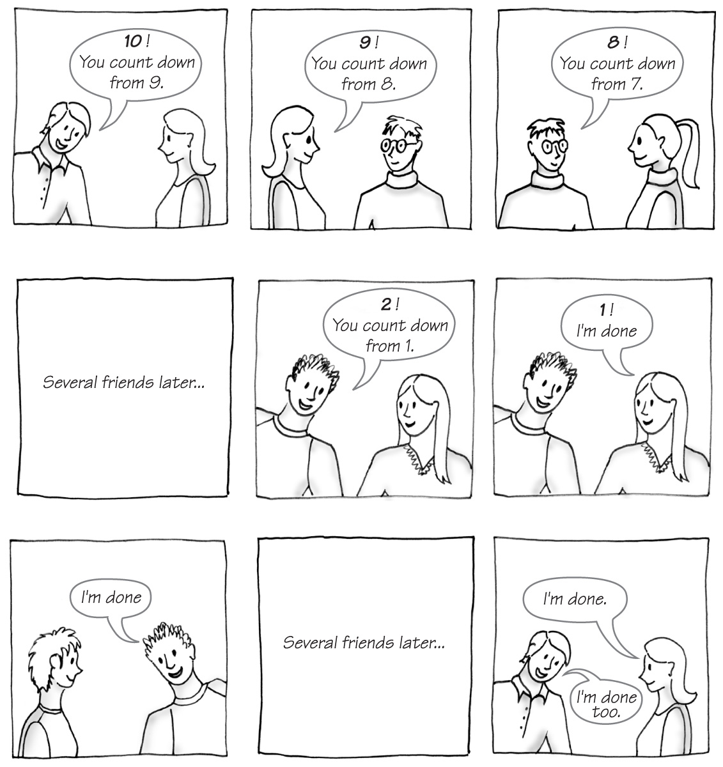
What is Recursion?
Carrano, Data Structures and Abstractions with Java, Second Edition, (c) 2007 Pearson Education, Inc. All rights reserved. 0-13-237045-X

Slide 6
What is Recursion?
In programming, recursion takes the form of a function that calls itself
-> Recursive function
int fac(int n) // compute the factorial of a number recursively
{
if (n == 0) // base case
return 1;
else // recursive step
return n * fac(n-1);
}
Each time function calls a copy of itself to work on smaller problem -> Recursive Call / Recursive Step

Slide 7
2. Constructing Recursive Solutions
4 Questions:
How to define the problem in terms of a smaller and similar problem?
Does each recursive call reduce size of problem?
What instance of the problem serve as base case?
As the problem size reduces, will you reach the base case?

Slide 8
Constructing Recursive Solutions
Structure of Recursive Function:
Function prototype must provide parameter(s)
Divides problem into 2 or more pieces
Division via selection control structures (if-else)
One piece that you know how to do
☞ Base case
The other piece(s) that you don’t know how to do yet
Take steps towards the base case to solve the problem
Recursion step usually includes a return
☞ Returns program control to caller to be combined with other pieces

Slide 9
Constructing Recursive Solutions
Problem : Compute the factorial of an integer n (n!)
Possible Iterative Definition:
factorial(n) = n * (n – 1) * (n – 2) * … * 1 (for n > 0)
factorial(0) = 1
int fac(int n) // iterative version
{
int result = 1;
for (int i = n; i >= 1; i--)
result = result * i;
return result;
}

Slide 10
Constructing Recursive Solutions
Problem : Compute the factorial of an integer n (n!)
Possible Recursive Definition:
1 if n = 0
n * factorial(n–1) if n > 0
factorial(n)
int fac(int n) // recursive version
{
if(n == 0)
return 1;
else
return n * fac(n-1);
}

Slide 11
Constructing Recursive Solutions
In fact, the expression of a factorial(n) in terms of factorial (n-1) is an example of Recurrence Relation in Mathematics.
Recurrence Relation:
A mathematical formula that generates the terms in a sequence from previous terms
Recurrence relation for factorial(n):
factorial(n) = n * [(n–1) * (n–2) * . . . * 1] = n * factorial(n–1)

Slide 12
Constructing Recursive Solutions
Writing Invariants:
Equally important as writing them for iterative functions
If precondition is violated, function would not behave correctly.
// pre: n >= 0.
// return The factorial of n
int fac(int n)
{
if(n == 0)
return 1;
else //Invariant: n > 0, so n-1 >= 0
//Thus fac(n-1) returns (n-1)!
return n * fac(n-1); // n * (n-1)! is n!
}
For the above example, there will be infinite recursive calls if precondition is violated because the function never reach the base case.

Slide 13
Constructing Recursive Solutions
Problem : Writing a String Backward
- Print the characters in a string in backward manner
Which of them works??
//stripping away last character
writeBackward(string s)
if (string is empty) // base case
do nothing
else // recursive step
{
write the last character of s
writeBackward(s minus its last character)
}

Slide 14
Constructing Recursive Solutions
//stripping away first character
writeBackward1(string s)
if (string is empty)
do nothing
else
{
write the first character of s
writeBackward1(s minus its first character)
}
Download from MEL

Slide 15
Constructing Recursive Solutions
//stripping away first character
writeBackward2(string s)
if (string is empty)
do nothing – this is the base case
else
{
writeBackward2(s minus its first character)
write the first character of s
}
Download from MEL

Slide 16
3. A Poor Solution to Simple Problem - Fibonacci
Fibonacci Sequence
The first two numbers are 0 and 1
Successive numbers are the sum of the previous two
0, 1, 1, 2, 3, 5, 8, 13, 21, 34, ...
Recursive definition for Fibonacci:
n if n is 0 or 1
fibonacci(n – 1) + fibonacci(n – 2) if n > 2
fibonacci(n)

Slide 17
3. A Poor Solution to Simple Problem - Fibonacci
int fib(int n) // recursive version
{
if (n == 0 || n == 1)
return n;
else
return fib(n-2) + fib(n-1);
}

Slide 18
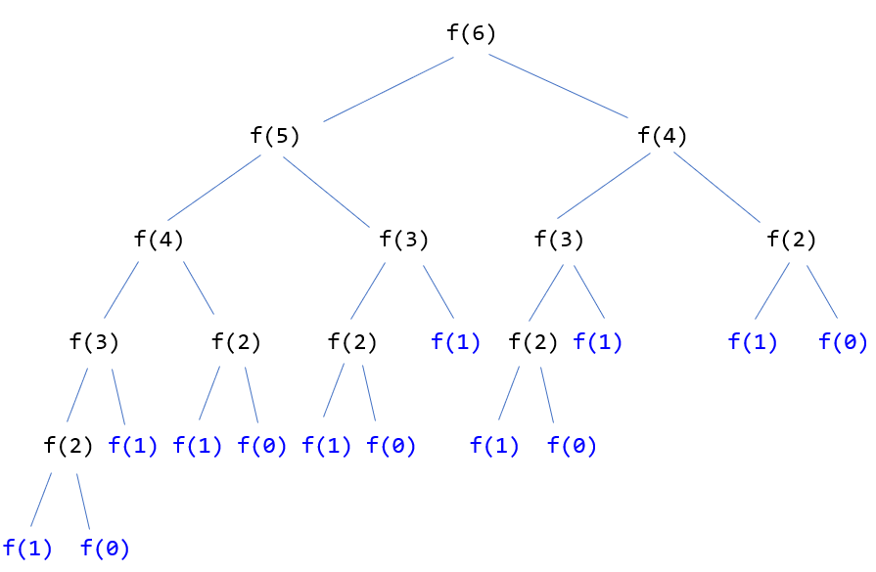
A Poor Solution to Simple Problem - Fibonacci
Time efficiency grows exponentially with n!

Slide 19
A Poor Solution to Simple Problem - Fibonacci
int fib(int n)
{
if (n == 0 || n == 1)
return n;
else
return fib(n-2) + fib(n-1);
}
fib(6) | Number of times function is called
fib(6) | 1
fib(5) | 1
fib(4) | 2
fib(3) | 3
fib(2) | 5
fib(1) | 8

Slide 20
4. Recursion in Array Processing
Recursive processing of an array:
Divide the array into two pieces repetitively
E.g. Searching for the maximum number in an array
Recursive Solution:
if (array has only one item)
maxArray(array) is the item in array
else if (array has more than one item)
maxArray(array) is the maximum of
maxArray(left half of array) and
maxArray(right half of arrray)

Slide 21
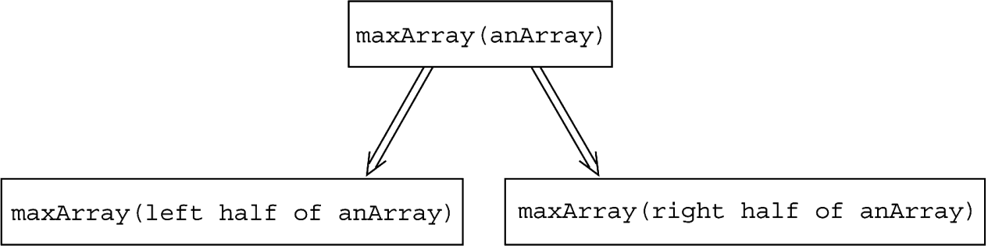
Recursion in Array Processing
Recursive processing of an array:
Copyright © 2007 Pearson Education, Inc. Publishing as Pearson Addison-Wesley. Ver. 5.0.

Slide 22
Recursion in Array Processing
How does recursive solution for array processing differ from Binary search?
Binary Search:
binarySearch(ItemType array[], ItemType target)
if (array is of size 1) // base case
Determine if array’s item is equal to target
else // recursive step
{
Find the midpoint of array
Determine which half of the array contains the target
if (target is in the first half of array) binarySearch(first half of array, target)
else
binarySearch(second half of array, target)
}
Binary search conquers only one of its subproblems at each step
Recursive solution for finding max whereas conquers both.
In addition, after recursive solution conquers the subproblems, it
must reconcile the two solutions (ie. Find max of the two maxima)

Slide 23
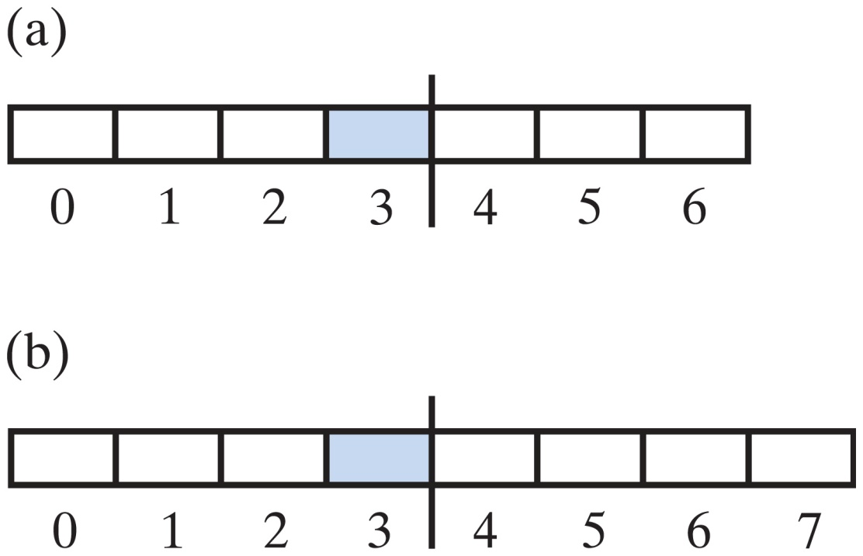
Recursion in Array Processing
Two arrays with middle elements within left halves
Carrano, Data Structures and Abstractions with Java, Second Edition, (c) 2007 Pearson Education, Inc. All rights reserved. 0-13-237045-X

Slide 24
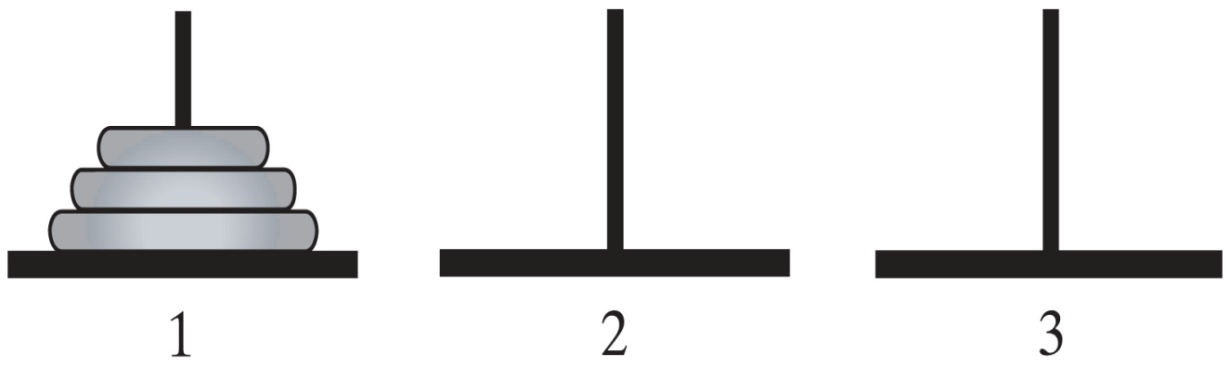
5. A Simple Solution to a Problem– Tower of Hanoi
Problem:
Tower of Hanoi -> https://www.youtube.com/watch?v=YstLjLCGmgg
Given n disks of different sizes and three poles 1, 2, 3,
how to move all the disks from 1 to 3, using pole 2 as a spare?
Carrano, Data Structures and Abstractions with Java, Second Edition, (c) 2007 Pearson Education, Inc. All rights reserved. 0-13-237045-X

Slide 25
A Simple Solution to a Problem– Tower of Hanoi
Rules for the Towers of Hanoi game
Only one disk can be moved at a time
Only the top disk can be moved
No disk can be placed on top of a smaller disk
Carrano, Data Structures and Abstractions with Java, Second Edition, (c) 2007 Pearson Education, Inc. All rights reserved. 0-13-237045-X

Slide 26
A Simple Solution to a Problem – Tower of Hanoi
Major steps:
If only 1 disk (i.e. n = 1), move it from pole 1 to 3
If more than 1 disks (i.e. n > 1)
Ignore the bottom disk and solve the problem for n – 1 disks with the small modification that pole 2 is the destination and pole 3 is the spare
After the above, n – 1 disks will be on pole 2 and the largest disk is on pole 1. So solve the problem for n-1 by moving the largest disk from pole 1 to 3
Proceed to move the n-1 disks from pole 2 to pole 3,
i.e. solve the problem with pole 2 as the source, pole 3 as destination and pole 1 as spare.

Slide 27
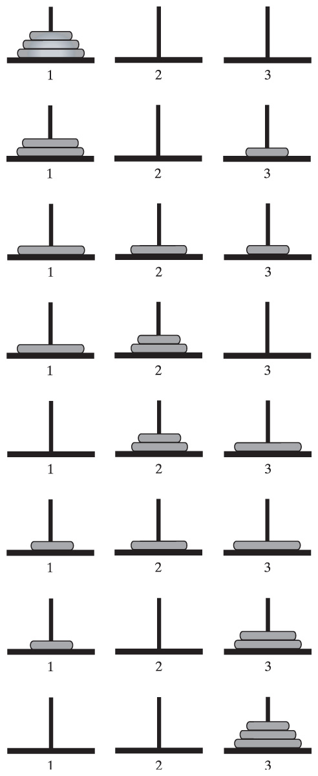
A Simple Solution to a Problem– Tower of Hanoi
Carrano, Data Structures and Abstractions with Java, Second Edition, (c) 2007 Pearson Education, Inc. All rights reserved. 0-13-237045-X

Slide 28
A Simple Solution to a Problem– Tower of Hanoi
See Tower of Hanoi Animation slides
Carrano, Data Structures and Abstractions with Java, Second Edition, (c) 2007 Pearson Education, Inc. All rights reserved. 0-13-237045-X

Slide 29
A Simple Solution to a Problem – Tower of Hanoi
Recursive solution for Tower of Hanoi
moveDisks(n, source, destination, spare)
{
if (n == 1) // base case
cout << "move disk from " << source << " to " << destination << endl;
else // recursive step
{
moveDisks(n-1, source, spare, destination)
moveDisks(1, source, destination, spare)
moveDisks(n-1, spare, destination, source)
}
}
Try other number of discs:
https://www.youtube.com/watch?v=YstLjLCGmgg
http://towersofhanoi.info/Animate.aspx

Slide 30
6. Recursion and Efficiency
Factors that affects the efficiency of a recursive solution are:
Inherent inefficiency of the recursive solution
-> possibly due to recomputation of same values repetitively
e.g. for fib (7), fib(3) is computed 5 times
Overhead associated with function calls
the call to a recursive function may generate large number of recursive calls e.g. fibonacci(n)
-> high (time) overhead for context switching and
allocating/de-allocating storage in each recursive call
-> high (space) overhead for storing activation records

Slide 31
Recursion and Efficiency
Recursion is best suited for problems
that are recursive in nature, or
there is no simple iterative solution to the problem.
E.g. Tower of Hanoi, BST, MergeSort, QuickSort, Games
However some recursive solutions can be very inefficient and should not be used.
E.g. fibonacci sequence

Slide 32
Time Complexity of Recursive Solutions
What do you think is the time complexity of recursive solution for factorial?
1 if n = 0
n * factorial(n–1) if n > 0
Time taken for the recursive solution:
factorial(n)
Constant time for fixed instructions in base case
1 if n = 0
1 + T(n–1) if n > 0
T(n)
Constant time for multiply operation
Time taken to solve problem size of n-1

Slide 33
Time Complexity of Recursive Solutions
Time taken for 1 less than original problem size would be:
1 if n = 0
1 + T(n–2) if n > 0
T(n-1)
Expanding the recurrence relation with repeated substitution,
T(n) = 1 + T(n- 1)
= 1 + 1 + T(n- 2)
= 1 + 1 + 1 + T(n-3)
= 1 + 1 + 1 +… + T(n - i) = i * 1 + T(n- i)
i times

Slide 34
Time Complexity of Recusive Solutions
Solve for i = n, T(n) = 1 + 1+… + T(n - n)
= n + T(0)
= n + 1 => O(n)
n times

Slide 35
Time Complexity of Recursive Solutions
Let’s evaluate time complexity for Tower of Hanoi:
moveDisks(n, src, dst, spr)
{
if (n == 1) // base case
cout << "move disk from " << source << " to " << destination << endl;
else // recursive step
{
moveDisks(n-1, src, spr, dst)
moveDisks(1, src, dst, spr)
moveDisks(n-1, spr, dst, src)
}
}
Constant time moving one disc from src to dst
1 if n = 1
1 + 2T(n–1) if n > 0
T(n)
Constant time for single step of moving 1 disc
Time taken to solve problem size of n-1

Slide 36
Time Complexity of Recursive Solutions
Expanding the recurrence relation with repeated substitution,
T(n) = 1 + 2T(n-1)
= 1 + 2[1 + 2T(n- 2)]
= 1 + 2 + 4T(n-2)
= 1 + 2 + 4[1 + 2T(n-3)]
= 1 + 2 + 4 + 8T(n-3)
ith time:
i = n - 1:
T(n) = 1 + 2 + 4 + 2^{n-1-1} + 2^{n-1} T(n-(n-1))
= 1 + 2 + 4 + 2^{n-2} + 2^{n-1} T(1)
= 1 + 2 + 4 + 2^{n-2} + 2^{n-1} => O(2^{n})
T(n) = 1 + 2 + 4 + … + 2^{i-1} + 2^{i} T(n-i)

Slide 37
Time Complexity of Recursive Solutions
Let us move on to Fibonacci…
n if n is 0 or 1
fibonacci(n – 1) + fibonacci(n – 2) if n > 2
Time taken for the recursive solution:
fibonacci(n)
Constant time for fixed instructions in base case
1 if n = 0
T(n-1) + T(n–2) + 1 if n > 0
T(n)
Time taken to solve problem size of n-1
Time taken to solve problem size of n-2
Addition to add the results

Slide 38
Time Complexity of Recursive Solutions
We simplify the expression to :
T(n) = T(n-1) + T(n–2) + 1
= T(n-1) + T(n-1) + 1 approximately
= 2T(n-1) + 1 approximately
Similar to Tower of Hanoi, this gives rise to O(2^{n}).

Slide 39
Further applications of Recursion
Recursion is also used commonly for:
Exhaustive Search (Exploring every possible combination from a set of choices or values.)
Applications:
producing all permutations of a set of values
enumerating all possible names, passwords, etc.
combinatorics and logic programming.
Often the search space consists of many decisions, each has several available choices
Can be potentially extremely expensive!

Slide 40
Further applications of Recursion
Example of exhaustive search:
Write a recursive function printAllBinary() that accepts an integer number of digits and prints all binary numbers that have that many digits.
void printAllBinary(int numDigits) {
printAllBinary(numDigits, "");
}
void printAllBinary(int digits, string soFar) {
if (digits == 0) {
cout << soFar << endl;
}
else {
printAllBinaryHelper(digits - 1, soFar + "0");
printAllBinaryHelper(digits - 1, soFar + "1");
}
}

Slide 41
Further applications of Recursion
Call tree for printAllBinary(2):
digits
soFar
2
“”
1
“0”
1
“1”
0
“00”
0
“01”
0
“10”
0
“11”

Slide 42
Further applications of Recursion
There are many more! It is to explore all possible search space in worst case.
E.g.
Given 6 < k < 12 integers, enumerate all possible subsets of size 6 in sorted order.
Computing all possible re-arrangement of the letters in a string.
Given three integers A, B, C (0 ≤ A, B, C ≤ 1000) find three other distinct integers x, y, z such that x + y + z = A

Slide 43
Further applications of Recursion
Recursion is commonly used as well for:
Backtracking (Build a solution incrementally, abandoning those solutions that are not suitable)
Applications:
Puzzle solving (Sudoku, Crosswords, etc.)
Game playing (Chess, Solitaire, anagrams, etc.)
Constraint satisfaction problems (scheduling, matching, etc.)
How is this different from exhaustive search?
Exhaustive recursion explores all possible combinations. In recursive backtracking, we try one choice and only undo decision if it does not work out.
Notes:
Backtracking essentially is Finding solution(s) by trying partial solutions and then abandoning them if they are not suitable..
Determine whether a solution exists
Find a solution
Find the best solution
Count the number of solutions
Print/find all the solutions

Slide 44
Further applications of Recursion
Recursive backtracking algorithm:
void findSolutions(n, other params) :
if (found a solution) :
solutionsFound = solutionsFound + 1;
displaySolution();
if (solutionsFound >= solutionTarget) :
System.exit(0);
return
for (val = first to last) :
if (isValid(val, n)) :
applyValue(val, n);
findSolutions(n+1, other params);
removeValue(val, n);
Notes:
Backtracking essentially is Finding solution(s) by trying partial solutions and then abandoning them if they are not suitable..)
https://www.geeksforgeeks.org/backtracking-introduction/

Slide 45
Recursion vs Iteration
Iteration | Recursion
Repetition control structure | Selection control structure
Involve repetition | Involve repetition
Achieves repetition through repetition control structure | Achieves repetition through repetitive function calls
Terminates when loop continuation condition is false | Terminates when base case is reached.
Mechanism involves constant modification of counter | Mechanism involves divide and conquer
Infinite iteration when loop continuation condition is always true | Infinite Recursion when problem is not reduced in such way that converges on the base case

Slide 46
Summary
Introduction of Recursion
Constructing Recursive Solutions
A Poor Solution to a Simple Problem
Recursion in Array Processing
A Simple Solution to a Difficult Problem
Recursion and Efficiency
Time Complexity of Recursive Solutions
Recursion vs Iteration

Slide 47
Appendix 1 - Tracing a Recursive Function
A Box Trace/ Activation Record consists of:
Input parameters into the function
Local variables in the function
Placeholder for the value returned by each recursive call from the current box
Return value of the function
fac(3): // n = 3
return 3 * fac(2)

Slide 48
Tracing a Recursive Function
Box Trace
is a systematic way to trace a recursive function call
corresponds to an activation record
contains the context (local environment) and result of call to the function
when a call is made to the function, the context of the current function is switched to the new one
during context switching, previous context must be saved so that it can be reinstated upon return from function call

Slide 49
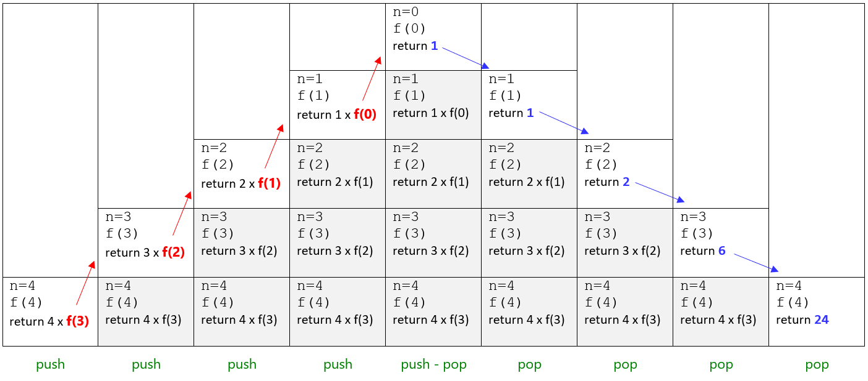
Box Trace - Example
factorial(4)
Memory Stack

