Slide 1

DSA
Week 8
Searching
Data Structures and Algorithms (DSA)
Prescribed Module/Elective
Diploma in CSF, IT
Year 2/3 (2020/21), Semester 4/6

Slide 2
Topics
Introduction to Searching
Sequential Search (Unsorted array)
Sequential Search (Sorted array)
Binary Search (Iterative)
Binary Search (Recursive)

Slide 3
References
1. Sample Program (on MEL)
☞ Sequential Search (Iterative)
☞ Sequential Search (Recursive)
2. Data Abstraction and Problem Solving with C++ 5th Edition
☞ chapter 2 (Binary Search)

Slide 4
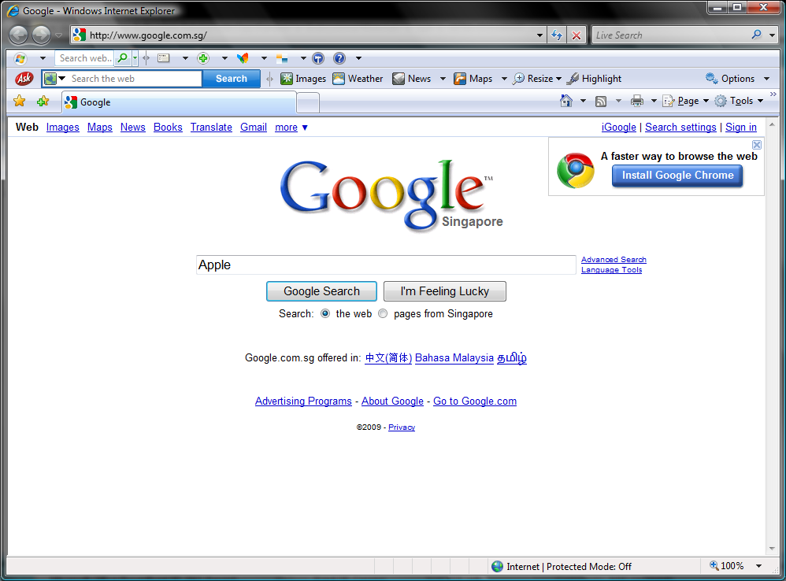
1. Introduction to Searching
Searching is one of the most common activities in our daily life.
e.g. searching for a book, person, tel no, file, movie, song, . . .

Slide 5
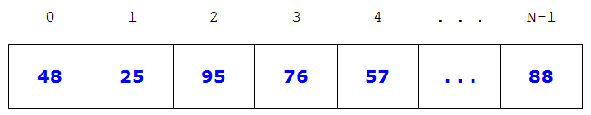

2. Sequential Search (Unsorted array)
Given an unsorted array of data,
How do you search for a target data?
e.g. search for 50
search for John

Slide 6



Sequential Search (Unsorted array) – Example 1
Search for : 76
Look at 1st data, 48 = 76? No, so continue to next data.
25 = 76? No, so continue to next data.
95 = 76? No, so continue to next data.
76 = 76? Yes, item found, stop.

Slide 7
Sequential Search (Unsorted array) – Example 2
Search for : 50
Look at 1st data, 48 = 50? No, so continue to next data.
25 = 50? No, so continue to next data.
95 = 50? No, so continue to next data.
. . .
. . .
88 = 50? No and there is no more data left. Stop.
Item not found

Slide 8
Sequential Search - Algorithm
int search(ItemType[] array, int n, ItemType target)
Set index to start of array(i.e. 0) While (not found and not end of array) if item at the index of the array is equal to target item found (return the index) else increment the index (by 1) End of array is reached, item is not found (return -1)

Slide 9
Sequential Search - Implementation
int search (int dataArray[], int n, int target)
{
for (int i=0; i<n; i++)
if ( dataArray[i] == target ) // found return i; return -1; // not found
}
Do you know how to implement this sequential search using recursion ?

Slide 10
Sequential Search - Efficiency
Unsorted Array
What is the worst number of searches (comparisons)?
What is the average number of searches (comparisons)?
Is there any way to improve the efficiency?
Notes:
Worst number of comparisons = N
Average number of comparisons = N / 2

Slide 11
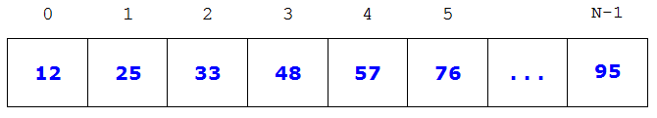
3. Sequential Search (Sorted array)
Given a sorted array of numbers,
How do you search for a target number ?

Slide 12



Sequential Search (Sorted array) – Example 1
Search for : 76
Look at 1st data, 12 = 76? No, so continue to next data.
25 = 76? No, so continue to next data.
33 = 76? No, so continue to next data.
76 = 76? Yes, item found, stop.

Slide 13
Sequential Search (Sorted array) – Example 2
Search for : 50
Look at 1st data, 12 = 50? No. 12 > 50? No, so continue to next data.
25 = 50? No. 25 > 50? No, so continue to next data.
33 = 50? No. 33 > 50? No, so continue to next data.
48 = 50? No. 48 > 50? No, so continue to next data.
57 = 50? No. 57 > 50? Yes, Number exceeded, stop
Item Not found

Slide 14
Sequential Search (Sorted array) - Algorithm
int search(ItemType[] array, int n, ItemType target)
Set index to start of array (i.e. 0) While (not found and not done and not end of array) if item at the index of the array is equal to target item found, (return the index) else if item at the index of the array is greater than target item not found, done (return -1) else increment the index (by 1) End of array is reached, item is not found (return -1)

Slide 15
Sequential Search (Sorted array) - implementation
int search (int numArray[], int n, int target)
{
for (int i=0; i<n; i++)
{
if ( numArray[i] == target ) // found return i;
else if ( numArray[i] > target ) // not found return -1;
}
return -1; // not found
}
Do you know how to implement this sequential search using recursion ?

Slide 16
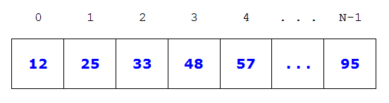
Sequential Search (Sorted array) - Efficiency
Sorted array
What is the average number of searches (comparisons)?
What is the worst number of searches (comparisons)?
Is there any way to improve the efficiency?
Notes:
Worst number of comparisons = N
Average number of comparisons = N / 2 (but with improvement in searching non-existent item)

Slide 17
4. Binary Search
Given a sorted array of numbers,
Can you search a target number in a more efficient way?
Can you divide and conquer?
e.g. searching a word in the dictionary
Notes:
Start from somewhere in the middle

Slide 18
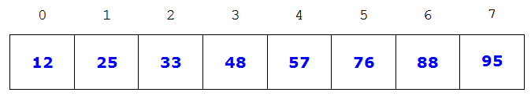
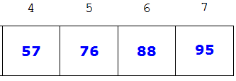
Binary Search - Example 1
Search for 76
mid = (0 + 7) / 2 (go to somewhere in the middle)
array[3] != 76 (compare the values)
array[3] < 76 (in second half)
mid = (4 + 7) / 2 (go to middle)
array[5] == 76 (compare the values)
found, return 5

Slide 19
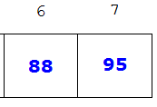
Binary Search - Example 2
Search for 80
mid = (0 + 7) / 2 = 3
array[3] != 80
array[3] < 80
mid = (4 + 7) / 2 = 5
array[5] != 80
array[5] < 80
mid = (6 + 7) / 2 = 6
array[6] != 80
array[6] > 80
Not found (first > last) , return -1

Slide 20
Binary Search - Algorithm
int binarySearch(ItemType[] array, int n, ItemType target)
Set first to start of array Set last to end of array While (first <= last) set mid = (first + last) / 2 if item at mid is equal to target item found (return mid) else if target is smaller than item at mid set last = mid – 1 // search first half else set first = mid + 1 // search second half End of search, item not found (return -1)

Slide 21
Binary Search - Implementation
int search (int dataArray[], int n, int target)
{
int first = 0;
int last = n-1;
while (first <= last)
{
int mid = (first + last) / 2
if ( dataArray[mid] == target ) // found return mid;
else if ( target < dataArray[mid] ) last = mid - 1; // search first half
else
first = mid + 1; // search second half
}
return -1; // not found
}
Do you know how to implement binary search using recursion ?

Slide 22
Binary Search - Efficiency
Sorted array
What is the worst number of searches (comparisons)?
What is the average number of searches (comparisons)?
Is there any searching technique that is faster than Binary Search ?
Notes:
Worst number of comparisons = log₂ N
Average number of comparisons = (log₂ N) / 2
Yes. Hashing

Slide 23
Efficiency - Comparisons
N | Sequential Search O(n) | Binary Search O(log₂ n)
1 | 1 | n=2 ->1
4 | 4 | 2
8 | 8 | 3
16 | 16 | 4
32 | 32 | 5
64 | 64 | 6
128 | 128 | 7
256 | 256 | 8
512 | 512 | 9
1024 | 1024 | 10
1000000 | 1000000 | 20

Slide 24
5. Binary Search (Recursive)
Sorted array
How do you search for a target number ?

Slide 25
Binary Search (Recursive) - Algorithm
int binarySearch(ItemType[] array, int first, int last, ItemType target)
If (first > last) item not found return -1 Else Set mid = (first + last) / 2 If item at index, mid, is equal to target item found, return mid Else If target is smaller than item at index return binarySearch(array, first, mid–1, target) // first half Else return binarySearch(array, mid+1, last, target) // second half

Slide 26
Note
Search | Array | Linked-List
Sequential | ✓ | ✓
Binary | ✓ | ✗
Sequential Search can be used to search for data in arrays and linked-lists
Binary Search can be used to search for data in arrays but not linked-lists
So what if we want to have the benefits of pointer-based implementation but at the same time tapping on benefits of Binary Search?
Do you know why ?
Solution: pointer-based Binary Search Trees
(learning in next topic)
Notes:
Using Binary search on arrays instead of Sequential search improves the time performance from O(n) to O(log n). However if binary search is done on linked list, locating the mid in every repetition is non-trival: traversal from the first to the middle node is necessary, taking O(n) time, which eventually gives O(n logn), with log n recursive calls/repetitions.

Slide 27
Summary
Introduction to Searching
Sequential Search (Unsorted array)
Sequential Search (Sorted array)
Binary Search (Iterative)
Binary Search (Recursive)

