Slide 1

Rajiv Gandhi University of Knowledge Technologies -Srikakulam
Facial mouse controlling system
(OpenCV)
Under the guidance of
Mrs. CH.Lakshmi Bala M.Tech, (Ph.d)
Assistant professor,
Project Guide,
Head of the Department,
Department of CSE,
RGUKT srikakulam.
Team Members: Team-53
D.Lokesh - S190127
K.Pavani - S190422
V.R.S.S Durga - S180732
G.Syam Venkata Sai - S190055

Slide 2
Table of contents
Problem statement
Abstract
Existed system
Disadvantages of existed systems
Proposed system
Advantages of proposed system
Resources
Libraries used
scope
conclusion

Slide 3
Problem statement
The project aims to develop a facial mouse-controlling system designed to help individuals with limited or no physical ability to interact with and operate computers using only their facial gestures. Traditional methods of computer interaction, which rely heavily on manual input tools like a mouse or keyboard, pose significant challenges for people with physical disabilities.
To address this issue, there is a need for a non-intrusive, effective, and precise system that can monitor facial expressions to control the mouse cursor and perform various computer tasks. This system would provide individuals with disabilities a more efficient way to interact with computers.

Slide 4
Abstract
Human-Computer Interaction (HCI) has evolved significantly with the availability of affordable devices like webcams and sensors. Gestures have become one of the most effective means of communication between humans and machines. Recent advancements in HCI include touch, voice, facial expressions, and movements of the head and hands, all aimed at making computers more user-friendly and enhancing interaction between humans and machines.
The "Facial Mouse Controlling System" is designed to allow users to control a virtual mouse using facial expressions. This system is particularly beneficial for physically disabled individuals who may find using a traditional mouse challenging. By using facial features such as the eyes, nose, and mouth, users can move the mouse cursor and perform clicks by blinking—left eye for left click and right eye for right click. Squinting activates the scroll mode, enabling easy navigation. This innovative approach offers a user-friendly and accessible way to interact with computers, enhancing usability for those with physical impairments.
Keywords: Facial gestures, dlib, cv2, faceutils, numpy

Slide 5
Existed system
We have an existed system of Computer cursor control using eye.
We have an existed system of Computer cursor control using hands.
We have an existed system of Facial gesture interfaces for expression and communication.
Disadvantages:
Facial gestures lack the precision of traditional mouse movements, making mouse control less accurate.
The existing system lacks zoom in and zoom out capabilities.
The system malfunctions when users wear spectacles.
The system struggles in low lighting conditions and requires an integrated webcam to function.

Slide 6
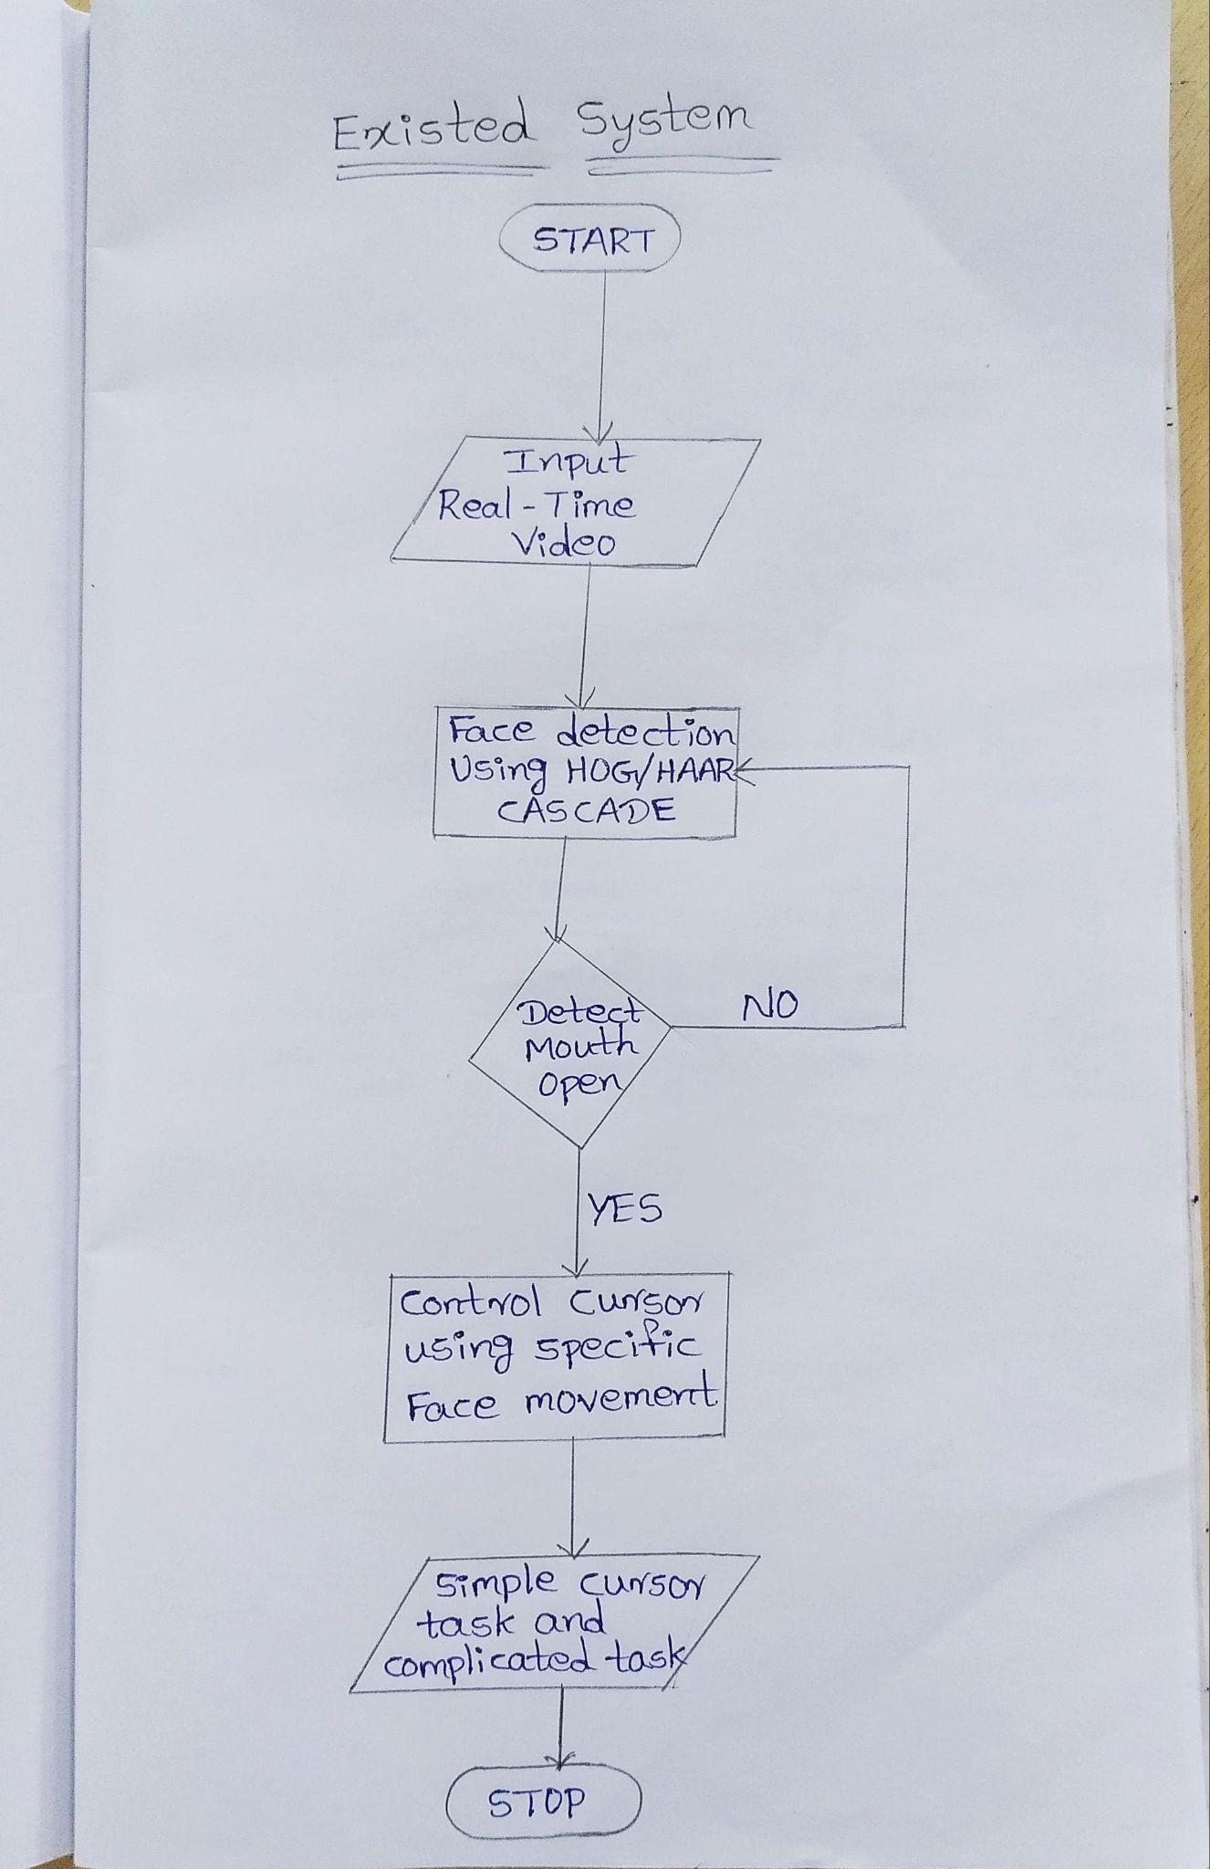
Workflow

Slide 7
Proposed system
Our proposed system is an innovative cursor control solution that utilizes facial expressions as input, offering a novel way to manage cursor movements on a computer screen. Unlike existing systems, our model supports users wearing spectacles and ensures high responsiveness and accuracy comparable to traditional input devices like a mouse or trackpad. This enables faster, more intuitive control of the cursor and precise interpretation of facial expressions.
Advantages:
Accessibility:Enables individuals with physical disabilities or limited mobility to control a computer mouse with facial movements.
Convenience: Allows users to control the mouse without physical touch, providing an intuitive interface.
Precision: Offers a high level of precision for mouse cursor control, enhancing navigation accuracy.
Reduced Risk of Injury: Helps reduce the risk of repetitive strain injuries and other physical ailments from prolonged mouse use.

Slide 8
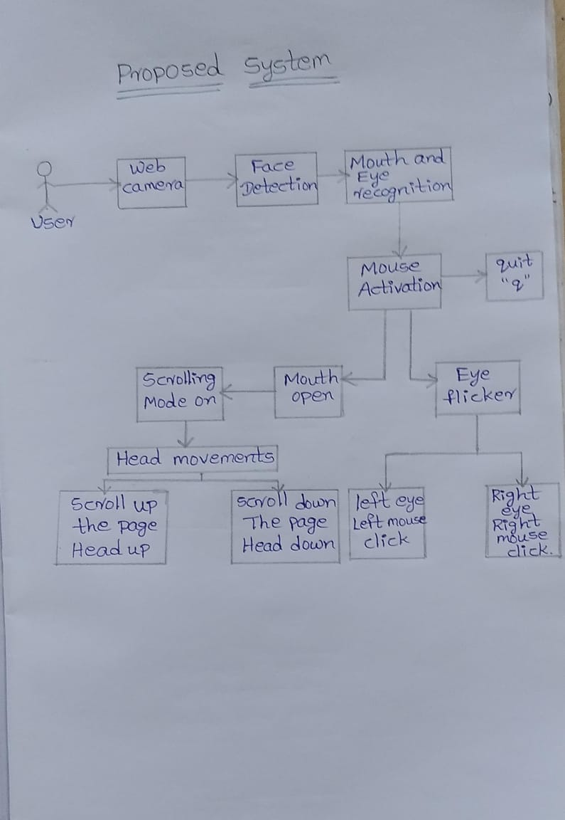
Workflow

Slide 9
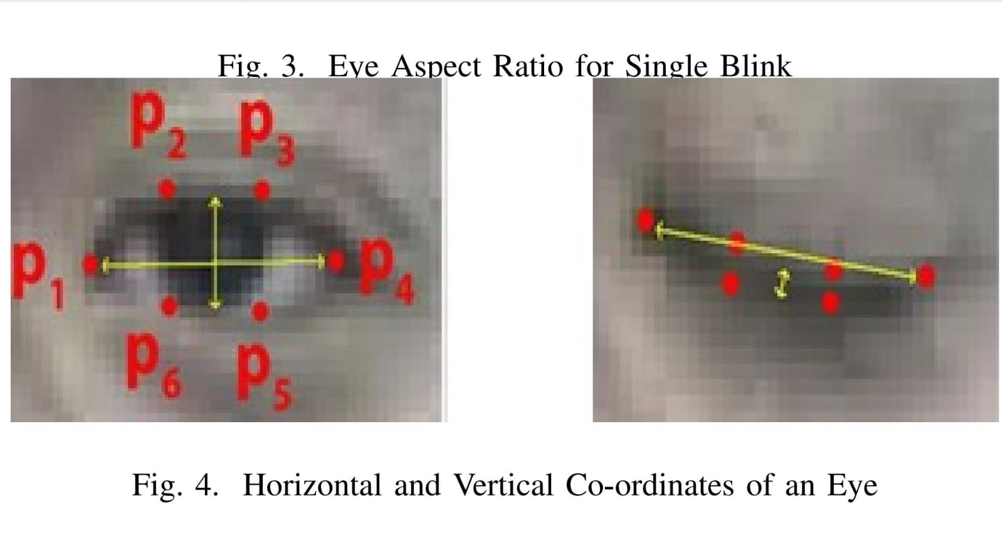
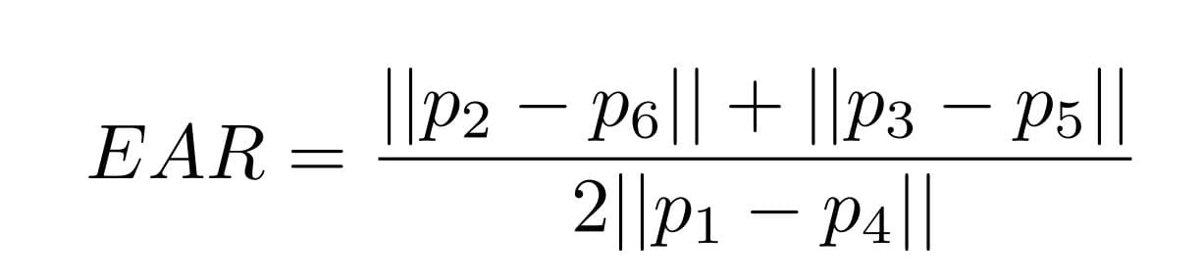
Algorithm
1. Initialization and Setup:
Import necessary libraries (imutils, dlib, cv2, pyautogui, numpy, time).
Define functions for calculating distances between points (dst), eye aspect ratio (Ear), mouth aspect ratio (Mar), and angle calculation (angle).
Eye Aspect Ratio(EAR):

Slide 10
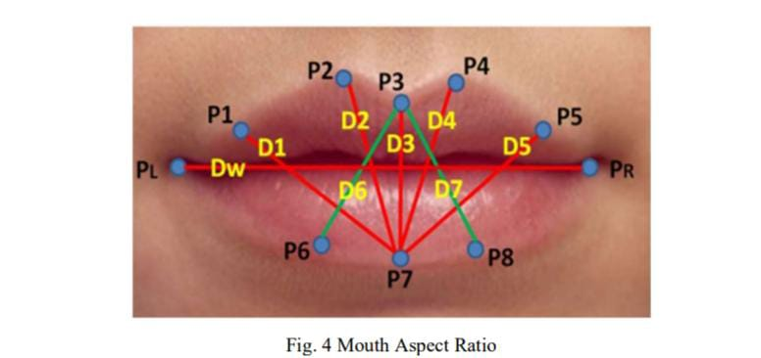
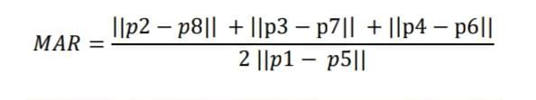
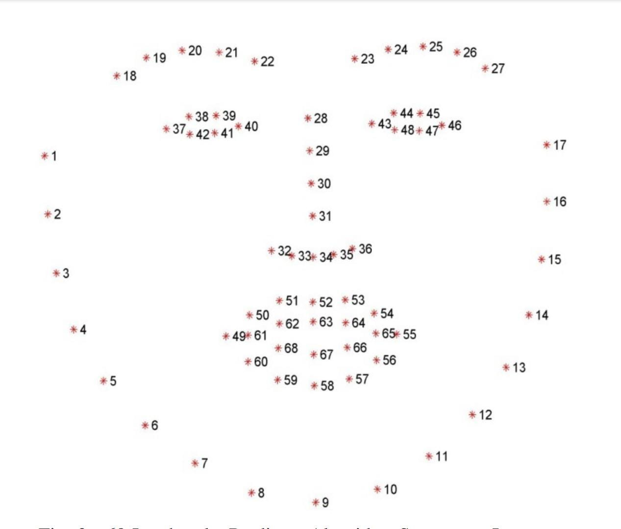
Algorithm (conti..)
Mouth Aspect Ratio(MAR):
2. Face Detection and Landmark Localization:
Load the pre-trained face detector and shape predictor.
Capture video from the default webcam.

Slide 11
Algorithm (conti..)
3. Main Processing Loop (Calibration Phase):
Continuously read frames from the webcam.
Convert frames to grayscale and apply histogram equalization for enhancing facial landmarks.
Detect faces in the grayscale image using the detector.
For each detected face:
Predict facial landmarks.
Calculate eye aspect ratio (Ear) and mouth aspect ratio (Mar).
Determine eye closure and mouth opening based on predefined thresholds and durations.
Draw contours around eyes and mouth on the live video feed.
Display text indications based on the detected actions.
Update arrays with relevant measurements.
4. Post-Calibration:
Calculate median values from recorded arrays to establish thresholds for actions (e.g., left-click, right-click, scrolling).

Slide 12
Algorithm (conti..)
5. Cursor Control Loop:
Reinitialize video capture for cursor control phase.
Continuously read frames and process similar to the calibration phase:
Detect facial landmarks and calculate eye aspect ratio (Ear), mouth aspect ratio (Mar), and other features.
Track the position of the nose tip to control cursor movement.
Depending on eye movements and face orientation:
Perform left-click or right-click.
Control scrolling based on head orientation and mouth opening.
Display cursor movement and scrolling mode activation feedback.
6. Error Handling:
Handle exceptions (such as when no landmarks are detected) gracefully by displaying appropriate messages on the screen.
7. Termination:
Press 'q' to exit the program.
8. Cleanup:
Release the webcam and close all OpenCV windows.

Slide 13
Libraries used
Numpy
OpenCV
PyAutoGUI
Dlib
Imutils

Slide 14
Scope of the project
A facial mouse controlling system aims to empower individuals with limited mobility, including those with conditions like spinal cord injuries, muscular dystrophy, cerebral palsy, or paralysis, by enabling independent computer interaction. This system allows users to control computers, tablets, or smartphones using facial gestures, offering an alternative hands-free input method. By implementing various facial gestures for actions such as clicking and scrolling, it provides a versatile and accessible means of navigating and interacting with digital devices, enhancing usability and independence for users with physical disabilities.

Slide 15
Conclusion
This research attempts to make computer interaction more accessible to physically challenged persons by employing face motions to control mouse activities and monitor the screen. The programme captures photographs using a camera and processes facial motions for identification. This unique idea has the potential to significantly enhance the experience of physically challenged folks who struggle to operate a regular mouse. It is a step towards making technology more inclusive and accessible to everybody.

Slide 16
Resources
1. Shashidhar R, Snehith K, Abhishek P K, Abhishek B Vishwagna, Pavitha N(2022) “Mouse
Cusor Control Using Facial Movements - An HCI Application”
2. Salsabiil Hasanah, Aulia Teaku Nururrahmah, Darlis Herumurti(2021)
“Comparative Analysis of Hands-free Mouse Controlling based on Face Tracking”
3. Palaniappan M, Sowmia K R, Aravindkumar S(2022) “Real Time Fatigue
Detection Using Shape Predictor 68 Face Landmarks Algorithm”

Slide 17
THANK YOU

