Slide 1
iContinuousIntegration
by Oleksandr Dodatko
EPAM Systems

Slide 2
What's covered
Managing shared projects with xCode
Building a project without xCode GUI
Creating “universal binary” libraries
Deploying project and libraries for QA

Slide 3
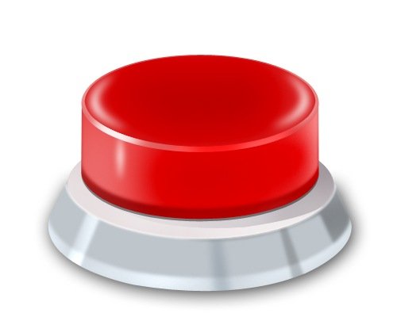
More FUN for developers
Unit testing with GHUnit
Using Hudson build server
( it has Chuck Norris plug-in )
Running applications on simulator without xCode

Slide 4
“Commonly used” Project organization

Slide 5
Wrong !!!

Slide 6
ONE Product,
ONE XCODE PROJECT

Slide 7
Library project howto
Easy, Modular Code Sharing Across iPhone Apps: Static Libraries and Cross-Project References

Slide 8
Library project howto
!!!!! Note !!!!!
Some more adjustments are still required.
!!!!! Note !!!!!
Easy, Modular Code Sharing Across iPhone Apps: Static Libraries and Cross-Project References

Slide 9
Setting up dependencies

Slide 10
Defining project structure
app
lib
frameworks
scripts
tools
test
certificates
deployment

Slide 11
Deployment : Desktop vs. mobile

Slide 12

Desktop applications
+

Slide 13
Mobile
?
?

Slide 14
Mobile QA
*.ipa

Slide 15
Building without xCode GUI
xcodebuild -project $PROJECT_NAME.xcodeproj
-target $TARGET_NAME
-configuration Release
-parallelizeTargets
-sdk iphonesimulator4.3
clean build

Slide 16
Creating *.ipa file
/usr/bin/xcrun
-sdk iphoneos PackageApplication
-v "${BUILD_DIR}/Release-iphoneos/${PROJECT_NAME}.app"
-o "${DEPLOYMENT_DIR}/${PROJECT_NAME}.ipa"
--sign "${DEVELOPER_NAME}"
--embed "${PROVISONING_PROFILE}"
DEVELOPER_NAME="iPhone Developer: Oleksandr Dodatko (ABCDEFG123456)"

Slide 17
How about unit testing?
Picking a framework
Running a test
Collecting results

Slide 18
Test frameworks chart
 | SenTest | Google | GHUnit
Xcode integration | + | + | ---
UIKit Support | --- | --- | +
Bundles support | --- | --- | +
Xml reports | --- | --- | + (lack of support for hudson CI)
Runs on device | +- ( Runtime tests only ) | +- ( Runtime tests only ) | +
Runs on simulator | +- ( logic tests only ) | +- ( logic tests only ) | +
Debugging (out of box) | --- | --- | +
UI snapshots comparing | --- | + | ---

Slide 19
GHUnit configuration
Add GHUnit.framework
Replace Main.h with the one from GHUnit
Remove “MainNibFile” entry from the info.plits
setenv( "GHUNIT_AUTORUN" , "YES", 1 );
setenv( "WRITE_JUNIT_XML", "YES", 1 );
// Not supported in the official GHUNIT
setenv( "GHUNIT_AUTOEXIT" , "YES", 1 );

Slide 20
Running test
"$TOOLS_DIR/iphonesim"
launch "$DEPLOYMENT_DIR/CITest.app"
4.2
ipad
NOTE : Use only FULL PATH to the app
as shown above

Slide 21
Collect results
TEMP_DIR=$(/usr/bin/getconf DARWIN_USER_TEMP_DIR)
TEST_DIR_NAME=test-results
TEST_RESULTS_DIR=$TEMP_DIR$TEST_DIR_NAME
## Now we can just copy test results
cd "$TEST_RESULTS_DIR"
pwd
cp *.xml "$TEST_PUBLISH_DIR"
cd "$LAUNCH_DIR"

Slide 22
Terminating simulator
killall -s -KILL -c "iphonesim"
killall -KILL -c "iphonesim"
killall -s -KILL -c "iPhone Simulator"
killall -KILL -c "iPhone Simulator"

Slide 23
Universal binaries
1. Build a library version for the device.
2. Build a library version for the simulator.
3. Combine them to a single binary
4. Deploy universal library to the “frameworks” directory.

Slide 24
Combining binaries
lipo -create
"${LIB_BUILD_DIR}/Release-iphoneos/libCITest_Model_Universal.a"
"${LIB_BUILD_DIR}/Release-iphonesimulator/
libCITest_Model_Universal.a"
-output "../frameworks/CITest-Model-Universal/Lib/libCITest_Model_Universal.a"

Slide 25
Build script should
Build main products
Create *.ipa packages for main products
Build unit tests
Run unit tests with iphonesim
Package *.ipa and *.app entries to *.zip archive
Prepare unit test reports for deployment

Slide 26
Build server should
Checkout project sources
Run build script
Deploy product archives
Publish test reports

Slide 27
Contacts
EPAM systems (Dnipropetrovsk) http://www.epam.com/
Github page : https://github.com/EmbeddedSources
https://github.com/EmbeddedSources/iOS-articles
Oleksandr Dodatko – senior objC developer
mail/jabber : dodikk88.reg@gmail.com
Skype : alexander.dodatko.work@skype.com
Github page : https://github.com/dodikk

