Slide 1

Team: Convo Neurons Project: Brain Tumor Detection Theme: Health Care
Pasckathon 3.0
1. Hrushikesh Kachgunde – Dr. D. Y. Patil Institute of Engineering Management and Research (Akurdi, Pune)
2. Amogh Patil - MGM's Jawaharlal Nehru Engineering College
(Aurangabad)

Slide 2
Brain Tumor Detection
Health Care is a serious problem domain, we at Convo Neurons believe to develop practical and reliable AI that can take responsibility for human lives.
Brain tumour is a serious issue with life threatening consequences. Tumors may be benign (not cancer) or malignant (cancer).
Tumors that are at early stage (small tumors) are hard to read by naked eye. Several tests need to be done on the patient to check for change in hormones hence increasing the cost of medical expenses.
With this model we aim to look for increase in accuracy to predict tumor with reducing the cost for tests.

Slide 3
Features of the Application
1. Predict as well as detect the location of the tumour in the brain.
2. Fast, Reliable and Accurate results.
3. Can be used with multiple patients at a time.
4. Cost efficient.
5. Works even on low end devices like mobile phones.

Slide 4
Novelty of the Application
Innovative technology that can lead mankind into the future.
There are very few innovations that are actually being implemented in the health care domain.
The model is built on U-net architecture whose research paper has already been made public.

Slide 5
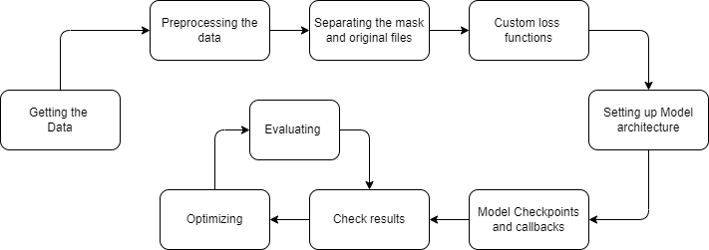
Modelling Approach
To build this model we will be using a set of 3929 scanned Brain MRI’s of 110 patients including there tumour images.
Pre-processing the data will be needed since we are using high resolution images of tiff format.
Custom loss functions will be coded to monitor the training of our model.
U-net architecture will be defined in the next process following creation of model checkpoints to save best model.
The dataset used for training the model already consists of images that have tumour located in them for a particular patient along with other features.

Slide 6
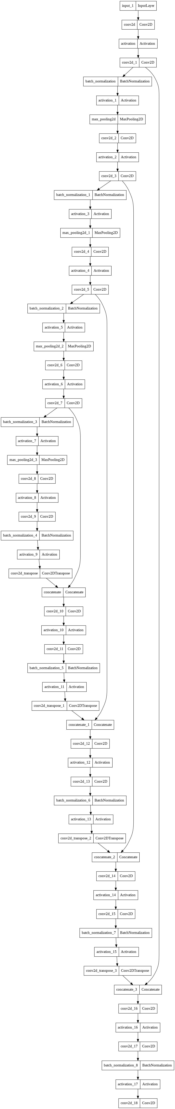
Model Architecture
The U-net architecture we propose will work on considering retaining the features learnt by the model after passing through a sequence of different convolutional and activation layers.
The filters will be retained in the same order they were used to find the patterns in first phase of the architecture.
The model to the left is our proposed model which would actually make sense if it were in horizontal position.
The model is expected to have a whopping 3,10,37,633 parameters to detect the mask which is the tumour in our problem statement. Overall during the model training all the images will be kept at (256, 256).
Visit this link to have a better look at the diagram: U-net Architecture

Slide 7

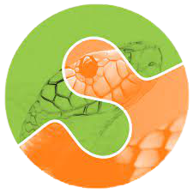


Tech Stack
Tensor-Flow
Scikit-Image
OpenCV
Stream-lit
Tensor-flow for model building and coding loss functions, OpenCV and Scikit-Image for image processing, Stream-lit for deploying the model to the web.

Slide 8

Business Plan & Market Survey
The model which we propose is highly cost efficient since there are no external charges except serving the model on a cloud computer.
For the time being we are using a free cloud service that allows Machine learning models to be deployed to the web free of cost.
AI in Health care is a promising stake. Giving it a chance is worth it, yet there are very few applications of the same. The market competition for our model is quite low.
The main problem that comes is reliability – Can machines be actually trusted on people’s lives? To solve this issue we suggest not to totally rely on the model but to some extent
Regulatory lines can be developed for a human involvement for sensitive cases or cases where the model drastically fails.

Slide 9
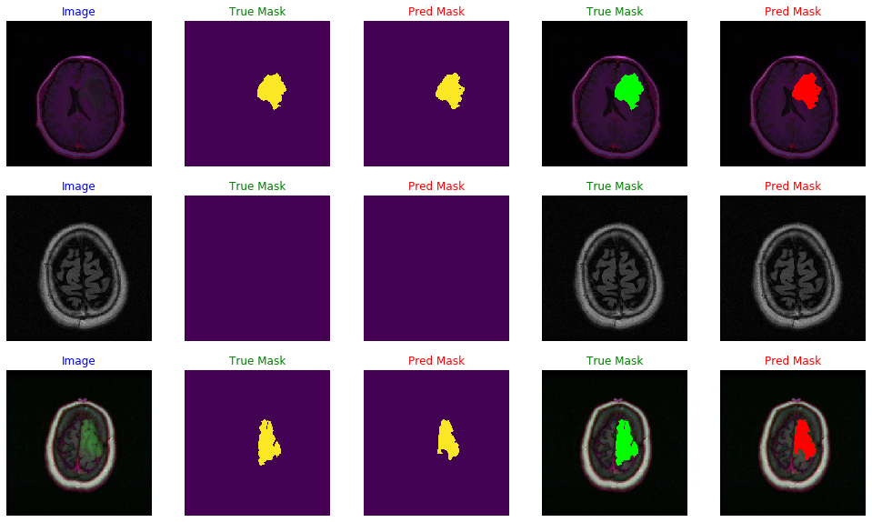
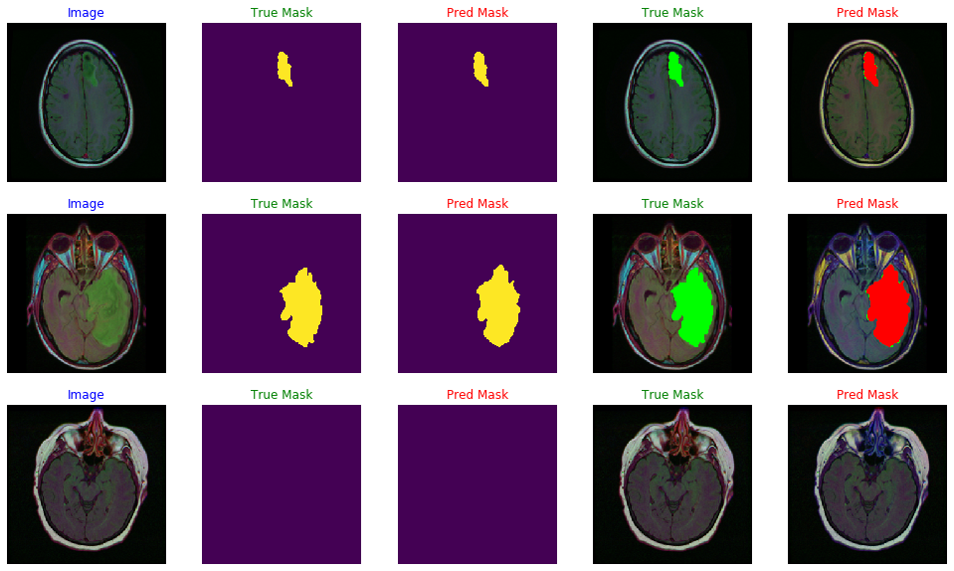
Some of the results from our Model

Slide 10
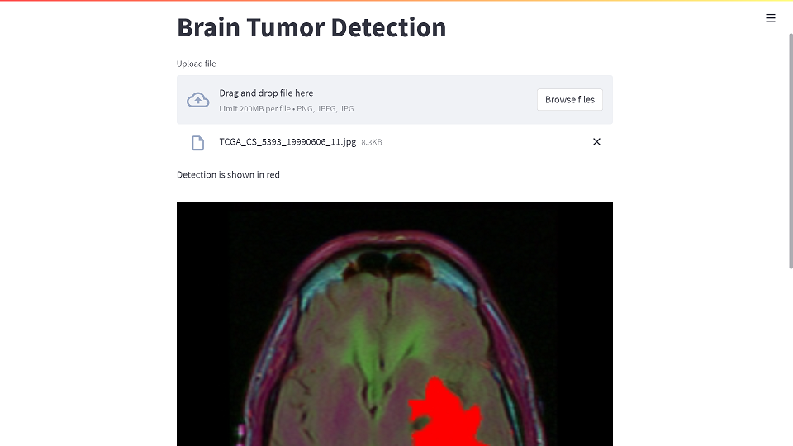
Proposed UI
Simple UI that takes an image of Brain MRI and predicts the tumour in red color
Brain Tumor Detection App

