Slide 1
Amazon Price Comparison
CSCI 4970: Capstone
Lucy Horpedahl, Nathan Noonan, Dan O’Doherty, Nick Richardson

Slide 2
Client
Justin Richardson
owner of Digital Attitudes
Small business in Crossroads Mall
Sells
Japanese animation collectibles
Movies
Books
More
Also sells used items
Bases prices on Amazon Marketplaces prices

Slide 3
Original Plan
Make new point-of-sale system for Digital Attitudes
Mostly same functionality as typical point-of-sale
Additional feature
Price comparison component
Allows specific items to be looked up on Amazon
Client can use these prices to determine if his prices need to be changed

Slide 4
New Plan
Reasons
Client’s current point-of-sale system was better than expected
Developing a full point-of-sale system would be a very big project
Narrowed project to only be a price comparison application
Separate application from database and current point-of-sale
Needs to read from and write to database
Search for prices on Amazon

Slide 5
Implementation
Microsoft Visual C# 2010 Express
Using this for development of application
Microsoft Studio SQL Server 2008
Creating duplicate database for development
The client’s database uses this software
Using this so the application will work on the client’s computer

Slide 6
Architecture
Database
Amazon
Application
Application reads from the database of inventory
Items need to be sent to Amazon in a request for prices
Amazon Web Services API
Web scraper
Results received from Amazon
Statistical analysis done to results (removing outliers, etc.)
Results will be displayed in application
Application writes to the database to modify prices

Slide 7
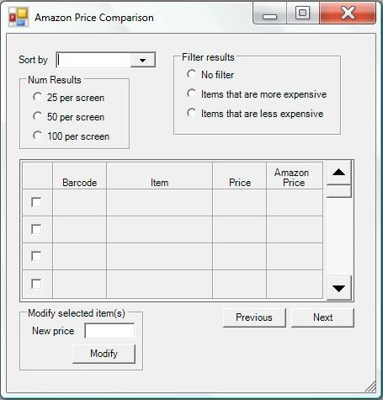
Form
Display the results
Offer a number of options
Allow sorting by
Price (low to high)
Price (high to low)
Difference (low to high)
Difference (high to low)
Change the number of results on a screen
Only show items with a higher price on Amazon or a lower price on Amazon
Allow prices to be modified from the form

Slide 8
Amazon
Amazon Web Services API
Contains code allowing a search of Amazon.com
Methods like “ItemSearch” and “ItemLookup”
Need AWS Access Key ID
Web scraper
If AWS does not work
Scrape page
Parse information (regular expressions)

Slide 9
To Do
Get application to communicate with database
Read from and write to
Get application to communicate with Amazon
Retrieve pricing information
Analyze prices
Remove outliers
Average
Display results on form
Average
Possibly highest and lowest prices

Slide 10

Questions?

