Slide 1
Large-Scale Parallel Collaborative Filtering for the Netflix Prize
Yunhong Zhou, Dennis Wilkinson, Robert Schreiber, and Rong Pan
LNCS 5034, pp. 337–348, 2008.

Slide 2
Abstract
Many recommendation systems suggest items to users by utilizing the techniques of collaborative filtering.
Two major problems that most CF approaches have to contend with are scalability and sparseness of the user profiles.
In this paper, we describe a CF algorithm alternating-least-squares with weighted-λ-regularization (ALS-WR).
We achieved a performance improvement of 5.91% over Netflix’s own Cine-Match recommendation system.

Slide 3
Introduction(1/2)
The Netflix Prize is a large-scale data mining competition held by Netflix for the best recommendation system algorithm for predicting user ratings on movies, based on a training set of more than 100 million ratings given by over 480,000 users to 17,700 movies.
Each training data point consists of a quadruple (user, movie, date, rating) where rating is an integer from 1 to 5. The test dataset consists of 2.8 million data points with the ratings hidden.
The goal is to minimize the RMSE when predicting the ratings on the test dataset. Netflix’s own recommendation system scores 0.9514 on the test dataset, and the grand challenge is to improve it by 10%.

Slide 4
Introduction(2/2)
The Netflix problem presents a number of practical challenges.
The size of the dataset is 100 times larger than previous benchmark datasets, resulting in much longer model training time and much larger system memory requirements.
Only about 1% of the user-movie matrix has been observed, with the majority of (potential) ratings missing.
There is noise in both the training and test dataset, due to human behavior.
The distribution of ratings per user in the training and test datasets are different.

Slide 5






Problem Formulation(1/6)
Let ${R=\{r_{ij}\}}_{nu∗nm}$denote the user-movie matrix.
The Netflix dataset consists of $n_{m}$= 17770 movies, $n_{u}$ = 488000 users, and $n_{r}$ ≈ 100 million known ratings.
R
…
$$M_{j}$$
$$M_{1}$$
4 |  | 3
 | 2
1 | 5
 | 3
$$U_{1}$$
$$U_{2}$$
…
$$U_{n}$$

Slide 6
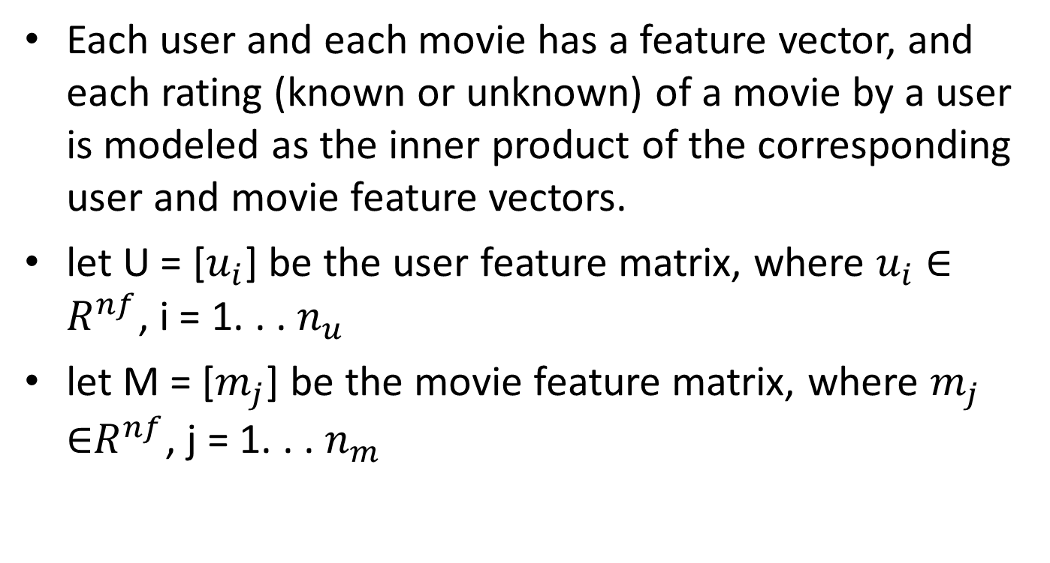
Problem Formulation(2/6)
Each user and each movie has a feature vector, and each rating (known or unknown) of a movie by a user is modeled as the inner product of the corresponding user and movie feature vectors.
let U = [$u_{i}$] be the user feature matrix, where $u_{i}$ ∈ $R^{nf}$, i = 1. . . $n_{u}$
let M = [$m_{j}$] be the movie feature matrix, where $m_{j}$ ∈$R^{nf}$, j = 1. . . $n_{m}$

Slide 7










Problem Formulation(3/6)
$$U_{1}$$
$$U_{2}$$
…
$$U_{n}$$
$$M_{1}$$
$$M_{2}$$
…
$$M_{j}$$
$$F_{1}$$
$$F_{1}$$
…
…
$$F_{k}$$
$$F_{k}$$
U: the user feature matrix
M: the movie feature matrix

Slide 8

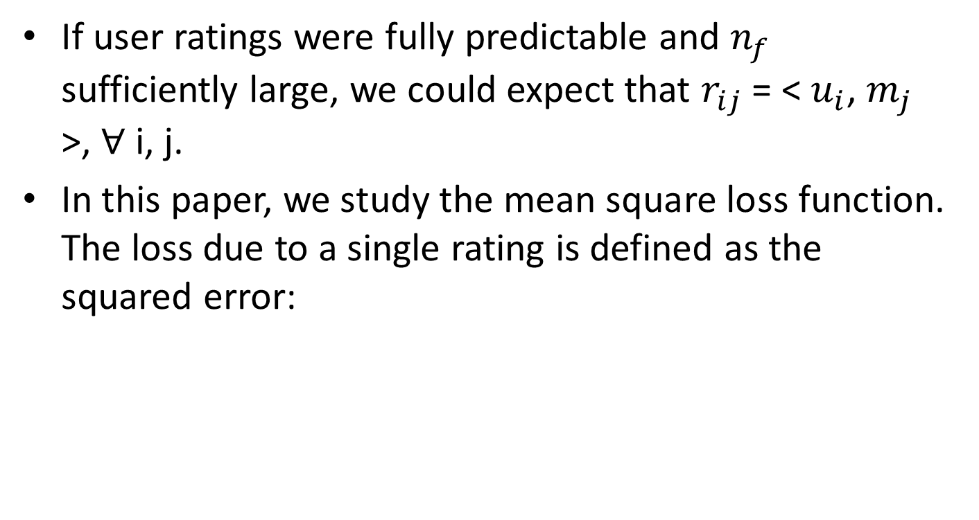
Problem Formulation(4/6)
If user ratings were fully predictable and $n_{f}$ sufficiently large, we could expect that $r_{ij}$ = < $u_{i}$, $m_{j}$ >, ∀ i, j.
In this paper, we study the mean square loss function. The loss due to a single rating is defined as the squared error:

Slide 9
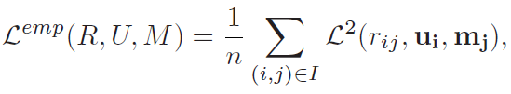

Problem Formulation(5/6)
Then we can define the empirical, total loss (for a given pair U and M) as the summation of loss on all the known ratings.
We can formulate the low-rank approximation problem as follows.

Slide 10

Problem Formulation(6/6)
When $n_{f}$ is relatively large, solving the problem overfits the data. To avoid overfitting, a common method appends a Tikhonov regularization term to the empirical risk function:

Slide 11
Approaches(1/5)
In this paper, we use alternating-least-squares (ALS) to solve the low-rank matrix factorization problem as follows:
Step 1. Initialize matrix M by assigning the average rating for that movie as the first row, and small random numbers for the remaining entries.
Step 2. Fix M, Solve for U by minimizing the objective function.
Step 3. Fix U, solve for M by minimizing the objective function similarly.
Step 4. Repeat Steps 2 and 3 until a stopping criterion is satisfied(If the change in RMSE is less than 0.0001).

Slide 12
















Approaches(2/5)
R
$$M_{1}$$
…
$$M_{j}$$
$$U_{1}$$
4 |  | 3
 | 2
1 | 5
 | 3
$$U_{2}$$
R$≈U^{T}M=\hat{R}$
…
$$U_{n}$$
U
M
$$U_{1}$$
$$U_{2}$$
…
$$U_{n}$$
$$M_{1}$$
$$M_{2}$$
…
$$M_{j}$$
$$F_{1}$$
$$F_{1}$$
…
…
$$F_{k}$$
$$F_{k}$$

Slide 13

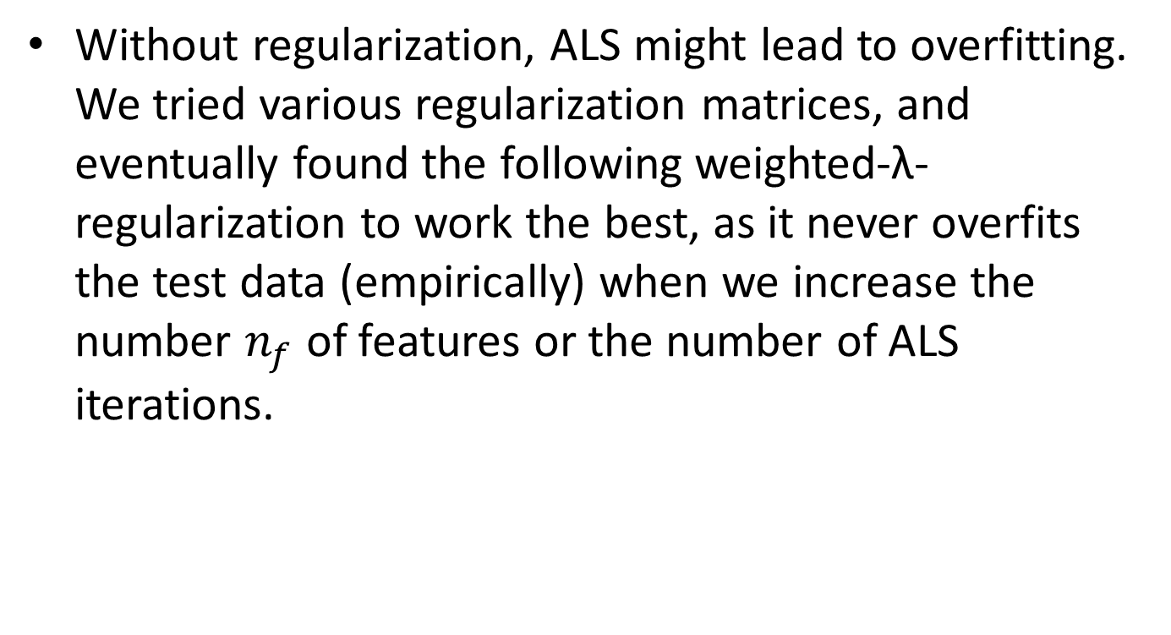
Approaches(3/5)
Without regularization, ALS might lead to overfitting. We tried various regularization matrices, and eventually found the following weighted-λ-regularization to work the best, as it never overfits the test data (empirically) when we increase the number $n_{f}$ of features or the number of ALS iterations.

Slide 14

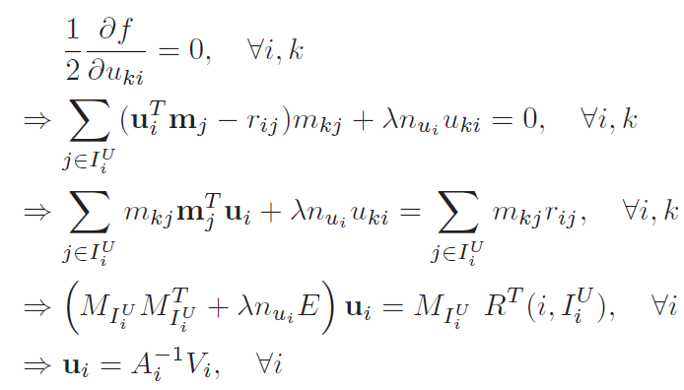


Approaches(4/5)
A given column of U, say $u_{i}$, is determined by solving a regularized linear least squares problem involving the known ratings of user i, and the feature vectors $m_{j}$ of the movies j ∈ that user i has rated.

Slide 15


Approaches(5/5)
Similarly, when M is updated, we can compute individual $m_{j}^{}$‘s via a regularized linear least squares solution, using the feature vectors of users who rated movie j, and their ratings of it, as follows:

Slide 16
Concluding Remarks
We introduced a simple parallel algorithm for large-scale collaborative filtering which, in the case of the Netflix prize, performed as well as any single method reported in the literature. Our algorithm is designed to be scalable to very large datasets.
ALS-WR in particular is able to achieve good results without using date or movie title information.
The fast runtime achieved through parallelization is a competitive advantage for model building and parameter tuning in general. It will be interesting to develop a theory to explain why ALS-WR never overfits the data.

