Slide 1
Data Mining:
Concepts and Techniques
(3rd ed.)
— Chapter 10 —
Jiawei Han, Micheline Kamber, and Jian Pei
University of Illinois at Urbana-Champaign &
Simon Fraser University
©2011 Han, Kamber & Pei. All rights reserved.

Slide 2
Chapter 10. Cluster Analysis: Basic Concepts and Methods
Cluster Analysis: Basic Concepts
Partitioning Methods
Hierarchical Methods
Density-Based Methods
Grid-Based Methods
Evaluation of Clustering
Summary

Slide 3
What is Cluster Analysis?
Cluster: A collection of data objects
  similar (or related) to one another within the same group
  dissimilar (or unrelated) to the objects in other groups
Cluster analysis (or clustering, data segmentation, …)
  Finding similarities between data according to the characteristics found in the data and grouping similar data objects into clusters
Unsupervised learning: no predefined classes (i.e., learning by observations vs. learning by examples: supervised)
Typical applications
  As a stand-alone tool to get insight into data distribution
  As a preprocessing step for other algorithms

Slide 4
Clustering for Data Understanding and Applications
Biology: taxonomy of living things: kingdom, phylum, class, order, family, genus and species
Information retrieval: document clustering
Land use: Identification of areas of similar land use in an earth observation database
Marketing: Help marketers discover distinct groups in their customer bases, and then use this knowledge to develop targeted marketing programs
City-planning: Identifying groups of houses according to their house type, value, and geographical location
Earth-quake studies: Observed earth quake epicenters should be clustered along continent faults
Climate: understanding earth climate, find patterns of atmospheric and ocean
Economic Science: market resarch

Slide 5
Clustering as a Preprocessing Tool (Utility)
Summarization:
  Preprocessing for regression, PCA, classification, and association analysis
Compression:
  Image processing: vector quantization
Finding K-nearest Neighbors
  Localizing search to one or a small number of clusters
Outlier detection
  Outliers are often viewed as those “far away” from any cluster

Slide 6
Quality: What Is Good Clustering?
A good clustering method will produce high quality clusters
  high intra-class similarity: cohesive within clusters
  low inter-class similarity: distinctive between clusters
The quality of a clustering method depends on
  the similarity measure used by the method
  its implementation, and
  Its ability to discover some or all of the hidden patterns

Slide 7
Measure the Quality of Clustering
Dissimilarity/Similarity metric
  Similarity is expressed in terms of a distance function, typically metric: d(i, j)
  The definitions of distance functions are usually rather different for interval-scaled, boolean, categorical, ordinal ratio, and vector variables
  Weights should be associated with different variables based on applications and data semantics
Quality of clustering:
  There is usually a separate “quality” function that measures the “goodness” of a cluster.
  It is hard to define “similar enough” or “good enough”
    The answer is typically highly subjective

Slide 8
Considerations for Cluster Analysis
Partitioning criteria
  Single level vs. hierarchical partitioning (often, multi-level hierarchical partitioning is desirable)
Separation of clusters
  Exclusive (e.g., one customer belongs to only one region) vs. non-exclusive (e.g., one document may belong to more than one class)
Similarity measure
  Distance-based (e.g., Euclidian, road network, vector) vs. connectivity-based (e.g., density or contiguity)
Clustering space
  Full space (often when low dimensional) vs. subspaces (often in high-dimensional clustering)

Slide 9
Major Clustering Approaches (I)
Partitioning approach:
  Construct various partitions and then evaluate them by some criterion, e.g., minimizing the sum of square errors
  Typical methods: k-means, k-medoids, CLARANS
Hierarchical approach:
  Create a hierarchical decomposition of the set of data (or objects) using some criterion
  Typical methods: Diana, Agnes, BIRCH, CAMELEON
Density-based approach:
  Based on connectivity and density functions
  Typical methods: DBSACN, OPTICS, DenClue
Grid-based approach:
  based on a multiple-level granularity structure
  Typical methods: STING, WaveCluster, CLIQUE

Slide 10
Major Clustering Approaches (II)
Model-based:
  A model is hypothesized for each of the clusters and tries to find the best fit of that model to each other
  Typical methods: EM, SOM, COBWEB
Frequent pattern-based:
  Based on the analysis of frequent patterns
  Typical methods: p-Cluster
User-guided or constraint-based:
  Clustering by considering user-specified or application-specific constraints
  Typical methods: COD (obstacles), constrained clustering
Link-based clustering:
  Objects are often linked together in various ways
  Massive links can be used to cluster objects: SimRank, LinkClus

Slide 11
Chapter 10. Cluster Analysis: Basic Concepts and Methods
Cluster Analysis: Basic Concepts
Partitioning Methods
Hierarchical Methods
Density-Based Methods
Grid-Based Methods
Evaluation of Clustering
Summary

Slide 12

Partitioning Algorithms: Basic Concept
Partitioning method: Partitioning a database D of n objects into a set of k clusters, such that the sum of squared distances is minimized (where c_{i} is the centroid or medoid of cluster C_{i})
Given k, find a partition of k clusters that optimizes the chosen partitioning criterion
  Global optimal: exhaustively enumerate all partitions
  Heuristic methods: k-means and k-medoids algorithms
  k-means (MacQueen’67, Lloyd’57/’82): Each cluster is represented by the center of the cluster
  k-medoids or PAM (Partition around medoids) (Kaufman & Rousseeuw’87): Each cluster is represented by one of the objects in the cluster

Slide 13
The K-Means Clustering Method
Given k, the k-means algorithm is implemented in four steps:
  Partition objects into k nonempty subsets
  Compute seed points as the centroids of the clusters of the current partitioning (the centroid is the center, i.e., mean point, of the cluster)
  Assign each object to the cluster with the nearest seed point
  Go back to Step 2, stop when the assignment does not change

Slide 14





An Example of K-Means Clustering
K=2
Arbitrarily partition objects into k groups
Update the cluster centroids
The initial data set
Loop if needed
Reassign objects
Partition objects into k nonempty subsets
Repeat
  Compute centroid (i.e., mean point) for each partition
  Assign each object to the cluster of its nearest centroid
Until no change
Update the cluster centroids

Slide 15
Comments on the K-Means Method
Strength: Efficient: O(tkn), where n is # objects, k is # clusters, and t is # iterations. Normally, k, t << n.
    Comparing: PAM: O(k(n-k)² ), CLARA: O(ks² + k(n-k))
Comment: Often terminates at a local optimal.
Weakness
  Applicable only to objects in a continuous n-dimensional space
    Using the k-modes method for categorical data
    In comparison, k-medoids can be applied to a wide range of data
  Need to specify k, the number of clusters, in advance (there are ways to automatically determine the best k (see Hastie et al., 2009)
  Sensitive to noisy data and outliers
  Not suitable to discover clusters with non-convex shapes

Slide 16
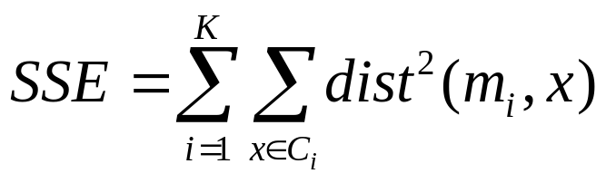
Evaluating K-means Clusters
Most common measure is Sum of Squared Error (SSE)
  For each point, the error is the distance to the nearest cluster
  To get SSE, we square these errors and sum them.
  x is a data point in cluster C_{i} and m_{i} is the representative point for cluster C_{i}
    can show that m_{i} corresponds to the center (mean) of the cluster
  Given two clusters, we can choose the one with the smallest error
  One easy way to reduce SSE is to increase K, the number of clusters
    A good clustering with smaller K can have a lower SSE than a poor clustering with higher K

Slide 17
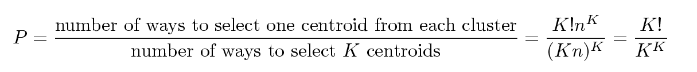
Problems with Selecting Initial Points
If there are K ‘real’ clusters then the chance of selecting one centroid from each cluster is small.
  Chance is relatively small when K is large
  If clusters are the same size, n, then
  For example, if K = 10, then probability = 10!/10¹⁰ = 0.00036
  Sometimes the initial centroids will readjust themselves in ‘right’ way, and sometimes they don’t
  Consider an example of five pairs of clusters

Slide 18
Solutions to Initial Centroids Problem
Multiple runs
  Helps, but probability is not on your side
Sample and use hierarchical clustering to determine initial centroids
Select more than k initial centroids and then select among these initial centroids
  Select most widely separated
Postprocessing
Bisecting K-means
  Not as susceptible to initialization issues

Slide 19
Handling Empty Clusters
Basic K-means algorithm can yield empty clusters
Several strategies
  Choose the point that contributes most to SSE
  Choose a point from the cluster with the highest SSE
  If there are several empty clusters, the above can be repeated several times.

Slide 20
Pre-processing and Post-processing
Pre-processing
  Normalize the data
  Eliminate outliers
Post-processing
  Eliminate small clusters that may represent outliers
  Split ‘loose’ clusters, i.e., clusters with relatively high SSE
  Merge clusters that are ‘close’ and that have relatively low SSE
  Can use these steps during the clustering process
    ISODATA

Slide 21

Variations of the K-Means Method
Most of the variants of the k-means which differ in
  Selection of the initial k means
  Dissimilarity calculations
  Strategies to calculate cluster means
Handling categorical data: k-modes
  Replacing means of clusters with modes
  Using new dissimilarity measures to deal with categorical objects
  Using a frequency-based method to update modes of clusters
  A mixture of categorical and numerical data: k-prototype method

Slide 22
What Is the Problem of the K-Means Method?
The k-means algorithm is sensitive to outliers !
  Since an object with an extremely large value may substantially distort the distribution of the data
K-Medoids: Instead of taking the mean value of the object in a cluster as a reference point, medoids can be used, which is the most centrally located object in a cluster
10
10
9
9
8
8
7
7
6
6
5
5
4
4
3
3
2
2
1
1
0
0
1
2
3
4
5
6
7
8
9
10
0
0
1
2
3
4
5
6
7
8
9
10

Slide 23

PAM: A Typical K-Medoids Algorithm
Total Cost = 20
10
9
8
Arbitrary choose k object as initial medoids
Assign each remaining object to nearest medoids
7
6
5
4
3
2
1
0
0
1
2
3
4
5
6
7
8
9
10
K=2
Randomly select a nonmedoid object,O_{ramdom}
Total Cost = 26
Do loop
Until no change
10
10
9
Compute total cost of swapping
9
Swapping O and O_{ramdom}
If quality is improved.
8
8
7
7
6
6
5
5
4
4
3
3
2
2
1
1
0
0
1
2
3
4
5
6
7
8
9
10
0
0
1
2
3
4
5
6
7
8
9
10

Slide 24
The K-Medoid Clustering Method
K-Medoids Clustering: Find representative objects (medoids) in clusters
  PAM (Partitioning Around Medoids, Kaufmann & Rousseeuw 1987)
    Starts from an initial set of medoids and iteratively replaces one of the medoids by one of the non-medoids if it improves the total distance of the resulting clustering
    PAM works effectively for small data sets, but does not scale well for large data sets (due to the computational complexity)
Efficiency improvement on PAM
  CLARA (Kaufmann & Rousseeuw, 1990): PAM on samples
  CLARANS (Ng & Han, 1994): Randomized re-sampling

Slide 25
Chapter 10. Cluster Analysis: Basic Concepts and Methods
Cluster Analysis: Basic Concepts
Partitioning Methods
Hierarchical Methods
Density-Based Methods
Grid-Based Methods
Evaluation of Clustering
Summary

Slide 26


Hierarchical Clustering
Produces a set of nested clusters organized as a hierarchical tree
Can be visualized as a dendrogram
  A tree like diagram that records the sequences of merges or splits

Slide 27
Strengths of Hierarchical Clustering
Do not have to assume any particular number of clusters
  Any desired number of clusters can be obtained by ‘cutting’ the dendogram at the proper level
They may correspond to meaningful taxonomies
  Example in biological sciences (e.g., animal kingdom, phylogeny reconstruction, …)

Slide 28
Hierarchical Clustering
Two main types of hierarchical clustering
  Agglomerative:
    Start with the points as individual clusters
    At each step, merge the closest pair of clusters until only one cluster (or k clusters) left
  Divisive:
    Start with one, all-inclusive cluster
    At each step, split a cluster until each cluster contains a point (or there are k clusters)
Traditional hierarchical algorithms use a similarity or distance matrix
  Merge or split one cluster at a time

Slide 29
Hierarchical Clustering
Use distance matrix as clustering criteria. This method does not require the number of clusters k as an input, but needs a termination condition
Step 0
Step 1
Step 2
Step 3
Step 4
agglomerative
(AGNES)
a
a b
b
a b c d e
c
c d e
d
d e
e
divisive
(DIANA)
Step 4
Step 3
Step 2
Step 1
Step 0

Slide 30

AGNES (Agglomerative Nesting)
Introduced in Kaufmann and Rousseeuw (1990)
Implemented in statistical packages, e.g., Splus
Use the single-link method and the dissimilarity matrix
Merge nodes that have the least dissimilarity
Go on in a non-descending fashion
Eventually all nodes belong to the same cluster

Slide 31
Dendrogram: Shows How Clusters are Merged
  Decompose data objects into a several levels of nested partitioning (tree of clusters), called a dendrogram
  A clustering of the data objects is obtained by cutting the dendrogram at the desired level, then each connected component forms a cluster

Slide 32
DIANA (Divisive Analysis)
Introduced in Kaufmann and Rousseeuw (1990)
Implemented in statistical analysis packages, e.g., Splus
Inverse order of AGNES
Eventually each node forms a cluster on its own

Slide 33
Distance between Clusters
X
X
Single link: smallest distance between an element in one cluster and an element in the other, i.e., dist(K_{i}, K_{j}) = min(t_{ip}, t_{jq})
Complete link: largest distance between an element in one cluster and an element in the other, i.e., dist(K_{i}, K_{j}) = max(t_{ip}, t_{jq})
Average: avg distance between an element in one cluster and an element in the other, i.e., dist(K_{i}, K_{j}) = avg(t_{ip}, t_{jq})
Centroid: distance between the centroids of two clusters, i.e., dist(K_{i}, K_{j}) = dist(C_{i}, C_{j})
Medoid: distance between the medoids of two clusters, i.e., dist(K_{i}, K_{j}) = dist(M_{i}, M_{j})
  Medoid: a chosen, centrally located object in the cluster

Slide 34



Centroid, Radius and Diameter of a Cluster (for numerical data sets)
Centroid: the “middle” of a cluster
Radius: square root of average distance from any point of the cluster to its centroid
Diameter: square root of average mean squared distance between all pairs of points in the cluster

Slide 35
Agglomerative Clustering Algorithm
More popular hierarchical clustering technique
Basic algorithm is straightforward
  Compute the proximity matrix
  Let each data point be a cluster
  Repeat
  Merge the two closest clusters
  Update the proximity matrix
  Until only a single cluster remains
Key operation is the computation of the proximity of two clusters
  Different approaches to defining the distance between clusters distinguish the different algorithms

Slide 36
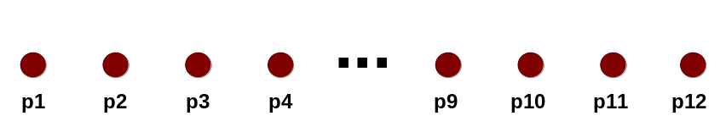
Starting Situation
Start with clusters of individual points and a proximity matrix
p1
p2
p3
p4
p5
. . .
p1
p2
p3
p4
p5
.
.
.
Proximity Matrix

Slide 37
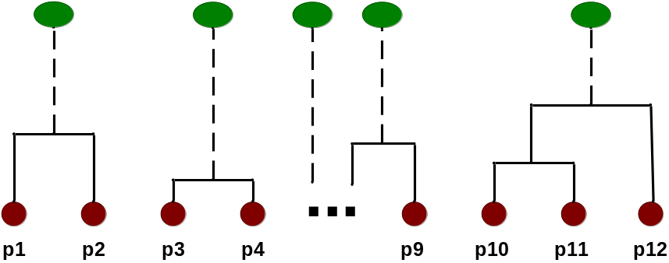
Intermediate Situation
After some merging steps, we have some clusters
C1
C2
C3
C4
C5
C1
C2
C3
C3
C4
C4
C5
Proximity Matrix
C1
C2
C5

Slide 38

Intermediate Situation
We want to merge the two closest clusters (C2 and C5) and update the proximity matrix.
C1
C2
C3
C4
C5
C1
C2
C3
C3
C4
C4
C5
Proximity Matrix
C1
C2
C5

Slide 39

After Merging
The question is “How do we update the proximity matrix?”
C2 U C5
C1
C3
C4
C1
?
C2 U C5
? ? ? ?
C3
C3
?
C4
C4
?
Proximity Matrix
C1
C2 U C5

Slide 40
How to Define Inter-Cluster Similarity
p1
p2
p3
p4
p5
. . .
p1
Similarity?
p2
p3
p4
p5
MIN
MAX
Group Average
Distance Between Centroids
Other methods driven by an objective function
  Ward’s Method uses squared error
.
.
.
Proximity Matrix

Slide 41
How to Define Inter-Cluster Similarity
p1
p2
p3
p4
p5
. . .
p1
p2
p3
p4
p5
MIN
MAX
Group Average
Distance Between Centroids
Other methods driven by an objective function
  Ward’s Method uses squared error
.
.
.
Proximity Matrix

Slide 42
How to Define Inter-Cluster Similarity
p1
p2
p3
p4
p5
. . .
p1
p2
p3
p4
p5
MIN
MAX
Group Average
Distance Between Centroids
Other methods driven by an objective function
  Ward’s Method uses squared error
.
.
.
Proximity Matrix

Slide 43
How to Define Inter-Cluster Similarity
p1
p2
p3
p4
p5
. . .
p1
p2
p3
p4
p5
MIN
MAX
Group Average
Distance Between Centroids
Other methods driven by an objective function
  Ward’s Method uses squared error
.
.
.
Proximity Matrix

Slide 44
How to Define Inter-Cluster Similarity
p1
p2
p3
p4
p5
. . .
p1
×
×
p2
p3
p4
p5
MIN
MAX
Group Average
Distance Between Centroids
Other methods driven by an objective function
  Ward’s Method uses squared error
.
.
.
Proximity Matrix

Slide 45
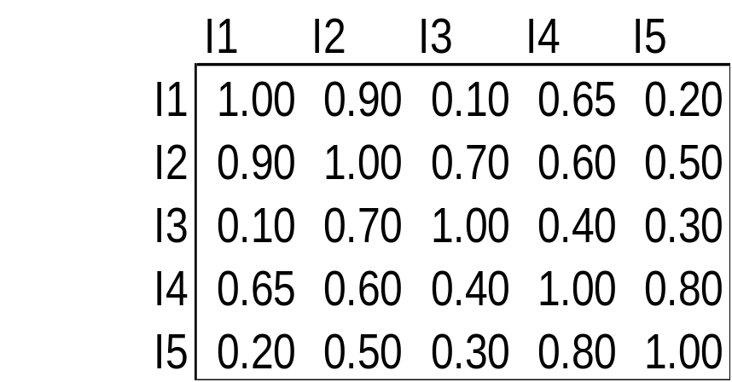
Cluster Similarity: MIN or Single Link
Similarity of two clusters is based on the two most similar (closest) points in the different clusters
  Determined by one pair of points, i.e., by one link in the proximity graph.
1
2
3
4
5

Slide 46

Hierarchical Clustering: MIN
5
1
3
5
2
1
2
3
6
4
4
Nested Clusters
Dendrogram

Slide 47

Cluster Similarity: MAX or Complete Linkage
Similarity of two clusters is based on the two least similar (most distant) points in the different clusters
  Determined by all pairs of points in the two clusters
1
2
3
4
5

Slide 48
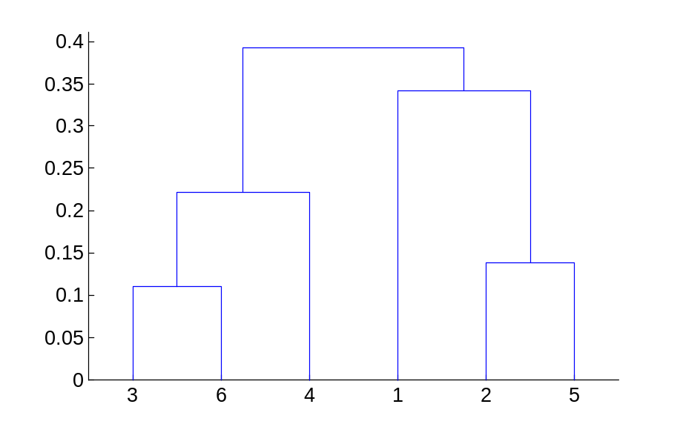
Hierarchical Clustering: MAX
4
1
2
5
5
2
3
6
3
1
4
Nested Clusters
Dendrogram

Slide 49
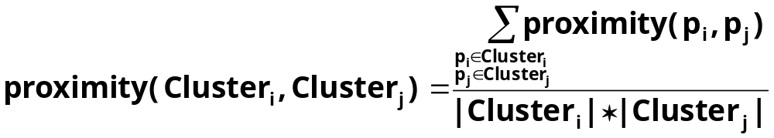

Cluster Similarity: Group Average
Proximity of two clusters is the average of pairwise proximity between points in the two clusters.
Need to use average connectivity for scalability since total proximity favors large clusters
1
2
3
4
5

Slide 50

Hierarchical Clustering: Group Average
5
4
1
2
5
2
3
6
1
4
3
Nested Clusters
Dendrogram

Slide 51
Hierarchical Clustering: Group Average
Compromise between Single and Complete Link
Strengths
  Less susceptible to noise and outliers
Limitations
  Biased towards globular clusters

Slide 52
Cluster Similarity: Ward’s Method
Similarity of two clusters is based on the increase in squared error when two clusters are merged
  Similar to group average if distance between points is distance squared
Less susceptible to noise and outliers
Biased towards globular clusters
Hierarchical analogue of K-means
  Can be used to initialize K-means

Slide 53
Hierarchical Clustering: Comparison
5
1
4
1
3
2
5
5
5
2
1
MIN
2
MAX
2
3
6
3
3
6
1
4
4
4
5
5
1
4
1
2
2
5
2
Ward’s Method
5
2
3
6
Group Average
3
3
6
4
1
1
4
4
3

Slide 54
Hierarchical Clustering: Problems and Limitations
Once a decision is made to combine two clusters, it cannot be undone
No objective function is directly minimized
Different schemes have problems with one or more of the following:
  Sensitivity to noise and outliers
  Difficulty handling different sized clusters and convex shapes
  Breaking large clusters

Slide 55
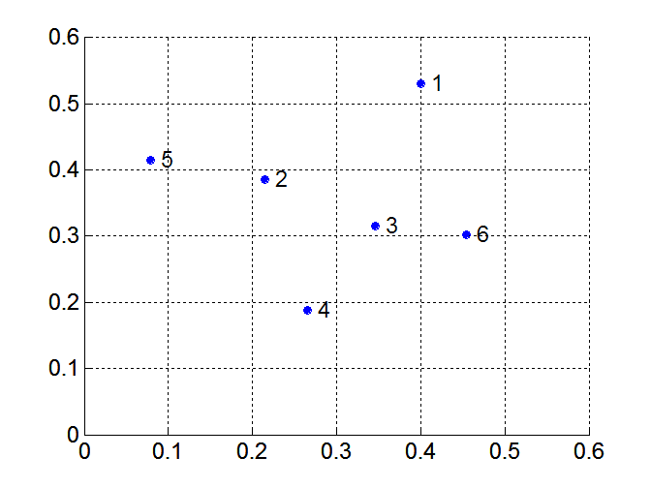
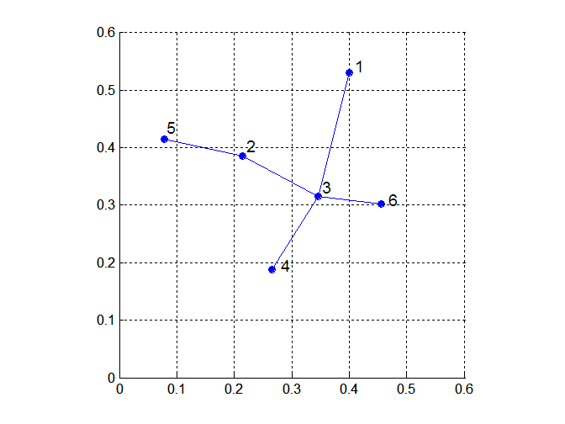
MST: Divisive Hierarchical Clustering
Build MST (Minimum Spanning Tree)
  Start with a tree that consists of any point
  In successive steps, look for the closest pair of points (p, q) such that one point (p) is in the current tree but the other (q) is not
  Add q to the tree and put an edge between p and q

Slide 56
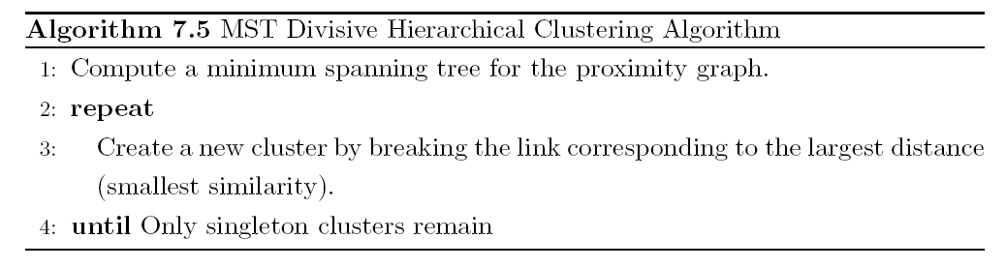
MST: Divisive Hierarchical Clustering
Use MST for constructing hierarchy of clusters

Slide 57
Chapter 10. Cluster Analysis: Basic Concepts and Methods
Cluster Analysis: Basic Concepts
Partitioning Methods
Hierarchical Methods
Density-Based Methods
Grid-Based Methods
Evaluation of Clustering
Summary

Slide 58
Density-Based Clustering Methods
Clustering based on density (local cluster criterion), such as density-connected points
Major features:
  Discover clusters of arbitrary shape
  Handle noise
  One scan
  Need density parameters as termination condition
Several interesting studies:
  DBSCAN: Ester, et al. (KDD’96)
  OPTICS: Ankerst, et al (SIGMOD’99).
  DENCLUE: Hinneburg & D. Keim (KDD’98)
  CLIQUE: Agrawal, et al. (SIGMOD’98) (more grid-based)

Slide 59
Density-Based Clustering: Basic Concepts
Two parameters:
  Eps: Maximum radius of the neighbourhood
  MinPts: Minimum number of points in an Eps-neighbourhood of that point
N_{Eps}(p): {q belongs to D | dist(p,q) ≤ Eps}
Directly density-reachable: A point p is directly density-reachable from a point q w.r.t. Eps, MinPts if
  p belongs to N_{Eps}(q)
  core point condition:
  |N_{Eps} (q)| ≥ MinPts
p
MinPts = 5
Eps = 1 cm
q

Slide 60
Density-Reachable and Density-Connected
Density-reachable:
  A point p is density-reachable from a point q w.r.t. Eps, MinPts if there is a chain of points p₁, …, p_{n}, p₁ = q, p_{n} = p such that p_{i+1} is directly density-reachable from p_{i}
Density-connected
  A point p is density-connected to a point q w.r.t. Eps, MinPts if there is a point o such that both, p and q are density-reachable from o w.r.t. Eps and MinPts
p
p₁
q
p
q
o

Slide 61
DBSCAN: Density-Based Spatial Clustering of Applications with Noise
Relies on a density-based notion of cluster: A cluster is defined as a maximal set of density-connected points
Discovers clusters of arbitrary shape in spatial databases with noise
Outlier
Border
Eps = 1cm
MinPts = 5
Core

Slide 62
DBSCAN
DBSCAN is a density-based algorithm.
  Density = number of points within a specified radius (Eps)
  A point is a core point if it has more than a specified number of points (MinPts) within Eps
    These are points that are at the interior of a cluster
  A border point has fewer than MinPts within Eps, but is in the neighborhood of a core point
  A noise point is any point that is not a core point or a border point.

Slide 63
DBSCAN: The Algorithm
Arbitrary select a point p
Retrieve all points density-reachable from p w.r.t. Eps and MinPts
If p is a core point, a cluster is formed
If p is a border point, no points are density-reachable from p and DBSCAN visits the next point of the database
Continue the process until all of the points have been processed

Slide 64
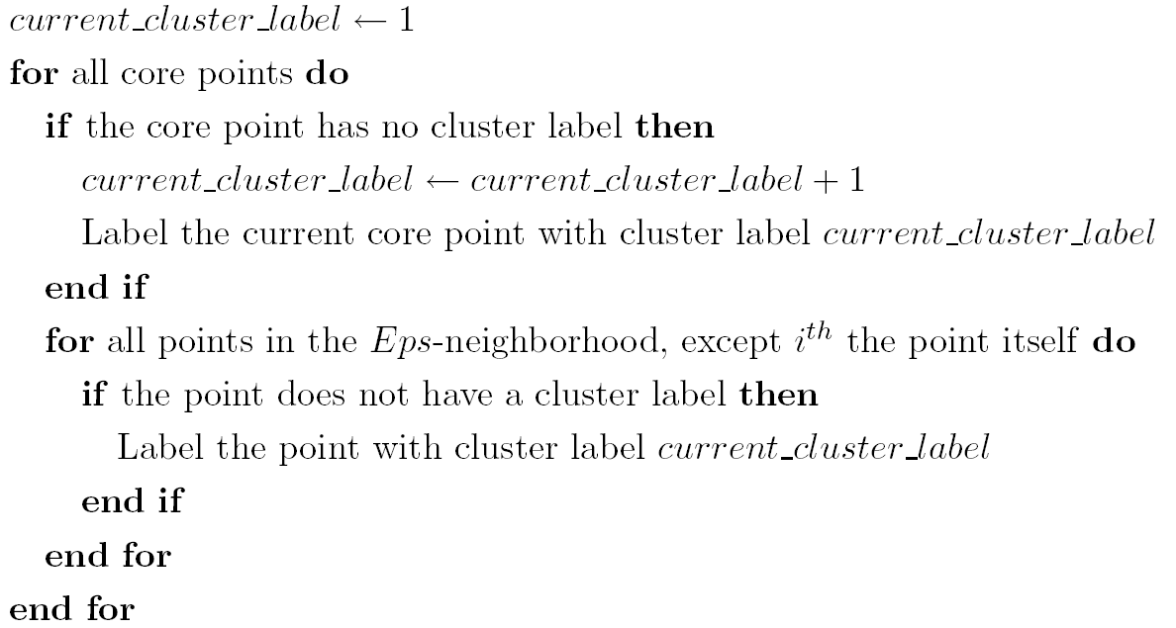
DBSCAN Algorithm
Eliminate noise points
Perform clustering on the remaining points

Slide 65
Chapter 10. Cluster Analysis: Basic Concepts and Methods
Cluster Analysis: Basic Concepts
Partitioning Methods
Hierarchical Methods
Density-Based Methods
Grid-Based Methods
Evaluation of Clustering
Summary

Slide 66
Chapter 10. Cluster Analysis: Basic Concepts and Methods
Cluster Analysis: Basic Concepts
Partitioning Methods
Hierarchical Methods
Density-Based Methods
Summary

Slide 67
Summary
Cluster analysis groups objects based on their similarity and has wide applications
Measure of similarity can be computed for various types of data
Clustering algorithms can be categorized into partitioning methods, hierarchical methods, density-based methods, grid-based methods, and model-based methods
K-means and K-medoids algorithms are popular partitioning-based clustering algorithms
Birch and Chameleon are interesting hierarchical clustering algorithms, and there are also probabilistic hierarchical clustering algorithms
DBSCAN, OPTICS, and DENCLU are interesting density-based algorithms
STING and CLIQUE are grid-based methods, where CLIQUE is also a subspace clustering algorithm
Quality of clustering results can be evaluated in various ways

