Slide 1
Introduction to Hadoop
MapReduce & Distributed file system (HDFS)

Slide 2
What is Hadoop
Hadoop is a software framework for distributed processing of large datasets across large clusters of computers
Large datasets → Terabytes or petabytes of data
Large clusters → hundreds or thousands of nodes
Hadoop is open-source implementation for Google MapReduce
Hadoop framework is based on
a simple programming model MapReduce - offline computing engine
a simple data model, any data will fit
HDFS – Hadoop distributed file system
HBase (pre-alpha) – online data access
Scalable: reliably store and process petabytes
Economical: distributes the data and processing across clusters of commonly available computers (in thousands)
Efficient: can process data in parallel on the nodes where the data is located.
Reliable: automatically maintains multiple copies of data and redeploys computing tasks based on failures

Slide 3
Hadoop: Assumptions
It is written with large clusters of computers in mind and is built around the following assumptions:
Hardware will fail.
Processing will be run in batches. Thus there is an emphasis on high throughput as opposed to low latency.
Applications that run on HDFS have large data sets. A typical file in HDFS is gigabytes to terabytes in size.
It should provide high aggregate data bandwidth and scale to hundreds of nodes in a single cluster. It should support tens of millions of files in a single instance.
Applications need a write-once-read-many access model.
Moving Computation is Cheaper than Moving Data.
Portability is important.

Slide 4
Design Principles of Hadoop
Need to process big data
Need to parallelize computation across thousands of nodes
Commodity hardware
Large number of low-end cheap machines working in parallel to solve a computing problem
This is in contrast to Parallel DBs
Small number of high-end expensive machines
Automatic parallelization & distribution
Hidden from the end-user
Fault tolerance and automatic recovery
Nodes/tasks will fail and will recover automatically
Clean and simple programming abstraction
Users only provide two functions “map” and “reduce”

Slide 5
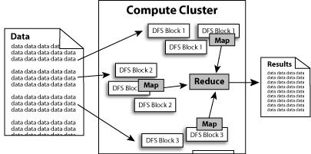
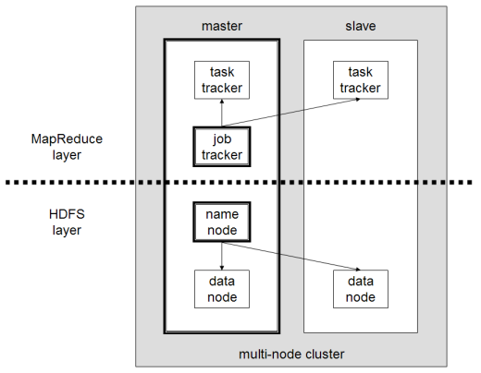
Hadoop framework
Hadoop framework consists on two main layers
Execution engine (MapReduce) - divides applications into many small blocks of work.
Distributed file system (HDFS) - creates multiple replicas of data blocks for reliability, placing them on computer nodes around the cluster.
MapReduce can then process the data where it is located.

Slide 6
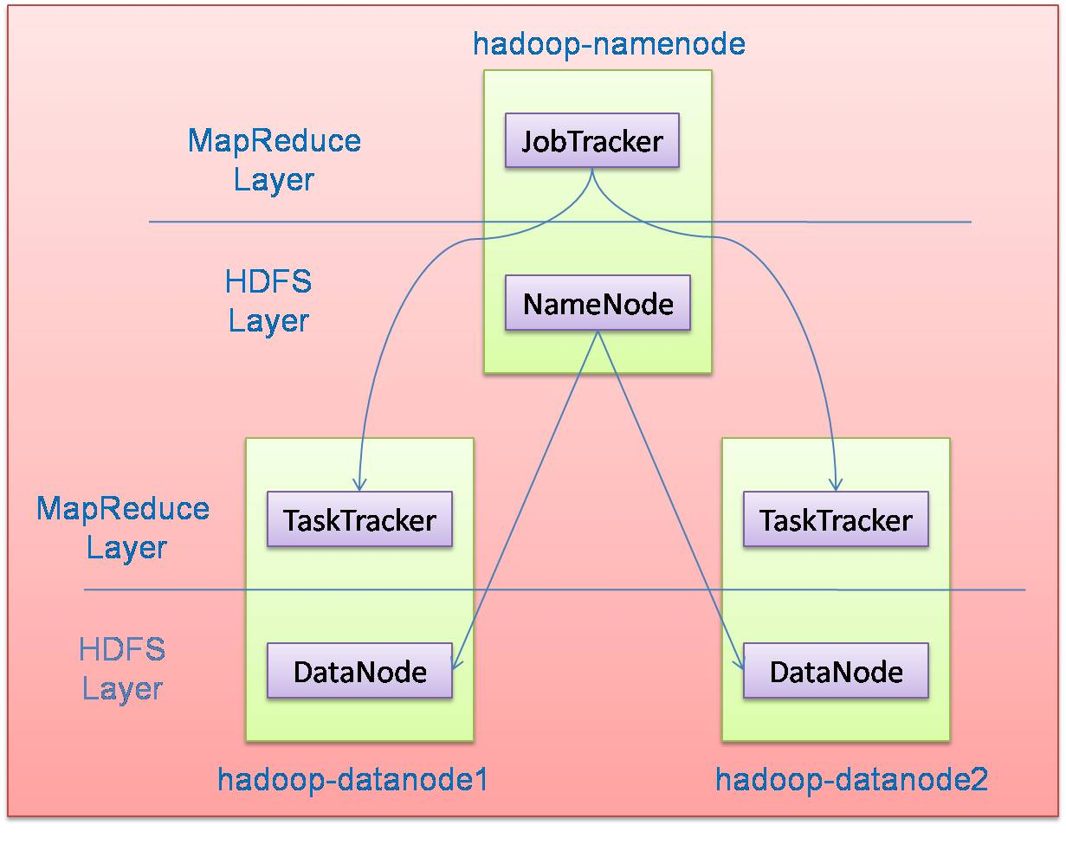
Hadoop Master/Slave Architecture
Hadoop is designed as a master-slave shared-nothing architecture
Master node (single node)
Many slave nodes

Slide 7
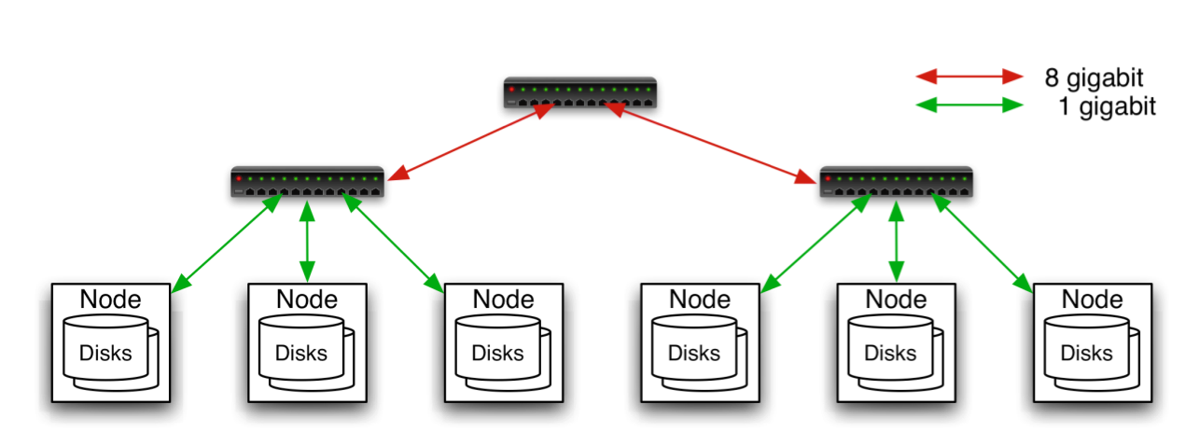
Commodity Hardware
Aggregation switch
Rack switch
Typically in 2 level architecture
Nodes are commodity PCs
30-40 nodes/rack
Uplink from rack is 3-4 gigabit
Rack-internal is 1 gigabit
Node: 2-8 processors, 4-16 hard drives, 4-10GB mem.
“share memory”
Cluster: 100’s-1000’s nodes
“share nothing”

Slide 8
MapReduce Paradigm
Programming model developed at Google
Sort/merge based distributed computing
Initially, it was intended for google internal search/indexing application, but now used extensively by more organizations (e.g., Yahoo, Amazon.com, IBM, etc.)
It is functional style programming (e.g., LISP) that is naturally parallelizable across a large cluster of workstations or PCS.
The underlying system takes care of the partitioning of the input data, scheduling the program’s execution across several machines, handling machine failures, and managing required inter-machine communication. (This is the key for Hadoop’s success)

Slide 9
MapReduce - Features
Fine grained Map and Reduce tasks
Improved load balancing
Faster recovery from failed tasks
Automatic re-execution on failure
In a large cluster, some nodes are always slow or flaky
Framework re-executes failed tasks
Locality optimizations
With large data, bandwidth to data is a problem
Map-Reduce + HDFS is a very effective solution
Map-Reduce queries HDFS for locations of input data
Map tasks are scheduled close to the inputs when possible

Slide 10
Word Count over a Given Set of Web Pages
see 1
bob 1
throw 1
see 1
spot 1
run 1
bob 1
run 1
see 2
spot 1
throw 1
see bob throw
see spot run
Can we do word count in parallel?

Slide 11
How does MapReduce work?
The run time partitions the input and provides it to different Map instances;
Map (key, value) → (key’, value’)
The run time collects the (key’, value’) pairs and distributes them to several Reduce functions so that each Reduce function gets the pairs with the same key’.
Each Reduce produces a single (or zero) file output.
Map and Reduce are user written functions
Mapper
Input: value: lines of text of input
Output: key: word, value: 1
Reducer
Input: key: word, value: set of counts
Output: key: word, value: sum
Launching program
Defines this job
Submits job to cluster

Slide 12
Worker, Task, Methods
Worker:
a process running on a machine that executes a number of Map (or Reduce) tasks assigned by the Master
Task
Consisting of a “partition” of the input file(s)
A Map (Reduce) task may invoke the Map(Reduce) method multiple times to process each key-value pair (or list) from the input
Method
Map (Reduce) method to be implemented by the user

Slide 13
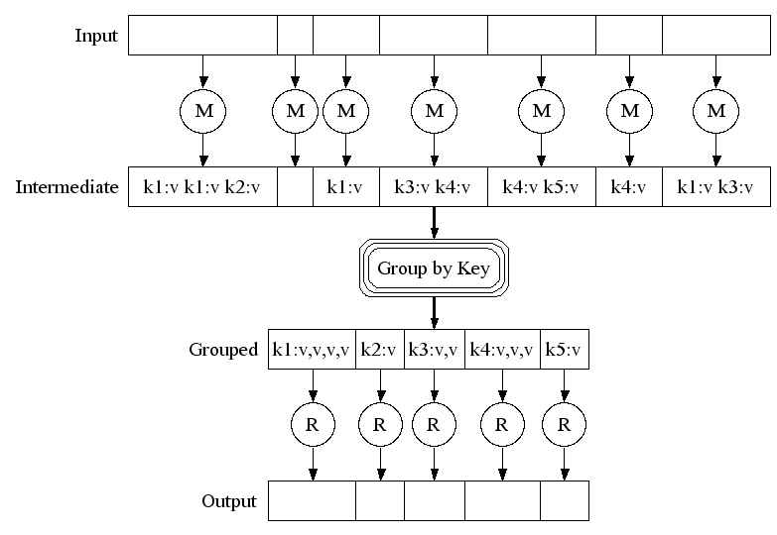
The MapReduce Framework

Slide 14
Example MapReduce: To count the occurrences of words in the given set of documents
map(String key, String value):
// key: document name; value: document contents; map (k1,v1) → list(k2,v2)
for each word w in value: EmitIntermediate(w, "1");
(Example: If input string is (“Saibaba is God. I am I”), Map produces {<“Saibaba”,1”>, <“is”, 1>, <“God”, 1>, <“I”,1>, <“am”,1>,<“I”,1>}
reduce(String key, Iterator values):
// key: a word; values: a list of counts; reduce (k2,list(v2)) → list(v2)
int result = 0;
for each v in values:
result += ParseInt(v);
Emit(AsString(result));
(Example: reduce(“I”, <1,1>) → 2)

Slide 15
MapReduce-Fault tolerance
Worker failure: The master pings every worker periodically. If no response is received from a worker in a certain amount of time, the master marks the worker as failed. Any map tasks completed by the worker are reset back to their initial idle state, and therefore become eligible for scheduling on other workers. Similarly, any map task or reduce task in progress on a failed worker is also reset to idle and becomes eligible for rescheduling.
Master Failure: It is easy to make the master write periodic checkpoints of the master data structures described above. If the master task dies, a new copy can be started from the last checkpointed state. However, in most cases, the user restarts the job.

Slide 16
Hadoop Master/Slave Architecture
Hadoop is designed as a master-slave shared-nothing architecture
Master node (single node)
Many slave nodes

Slide 17
HDFS
The Hadoop Distributed File System (HDFS) is a distributed file system designed to run on commodity hardware. It has many similarities with existing distributed file systems. However, the differences from other distributed file systems are significant.
highly fault-tolerant and is designed to be deployed on low-cost hardware.
provides high throughput access to application data and is suitable for applications that have large data sets
relaxes a few POSIX (Portable Operating System Interface) requirements to enable streaming access to file system data
part of the Apache Hadoop Core project. The project URL is http://hadoop.apache.org/core/
17

Slide 18
HDFS Architecture
Namenode
Metadata(Name, replicas..)
(/home/foo/data,6. ..
Metadata ops
Client
Block ops
Read
Datanodes
Datanodes
B
replication
Blocks
Rack1
Write
Rack2
Client

Slide 19
Namenode and Datanodes
HDFS cluster consists of a single Namenode, a master server that manages the file system namespace and regulates access to files by clients
There are a number of DataNodes usually one per node in a cluster
The DataNodes manage storage attached to the nodes that they run on
HDFS exposes a file system namespace and allows user data to be stored in files
A file is split into one or more blocks and set of blocks are stored in DataNodes
DataNodes: serves read, write requests, performs block creation, deletion, and replication upon instruction from Namenode

Slide 20
File system Namespace
Hierarchical file system with directories and files
Create, remove, move, rename etc
Namenode maintains the file system
Any meta information changes to the file system recorded by the Namenode
An application can specify the number of replicas of the file needed: replication factor of the file. This information is stored in the Namenode

Slide 21
Distributed File System
Single Namespace for entire cluster
Data Coherency: Write-once-read-many access model
Files are broken up into blocks: Typically 64MB block size; Each block replicated on multiple DataNodes
Intelligent Client: Client can find location of blocks; Client accesses data directly from DataNode
Main Properties of HDFS
Large: A HDFS instance may consist of thousands of server machines, each storing part of the file system’s data
Replication: Each data block is replicated many times (default is 3)
Failure: Failure is the norm rather than exception
Fault Tolerance: Detection of faults and quick, automatic recovery from them is a core architectural goal of HDFS
Namenode is consistently checking Datanodes

Slide 22
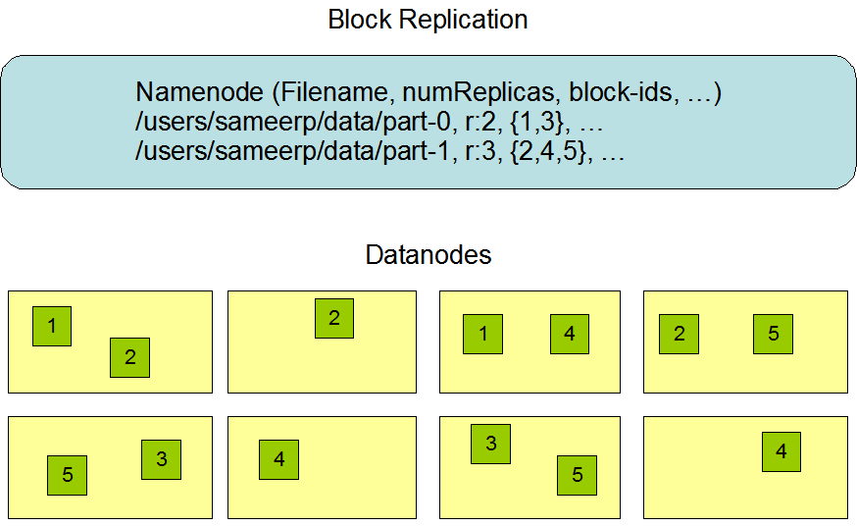
Hadoop Distributed File System (HDFS)
Centralized namenode
- Maintains metadata info about files
File F
1
2
3
4
5
Blocks (64 MB)
Many datanode (1000s)
- Store the actual data
- Files are divided into blocks
- Each block is replicated N times
(Default = 3)

Slide 23
Filesystem Metadata
The HDFS namespace is stored by Namenode
Types of metadata: List of files, List of Blocks for each file, List of DataNodes for each block, File attributes, e.g. creation time, replication factor
Namenode uses a transaction log called the EditLog to record every change that occurs to the filesystem meta data.
creating a new file, Change replication factor of a file, file deletions etc
EditLog is stored in the Namenode’s local filesystem
Entire filesystem namespace including mapping of blocks to files and file system properties is stored in a file FsImage. Stored in Namenode’s local filesystem.

Slide 24
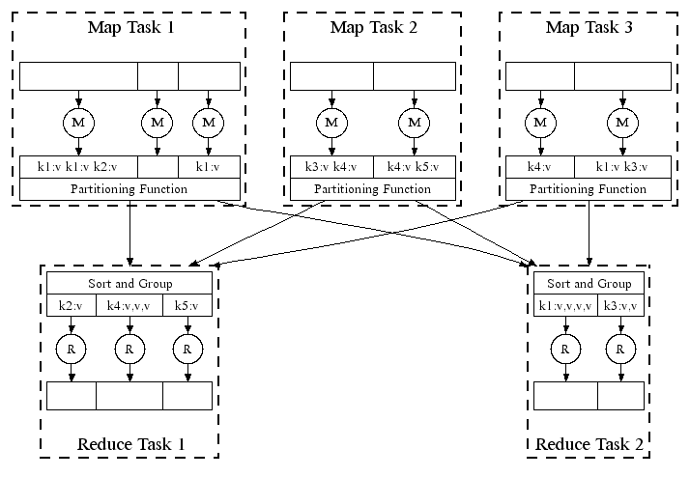
Automatic Parallel Execution in MapReduce
Handles failures automatically, e.g., restarts tasks if a node fails; runs multiples copies of the same task to avoid a slow task slowing down the whole job

Slide 25
Mapping workers to Processors
The input data (on HDFS) is stored on the local disks of the machines in the cluster. HDFS divides each file into 64 MB blocks, and stores several copies of each block (typically 3 copies) on different machines.
The MapReduce master takes the location information of the input files into account and attempts to schedule a map task on a machine that contains a replica of the corresponding input data. Failing that, it attempts to schedule a map task near a replica of that task's input data. When running large MapReduce operations on a significant fraction of the workers in a cluster, most input data is read locally and consumes no network bandwidth.

Slide 26
Task Granularity
The map phase has M pieces and the reduce phase has R pieces.
M and R should be much larger than the number of worker machines.
Having each worker perform many different tasks improves dynamic load balancing, and also speeds up recovery when a worker fails.
Larger the M and R, more the decisions the master must make
R is often constrained by users because the output of each reduce task ends up in a separate output file.
Typically, (at Google), M = 200,000 and R = 5,000, using 2,000 worker machines.

Slide 27
Additional support functions
Partitioning function: The users of MapReduce specify the number of reduce tasks/output files that they desire (R). Data gets partitioned across these tasks using a partitioning function on the intermediate key. A default partitioning function is provided that uses hashing (e.g. .hash(key) mod R.). In some cases, it may be useful to partition data by some other function of the key. The user of the MapReduce library can provide a special partitioning function.
Combiner function: User can specify a Combiner function that does partial merging of the intermediate local disk data before it is sent over the network. The Combiner function is executed on each machine that performs a map task. Typically the same code is used to implement both the combiner and the reduce functions.

Slide 28
Map-Reduce Execution Engine (Example: Color Count)
Input blocks on HDFS
Produces (k, v)
( , 1)
Shuffle & Sorting based on k
Consumes(k, [v])
( , [1,1,1,1,1,1..])
Produces(k’, v’)
( , 100)
Users only provide the “Map” and “Reduce” functions

Slide 29
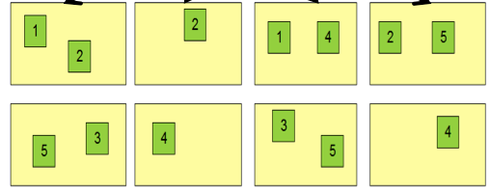
Properties of MapReduce Engine
Job Tracker is the master node (runs with the namenode)
Receives the user’s job
Decides on how many tasks will run (number of mappers)
Decides on where to run each mapper (concept of locality)
Node 1
Node 2
Node 3
This file has 5 Blocks → run 5 map tasks
Where to run the task reading block “1”
Try to run it on Node 1 or Node 3

Slide 30
Properties of MapReduce Engine (Cont’d)
Task Tracker is the slave node (runs on each datanode)
Receives the task from Job Tracker
Runs the task until completion (either map or reduce task)
Always in communication with the Job Tracker reporting progress
In this example, 1 map-reduce job consists of 4 map tasks and 3 reduce tasks

Slide 31
Key-Value Pairs
Mappers and Reducers are users’ code (provided functions)
Just need to obey the Key-Value pairs interface
Mappers:
Consume <key, value> pairs
Produce <key, value> pairs
Reducers:
Consume <key, <list of values>>
Produce <key, value>
Shuffling and Sorting:
Hidden phase between mappers and reducers
Groups all similar keys from all mappers, sorts and passes them to a certain reducer in the form of <key, <list of values>>

Slide 32
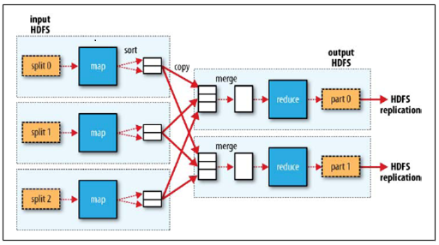
MapReduce Phases

Slide 33
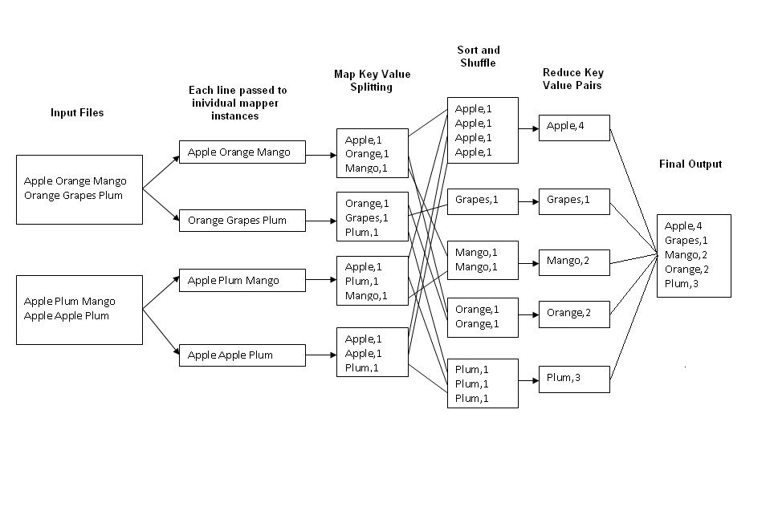
Example 1: Word Count
Job: Count the occurrences of each word in a data set
Map
Tasks
Reduce
Tasks

Slide 34
Example 2: Color Count
Job: Count the number of each color in a data set
Input blocks on HDFS
Produces (k, v)
( , 1)
Shuffle & Sorting based on k
Consumes(k, [v])
( , [1,1,1,1,1,1..])
Produces(k’, v’)
( , 100)
Part0001
Part0002
Part0003
That’s the output file, it has 3 parts on probably 3 different machines

Slide 35
Example runs [1]
Cluster configuration: ≈1800 machines; each with two 2GHz Intel Xeon processors with 4GB of memory (1-1.5 GB reserved for other tasks), two 160GB IDE disks, and a gigabit Ethernet link. All of the machines were in the same hosting facility and therefore the round-trip time between any pair of machines was less than a millisecond.
Grep: Scans through 10¹⁰ 100-byte records (distributed over 1000 input file by GFS), searching for a relatively rare three-character pattern (the pattern occurs in 92,337 records). The input is split into approximately 64MB pieces (M = 15000), and the entire output is placed in one file (R = 1). The entire computation took approximately 150 seconds from start to finish including 60 seconds to start the job.
Sort: Sorts 10 ¹⁰ 100-byte records (approximately 1 terabyte of data). As before, the input data is split into 64MB pieces (M = 15000) and R = 4000. Including startup overhead, the entire computation took 891 seconds.

Slide 36
MapReduce Runtime (see figure on next slide)
When a user MapReduce job is started
Splits the input file(s) into smaller chunks
Starts up a “Master” on a node
Starts up “Workers” on multiple nodes
Master schedules and assigns Map and Reduce “tasks” to Workers for execution

Slide 37
MapReduce Runtime
User
Program
fork
fork
fork
Master
assign
Map tasks
assign
Reduce tasks
Input Data
Worker
write
Output
File 0
local
write
Worker
Split 0
read
Split 1
Worker
Split 2
Output
File 1
Worker
Worker
remote
read,
sort (group)

Slide 38
Execution overview
1. The MapReduce library in the user program first splits input files into M pieces of typically 16 MB to 64 MB/piece. It then starts up many copies of the program on a cluster of machines.
2. One of the copies of the program is the master. The rest are workers that are assigned work by the master. There are M map tasks and R reduce tasks to assign. The master picks idle workers and assigns each one a map task or a reduce task.
3. A worker who is assigned a map task reads the contents of the assigned input split. It parses key/value pairs out of the input data and passes each pair to the user-defined Map function. The intermediate key/value pairs produced by the Map function are buffered in memory.
4. The locations of these buffered pairs on the local disk are passed back to the master, who forwards these locations to the reduce workers.

Slide 39
Execution overview (cont.)
5. When a reduce worker is notified by the master about these locations, it uses RPC remote procedure calls to read the buffered data from the local disks of the map workers. When a reduce worker has read all intermediate data, it sorts it by the intermediate keys so that all occurrences of the same key are grouped together.
6. The reduce worker iterates over the sorted intermediate data and for each unique intermediate key encountered, it passes the key and the corresponding set of intermediate values to the user's Reduce function. The output of the Reduce function is appended to a final output file for this reduce partition.
7. When all map tasks and reduce tasks have been completed, the master wakes up the user program---the MapReduce call in the user program returns back to the user code. The output of the mapreduce execution is available in the R output files (one per reduce task).

Slide 40
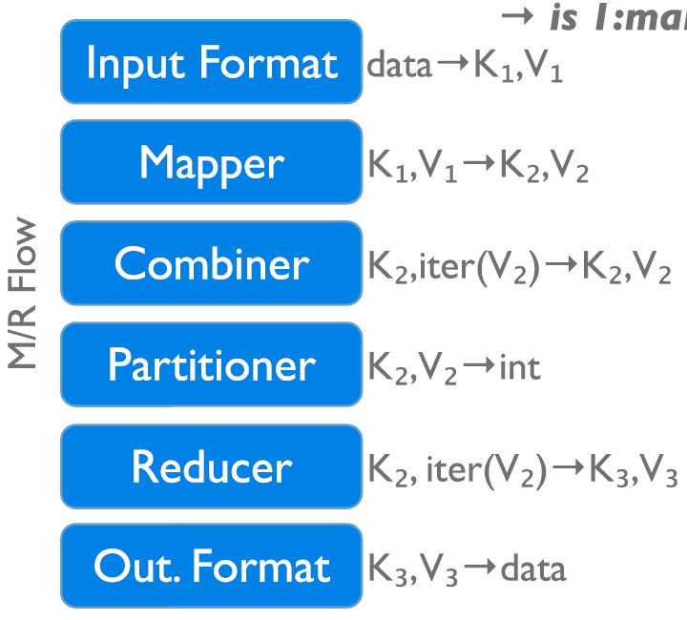
Data Flow in a MapReduce Program in Hadoop
→ 1:many
InputFormat
Map function
Partitioner
Sorting & Merging
Combiner
Shuffling
Merging
Reduce function
OutputFormat

Slide 41
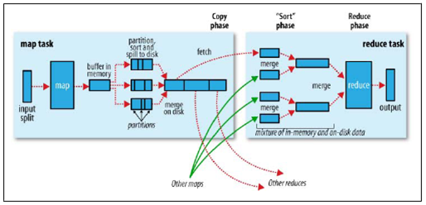
Shuffle & Sort in MapReduce

Slide 42
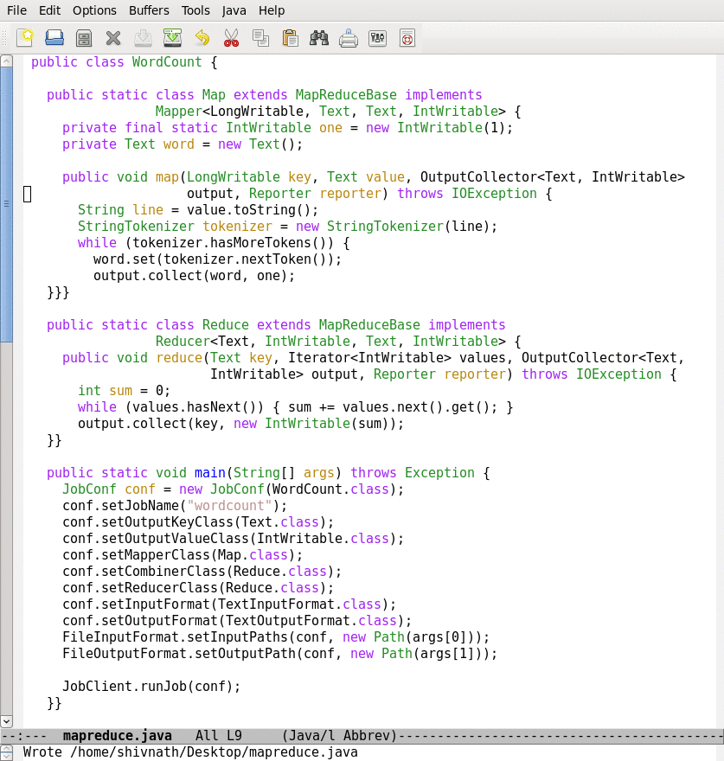
Lifecycle of a MapReduce Job
Map function
Reduce function
Run this program as a
MapReduce job

Slide 43
Example: k-mean clustering
Map: (-, point) → (clusterID, point)
Reduce: (clusterID, list(point)) → (clusterID, newCentroid)
Run a sequence of MapReduce jobs until clusters unchanged
c1, c2,…,c5
c5, p1
c2, p2
c2, p3
c1, p4
…
c1:
p4, p_{N}, …
c2:
p2,p3,p_{N-1}
c3:
……
c4:
…
c5:
p1, …
p1
p2
p3
p4
…
…
p_{N}
c1, cent1
c2, cent2
Reduce
Map
Reduce
c3, cent3
Map
…
c2, p_{N-1}
c1, p_{N}
c4, cent4
c5, cent5
Reduce

Slide 44
HDFS more details

Slide 45
Namenode
Manages File System Namespace
Maps a file name to a set of blocks
Maps a block to the DataNodes where it resides
Cluster Configuration Management
Replication Engine for Blocks
Keeps image of entire file system namespace and file Blockmap in memory.
When the Namenode starts up it gets the FsImage and Editlog from its local file system, update FsImage with EditLog information and then stores a copy of the FsImage on the filesytstem as a checkpoint.
Periodic checkpointing is done. So that the system can recover back to the last checkpointed state in case of a crash.

Slide 46
Datanode
A Datanode stores data in files in its local file system.
Datanode has no knowledge about HDFS filesystem
It stores each block of HDFS data in a separate file.
A Block Server: Stores data in the local file system (e.g. ext3); Stores metadata of a block (e.g. CRC); Serves data and metadata to Clients
Datanode does not create all files in the same directory.
It uses heuristics to determine optimal number of files per directory and creates directories appropriately:
When the filesystem starts up it generates a list of all HDFS blocks and send this report to Namenode: Blockreport
Block Report: Periodically sends a report of all existing blocks to the NameNode
Facilitates Pipelining of Data: Forwards data to other specified DataNodes

Slide 47
Data Replication
HDFS is designed to store very large files across machines in a large cluster
Each file is a sequence of blocks; All blocks in the file except the last are of the same size
Blocks are replicated for fault tolerance
Block size and replicas are configurable per file
The Namenode receives a Heartbeat and a BlockReport from each DataNode in the cluster
BlockReport contains all the blocks on a Datanode
Replication Engine: NameNode detects DataNode failures
Chooses new DataNodes for new replicas
Balances disk usage
Balances communication traffic to DataNodes

Slide 48
DataNode failure and heartbeat
A network partition can cause a subset of Datanodes to lose connectivity with the Namenode.
Namenode detects this condition by the absence of a Heartbeat message.
Namenode marks Datanodes without Hearbeat and does not send any IO requests to them.
Any data registered to the failed Datanode is not available to the HDFS.
Also the death of a Datanode may cause replication factor of some of the blocks to fall below their specified value
The necessity for re-replication may arise due to:
A Datanode may become unavailable,
A replica may become corrupted,
A hard disk on a Datanode may fail, or
The replication factor on the block may be increased

Slide 49
Block Placement - Current Strategy
One replica on local node; Second replica on a remote rack; Third replica on same remote rack; Additional replicas are randomly placed
Clients read from nearest replicas
Heartbeats
DataNodes send hearbeat to the NameNode - Once every 3 seconds
NameNode uses heartbeats to detect DataNode failure
Data Correctness
Use Checksums to validate data : Use CRC32
File Creation: Client computes checksum per 512 bytes; DataNode stores the checksum
File access: Client retrieves the data and checksum from DataNode; If Validation fails, Client tries other replicas

Slide 50
Data Pieplining
Client retrieves a list of DataNodes on which to place replicas of a block
Client writes block to the first DataNode
The first DataNode forwards the data to the next node in the Pipeline
When all replicas are written, Client moves on to write next block in file
Secondary NameNode
Copies FsImage and Transaction Log from Namenode to a temporary directory
Merges FSImage and Transaction Log into a new FSImage in temporary directory
Upload new FSImage to NameNode; Transaction Log on NameNode is purged
Rebalancer
Goal: % disk full on DataNodes should be similar
Usually run when new DataNodes are added
Cluster is online when Rebalancer is active
Rebalancer is throttled to avoid network congestion

Slide 51
The Communication Protocol
All HDFS communication protocols are layered on top of the TCP/IP protocol
A client establishes a connection to a configurable TCP port on the Namenode machine. It talks ClientProtocol with the Namenode.
The Datanodes talk to the Namenode using Datanode protocol.
RPC abstraction wraps both ClientProtocol and Datanode protocol.
Namenode is simply a server and never initiates a request; it only responds to RPC requests issued by DataNodes or clients.

Slide 52
User Interface & Application Programming Interface
Commads for HDFS User:
hadoop dfs -mkdir /foodir; hadoop dfs -cat /foodir/myfile.txt
hadoop dfs -rm /foodir/myfile.txt
Commands for HDFS Administrator
hadoop dfsadmin -report
hadoop dfsadmin -decommision datanodename
Web Interface - http://host:port/dfshealth.jsp
HDFS provides Java API for application to use
Python access is also used in many applications
A C language wrapper for Java API is also available
A HTTP browser can be used to browse the files of a HDFS instance

